Slide 1
Storm Event Analysis of Karst Groundwater Quality Variability in the Hidden River Cave System, Hart County, Kentucky
Amy Hourigan
Co-authors: Patricia Kambesis, Jason Polk
Western Kentucky University

Slide 2
Hidden River Cave (HRC)
Horse Cave, KY (Mammoth Cave Biosphere Region)
The Mammoth Cave karst groundwater system contains 28 major groundwater basins, including the Hidden River groundwater subbasin (Quinlan and Ewers 1989; Meiman et al. 2001).
HRC is one of the main tributaries of the Hidden River groundwater subbasin that spans parts of Barren, Hart, and Metcalf counties.
Hidden River Cave consists of a dendritic network of canyons and collapsed domes, formed in Mississippian-aged carbonates.
A major trunk stream flows through the cave, contributing recharge to the Mammoth Cave aquifer, and supports a variety subsurface ecosystems.

Slide 3
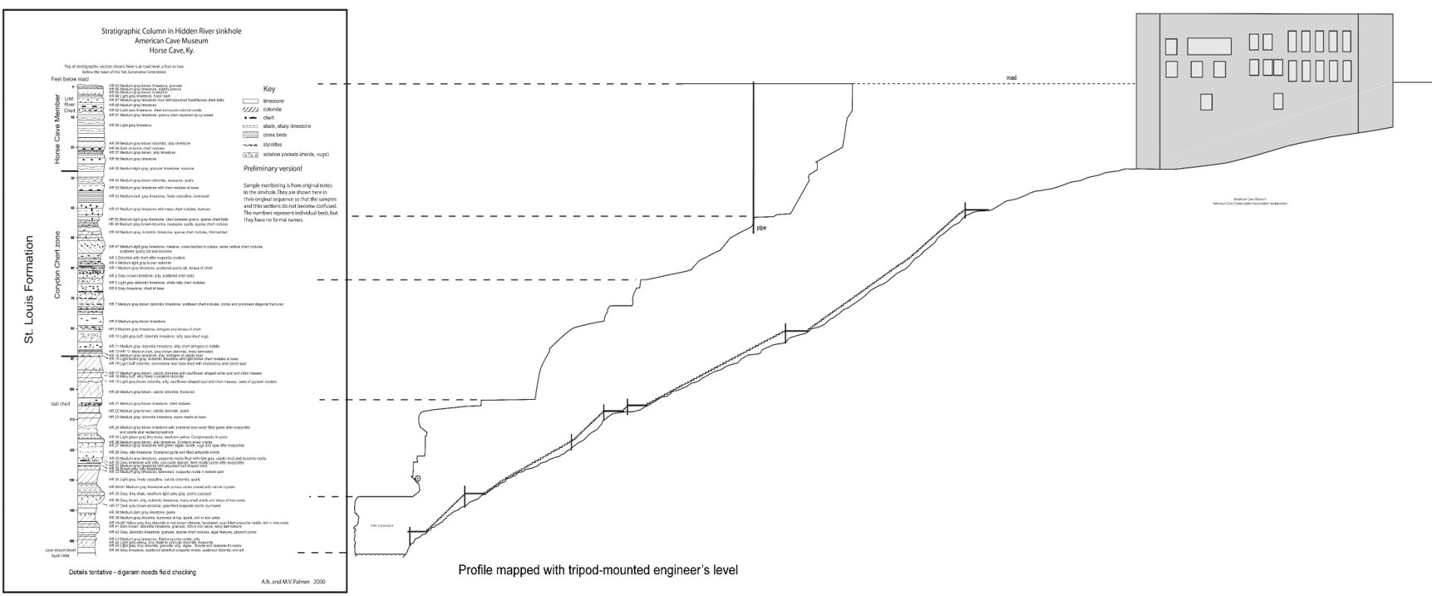
Located beneath the town of Horse Cave, in Hart Co. Kentucky.
The cave entrance is a sinkhole collapse managed by the American Cave Museum.
Palmer and Palmer 2000

Slide 4
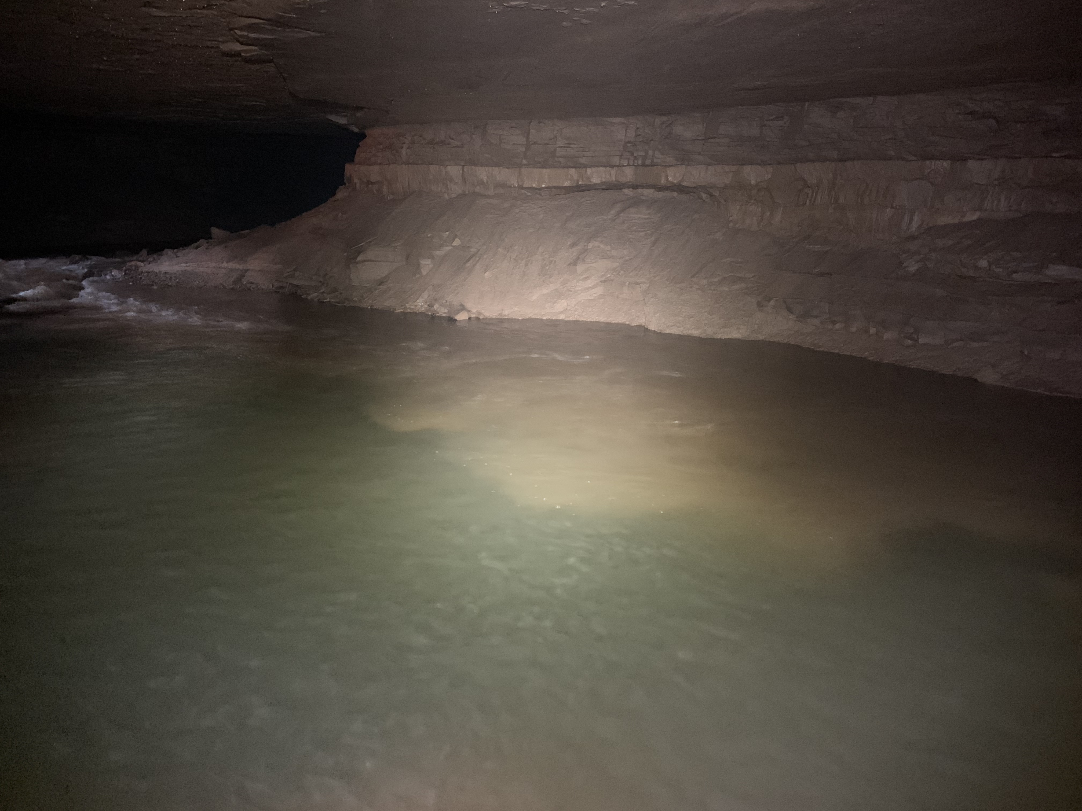
A smaller stream named south river drains ~8km² and has been explored up three main tributaries: kneebuster, lover’s lane, and wheet river.
Wheet river is the dominant source of the south river (raedts and smart 2015).
The east river rises from the breakdown rubble near the bottom of the entrance.
This is the Main Trunk Stream, which drains ~150 km² (quinlan and rowe 1977).

Slide 5
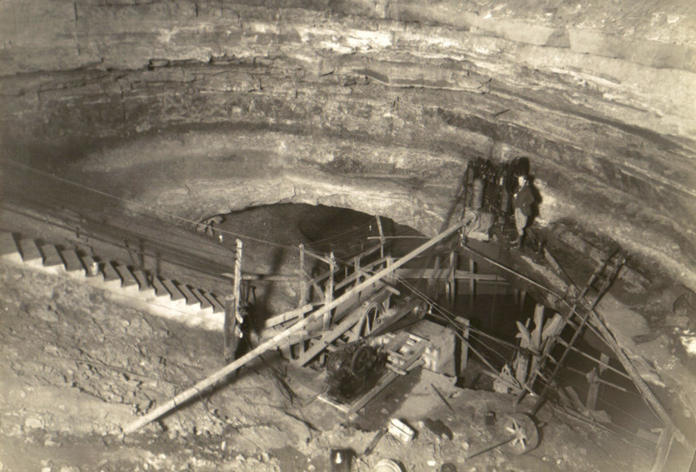
A history of water quality problems

Slide 6
Since early settlement of Horse Cave: trash and sewage disposed of in cave passages, shallow wells, and nearby sinkholes.
1930s: Hidden River Cave, the local water source, was polluted.
1940s: Tours ended - noxious odors filled town and waste from local industries depleted the stream of dissolved oxygen.
1950s: The odors continued to rise from the cave entrance and cave biota disappeared from the main stream passages and was replaced with organisms that could live in low oxygen environments.
1960s: A domestic sewage treatment plant was constructed, but wastewater from the plant was injected into wells hydrologically connected to Hidden River Cave.
1970s: A leaking gasoline tank polluted the cave system and could be smelled in the basements of local homes.
(Source: HiddenRiverCave.com)

Slide 7
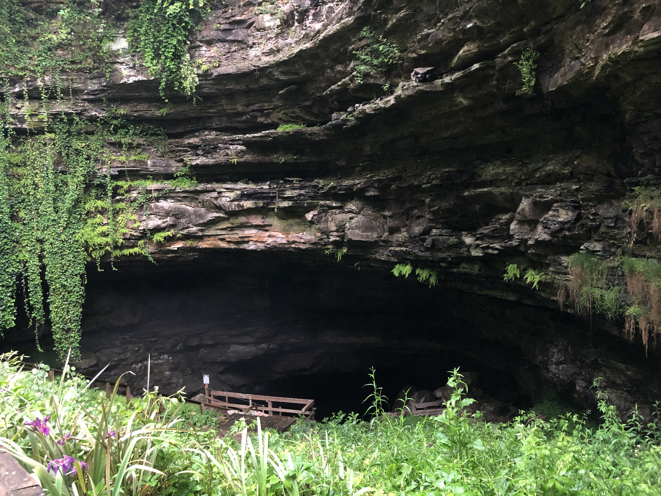
A Remediation Success Story

Slide 8
1981: The epa proposed a new regional sewage treatment facility ending subsurface effluent discharge – by channeling wastewater to a new treatment plant in munfordville, where it was treated again before being released into the green river (lewis 1995, raedts and smart 2015).
Late 1980s: Water Quality improved to a degree that the cave biota returned to the main stream passages.
1992: The american cave museum (acm), managed by the american cave conservation association (acca) opened in horse cave.
1993: Limited tours of the cave began again after 50 years of closure.
1995: Extended tours were offered, and an educational program was created to teach visitors about the protection and conservation of caves and karst (lewis 1995, foster 2009).

Slide 9
PURPOSE OF STUDY
Karst groundwater quality is impacted by land use and ingress of contaminants during storm events. Fast flow within 12-24 hours in the HRC system suggests close connections between surface inputs and groundwater. In HRC, die-offs of cave biota have been documented, most recently in 2019.
Research Question 1: Do speedy hydrologic response times in HRC result in contaminant surges through the system during a precipitation event?
Research Question 2: Are there contaminants detected that pose a significant threat to the stygobiont populations of HRC?
The purpose of this study was to document contaminant concentrations and geochemical response of the two streams during a storm event.

Slide 10
Methodology
Hourly sample collection (1000 -1600)
Storm produced 1.38” precipitation in 24 hours (KY Mesonet)
Sample sites: East River (Main Trunk) and Wheet River (Major Tributary)
In situ: pH, Turbidity, Total Suspended Solids, Specific Conductivity, Temperature, Dissolved Oxygen, Total Chlorine (Equipment: YSI ProDSS multiparameter handheld sonde, Hach DR900)
Laboratory: Anions, Cations (Metals), Total Organic Carbon, Biochemical Oxygen Demand, Chemical Oxygen Demand, E. coli, Oil and Grease (WKU-HydroAnalytical Lab)

Slide 11
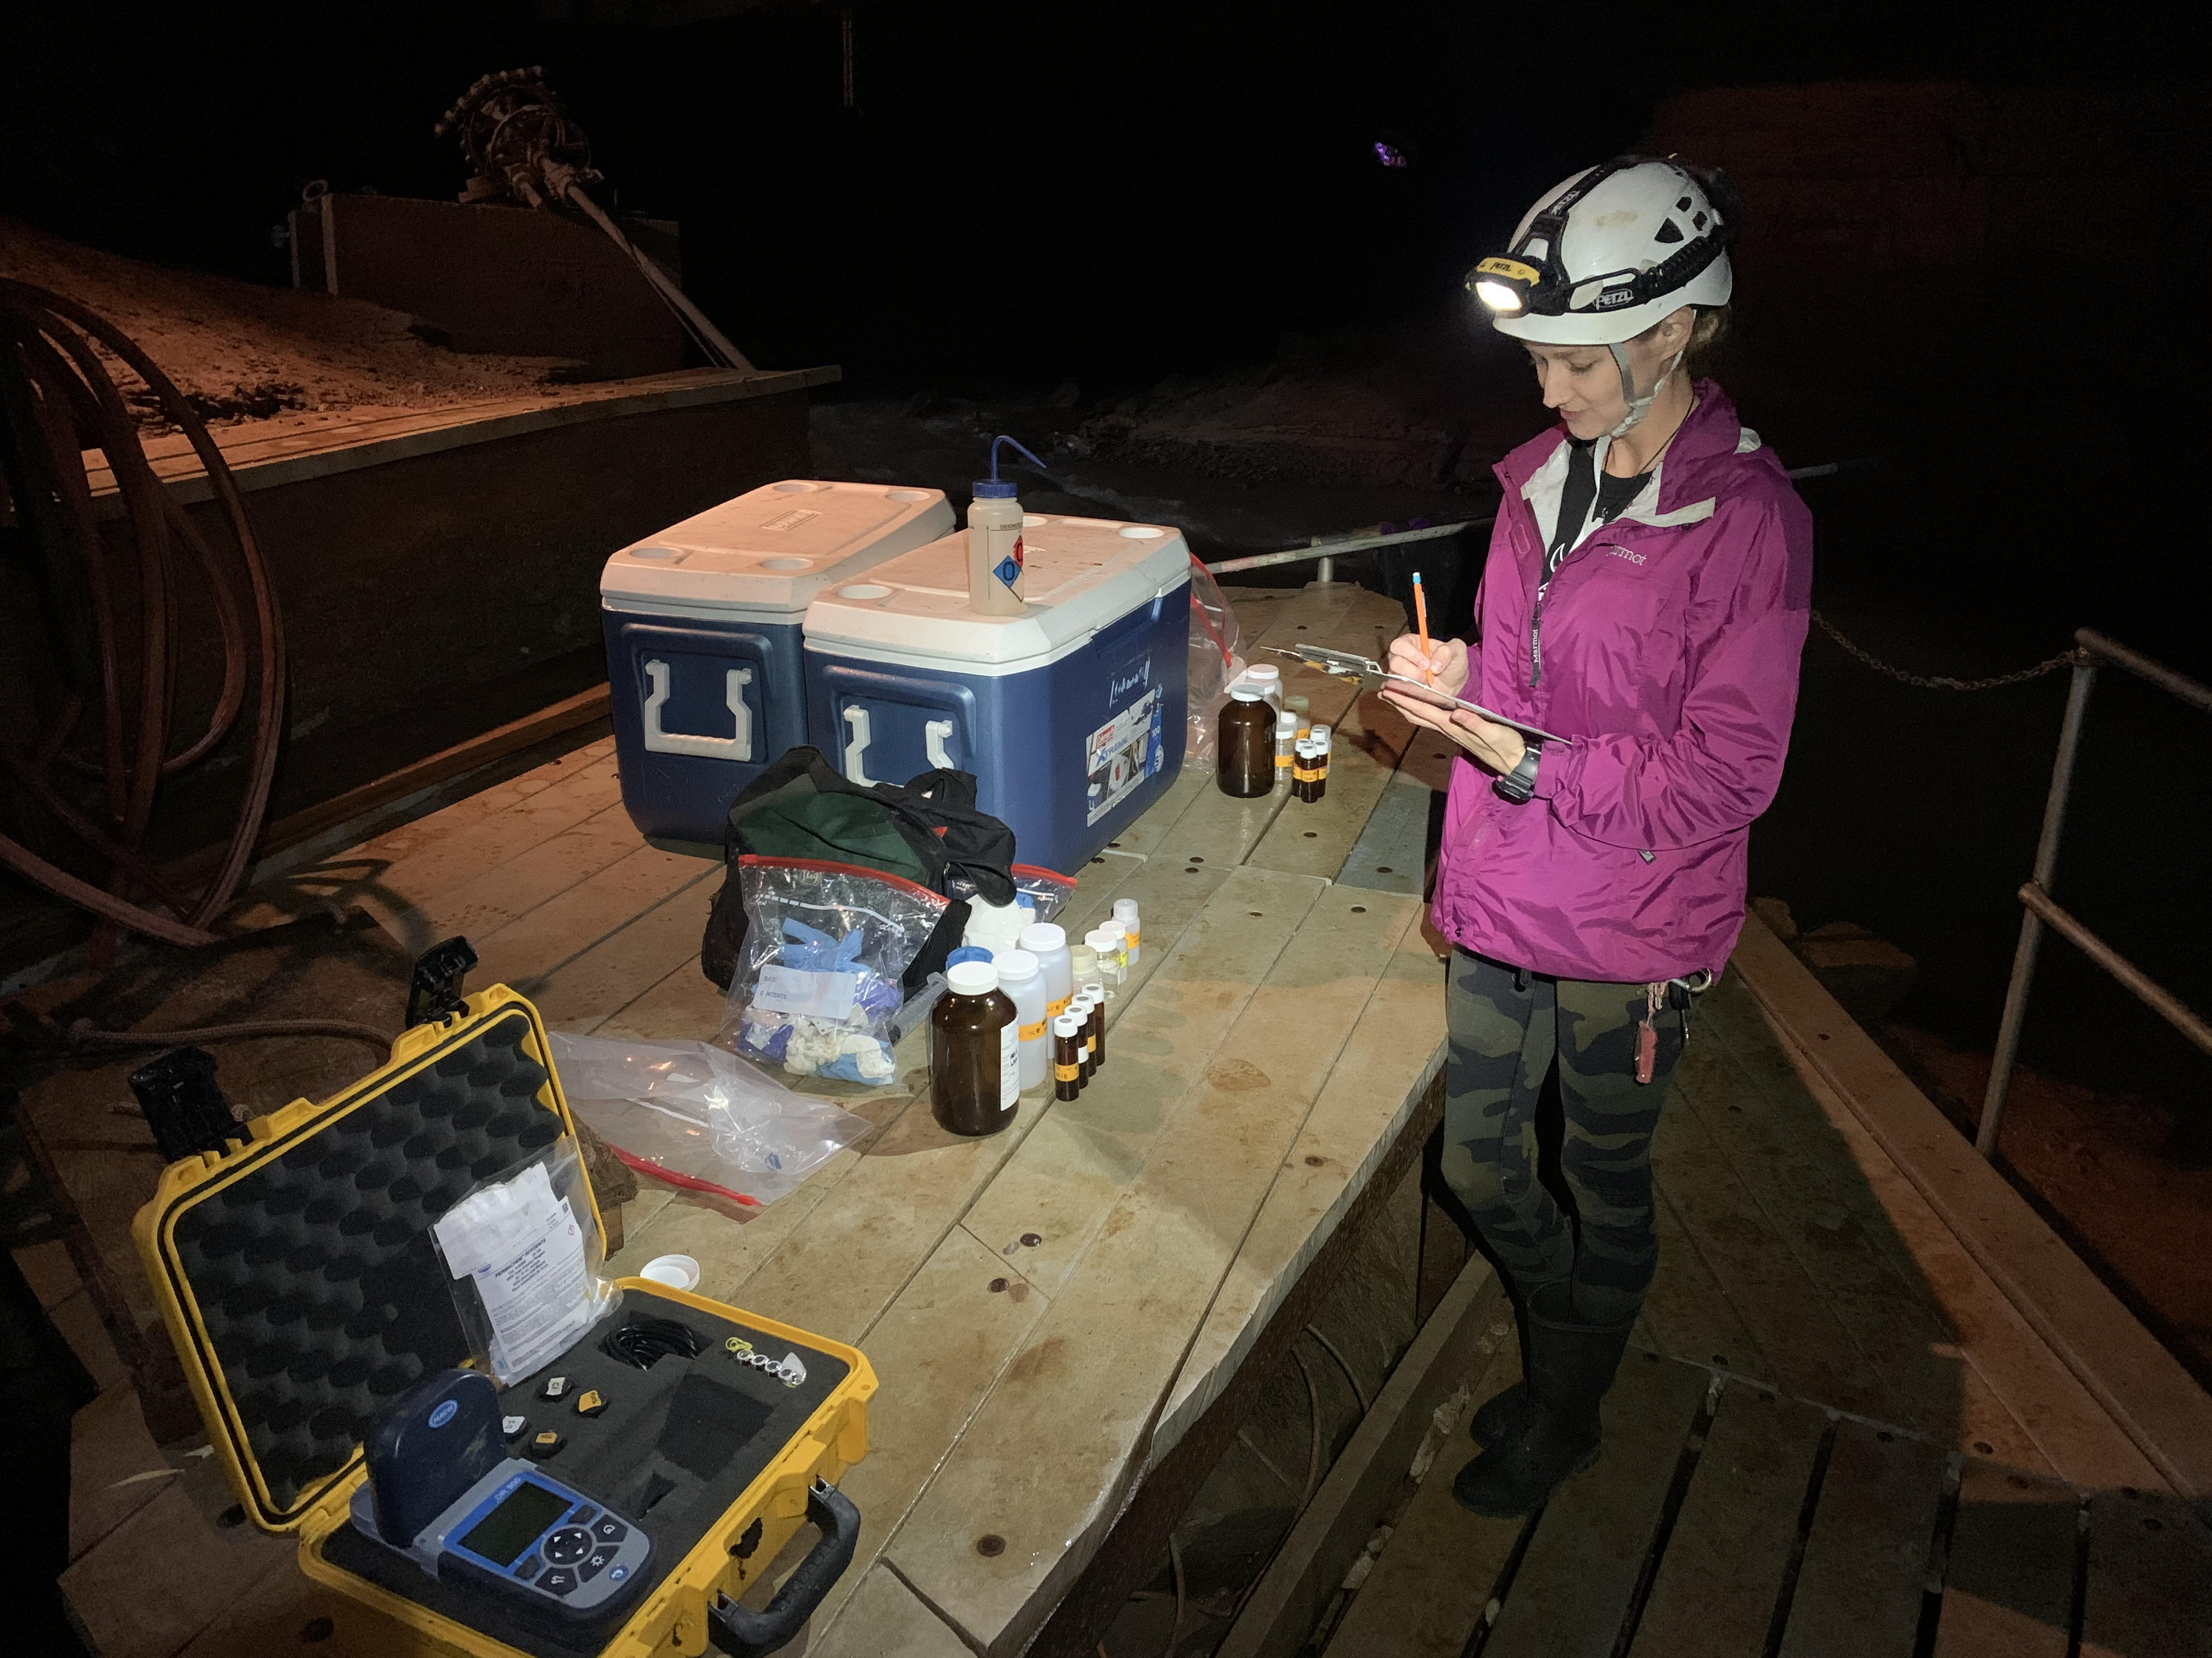
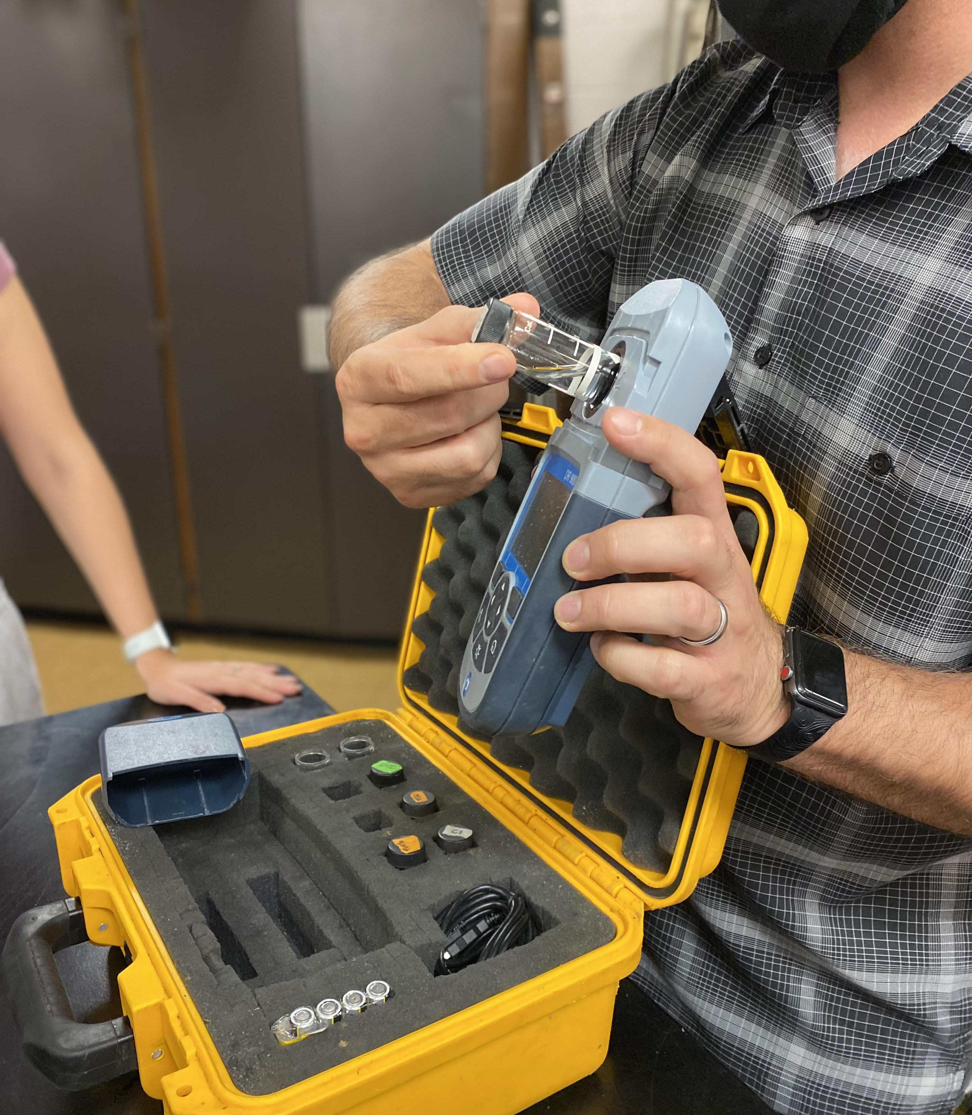
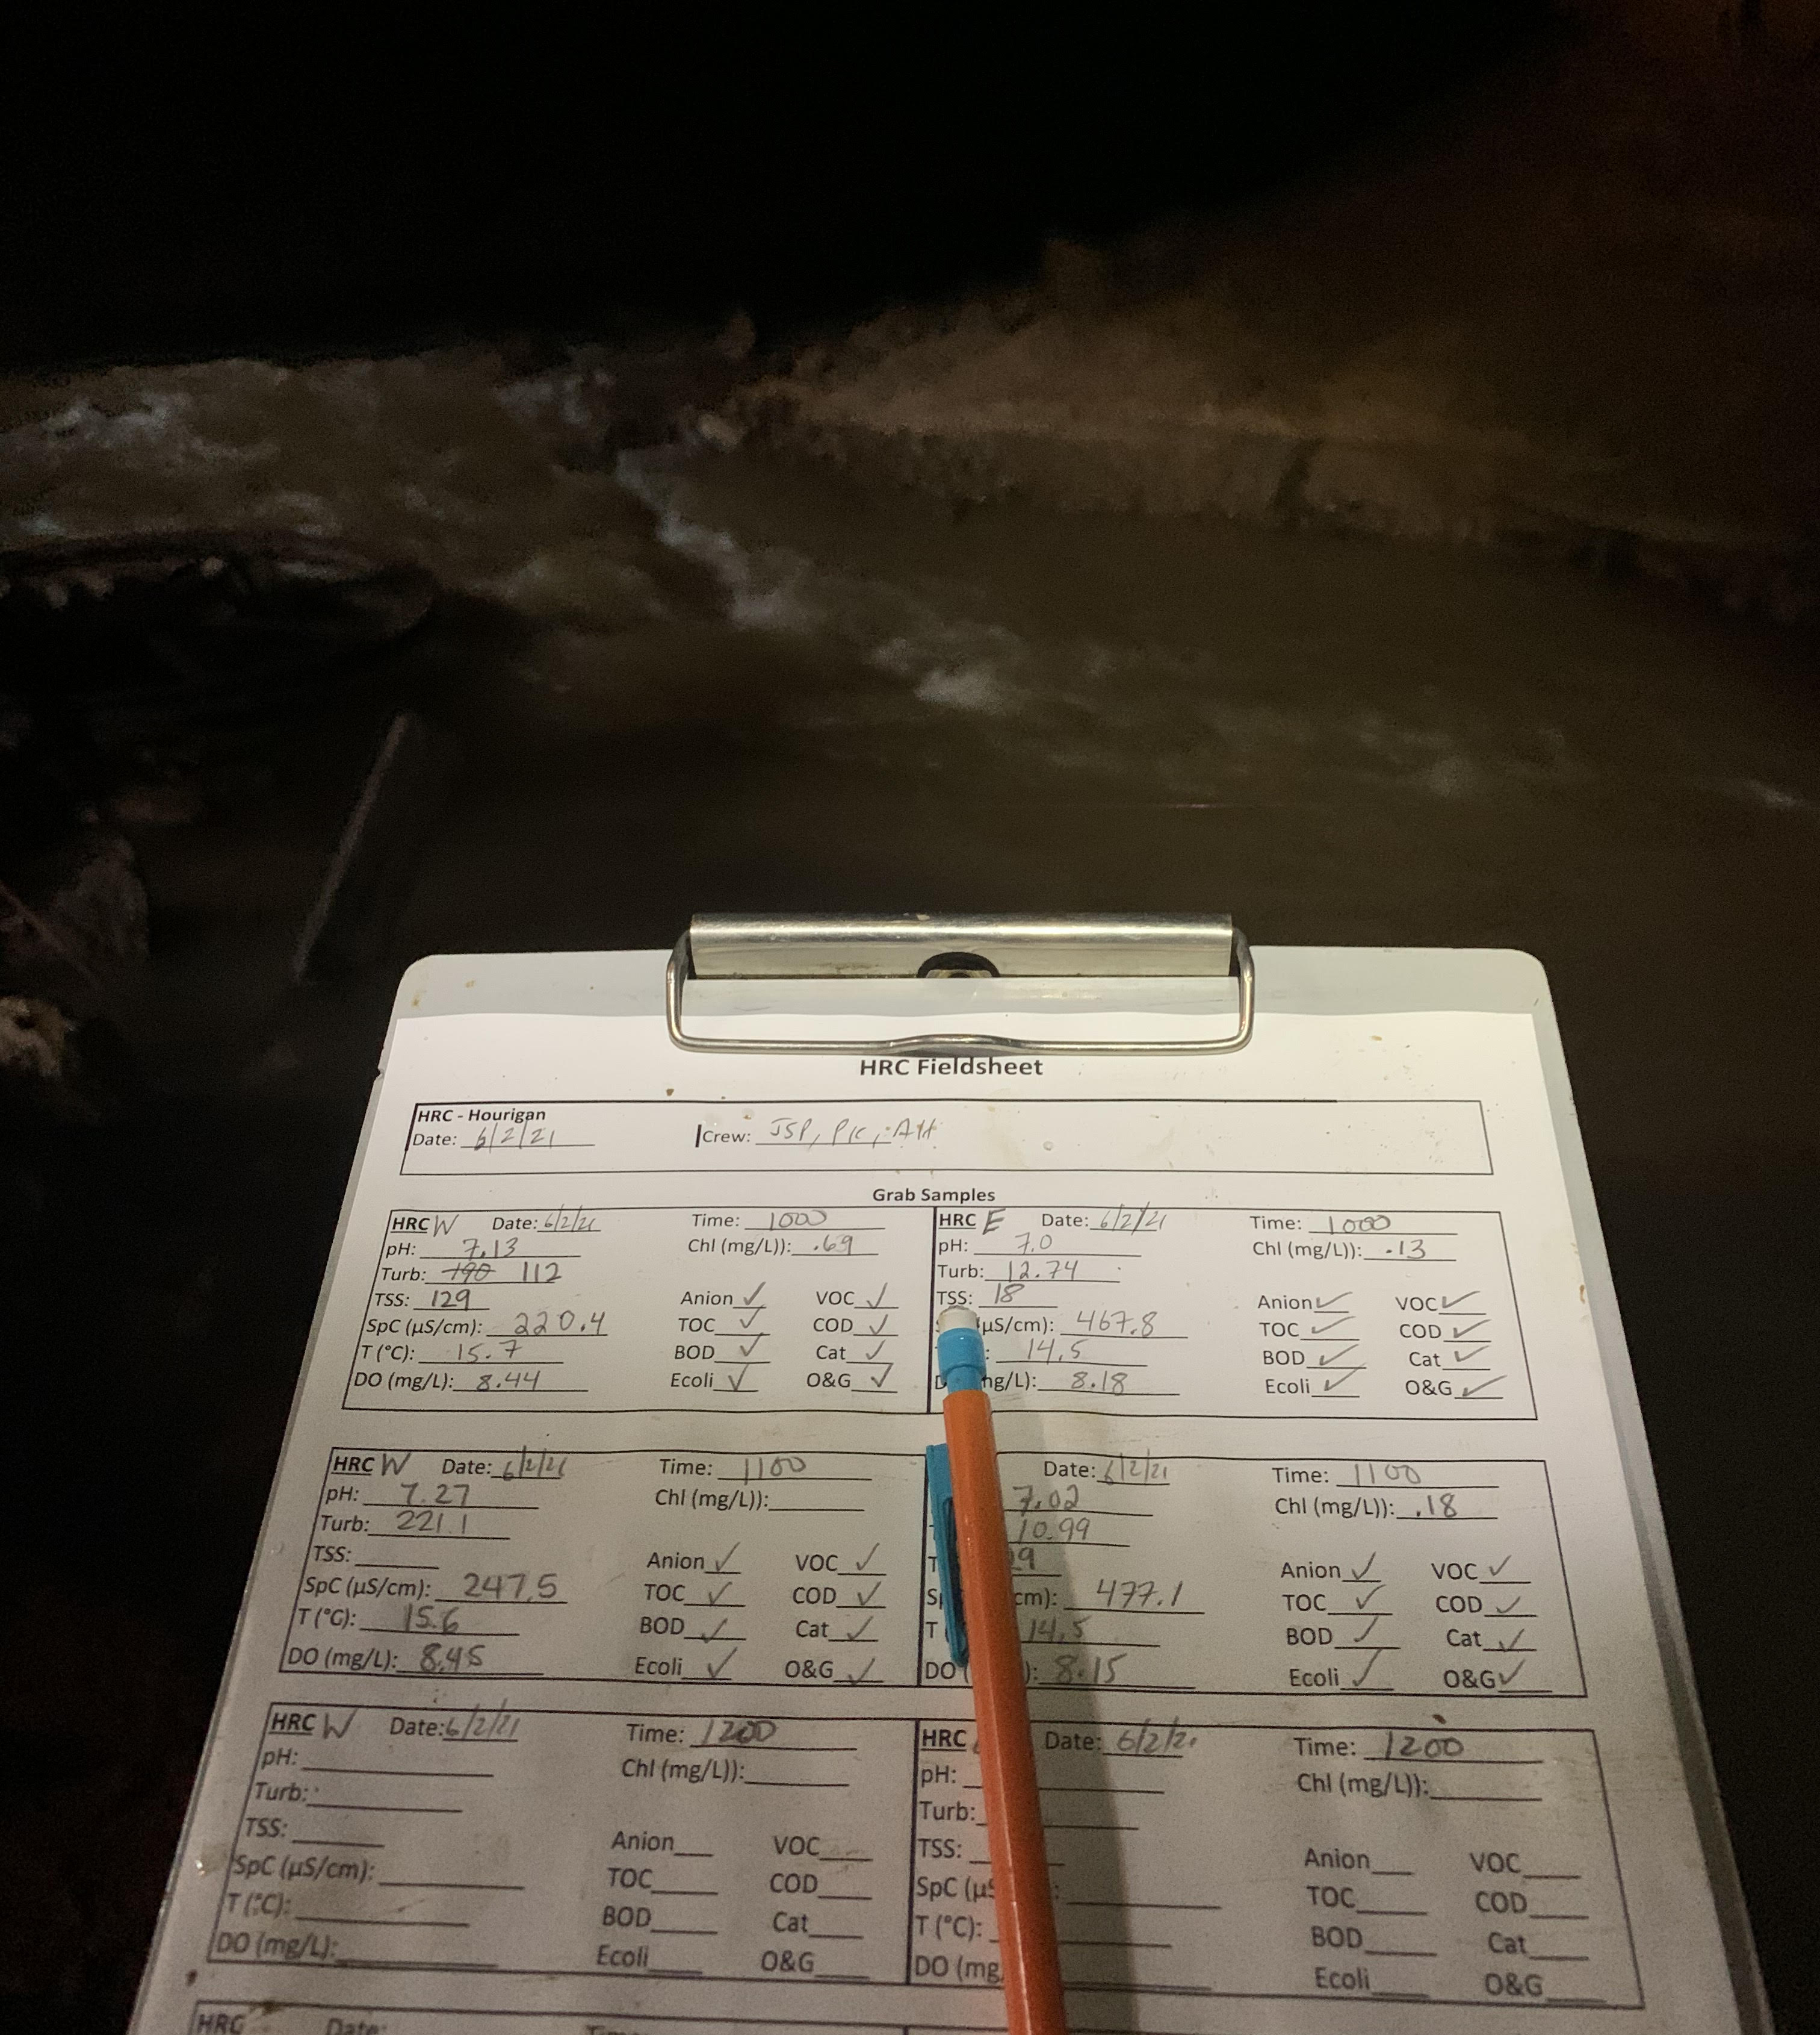
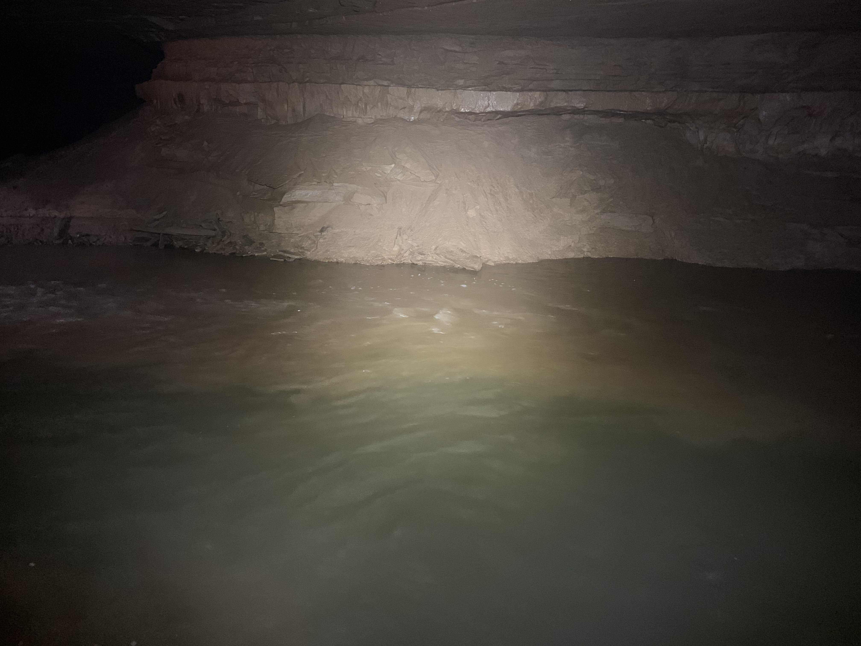
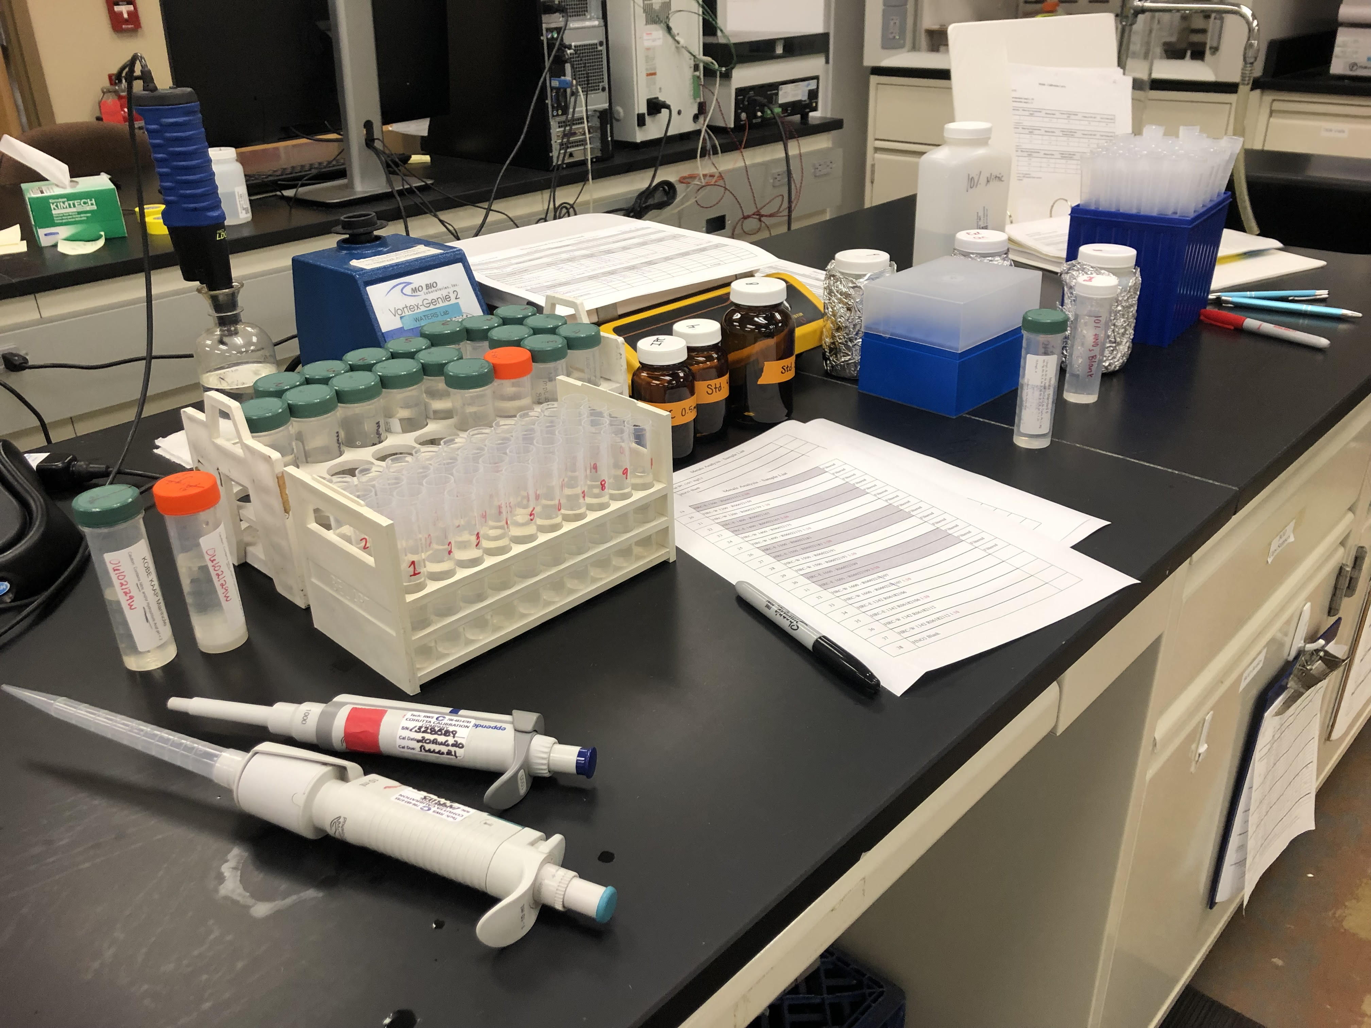

Slide 12
Data Analysis
ALL Data were compiled into a master data sheet
Data were inspected against water quality expectations
Data were plotted in stack scatterplots (origin pro software)

Slide 13
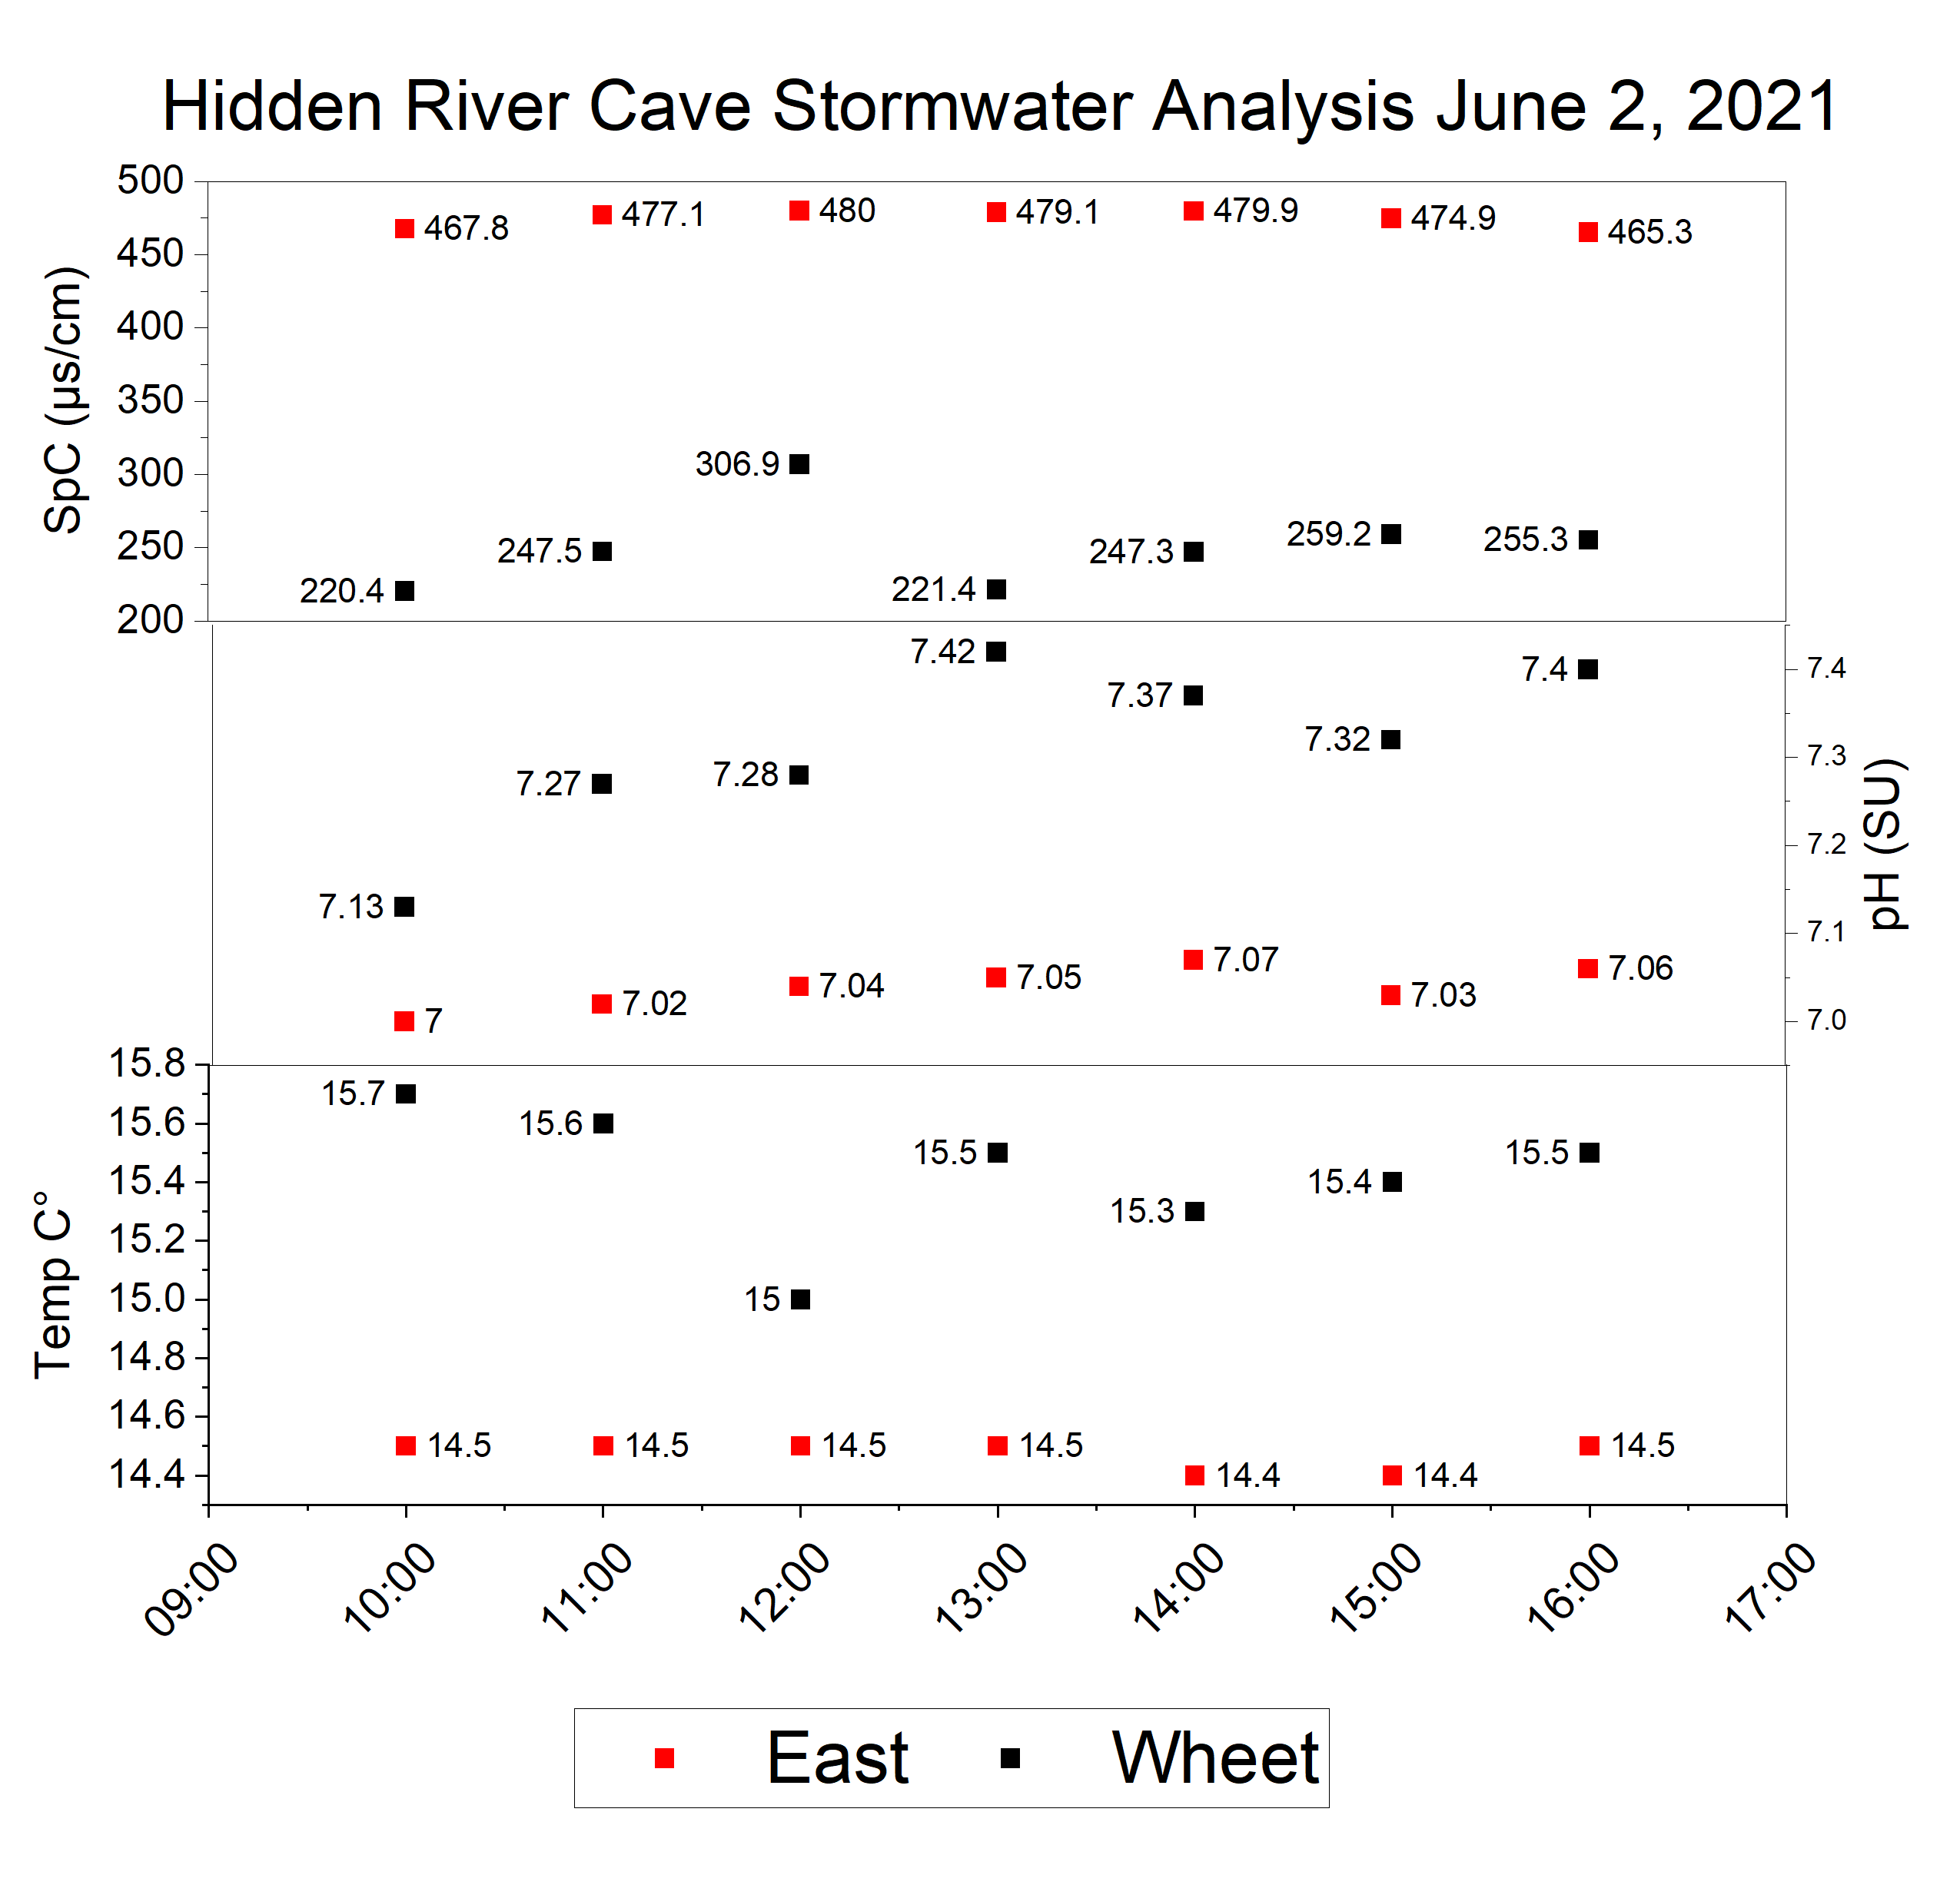
results

Slide 14
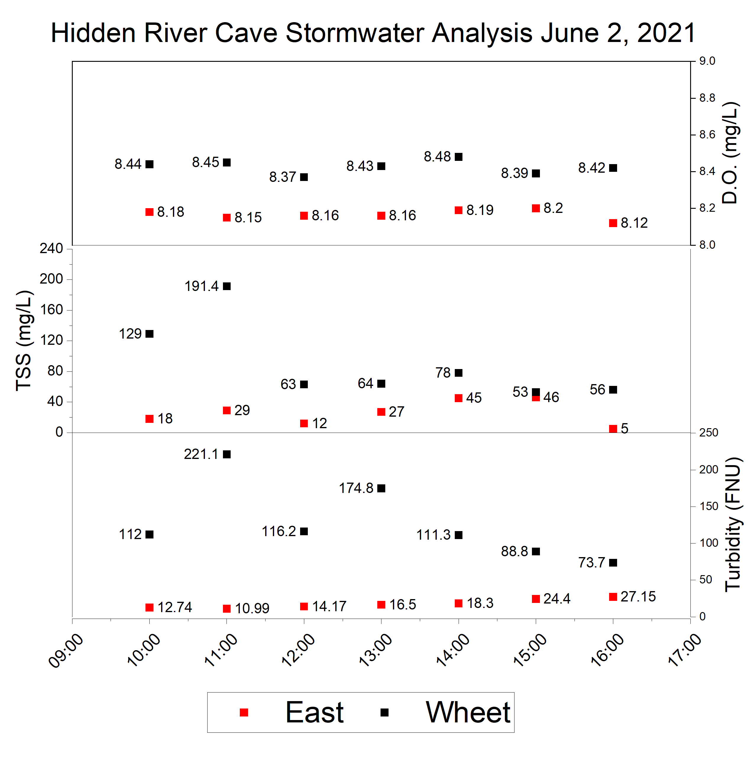
results

Slide 15
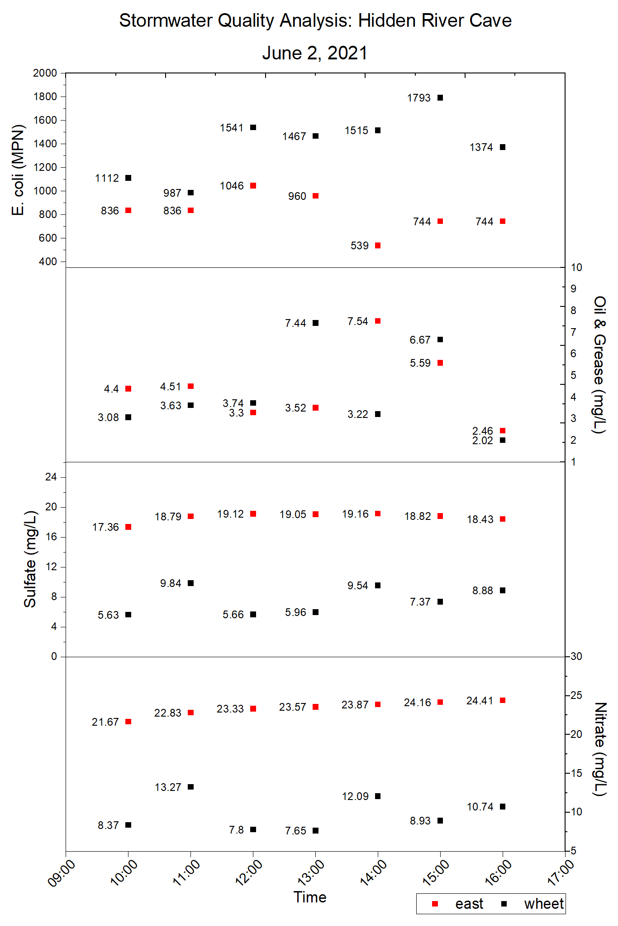
results
The contaminants that appeared in the samples for both subsurface streams were:
E. coli
Oil and Grease
Sulfates
Nitrates

Slide 16
Results
There are concentrations of contaminants present in all samples that have the potential to pose a risk to the cave biota.
The results confirm a difference in the water quality conditions between the East and Wheet Rivers.
Some parameters demonstrated a surge in concentrations during the sampled storm event.

Slide 17
references
KY mesonet. 2021. Monthly climatological summary. Hart county, kentucky. Https://www.Kymesonet.Org/monthly_summaries.Html?County=hdyv
Foster, D.G., 2009. American cave museum and hidden river cave, horse cave, kentucky. Field trip 31: exploration and science in the mammoth cave system, july 27 to august 2. Huntsville, AL: national speleological society.
Lewis, j. 1995. The devastation and recovery of caves and karst affected by industrialization. In rea, T. (Ed.) Proceedings of the 1995 national cave management symposium: spring mill state park, october 25-28. Mitchell, IN: national cave management symposium steering committee, 214-227.
Meiman, j., Groves, C., Herstein, S., 2001. In-cave dye tracing and drainage basin divides in the mammoth cave karst aquifer, kentucky. In kuniansky, E.L. (Ed.) U.S. Geological survey karst interest group proceedings, water-resources 131.
Quinlan, j.F., Ewers, R.O., 1989. Subsurface drainage in the mammoth cave area. In white, W.B., White, E.L. (Eds.) Karst hydrology: concepts from the mammoth cave area. New york, NY: van nostrand reinhold, 65-103.
Quinlan, j.F., Rowe D.R., 1977. Hydrology and water quality in the central kentucky karst: phase I. Lexington, KY: university of kentucky, water resources research institute, research report no. 101. Investigations report 01-4011, 179-185.
Raedts, c., Smart, C., 2015. Tracking of karst contamination using alternative monitoring strategies: hidden river cave, kentucky. Proceedings of the 14th multidisciplinary conference on sinkholes and the engineering and environmental impacts of karst. Rochester, MN: national cave and karst research institute, 327-336.

