Slide 1




EXAMINING HYDROGEOLOGICAL DYNAMICS OF BASELEVEL AND REVERSE FLOW OF THE GREEN RIVER AND MAJOR SPRINGS OF MAMMOTH CAVE, KENTUCKY
Matthew Cecil, Jason Polk, Rick Toomey, Pat Kambesis, Chris Groves
Department of Earth, Environmental & Atmospheric Sciences
Western Kentucky University, Bowling Green, Kentucky

Slide 2
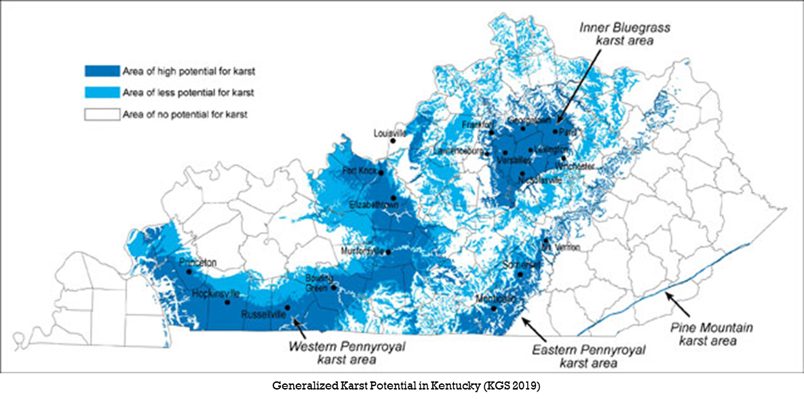
Introduction and Background
Karst Systems underlie over 50% of the United States
  About 55% of Kentucky, including most major cities
Karst aquifers provide more than 25% of the world’s population with water resources (Ford and Williams 2007)
Understanding the dynamics of karst aquifers can be difficult, but necessary
Notes:
A terrain, generally underlain by limestone or dolomite, in which the topography is chiefly formed by the dissolving of rock and which may be characterized by sinkholes, sinking streams, closed depressions, subterranean drainage, and caves. (Monroe, W.H., 1970, A glossary of karst terminology: U.S. Geological Survey, Water-Supply Paper 1899, 26 p.)
Over 68 percent of fresh water found on Earth is contained in icecaps and glaciers and 30 percent can be found in groundwater (Gleick 1993)
Surface water and groundwater in non-karstic terrain is easily distinguishable from one another. However, the vast conduit systems in a karst terrain, complicate the distinction between surface and groundwater hydrology.

Slide 3
Broader Impacts
Karst aquifers are a vital source of groundwater
Understanding karst aquifers ensures better engineering, agricultural, and environmental health practices
Isotope hydrology can better help to understand the complex hydrological system, including sourcing and path dynamics
Better understanding of Mammoth Cave response to recharge and storm events, particularly flooding of the Green River
Notes:
Isotopic analysis gives us the best opportunity to understand the complexity of a karst aquifer
By looking at O+H, we can eliminate any carbonate or geological influence on the data
Understanding sourcing is important
Seasonal variabilities?

Slide 4
Research Questions
What are the primary input sources, mixing dynamics, and recharge regimes of River Styx and Echo River Springs?
Can isotope and hydrologic tracing indicate flow reversals between Echo River and River Styx Springs?
What are the impacts of storm events, varying seasonal conditions, and dam releases on the hydrologic regime of River Styx and Echo River Springs?
Notes:
The focus of this study is to improve source delineation and flowpath dynamics for the hydrologic regime between the Green River, the River Styx, and Echo River using isotopic analysis combined with discharge, temperature, and other hydrologic data
The goal is to provide information on the effects that spring flow reversals have on hydrologic variability under differing conditions. It also looks to provide information regarding the sources of recharge feeding primary inputs and tributaries to baselevel springs in Mammoth Cave, and further understanding of complex groundwater flow in well-developed karst systems, which are often subject to flooding and contamination, as well as human modification from development, dams, and alteration of natural drainage systems

Slide 5
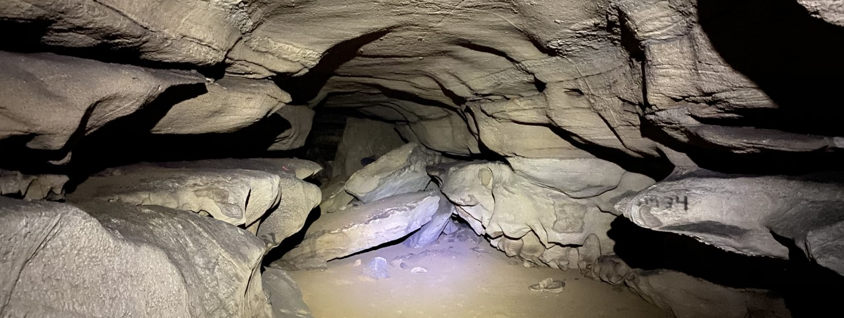
Mammoth Cave National Park
Established in 1941
World Heritage Site (1981)
International Biosphere Reserve (1990)
Notes:
The complex hydrological regime of the Mammoth Cave system has been studied in the past, but there are still aspects yet to be fully looked at in fine detail. Pollution and other contaminants can be introduced into the cave system during a reverse flow event (Trimboli and Toomey 2019)
The Park has more than two million visitors a year, and close to 500,000 of those visitors take cave tours
215 square kilometers of protected land and over 647 kilometers of surveyed cave passages

Slide 6
Study
Area
Monitoring sites at Styx and Echo Springs as primary outlets (water level)
In-cave sites at River Styx Boardwalk and Minehaha (water level)
Surface monitoring of Green River Upstream (water level)
Comprises two different size basins with primary connection to active cave-forming river layers within Mammoth Cave
From: Kipper 2019
Notes:
The focus of this study is to improve source delineation and flowpath dynamics for the hydrologic regime between the Green River, the River Styx, and Echo River using isotopic analysis combined with discharge, temperature, and other hydrologic data
The goal is to provide information on the effects that spring flow reversals have on hydrologic variability under differing conditions. It also looks to provide information regarding the sources of recharge feeding primary inputs and tributaries to baselevel springs in Mammoth Cave, and further understanding of complex groundwater flow in well-developed karst systems, which are often subject to flooding and contamination, as well as human modification from development, dams, and alteration of natural drainage systems

Slide 7
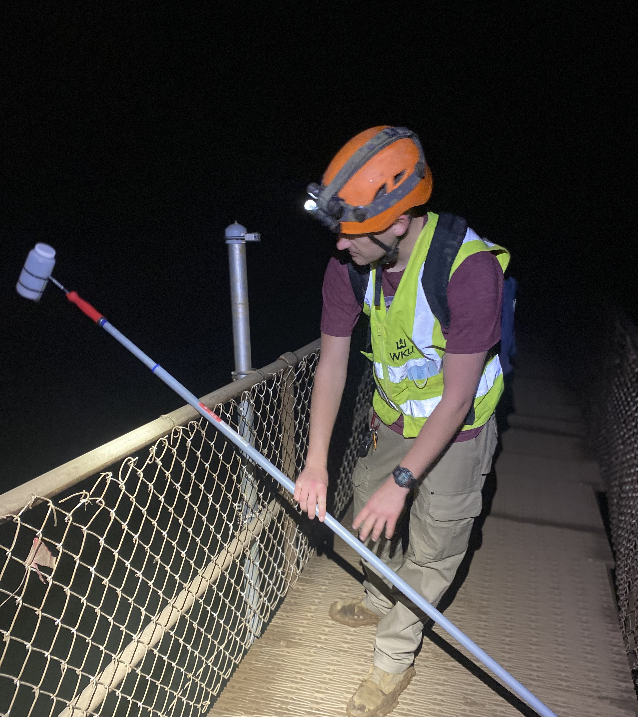
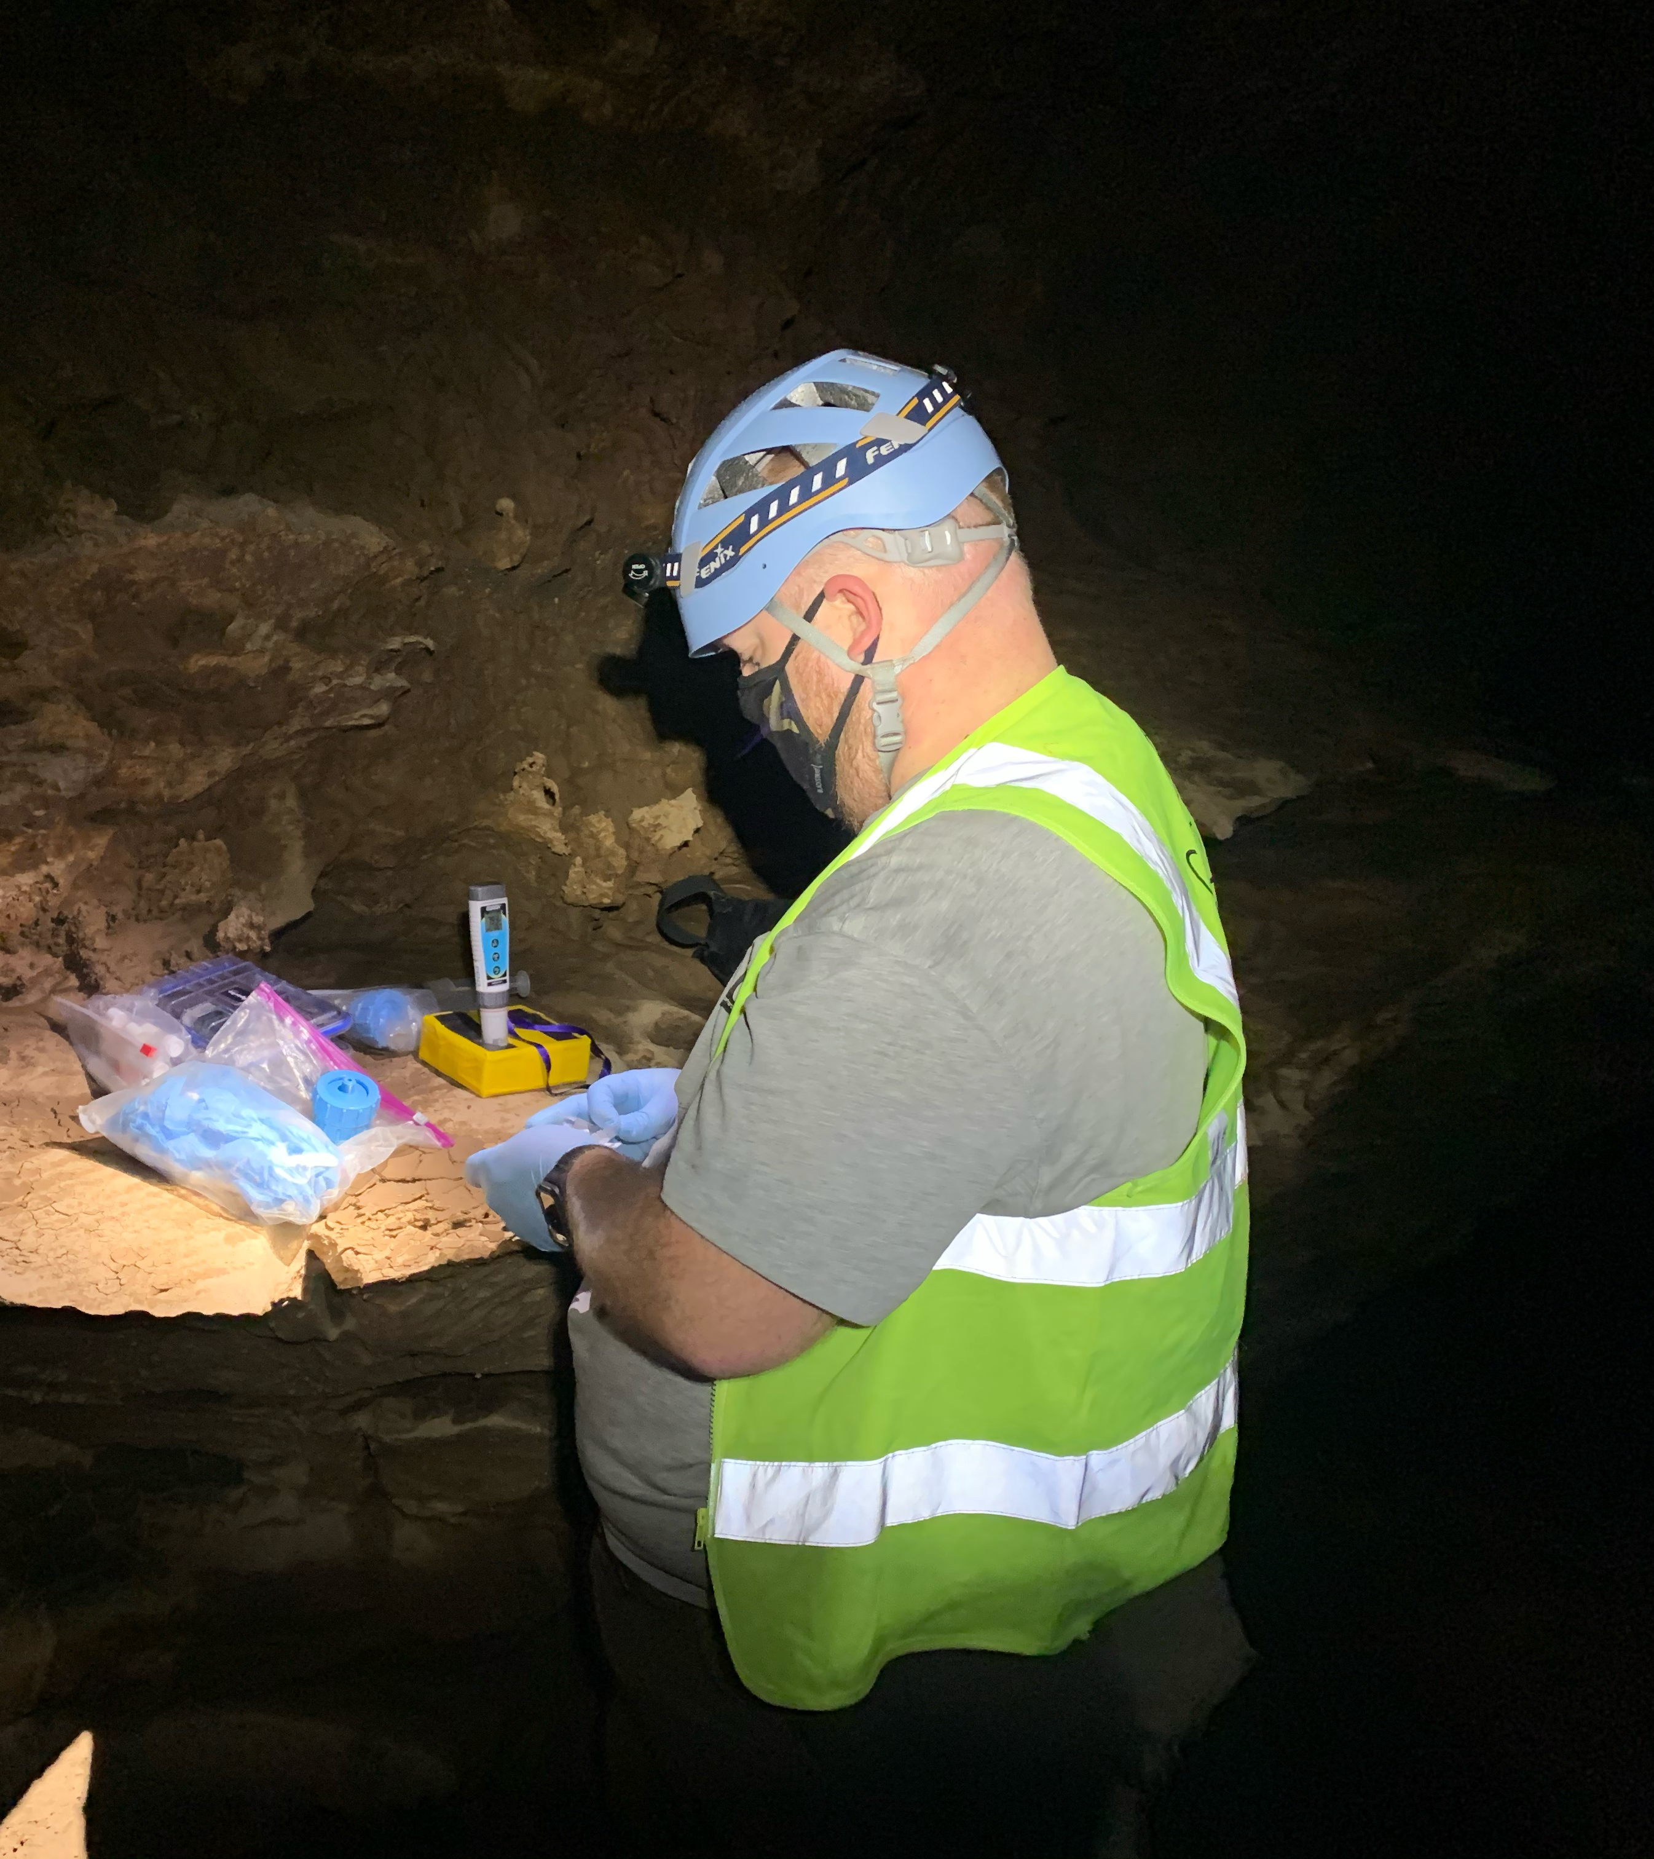
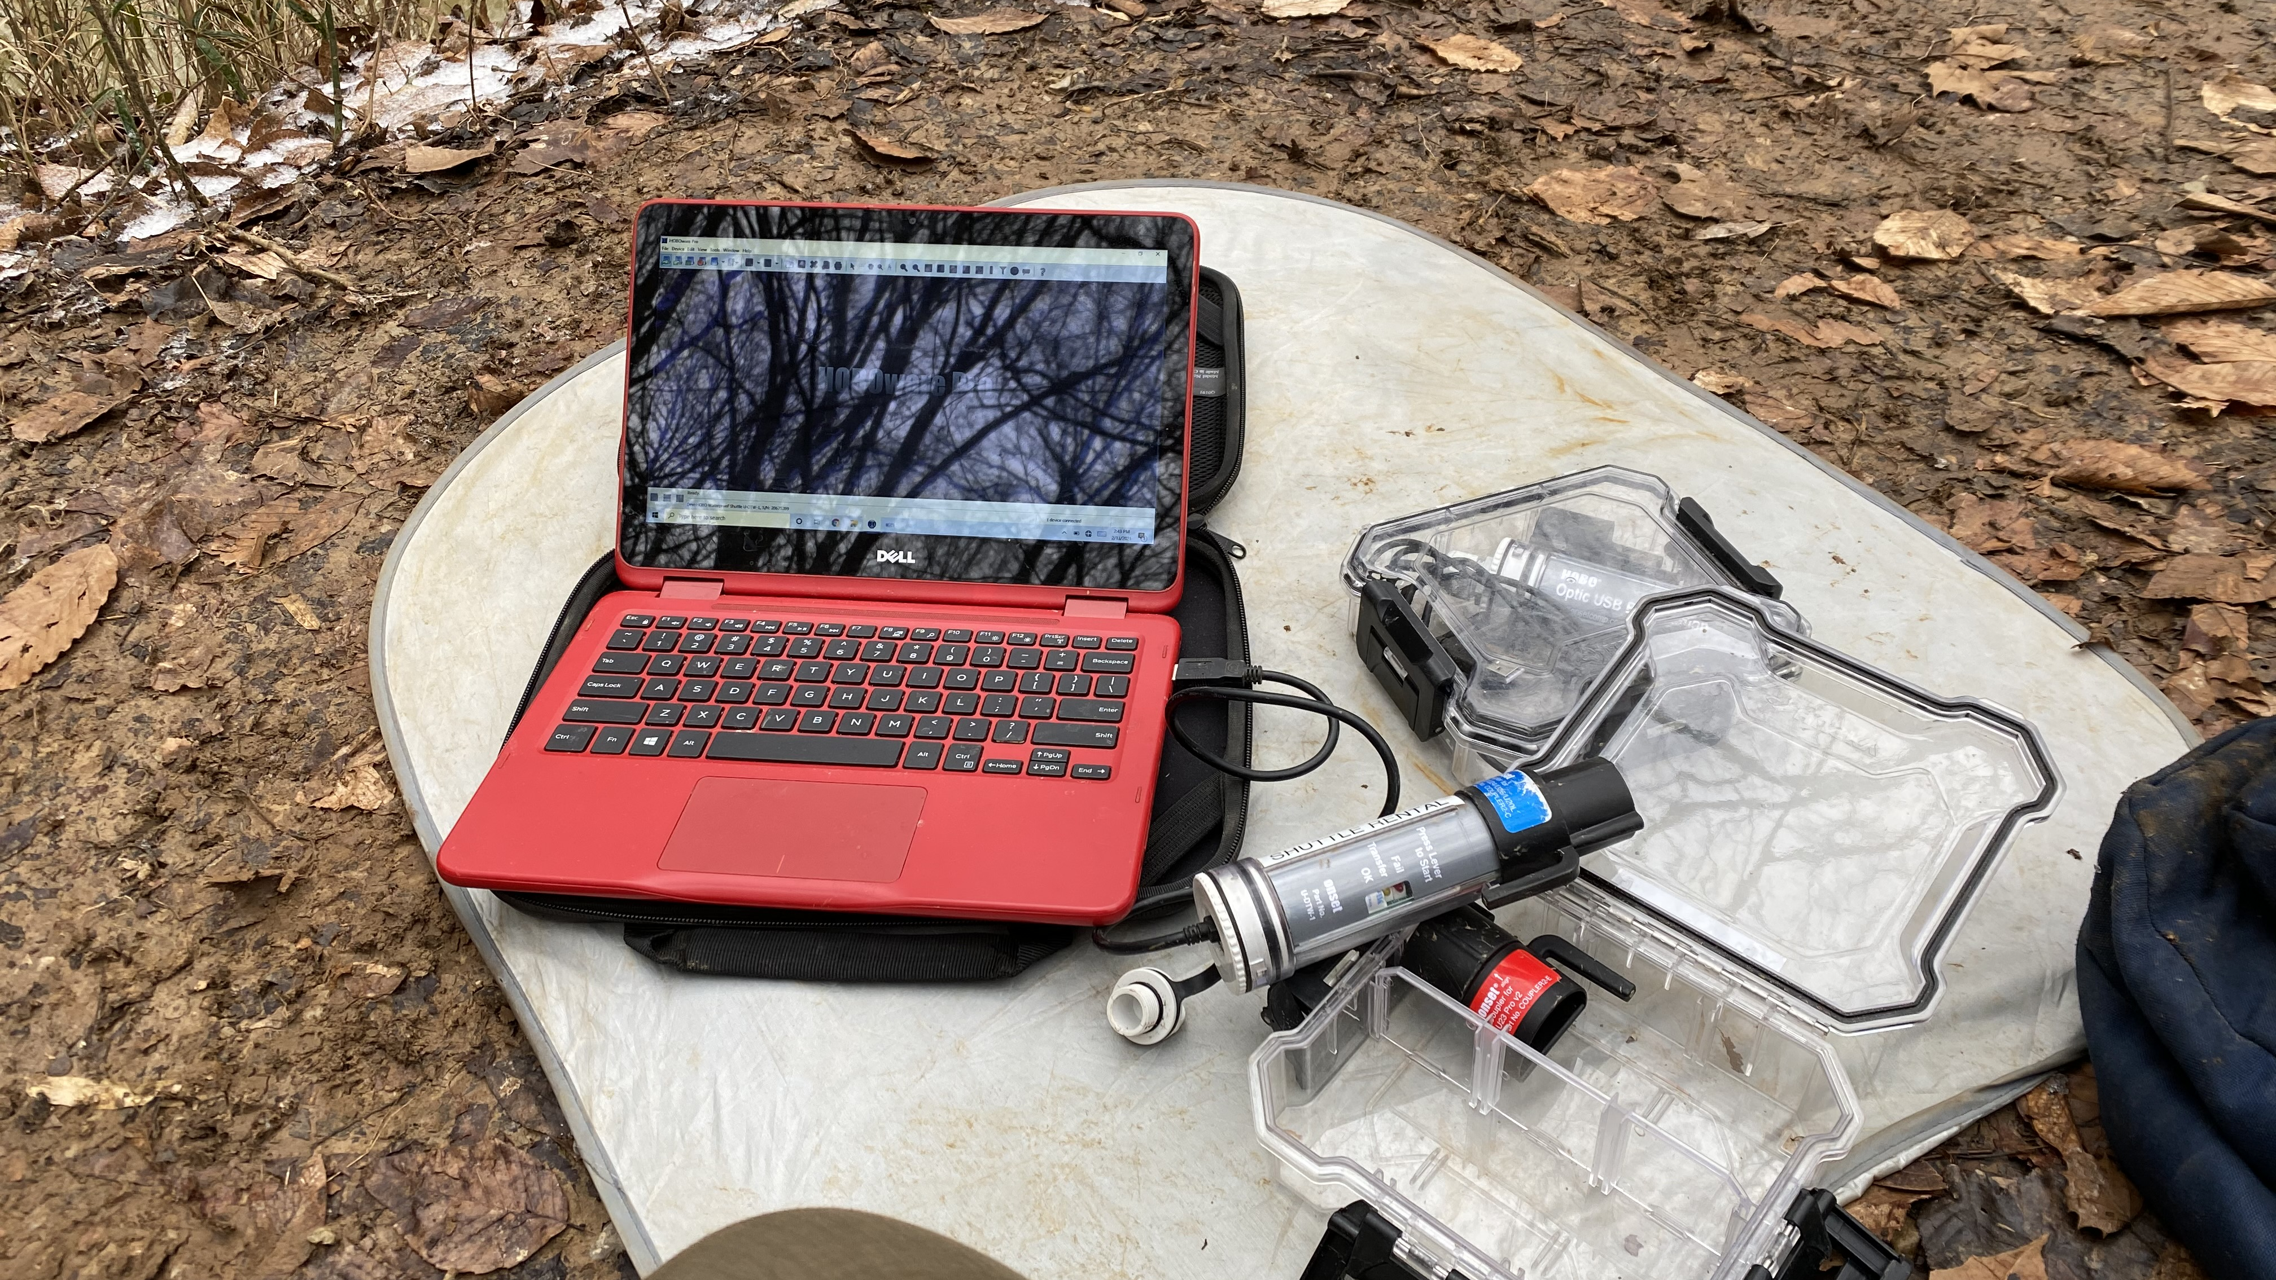
Methods
17 sites selected for sampling and monitoring
2 Weather Stations with rain gauges
6 stilling wells with HOBO UL20 water level loggers
15 sites with geochemical monitoring
All sites include hydrogen/oxygen isotope Sampling
Notes:
To understand the hydrological regime of Mammoth Cave at the selected springs, 17 total sites are used for sampling and monitoring
The sites hope to best represent the areas affected by the reverse flow phenomenon, as well as allow for a representative sample for baseflow and storm event dynamics through the epikarst and vadose zone as they recharge the major in-cave rivers feeding the springs

Slide 8
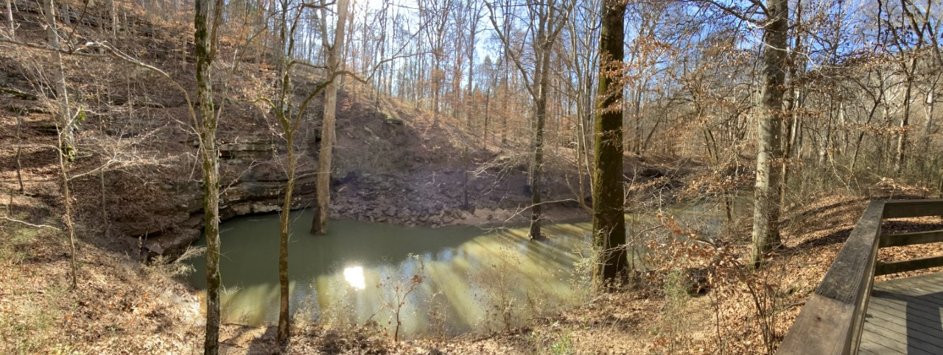
Discharge and Water Level
Onset HOBO UL20 at six input/output sites for stage height
Discharge measurements
Dam release data
Notes:
Water level loggers (Onset HOBO UL20) are installed at each of the six input/output sites to collect stage and temperature at 10-minute intervals
Discharge measurements are collected regularly at River Styx Spring, Echo River Spring, and a Combination site of Echo River Spring and Accessory Spring using United States Geological Survey (USGS) standard equipment and methods
A SonTek ADCP (Acoustic Doppler Current Profiler) is used for automated discharge measurements.
Green River dam release and water level/discharge data will also be collected over this period from USGS gauging stations to establish when artificially-induced baselevel changes or reversals occur.

Slide 9
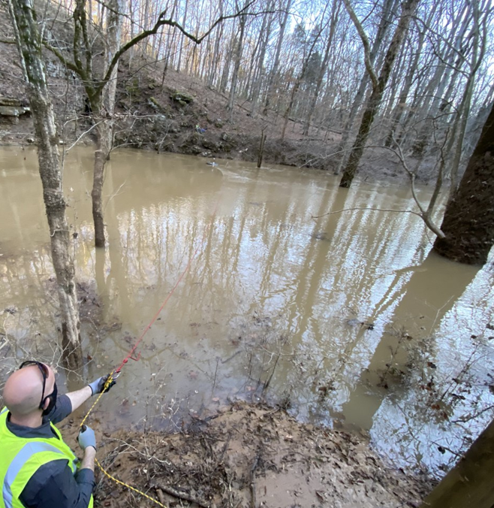
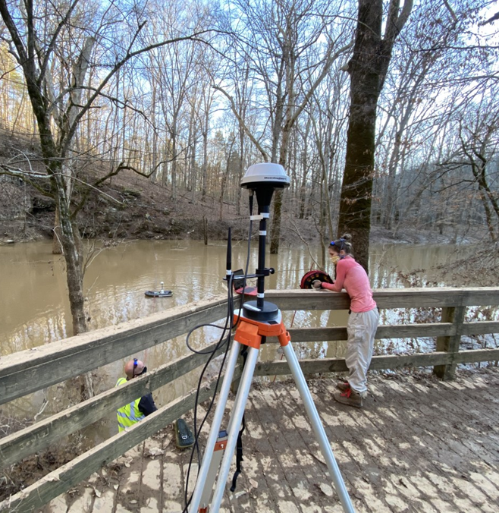
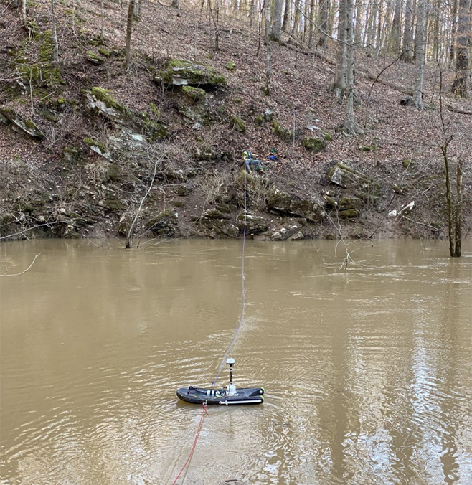
SonTek ADCP M9 RiverSurveyor
Notes:
The RiverSurveyor is a river discharge measurement system that uses multiple acoustic frequencies with precise GPS location to create discharge measurements and bathymetric profiles

Slide 10
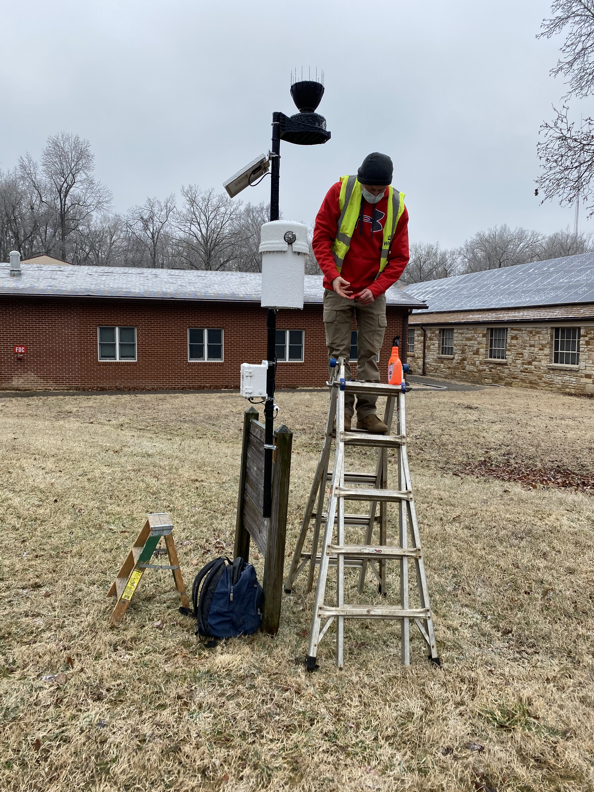
Precipitation Monitoring and Sampling
Two HOBO weather stations (mm/hour)
  Located within pre-delineated drainage basins for Echo River and River Styx
  2-minute intervals using a tipping bucket collected weekly and after rain events
  Isotope samples collected weekly
Notes:
Rain gauges are used within the two main drainage basins (already delineated) for Echo and River Styx Springs to collect high-resolution rainfall data (10-minute) and include approved IAEA (International Atomic Energy Agency) water isotope (oxygen and hydrogen) collection devices (Wilde et al. 2015)

Slide 11
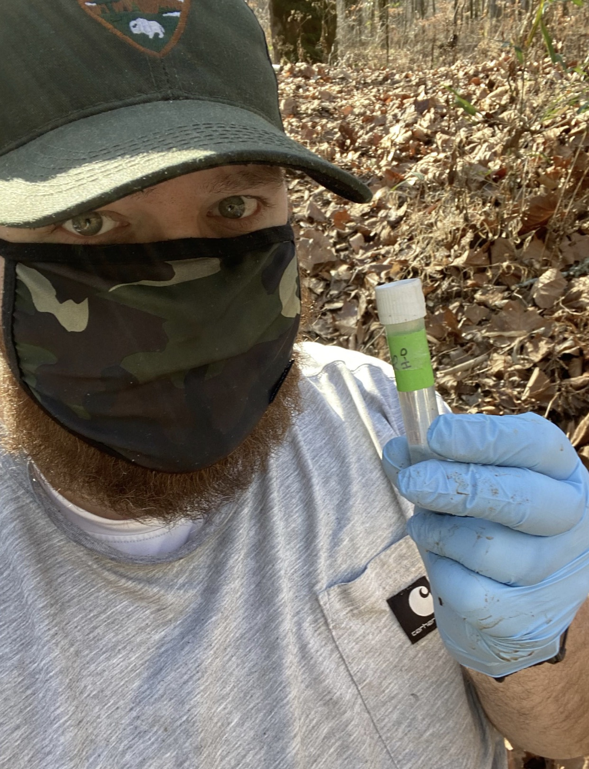
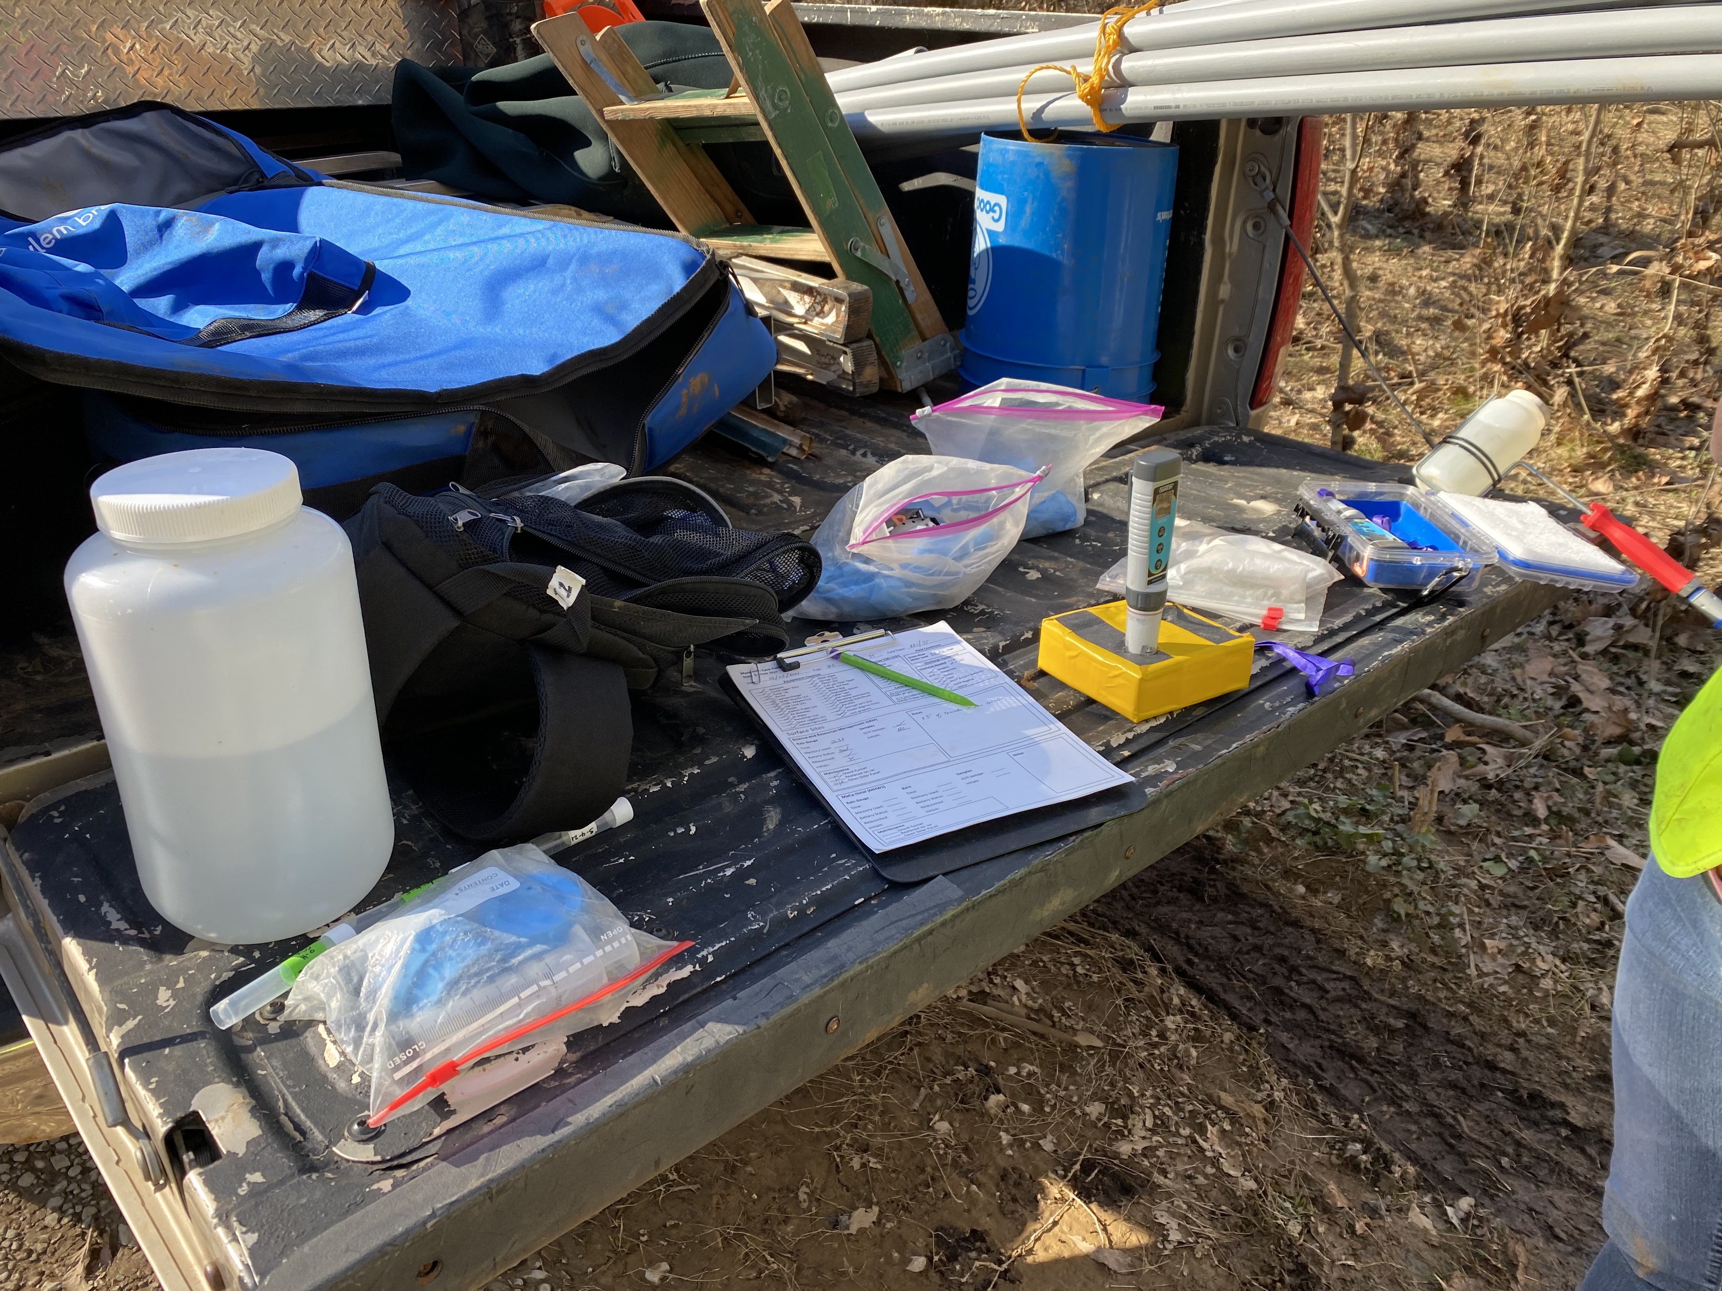
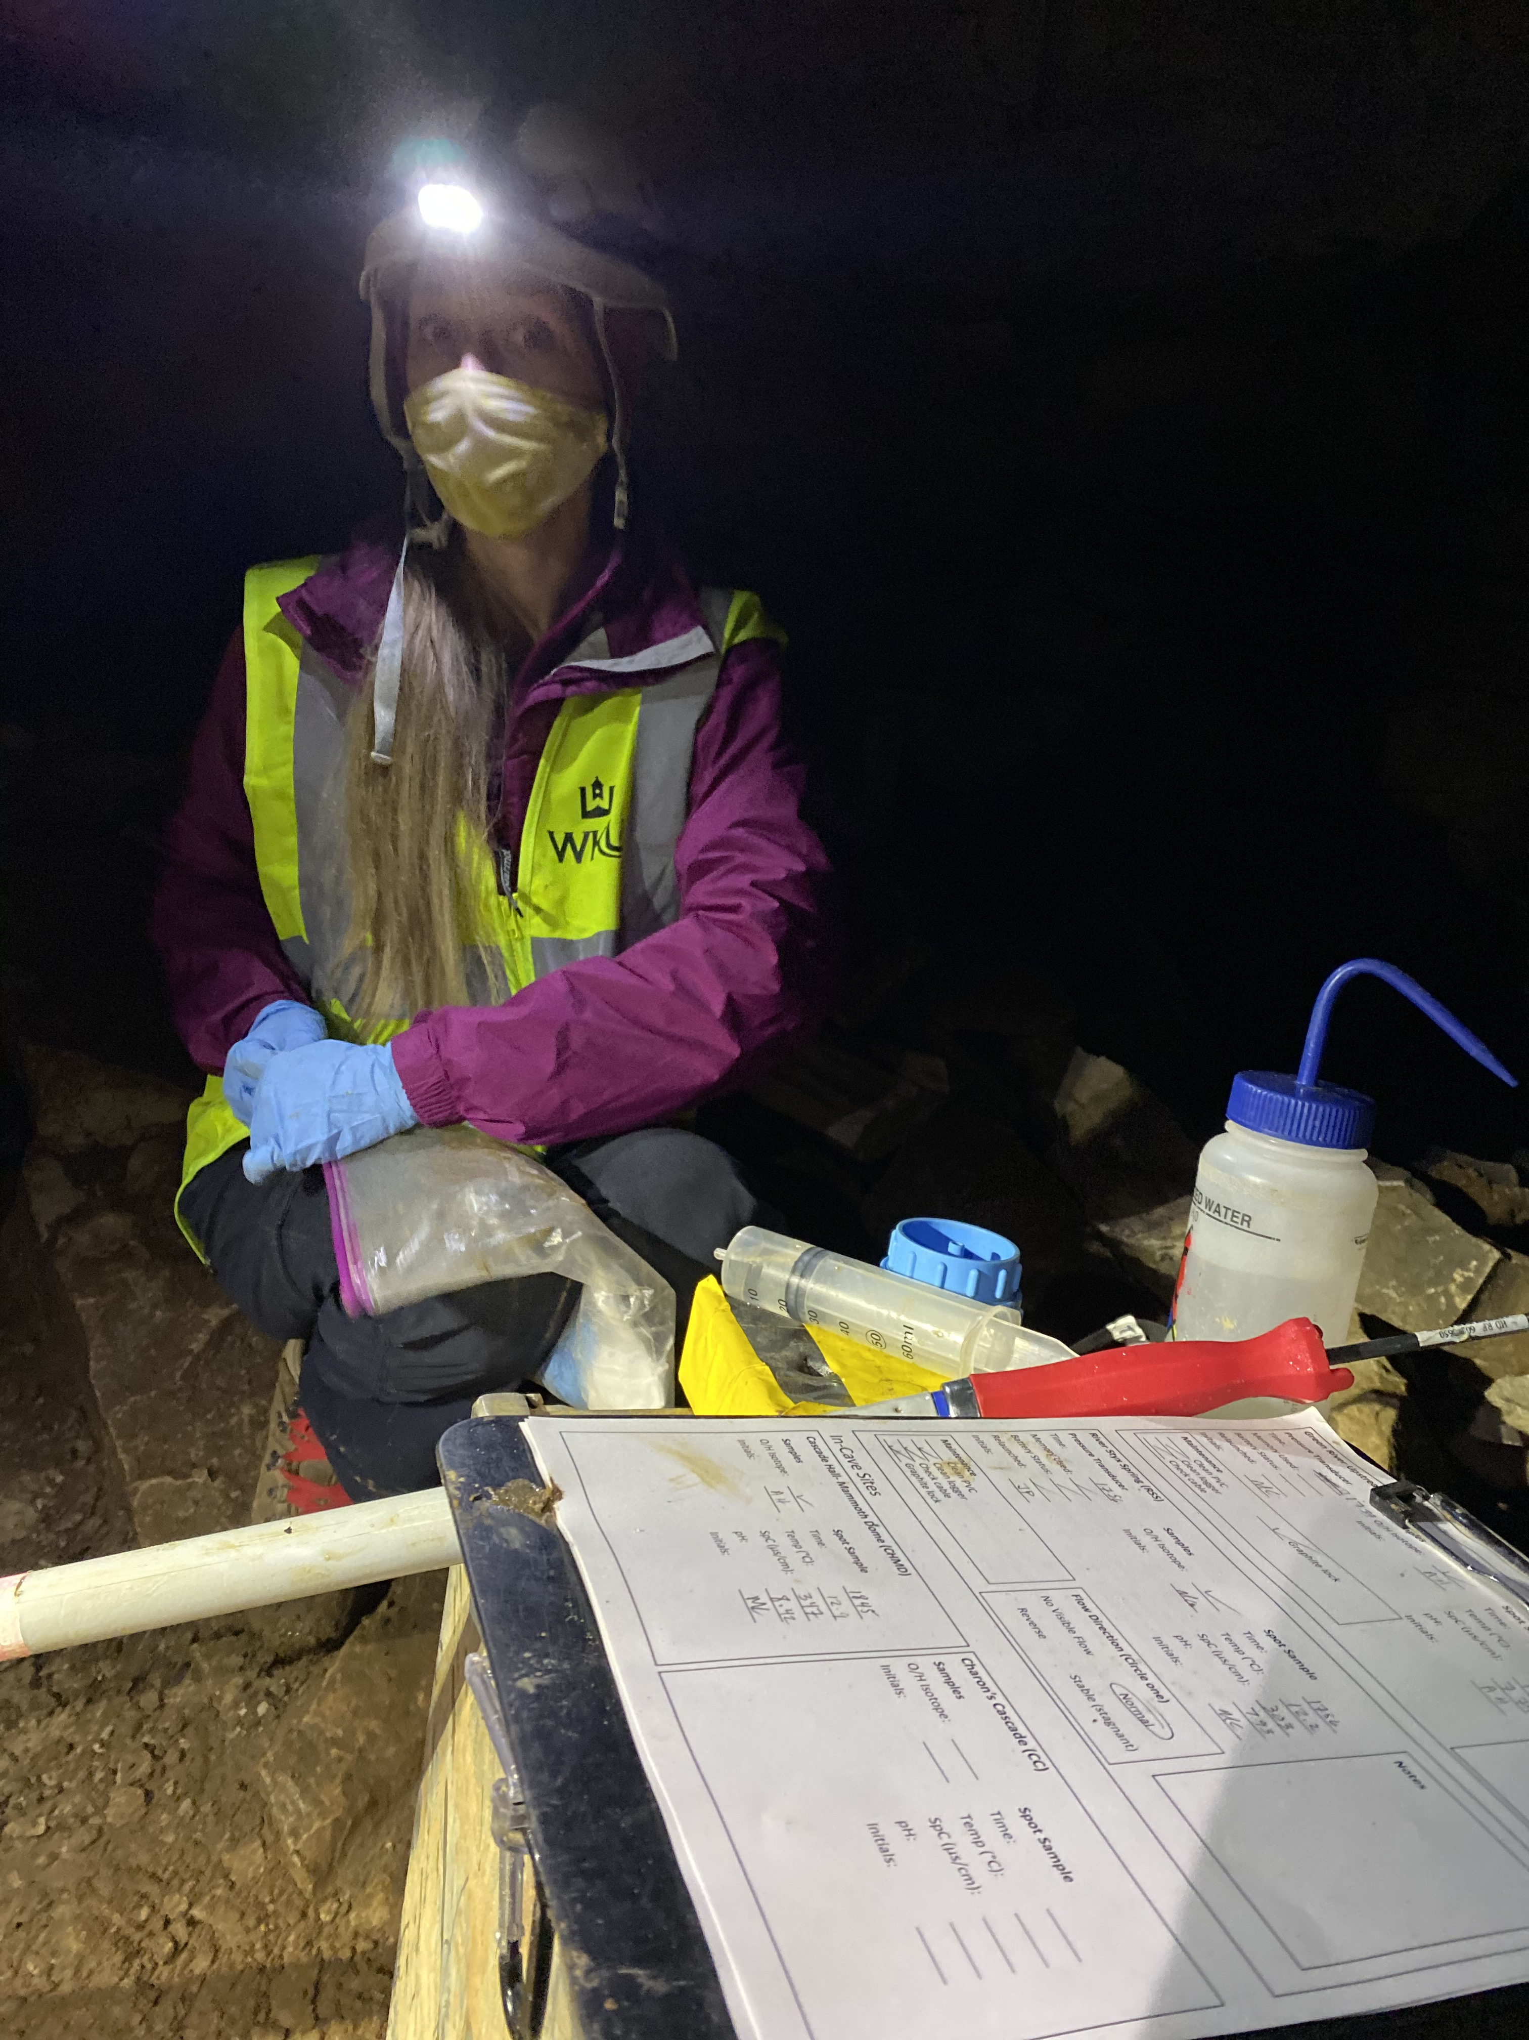
Isotope Sampling
Water for oxygen and hydrogen isotopes
10 mL vials
Stored at 4°C until analysis
Notes:
Each week from the start date in January 2021 through June 2021, water samples for isotope analysis (O and H) will be collected from each of groundwater and surface sites.
The O and H isotope samples will be collected in 10 mL vials with no preservative directly from the water source, sealed with no headspace, wrapped with parafilm to prevent outgassing and fractionation, and stored at 4°C until analysis (Wilde et al. 2004).

Slide 12

Sample and Data Analysis
University of Kentucky & University of Utah Stable Isotope Labs
Determining sourcing (mixing model)
OriginPro software
Notes:
Isotope samples will be analyzed at the University of Kentucky and University of Utah’s Stable Isotope Labs using a Los Gatos Research T-LWIA-45-EP liquid water isotope analyzer
The samples will be normalized to Vienna Standard Mean Ocean Water (VSMOW) using the IAEA standards VSMOW2 and VSLAP, along with a local standard
Amount-weighted rainfall isotope data will be used to create a local meteoric water line to compare surface and in-cave isotope data, which will be used to determine the sourcing and evolution of rainfall through the system (Polk et al. 2012), including when reversals occur
This will be used in conjunction with rainfall amount data and water level data to quantify the relationship between recharge, rainfall amount, and composition of the baselevel and flood stage groundwater as the Green River and the two springs flux between normal and reverse flow into the cave
OriginPro software will be used for data analysis and to represent the data graphically
Mixing models showing composition and influence of recharge sources along the flow system and reversal flowpaths will be created by identifying trends with precipitation amounts, discharge data, and isotopic analysis and correlating it with the meteoric water lines and reversal conditions

Slide 13
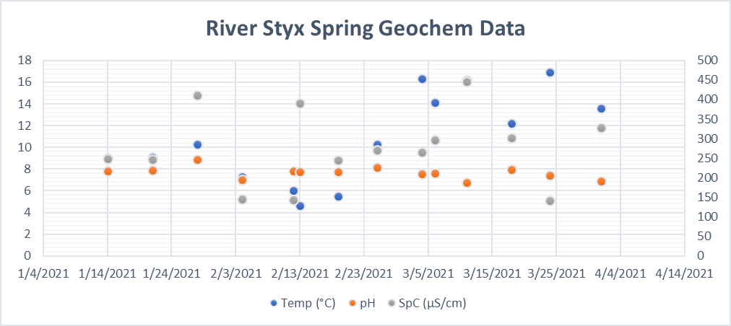
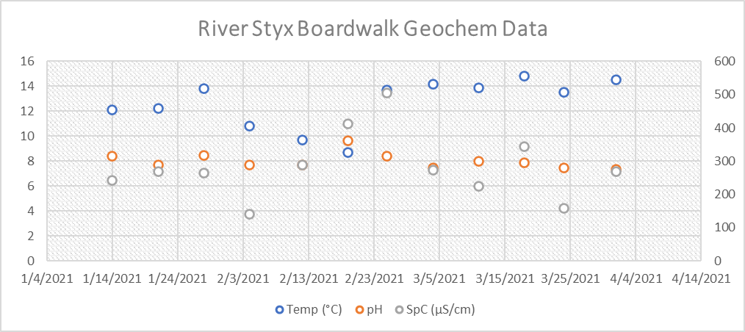
Preliminary
Results

Slide 14
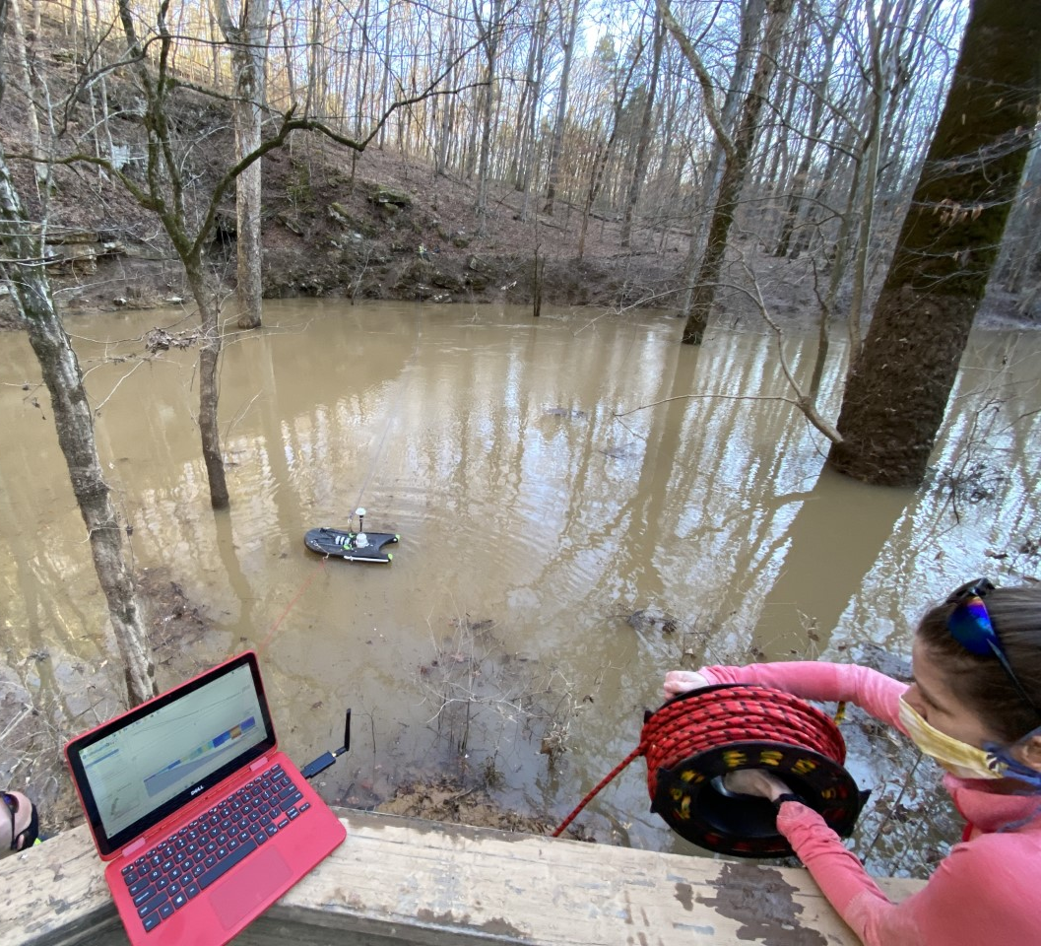
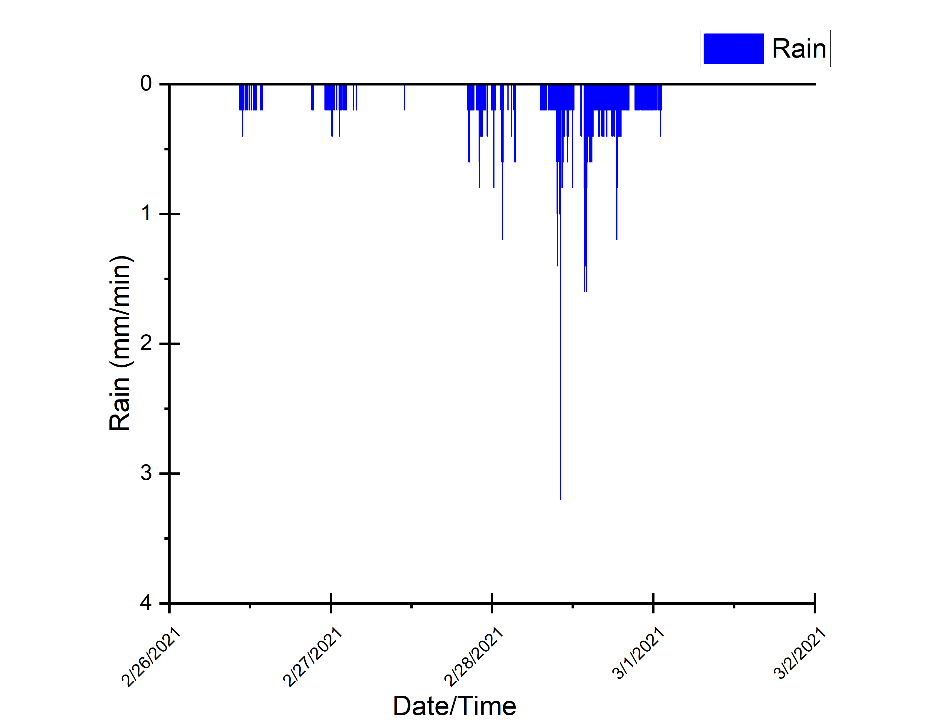
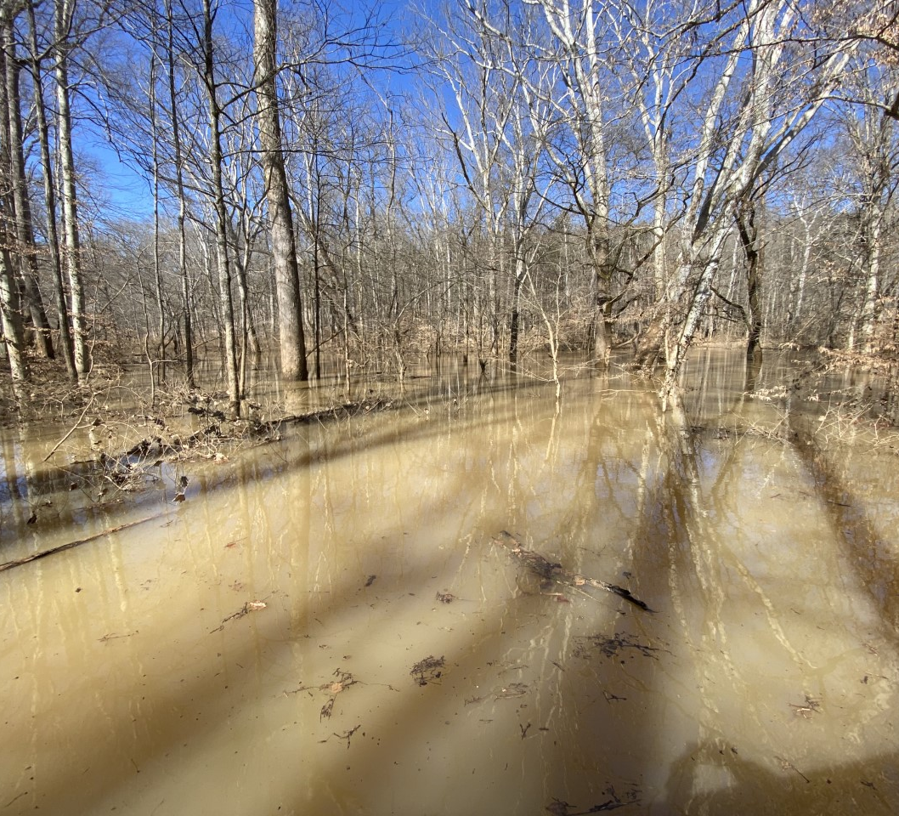
February 28- March 1, 2021 Flood Event
Total Precip =
114 mm (4.48 in)
Notes:
125 mm of rain between 2/25/2021 and 3/4/2021

Slide 15
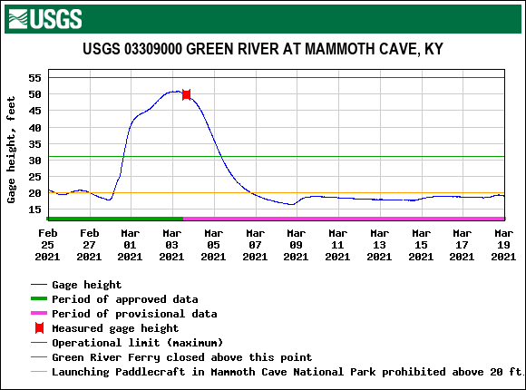
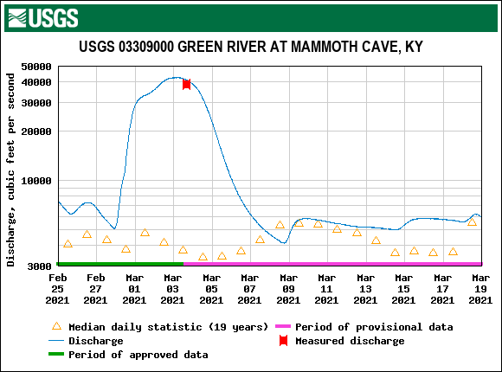
Green River Response
Feb 28 Event

Slide 16
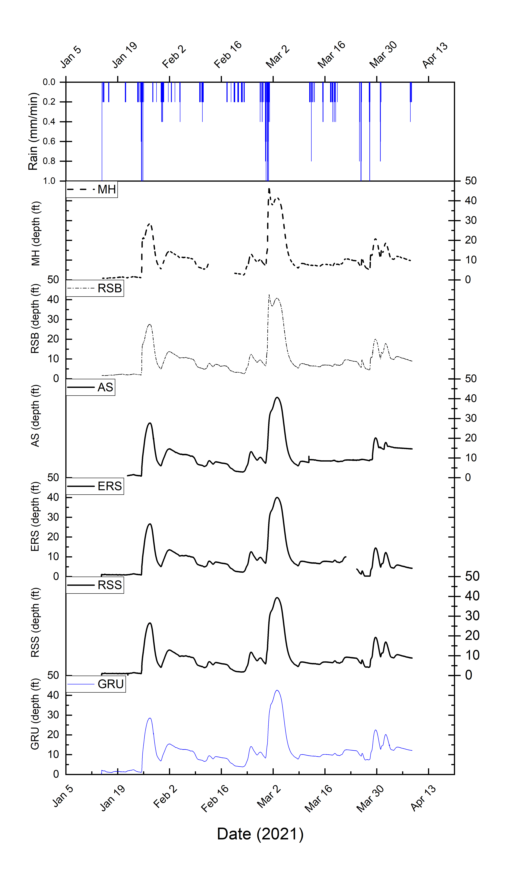
Results & discussion
Large flooding event of Feb 28 caused rapid response of both in-cave and surface sites
RSS and MH in-cave sites demonstrate a pulse of storage water pushed out ahead of the recharge event
Surface sites (RSS, ERS, GRU, AS) lag response to in-cave sites
Hydrographs look similar through event on recession due to backflooding of Green dominating flow regime
Need isotope and discharge data processed to determine timing of reversal and response to smaller events

Slide 17
Results & Discussion
Results & FUTURE WORK
Collecting some of the first comprehensive discharge data under flood conditions for Styx and Echo Springs
Indications of complex recharge/discharge relationship based on water levels and discharge measurements thus far
Add to the baseline data for flooding and reversal events
Future work includes sampling through December 2021 and developing mixing models and completing isotopic analysis
Results from those will aid in understanding of sourcewater inputs, mixing dynamics, and recharge regimes
Provide MACA managers with useful information
Notes:
This research will add to the baseline data for flooding and reversal events between the Green River, River Styx, and Echo Spring, which can impact tourism, exploration, sensitive biota and ecosystems, and potential contamination events within Mammoth Cave, especially since the removal of Lock and Dam No. 6. created a new hydrologic regime between the cave system and Green River.
Through this study, a better understanding of sourcewater inputs, the mixing dynamics, and the recharge regimes will be created through the use of isotopes and water level as tracers of rainfall and groundwater through the system. While other hydrologic studies have occurred at Mammoth Cave National Park, there have been no studies to isotopically characterize these karst aquifers withing the Park.
This study aims to provide Mammoth Cave National Park managers with information to help them make scientifically informed decisions to protect the cave environment, manage flooding, and establish longer-term monitoring of the hydrologic conditions controlling the evolution of Mammoth Cave, as well as provide a conceptual model of complex telogenetic fluvial karst recharge and baselevel response dynamics applicable to many other caves around the world
Results from this study can possibly be used in improving the interpretation and understanding of Mammoth Cave and the regionally-important Green River; improved scientific information regarding the story of how the cave formed, is forming, and will evolve in the future will be incorporated into guide training at Mammoth Cave National Park for use in guided tours and their Visitor’s Center, which hosts nearly two million visitors per year, thus providing a perfect outlet for ensuring that the outcomes of the study and advancement of knowledge on Mammoth Cave can be broadly disseminated to the public and the Park staff supporting future research efforts.

Slide 18
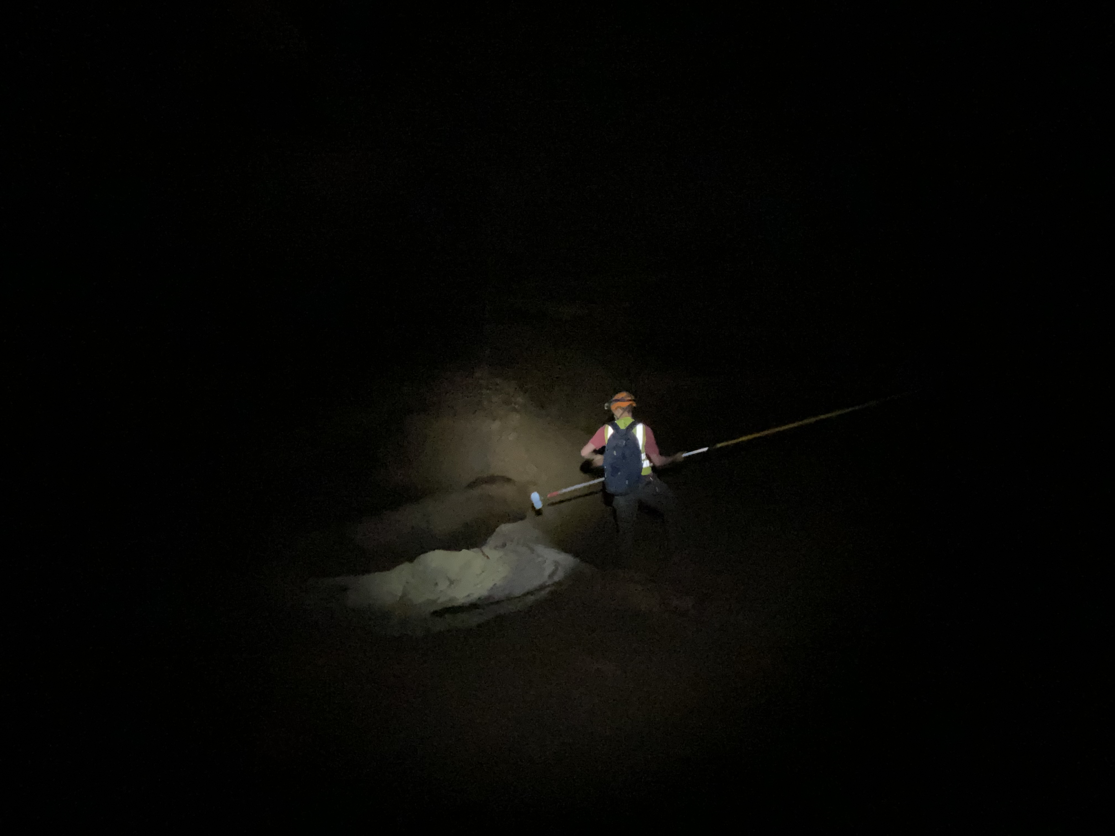
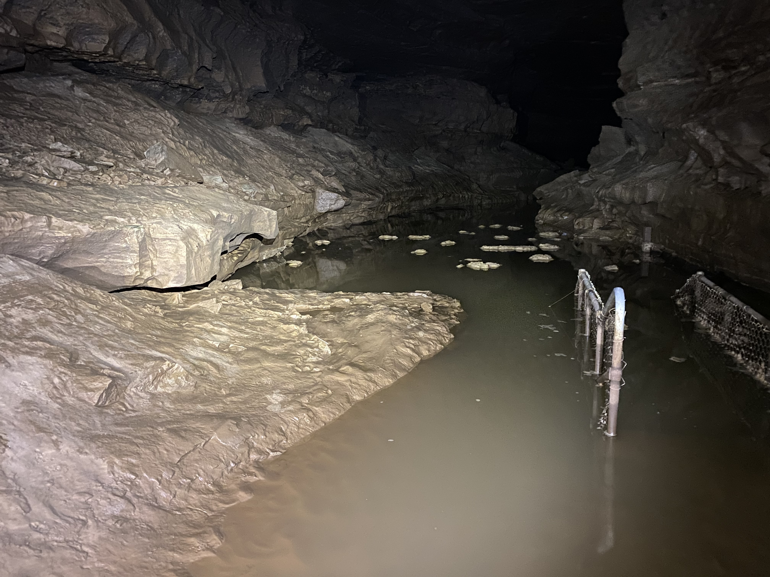
Questions?

