Slide 1
The Reduction of the Intensity of Gamma-rays as They Traverse Through Humimic Medical’s Gel #5
Anna Grace Ehr¹ and Ignacio Birriel²
Morehead State University
1: Department of Biology and Chemistry
2: Department of Physics, Earth Science, & Space Systems Engineering
Notes:
Add morehead, ky

Slide 2
Introduction: Medical Gel #5 by Humimic Medical
Humic Medical is a company that produces medical gels used for training on various medical procedures.
Gel #5 is the softest gel Humimic has to offer.
Density: 898.448 [Kg/m³]
It closely simulates blood clots and brain tissue.
Its texture makes it useful for medical imaging and surgical training procedures.

Slide 3
Introduction: Ionizing Radiation Shielding
Alpha particles are positively charged and can be stopped by a single sheet of paper.
Beta particles (electrons) are negatively charged and more penetrating, but still can be absorbed by various materials. In cases where high-energy beta particles are emitted, shielding must be accomplished with low atomic weight materials, e.g. plastic, wood, water, or acrylic glass.
Gamma-rays are neutral and are the most penetrating of these three particles. Gamma particles are best absorbed by materials with high atomic numbers and density, like lead.

Slide 4
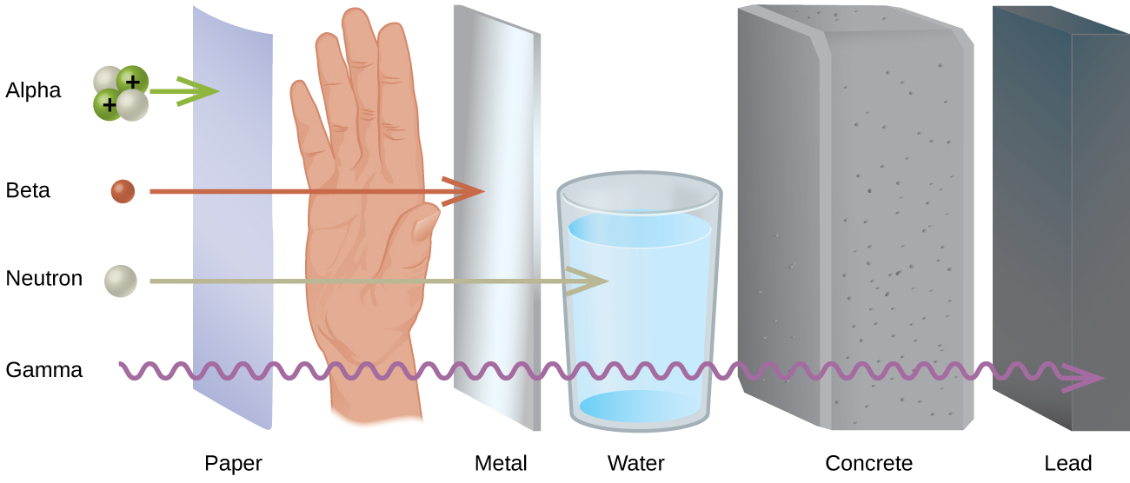
Introduction: Radiation Protection
Radiation protection is defined by the International Atomic Energy Agency as "the protection of people from harmful effects of exposure to ionizing radiation, and the means for achieving this". Exposure can be from a source of radiation external to the human body or due to internal irradiation caused by the ingestion of radioactive contamination.
Notes:
make two columns - text in 1 and pic in 1

Slide 5
Introduction: Mass Attenuation Coefficient, μ
The mass attenuation coefficient of the volume of a material characterizes how easily it can be penetrated by a beam of light, sound, particles, or other energy or matter.
Tables of photon mass attenuation coefficients are used in radiological physics, radiography (for medical and security purposes), diffraction, dosimetry, crystallography, interferometry, and other branches of physics.
The SI unit is meters squared per kilogram (m²/kg).

Slide 6
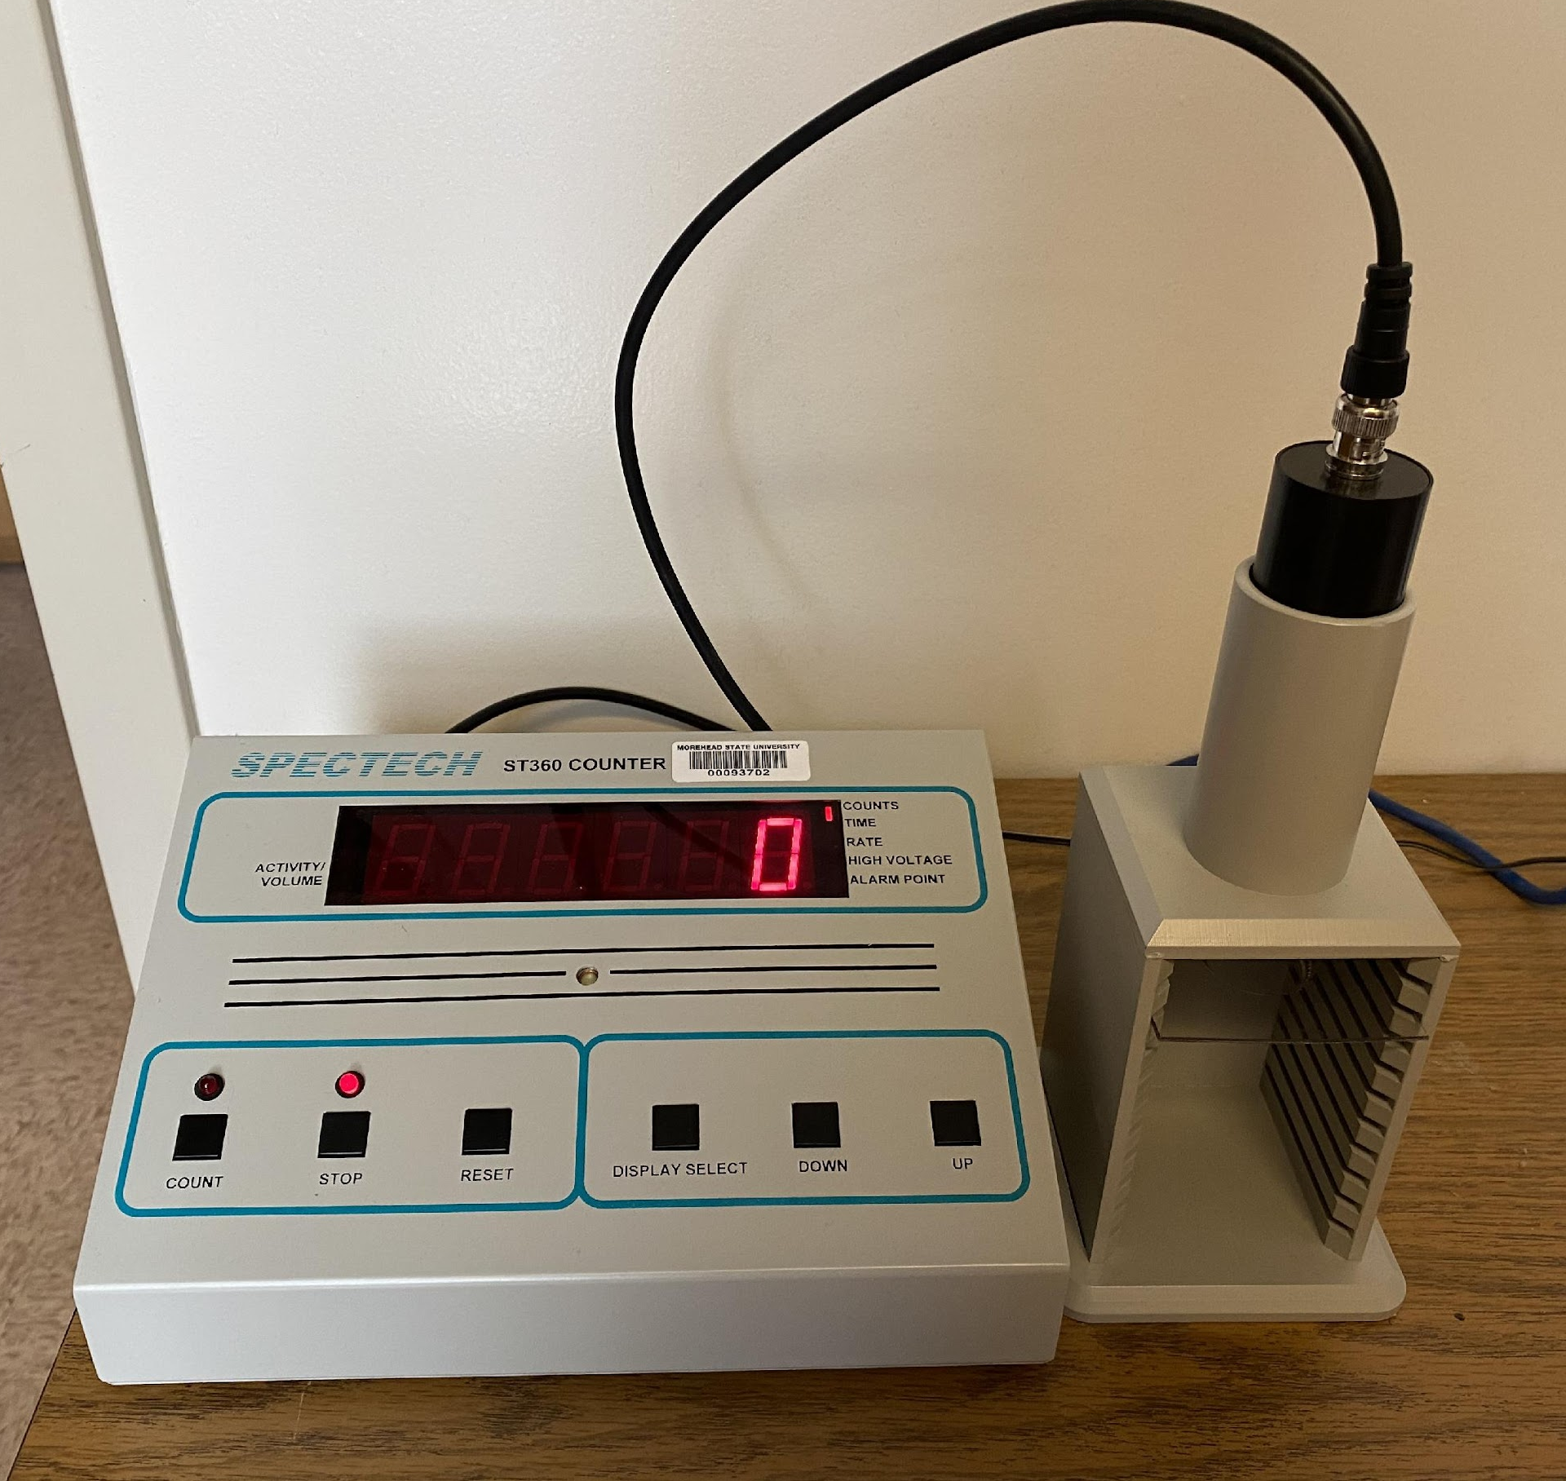
Our Equipment
Introductory Geiger-Mueller Lab System
ST360 Radiation Counter
35mm diameter end windowed
Geiger Mueller Tube and stand
8 Solid Source Set (contains eight
different gamma emitting isotopes)
Manufacturer:
SPECTRUM TECHNIQUES, LLC

Slide 7
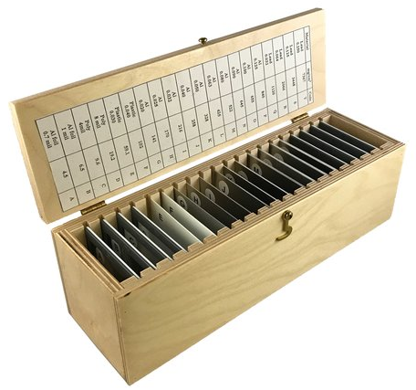
Experiment:
Calibrated Absorbers
Lead
Aluminum
Plastic

Slide 8
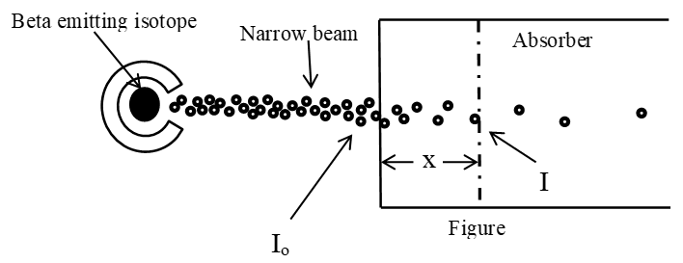
Experiment - Mass Attenuation Coefficient
The exponential nature of the observed rate of absorption can be modeled mathematically by the expression:
$I=I_{0}e^{−μx}$
where
I is the intensity of the beam after passing through the absorbing material,
μ is the mass attenuation coefficient,
X is the mass thickness. (density of the material, g/cm³, times its length, cm)

Slide 9
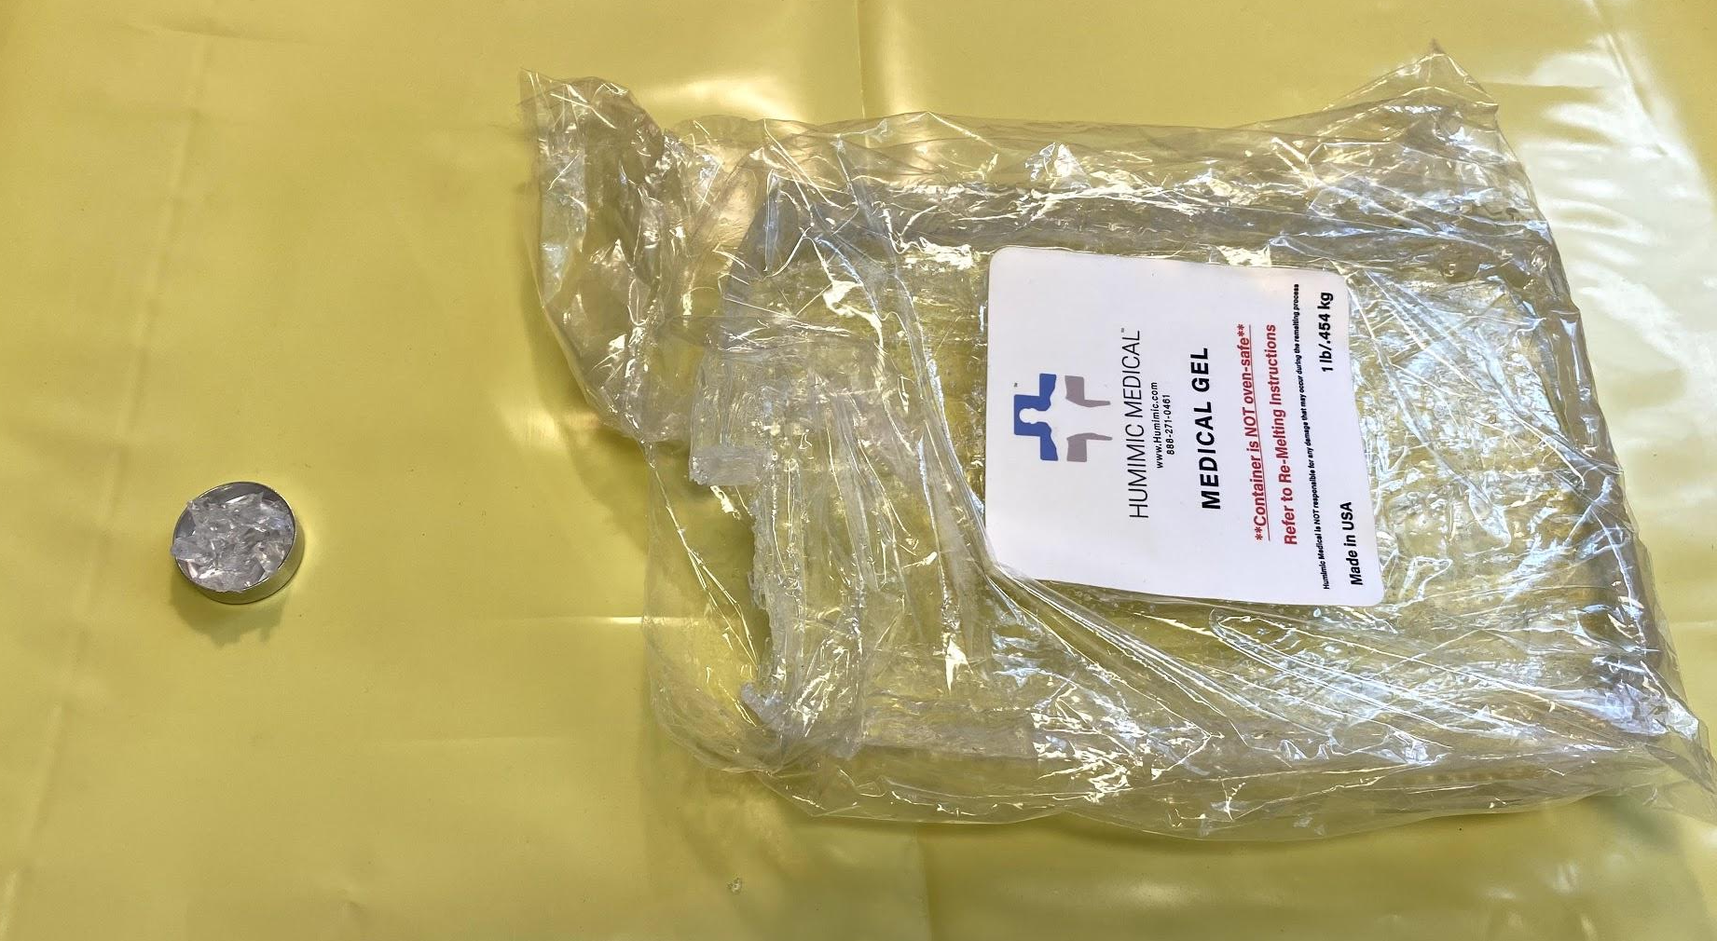
Preparing the Gel:
Cut up medical gel into small chunks and used those to fill the various metal planchets.
Planchets had a 1-inch diameter.

Slide 10
Preparing the Gel:
Placed planchets into an oven for 4 hours at 250° to melt the gel. All air bubbles are removed. Let stand overnight.

Slide 11
Preparing the Gel:
Removed the gels from the planchets and measure the thickness of each gel sample using calipers:
Thickness:
sample 1 | 0.050
sample 2 | 0.110
sample 3 | 0.140
sample 4 | 0.210
sample 5 | 0.295
sample 6 | 0.335
sample 7 | 0.400
sample 8 | 0.450
sample 9 | 0.480
sample 10 | 0.560
 | in cm

Slide 12
Data:
Calculated average background count and the resolving time of the detector.
Ran 300 second counts for three trials, testing each gel sample against each source (Co-60, Cd-109 and Mn-54).
Notes:
make 2 separate slides, clean up table

Slide 13
Methods:
For this experiment the intensity of the detected radiation will be assumed to be approximately proportional to the measured count rate, r, thus:
$$r=r_{0}e^{−μx}$$
rewriting
$\ln\left(\frac{r_{o}}{r}\right)=μx$
Note: To calculate mass thickness, X, multiply the density of the material times its length
This equation can be plotted on Excel, where μ is the slope.

Slide 14
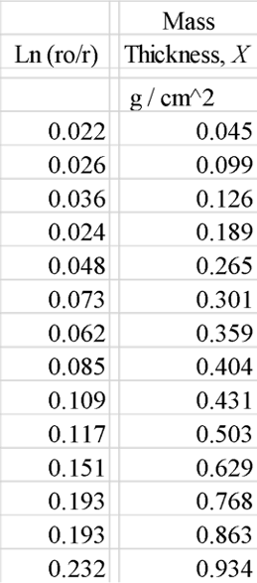
Data: Cobalt-60, plotting ln(r₀/r) = μX
Ln(r₀/r)
Mass Thickness, g/cm^2
Notes:
crop out corrected counts, add x axis units

Slide 15
Data: Cadmium-109, plotting ln(r₀/r) = μX
Ln(r_{o}/r)
Mass Thickness, g/cm^2

Slide 16
Data: Manganese-54, plotting ln(r₀/r) = μX
Ln(r_{o}/r)
Mass Thickness, g/cm^2

Slide 17
Results:
Use the slope of our Excel plot the mass attenuation coefficient, μ, for each radioactive source is:
Virtual X-Ray Imaging Library on GPU:

Slide 18
Results:
As the thickness of the absorber is increased, the fraction of the radiation passing through will decrease.
When exactly half the radiation passes through the absorber, the thickness of the absorber is called the half thickness, X_{1/2}.
Eqn: $r=\frac{1}{2}r_{0}=r_{0}e^{−μx}$solving for $x_{1/2}$: $x_{1/2}=\frac{ln(2)}{μ}=\frac{0.693}{μ}$

Slide 19
Questions
References:
HUMIMIC MEDICAL Healthcare Products, https://humimic.com/product/gelatin-5-medical-gel-by-the-pound/
Spectrum Techniques Lab Manual, Student Version, July, 2002
Virtual X-Ray Imaging Library on GPU, http://gvirtualxray.sourceforge.net/gvirtualxray.php

