Slide 1
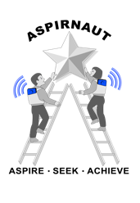
SetD2 Mutations decrease Methylation of eef1a1 and dysregulate protein synthesis in kidney cancer
Sharon Lee
Haake Lab
Kentucky Academy of Science
2021 November 5

Slide 2
Acknowledgements
Aspirnaut
Julie Hudson, M.D,. M.A.
Billy Hudson, Ph.D.
Tetyana Pedchenko, Ph.D.
Elena Pokidesheva, Ph.D.
Susan Allison, Ph.D.
Aaron Fidler, Ph.D.
Igor Babailov, MFA/Ph.D., Hon RAA, KStA
Rachel Baugh, MS, OLY
Irene McKirgan, M.S.M
Richard Taran, Ph.D.
Distinguished Speakers
Fellow Aspirnauts
Lab
Scott Haake, MD
Rebecca Prather
Cathy Xiu
Kimryn Rathmell, MD, PhD
Frank Mason, PhD
Maddi Landis
Matt Madden
Rathmell^2 Speakers
Funding
Berea/Aspirnaut™/Hal Moses Summer Research Internships
Vanderbilt University Medical Center
Center for Matrix Biology
Aspirnaut™

Slide 3
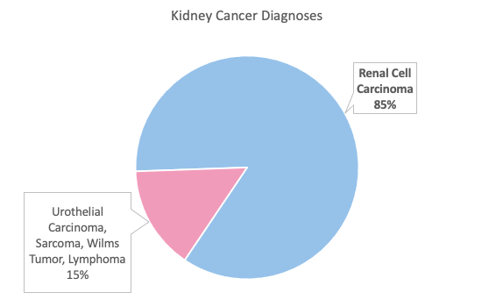
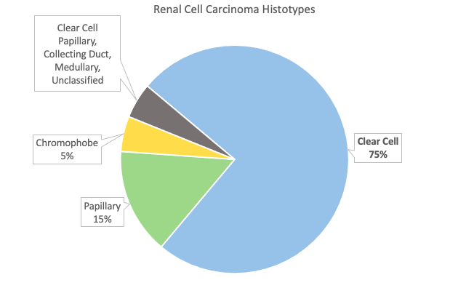
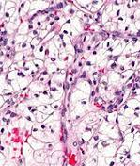
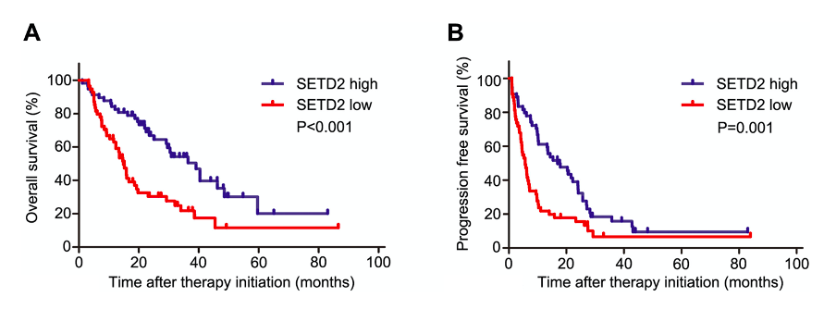
Kidney Cancer
5%
Healthy
Clear Cell RCC

Slide 4
SETD2
Methyltransferase
Histone 3- Lysine 36
SETD2 Crystal Structure

Slide 5
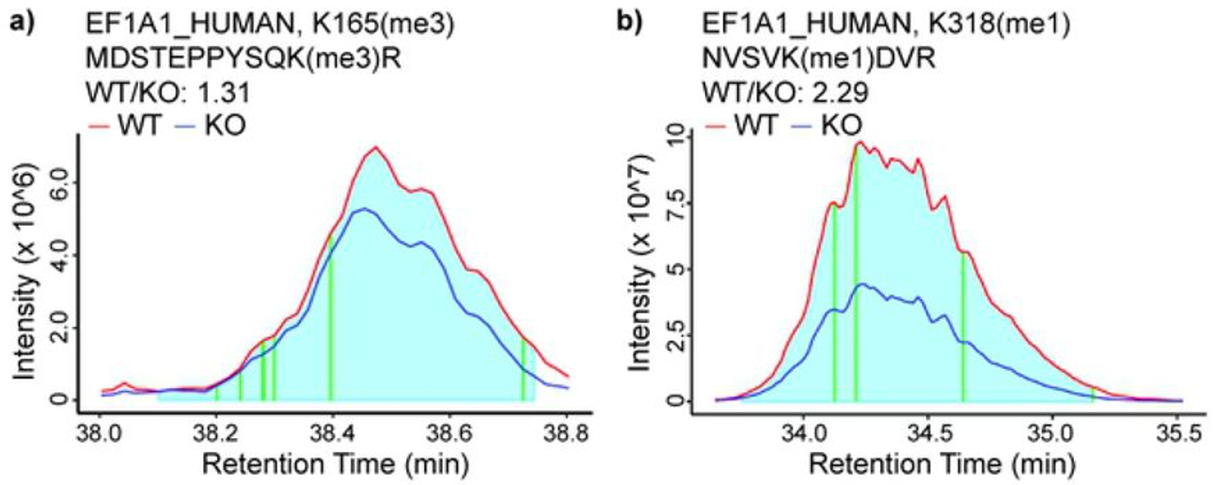
EEF1A1
EEF1A1KMT2 (K318)
EEF1A1KMT3 (K165)

Slide 6
Hypothesis
EEF1AKMT2/3 function as tumor suppressors, and their loss of expression in SETD2-mutated kidney cancer promotes tumor formation and dysregulates protein translation.

Slide 7
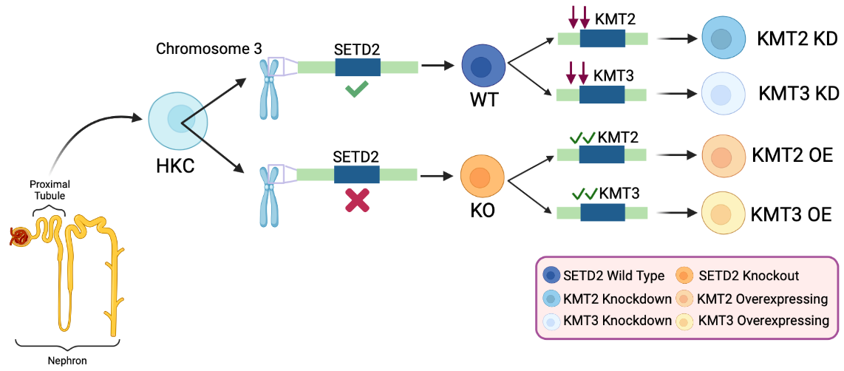
Cell Lines

Slide 8
SOFT Agar

Slide 9
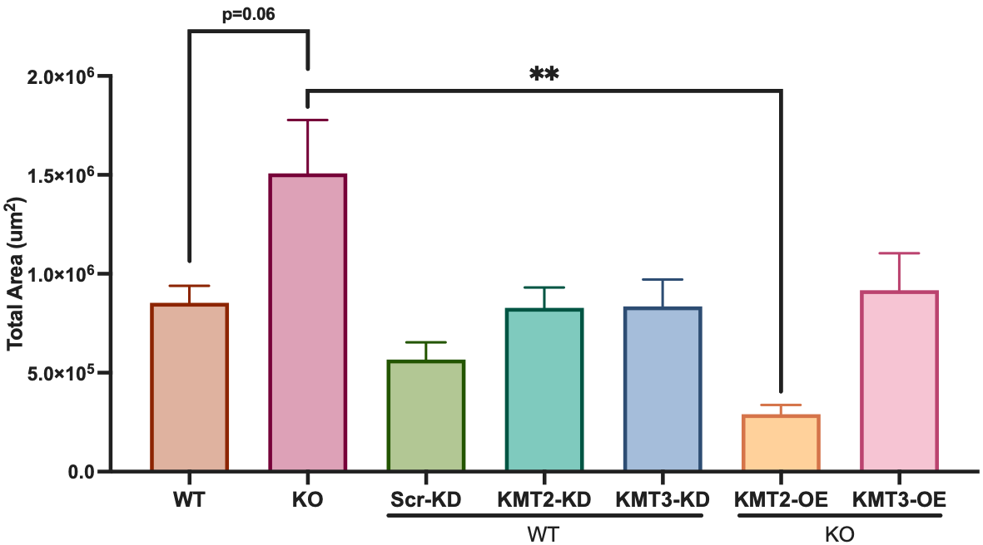
Soft agar results

Slide 10
Homopropargylglycine (HPG) Alexa Fluor 594 Click it Reaction

Slide 11
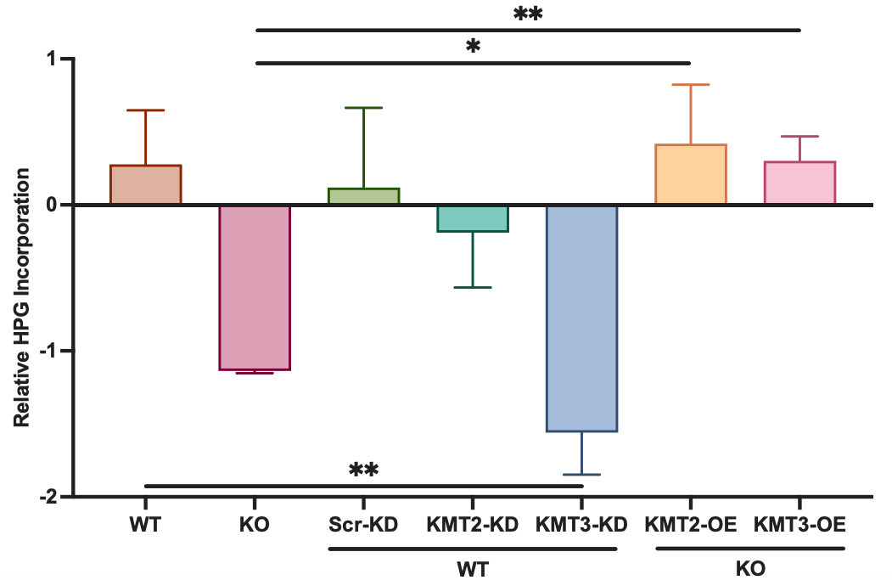
HPG Click it Assay results

Slide 12
Conclusion
Loss of SETD2 promotes clear cell RCC progression including increased soft agar colony formation and dysregulated protein synthesis.
Loss of SETD2 function causes decreased methylation of eEF1A via decreased expression of methyltransferases EEF1AKMT2/3.
Overexpression of EEF1AKMT2 in cells lacking functional SETD2 decreases colony formation and increases protein synthesis.

Slide 13
Moving forward
Optimize of the Click iT HPG Alexa Fluor 594 Protein Synthesis Assay
Explore the synthetic lethality of the SETD2 as an approach to anti-cancer therapy
Investigate the “translational code” that regulates protein translation, its role in malignancy and the emerging data of methylation of eEF1A1 in cancer.

Slide 14
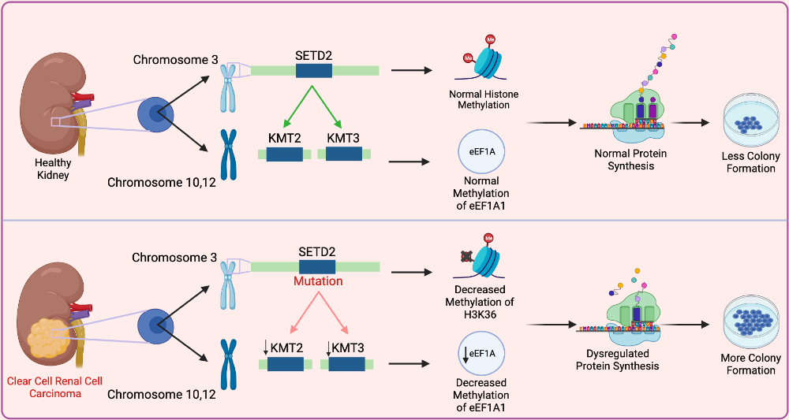
Questions

