Slide 1
Does the Flash Effect Depend on Oxygen Concentration?
Department of Radiation Oncology
Yogesh Budhathoki
Koumenis Lab
August 12, 2021
Notes:
This summer I worked in the Koumenis lab within the department of radiation oncology at university of Pennsylvania. And my research project is based on if the FLASH effect depends on the oxygen concentration of cells.
Change the title: Hypoxia/Mechanism behind Flash effect

Slide 2
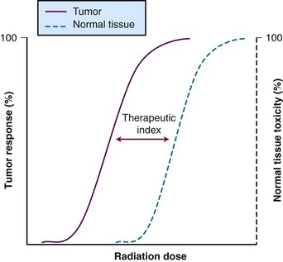
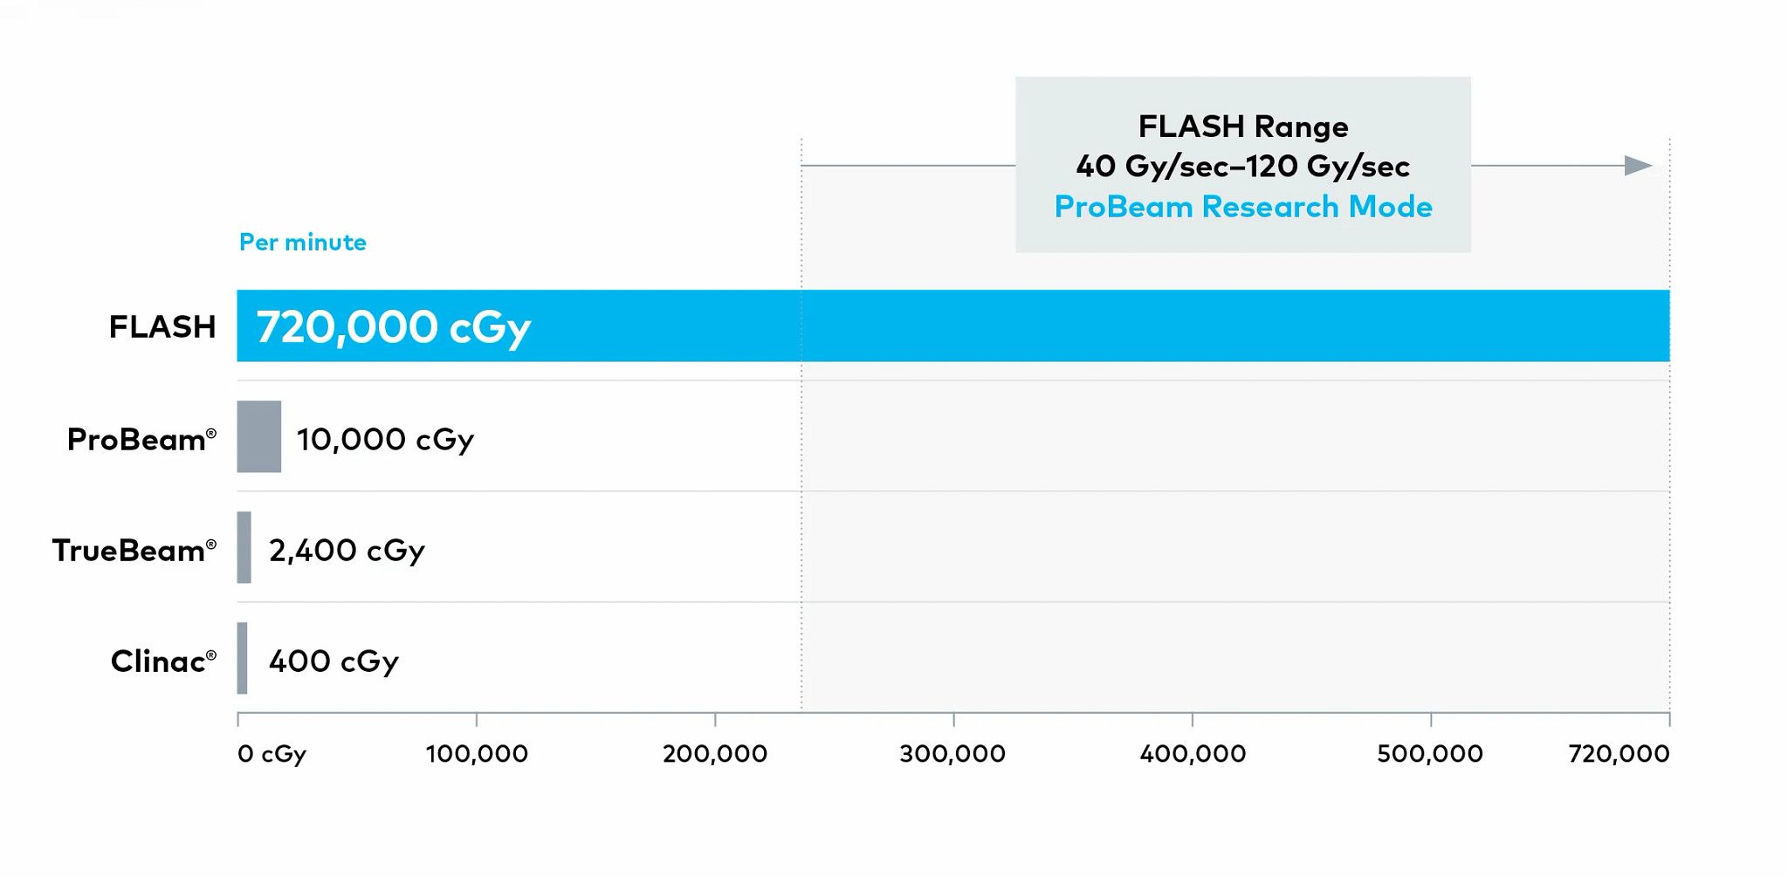
What is Flash Radiotherapy?
Ultra-High dose radiation in short time period
Flash Effect
Increased Therapeutic Window
Dose Rates
https://www.varian.com/fi/about-varian/research/flashforward-consortium
https://oncohemakey.com/interaction-of-chemotherapy-and-radiation/
Background
Hypothesis
Experiments
Results
Notes:
Now before I talk about flash effect, we have to know what flash radiotherapy is. Flash radiotherapy is the administration of an ultra-high dose of radiation over a short time period. This figure represent the dose rate of flash vs the conventional radiotherapy where flash rate is 720,000 centiGray per minute whereas other conventional radiotherapy have dose rate less than 10000 centiGray per second.
Flash radiotherapy induces a phenomenon known as the Flash effect, whereby the ultra-high dose rate radiation reduces the normal tissue toxicities commonly associated with conventional radiotherapy while maintaining local tumor control. In the graph above we have tumor response in y axis and radiation dose in X axis. FLASH reduces the normal tissue toxicity by increasing the therapeutic window between the tumor control and the normal tissue complication.
In recent years, the Flash effect has been confirmed in many studies, both in-vitro and in-vivo.

Slide 3
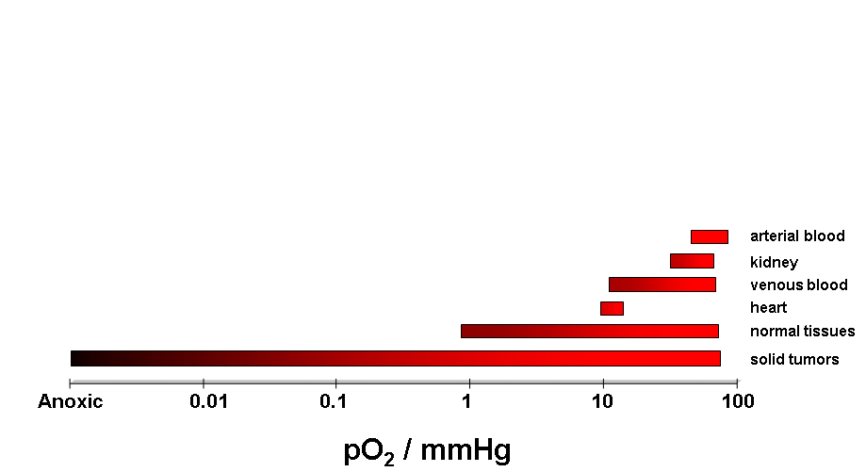
Hypoxia Hypothesis
Radiobiologically Relevant Hypoxia
0 to ~3-4% Oxygen (0 to about 30 mmHg)
21% O₂ in air = 760×21% = 160 mmHg
~3-8% O₂ in tissues = 21- 60 mmHg
Hall EJ. Radiobiology for the radiologist., 1988
Background
Hypothesis
Experiments
Results
Notes:
While, the underlying mechanism(s) behind the FLASH effect are not fully understood yet, the oxygen depletion or the hypoxia hypothesis is one of the most current valid hypotheses, which is about if the flash effect depends upon the oxygen concentration.
Now what is Radiobiologically relevant hypoxia?
Any cell with 0-4% oxygen is considered hypoxic. It translates to 0 to about 30 mmHg. Normally tissues have 3-8% oxygen. This figure represents the partial pressure of oxygen various tissues including the tumors which has a huge range from being anoxic to normoxic.
So the hypoxia hypothesis is based on the principle that under hypoxic conditions, the damage due to radiation is lower compared to the normoxic condition.

Slide 4
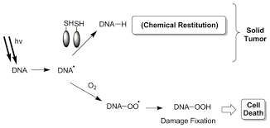
Chemical Restitution
Chemical restoration, no enzyme involved
https://europepmc.org/article/PMC/4711945
Background
Hypothesis
Experiments
Results
Notes:
The reason behind the higher damage with increasing oxygen is due to inhibition of chemical restitution. Chemical restitution is the process of fixing DNA damage through chemical process. It is not a biological repair and no enzymes are involved.
This figure shows the mechanism of chemical restitution. So, irradiation creates formation of super hydroxyl radicals that react with DNA, extracts a hydrogen and creates DNA free radicals. The DNA free radical can be restored by sulfhydryl group from other proteins and glutathione by chemical restitution, but if there is high amount of oxygen present in the cell, the oxygen molecule reacts with the DNA free radical forming un-restorable damage leading to the cell death.
Hence, again, higher the oxygen, higher the unrestorable damage, higher the cell death, this is called the oxygen effect.

Slide 5
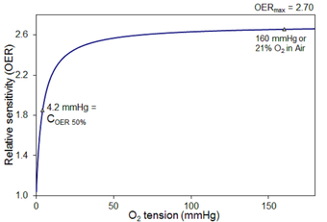
Oxygen Effect
Less than 1% atmospheric pressure of oxygen
Oxygen Enhancement Ratio (OER)
Background
Hypothesis
Experiments
Results
Notes:
Now, for the oxygen effect to work, tissues need to have less than 1% atmospheric pressure of oxygen which can be again translated to about 36 mmHg. In this graph, we have radiation dose in x-axis and surviving fraction in y-axis and we see higher survival of cells in hypoxic condition (about 0.1) compared to aerobic conditions (0.01) even at the same radiation dose of 15 Gy. So, there is higher relative damage under the aerobic condition compared to the hypoxic condition.
(next figure) Now this relative damage can be enhanced up to 3 times as shown by the graph here. This ratio of radiation dose for hypoxic condition to normoxic condition that yield the same surviving fraction of cell is called oxygen enhancement ratio.
https://radiologykey.com/oxygen-effect-and-reoxygenation/

Slide 6
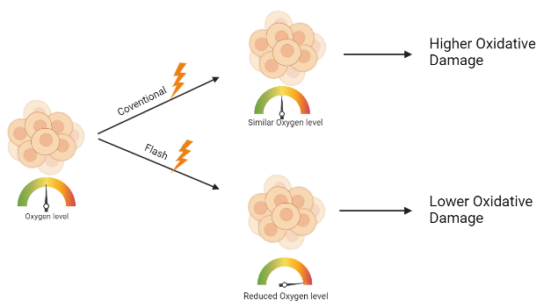
Research Hypothesis
“Flash effect itself is causing the hypoxia, protecting the normal tissue”
Background
Hypothesis
Experiments
Results
Notes:
Our hypothesis is that the FLASH effect itself is causing the hypoxia protecting the tissue, so if it is true, we will see higher survival of cells with FLASH RT compared to the standard RT for the same dose. As shown in the figure, if conventional therapy is used, the oxygen level stays and hence there is higher oxidative damage. But when Flash radiation is used, it creates hypoxic environment and hence reduces the oxidative damage due to free radical formation.

Slide 7
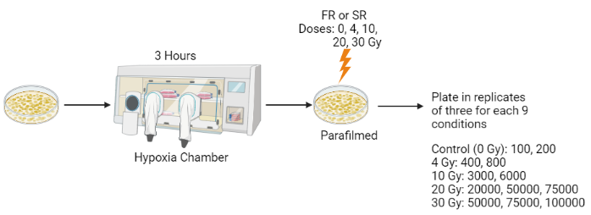
Clonogenic Assay
Cell line used for experiment: A375 Human Melanoma
Oxygen Concentrations: 0.5%, 1.5%, 3%, and 20 %
Background
Hypothesis
Experiments
Results
Notes:
In order to test our hypothesis, we performed clonogenic assay. Clonogenic assay is an in vitro cell survival assay based on the ability of a single cell to grow into a colony of at least 50 cells. The cell line used was A375 Human Melanoma cancer cell lines
For our clonogenic, we had four different oxygen concentration of 0.5%, 1,5%, 3% and 20% (or normoxic conditions). Cells were placed in hypoxia chamber for 3 hours with specific oxygen concentration and then divided and irradiated in nine different groups of control, 4Gy FR, 4GySR, 10, 20, and 30 Gy. Then they were cultured with specific number in replicates of three until 10 days. On 10th day, the culture plates were stained with Trypan blue for colonies counting (make a flow chart).

Slide 8
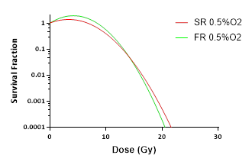
Results from Clonogenic Assay
FR: Flash Radiation
SR: Standard Radiation
0.5% Oxygen FR vs. SR
1.5% Oxygen FR vs. SR
3% Oxygen FR vs. SR
Background
Hypothesis
Experiments
Results
Notes:
I did not have enough time to finish clonogenic assay for 20 % oxygen. These are the graph for surviving fraction for each hypoxia concentration. The X-axis is the radiation dose and y-axis is the survival fraction. First, the 30 Gy dose of radiation that we used was too high, so there was no survival at all. From the graph, we can tell that we do not see very much difference between flash and conventional irradiation at 0.5 and 1.5% oxygen.
But at 3% oxygen, we see higher survival fraction with the flash compared to the standard radiation.
Overall, 0.5 and 1.5 are already very hypoxic and flash is not able to create more hypoxic environment to reduce the radiation damage, hence the radiation damage is similar for at 0.5% and 1.5% oxygen. But at 3%, flash can protect the tissue by reducing the oxygen damage by bringing the oxygen level even lower, creating the instant hypoxic environment.

Slide 9
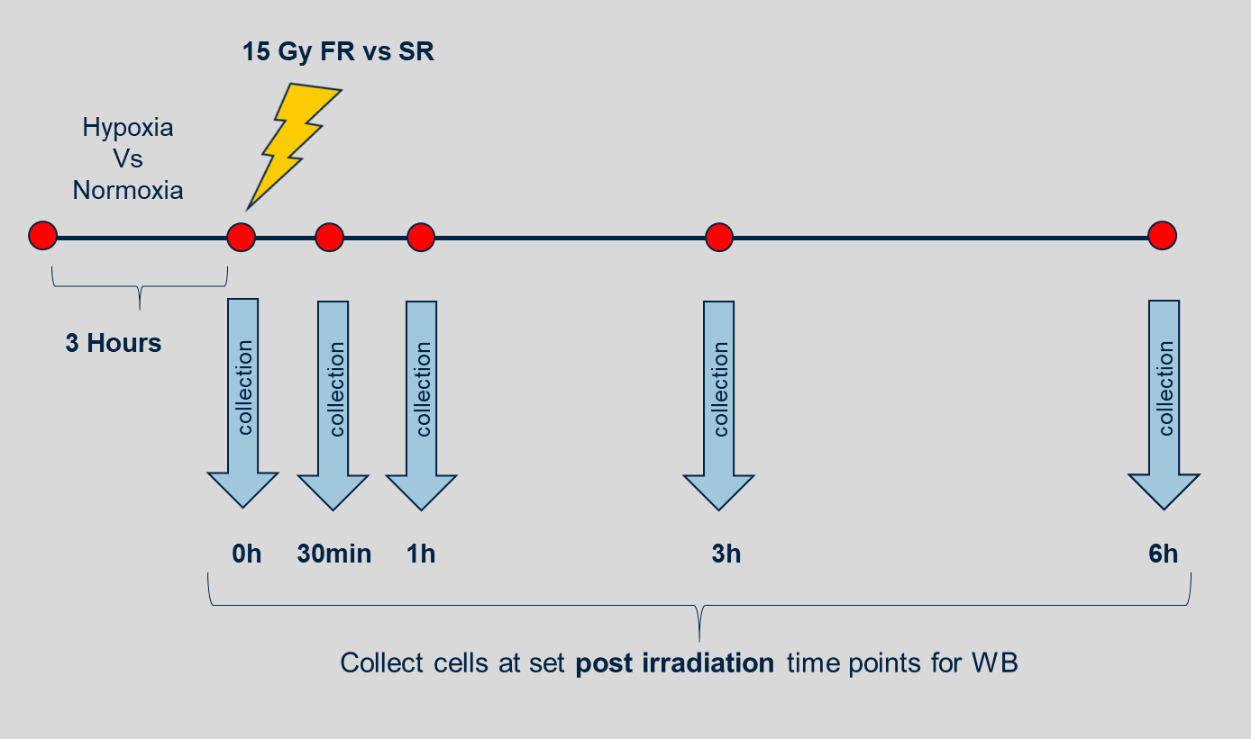
Western Blot Experimental Setup
GammaH2AX
House Keeping:
Beta Actin
Background
Hypothesis
Experiments
Results
Notes:
We also performed western blot to measure the double strand DNA breaks at each different doses of radiation for both flash or conventional radiotherapy. For the western blot, we placed the cells in hypoxia chamber 3 hours prior to the experiment and then radiated them with 15 gray flash and conventional radiotherapy. The oxygen levels tested were 0.5%, 1.5%, 3%, and 20% or Normoxia.
Once irradiated, the cells were collected at each time point of 0 h, 30 mins, 1 hr, 3, hr, and 6 hour time period and centrifuged for the western blot to measure the DNA damage at various time post irradiation. GammaH2AX, a rabbit monoclonal was used as the primary antibody and it binds to the histone at the site of double strand DNA break. Beta actin was used as the housekeeping protein.

Slide 10
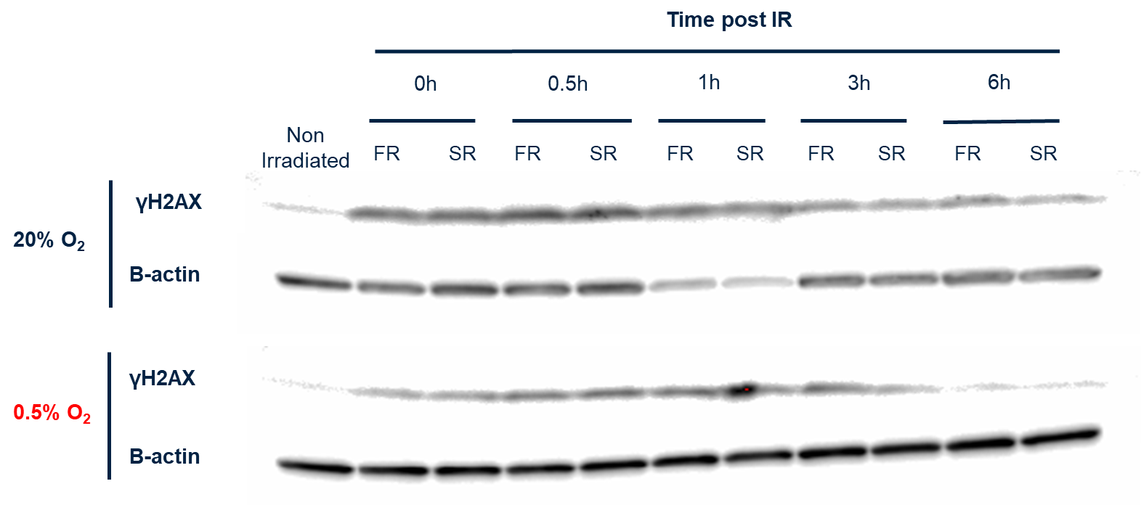
Normoxia (20%) vs. 0.5% Oxygen
Background
Hypothesis
Experiments
Results
Notes:
This is the western blot result for the 0.5% vs 20% oxygen level. We have time post irradiation in the top, and the order of bands are from non-irradiated control and flash and then standard for each time point. The top box is for 20% oxygen and bottom one is for the 0.5% oxygen. Each box have the band for gammaH2AX expression on top and their control b-actin in bottom.
We can see that damage due to radiation is higher at 20% compared to the 0.5% as the bands are darker. The DNA damage is higher in 0hr and peaks at 0.5hour by the highest expression of gammaH2xa, and the expression of gamma reduces as time passes due to various DNA repair mechanisms.
The barographs represent the quantification of WB. At this oxygen level There is not much difference between flash radiation vs Standard radiation in terms of DNA damage.

Slide 11
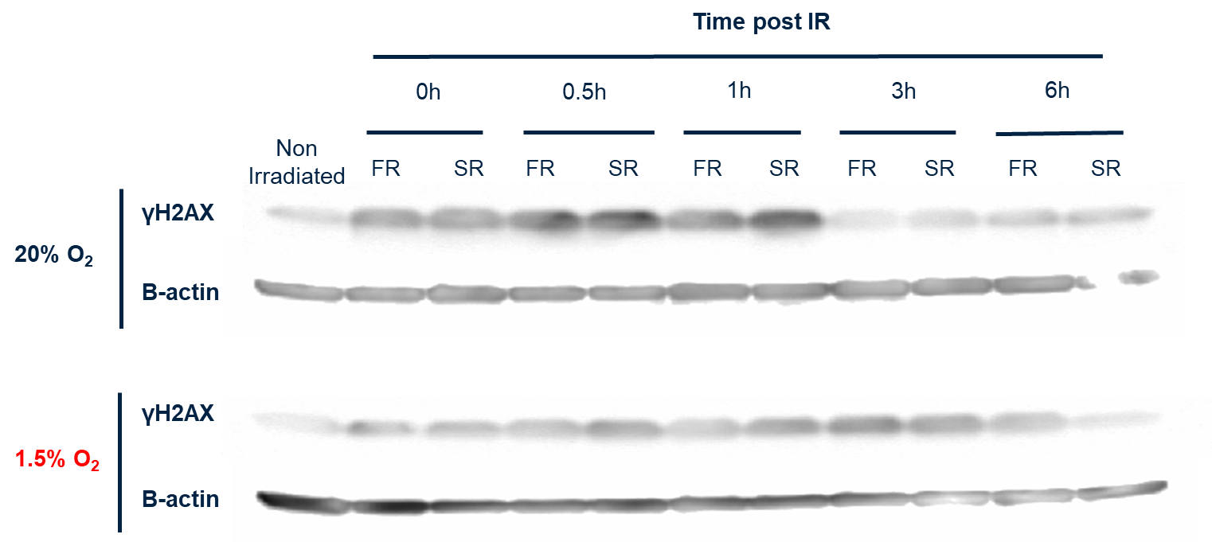
Normoxia vs. 1.5% Oxygen
Background
Hypothesis
Experiments
Results
Notes:
Here at 1.5% we do see similar effect as 0.5% oxygen level with only slight difference at levels of gammah2ax expression between FR and SR at 0.5 hours post irradiation. The expression of gammah2ax is lower for FR compared to SR.
we see general difference in DNA damage between 20% vs. 1.5% showing that hypoxia protects the cells. There is not much difference in the in flash vs. standard radiation. A slight difference can be seen at 0.5 hour time where flash radiation has less damage than standard radiation as boxed by the red. The bar graph do not show the significant difference between the flash vs standard radiation.

Slide 12
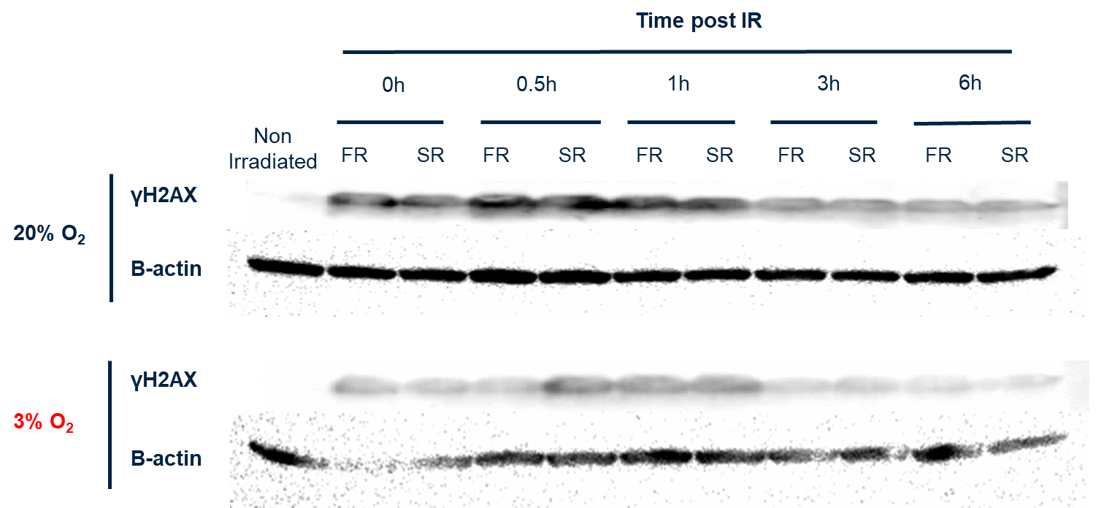
Normoxia vs. 3% Oxygen
Background
Hypothesis
Experiments
Results
Notes:
Here at 3% oxygen level, we can see a clear difference of gammah2ax expression levels at 0.5 hours post radiation with the flash radiation having lower expression of gammah2XAX compared to SR indicating that there is more protection with FR. But we do not see much difference at 20% oxygen because flash is not capable of creating hypoxic environment for 20% oxygen. But, the 3% oxygen can be reduced even lower and radiation damage can also reduce with it,

Slide 13
Conclusion
The protective effect of flash is shown in higher oxygen level in the clonogenic survival assay
Similar effects were observed on the western blot using gammaH2AX marker
Notes:
Put clonogenic plates under same condition together to compare
The protective effect of flash is shown in higher oxygen level in the clonogenic survival assay, as we saw in the 3% oxygen graph.
Similar effects were observed on the western blot using gammh2ax marker as at 3% oxygen, we had clear difference between the western blot band for flash vs standard at 0.5hour time point.

Slide 14
Future Directions
Different cell lines both tumor and normal cells
Test different oxygen concentrations
Use different times for gammaH2AX post irradiation
Control the hypoxic samples so that they do not get oxygenated
Notes:
In the future, we hope to replicate the experiment with different cell lines and test different oxygen concentrations and additional time points post-irradiation.
Different cell lines both tumor and normal cells
Use big variety of oxygen 0.5 to 5%
Use different times for gammaH2ax post irradiation
Control the hypoxic samples so that they do not get oxygenated

Slide 15
Acknowledgements
Mentor, and Koumenis lab
Supers Program
Cohort
Berea College
Notes:
Special thanks to my mentor Denisa and the Koumenis lab who helped and guided me with the project. Thanks to supers program, amazing cohort, and my college for the opportunity.

Slide 16
Notes:
Special thanks to my mentor Denisa and members of Koumenis lab who helped and guided me with the project. Any questions and comments?

