Slide 1
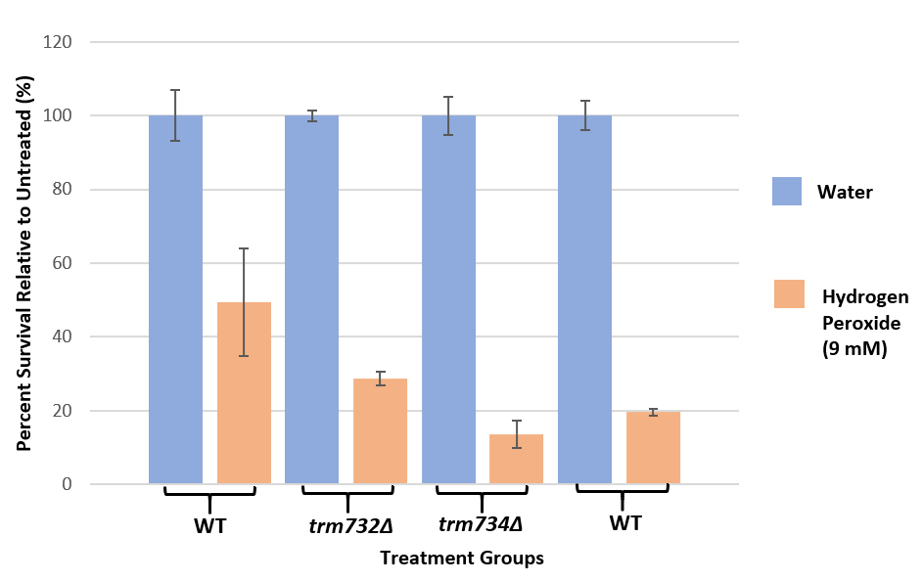
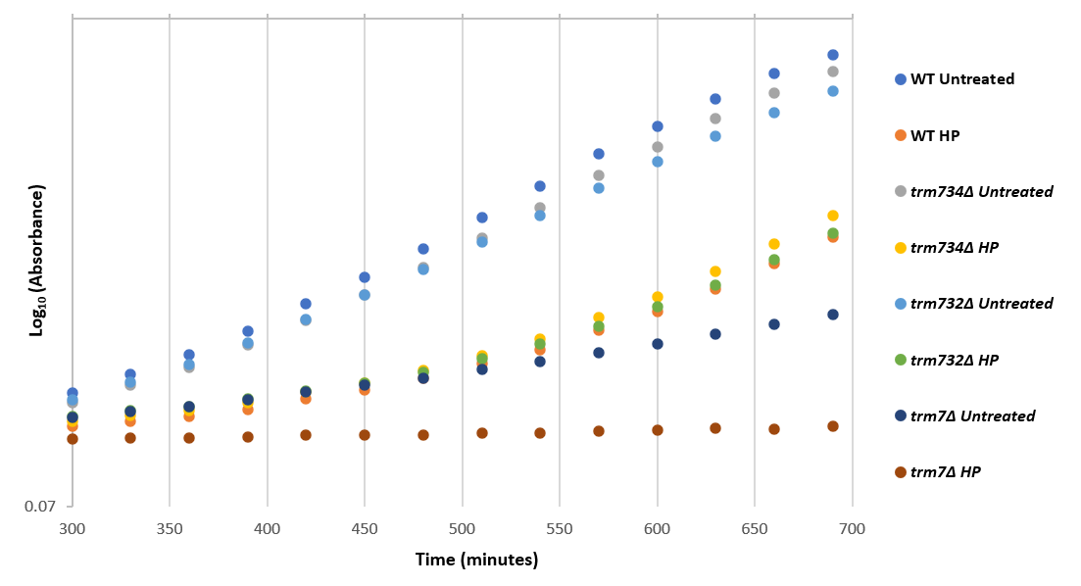
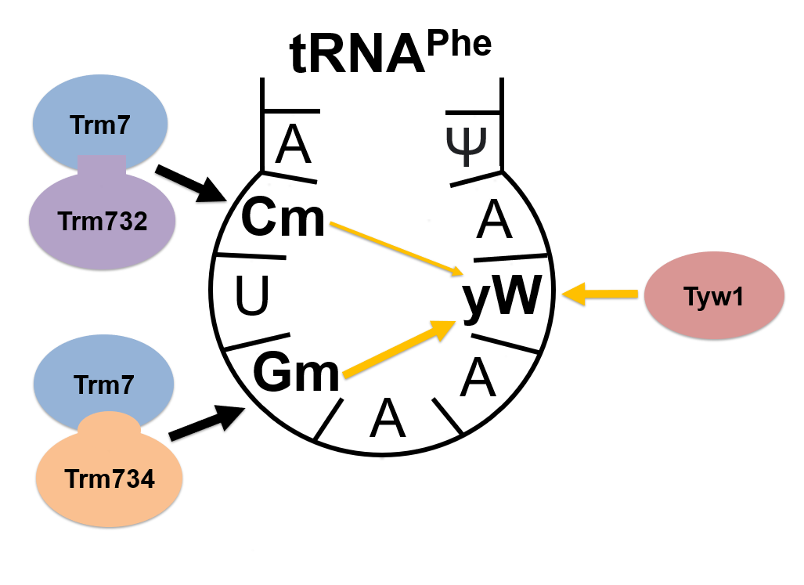
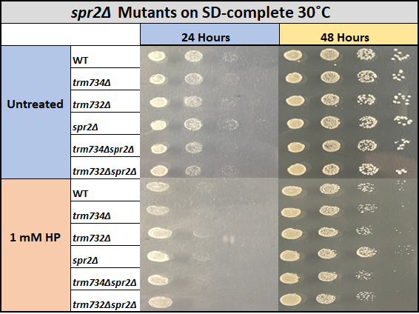
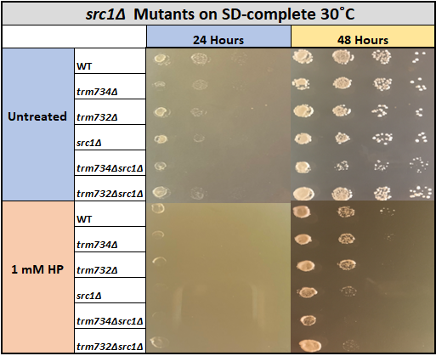
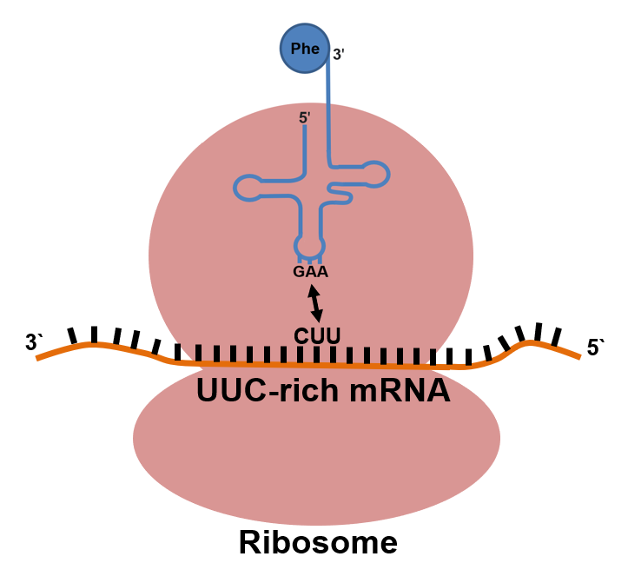
Defining the role of tRNA^{Phe} anticodon loop modifications in Saccharomyces cerevisiae through stress testing
Samuel Seibert, Nick Korzenborn, Alexis Eckart, Evan Groneman, Holly M. Funk and Michael P. Guy
Department of Chemistry and Biochemistry, Northern Kentucky University, Nunn Drive, Highland Heights, KY 41099
Abstract
In Saccharomyces cerevisiae, methyl groups are added to the 2`-O position of nucleotides C₃₂ and G₃₄ of tRNA^{Phe} to facilitate translation. The methyltransferase Trm7 interacts separately with accessory proteins Trm732 and Trm734 to accomplish both modifications, and at least one modification is required for healthy growth under non-stressed conditions. Although the function of the Gm₃₄ modification is known, the functional purpose of the Cm₃₂ modification is not. Hydrogen peroxide and the arginine analogue canavanine were employed as stressors to better define the sensitivities of yeast strains lacking Cm₃₂, Gm₃₄, or both modifications. Strains lacking TRM7 (trm7Δ mutants), TRM732 or TRM734 appear to show lowered resistance to oxidative stress caused by hydrogen peroxide. Growth tests indicate that the trm734Δsrc1Δ mutant grows poorly in hydrogen peroxide compared to the trm734Δ or src1Δ mutants . Inconsistent with previous research, the trm734Δ mutant does not display an increased canavanine resistance compared to a wild-type strain.
Oxidative Stress Survival Assay
trm732Δ mutants may be sensitive to oxidative stress
Canavanine spot test
The trm732Δ mutants appear to show lowered survival rates compared to wild-type.
Based on survival tests, it is uncertain whether the trm732Δ mutant displays greater survival than the trm7Δ and trm734Δ mutants.
Shi et al. found that trm734Δ mutants have a drastically increased resistance to canavanine exposure at 2 µg/mL.¹¹
We replicated the procedure used in this paper and found that trm734Δ mutants don't seem to show increased resistance to canavanine exposure at any of the tested concentrations.
trm7Δ
Hydrogen peroxide growth curve
trm732Δ and trm734Δ single mutants grow like wild-type
Next steps
After treatment with 2 mM hydrogen peroxide, the trm732Δ and trm734Δ mutants appeared healthy.
This test will be repeated because wild-type treated and untreated growth rates did not vary, although they previously varied when treated with 2 mM hydrogen peroxide.
Overexpression of tRNA^{Phe} rescues trm7Δ mutants from poor growth.¹ Strains over-expressing tRNA^{Phe} will be used to verify the phenotypes from the survival test.
Additional spot tests will be performed to further define genetic interactions of trm732Δ and trm734Δ mutants.
Vital tRNA^{Phe} anticodon loop 2`-O ribose methylations
Cm₃₂ is methylated after Trm7 binds to Trm732.^{1,2}
The yW₃₇ modification results when Cm₃₂ or Gm₃₄ are present.¹
Gm₃₄ is methylated after Trm7 binds to Trm732.^{1,2}
Tyw1 begins the synthesis of yW₃₇ which is significant for codon recognition.^{1,3}
Significance
Hydrogen peroxide spot tests
Non-syndromic X-linked Intellectual Disability occurs when there are mutations in FTSJ1,¹² the human homolog to TRM7.^{13,14}
The human homologs to TRM732 and TRM734 are THADA and WDR6, respectively.¹³
Interactions among Saccharomyces cerevisiae genes TRM7, TRM732, and TRM734 could reflect the activity of their corresponding human homologs.
Methyltransferase proteins such as Trm7 add methyl groups to molecules.^{1,2}
The instability of unmodified tRNA^{Phe} when both modifications are missing in trm7Δ mutants causes an observable growth defect.¹
The trm7Δ mutant phenocopies the trm732Δtrm734Δ double mutant because Trm7 cannot modify tRNA^{Phe} without Trm732 or Trm734.¹
Oxidative stress recovery requires rapid translation
Acknowledgments
Thanks to the NKU College of Arts and Sciences, the Department of Chemistry, and the Guy Lab for making this research possible. Thanks to the Center for Integrative Natural Science and Mathematics (CINSAM), the Kentucky IDeA Network of Biomedical Research Excellence (KY INBRE), and the National Institutes of Health (NIH) for funding this research. A special thanks is extended to Holly Funk and Dr. Guy who continually supported the growth and learning of undergraduate researchers in the Guy lab.
Damage caused by oxidative stress necessitates immediate recovery responses.⁴
The trm734Δ⁵ and trm7Δ⁶ mutants have both shown hydrogen peroxide sensitivity.
Numerous oxidative stress recovery genes encode mRNA transcripts rich in the UUC codon.⁶
SPR2-associated mutants appear to lack visible phenotypes
trm734Δsrc1Δ may be sensitive to oxidative stress
References
The SPR2 gene encodes a spore-wall protein⁹ and may genetically interact with the TRM732 gene.¹⁰
There is no obvious growth deficiency for trm732Δspr2Δ or trm734Δspr2Δ exposed to oxidative stress.
The SRC1 gene has been linked to sister chromatid separation⁷ and may genetically interact with the TRM7 gene.⁸
trm734Δsrc1Δ mutants seem to show decreased resistance to oxidative stress because of their minimal growth in 1 mM hydrogen peroxide.
1. Guy M. P., Podyma B. M., Preston M. A., Shaheen H. H., Krivos K. L., Limbach P. A., Hopper A. K., Phizicky E. M. Yeast Trm7 interacts with distinct proteins for critical modifications of the tRNAPhe anticodon loop. RNA. 2012;18(10):1921–1933. doi:10.1261/rna.035287.112
2. Pintard L. Trm7p catalyses the formation of two 2'-O-methylriboses in yeast tRNA anticodon loop. The EMBO Journal. 2002;21(7):1811–1820. doi:10.1093/emboj/21.7.1811
3. Noma A., Kirino Y., Ikeuchi Y., Suzuki T. Biosynthesis of wybutosine, a hyper-modified nucleoside in eukaryotic phenylalanine tRNA. The EMBO Journal. 2006;25(10):2142–2154. doi:10.1038/sj.emboj.7601105
4. Farrugia G., Balzan R. Oxidative Stress and Programmed Cell Death in Yeast. Frontiers in Oncology. 2012;2. doi:10.3389/fonc.2012.00064
5. Brown J. A., Sherlock G., Myers C. L., Burrows N. M., Deng C., Wu H. I., Mccann K. E, Troyanskaya O. G., Brown J. M. Global analysis of gene function in yeast by quantitative phenotypic profiling. Molecular Systems Biology. 2006;2(1). doi:10.1038/msb4100043
6. Endres L., Rose R. E., Doyle F., Rahn T., Lee B., Seaman J., Mcintyre W. D., Fabris D. 2'-O-ribose methylation of transfer RNA promotes recovery from oxidative stress in Saccharomyces cerevisiae. Plos One. 2020;15(2). doi:10.1371/journal.pone.0229103
7. Rodríguez-Navarro, S., Carlos Igual, J., Pérez-Ortín, J. E. Src1: An Intron-Containing Yeast Gene Involved in Sister Chromatid Segregation. Yeast 2001, 19 (1), 43–54.
8. Wilmes, G. M.; Bergkessel, M.; Bandyopadhyay, S.; Shales, M.; Braberg, H.; Cagney, G.; Collins, S. R.; Whitworth, G. B.; Kress, T. L.; Weissman, J. S.; Ideker, T.; Guthrie, C.; Krogan, N. J. A Genetic Interaction Map of RNA-Processing Factors Reveals Links between Sem1/Dss1-Containing Complexes and mRNA Export and Splicing. Molecular Cell 2008, 32 (5), 735–746.
9. Hepworth, S. R.; Ebisuzaki, L. K.; Segall, J. A 15-Base-Pair Element Activates the sps4 Gene Midway through Sporulation in Saccharomyces Cerevisiae. Molecular and Cellular Biology 1995, 15 (7), 3934–3944.
10. Costanzo, M.; Baryshnikova, A.; Bellay, J.; Kim, Y.; Spear, E. D.; Sevier, C. S.; Ding, H.; Koh, J. L. Y.; Toufighi, K.; Mostafavi, S.; Prinz, J.; St. Onge, R. P.; VanderSluis, B.; Makhnevych, T.; Vizeacoumar, F. J.; Alizadeh, S.; Bahr, S.; Brost, R. L.; Chen, Y.; Cokol, M.; Deshpande, R.; Li, Z.; Lin, Z.-Y.; Liang, W.; Marback, M.; Paw, J.; San Luis, B.-J.; Shuteriqi, E.; Tong, A. H.; van Dyk, N.; Wallace, I. M.; Whitney, J. A.; Weirauch, M. T.; Zhong, G.; Zhu, H.; Houry, W. A.; Brudno, M.; Ragibizadeh, S.; Papp, B.; Pal, C.; Roth, F. P.; Giaever, G.; Nislow, C.; Troyanskaya, O. G.; Bussey, H.; Bader, G. D.; Gingras, A.-C.; Morris, Q. D.; Kim, P. M.; Kaiser, C. A.; Myers, C. L.; Andrews, B. J.; Boone, C. The Genetic Landscape of a Cell. Science 2010, 327 (5964), 425–431.
11. Shi, Y., Stefan, C. J., Rue, S. M., Teis, D., Emr, S. D. Two Novel WD40 Domain–Containing Proteins, Ere1 and Ere2, Function in the Retromer-Mediated Endosomal Recycling Pathway. Mol Biol Cell 2011, 22 (21), 4093–4107. https://doi.org/10.1091/mbc.E11-05-0440.
12. Freude K., Hoffmann K, Jensen L., Delatycki M. B., Portes V. D., Moser B., Hamel B., Bokhoven H. V., Moraine C., Fryns J., et al. Mutations in the FTSJ1 Gene Coding for a Novel S-Adenosylmethionine–Binding Protein Cause Nonsyndromic X-Linked Mental Retardation. The American Journal of Human Genetics. 2004;75(2):305–309. doi:10.1086/422507
13. Guy, M. P., Phizicky, E. M. Conservation of an Intricate Circuit for Crucial Modifications of the tRNA^{Phe} anticodon Loop in Eukaryotes. RNA 2015, 21 (1), 61–74.
14. Guy M. P., Shaw M., Weiner C. L., Hobson L., Stark Z., Rose K., Kalscheuer V. M., Gecz J., Phizicky E. M. Defects in tRNA Anticodon Loop 2′-O-Methylation Are Implicated in Nonsyndromic X-Linked Intellectual Disability due to Mutations in FTSJ1. Human Mutation. 2015;36(12):1176–1187. doi:10.1002/humu.22897

