Slide 1

Exploring the matings of Misiurewicz polynomials with finite subdivision rules
Jeremiah Zonio
Bellarmine University

Slide 2



Transformations in the complex plane
$$Im$$
If we define some complex function $f$ we can associate the function with a transformation on each point of the complex plane.
One may observe an orbit of a point by inputting a starting position into $f$, and then feeding the output of the function back into $f$.
Each time an output is fed back into $f,$ one takes an iterate of the function.
$$Re$$

Slide 3

Filled Julia sets: the bounded orbits
If we mark all the orbits which stay close to their starting point, we will have what is called the filled Julia set of a function
As one may note, this region is a self-similar fractal

Slide 4
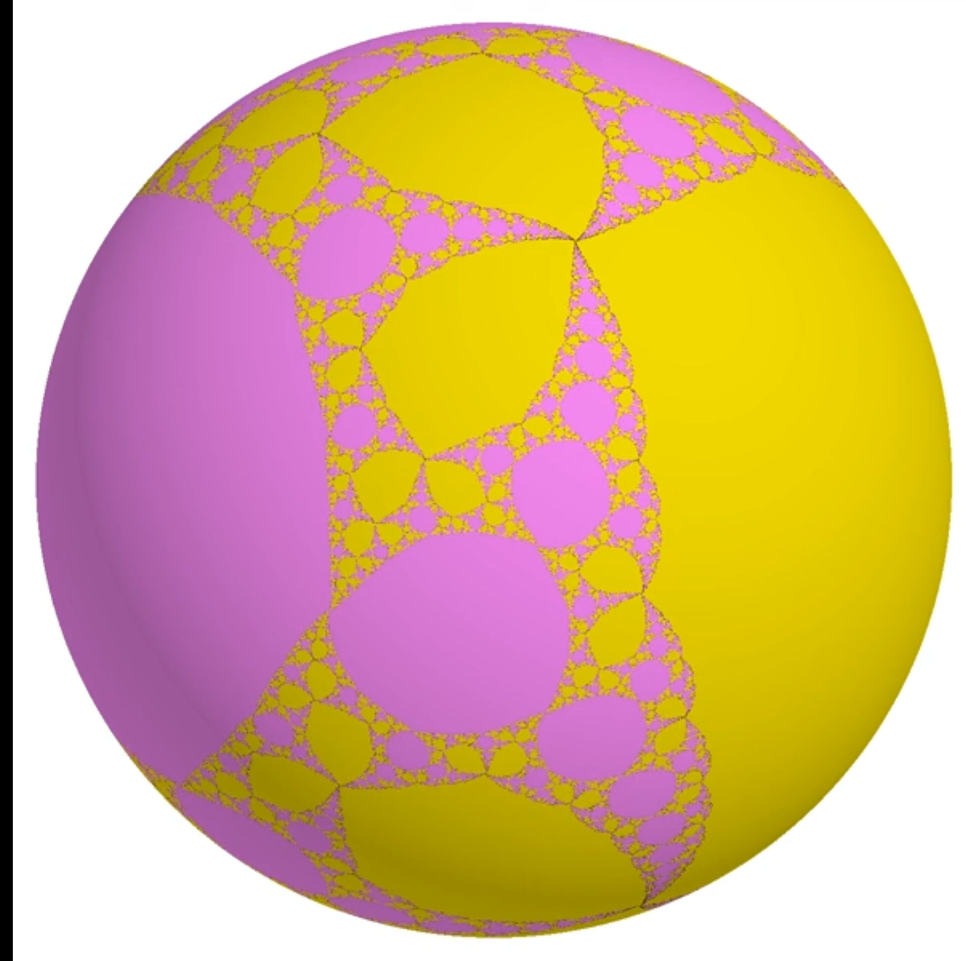

Rational Functions
Of the form $\frac{p\left(x\right)}{q\left(x\right)}$ where $p(x)$ and $q(x)$ are complex polynomials
Orbits mimic behavior of two filled Julia sets on a sphere instead of a plane
(https://www.math.univ-toulouse.fr/~cheritat/MatMovies/RabbitBasilica/)

Slide 5
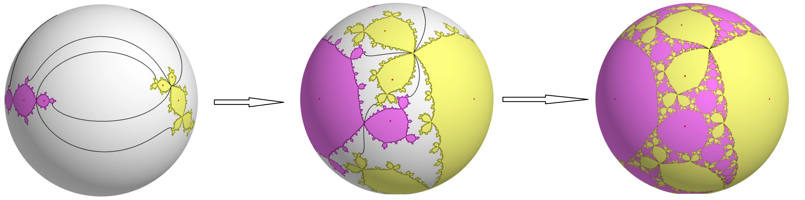
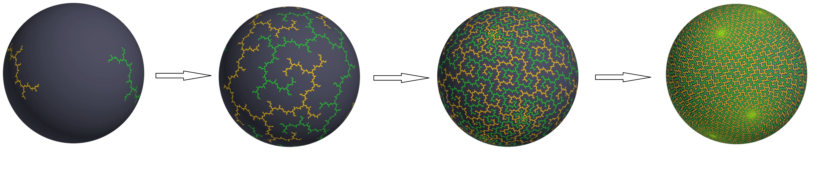
Polynomial Mating
Glues together two filled Julia sets which only cross at shared borders
Easy to conceptualize when the filled Julia sets have an interior, much hard when gluing regions with no interior together
(https://www.math.univ-toulouse.fr/~cheritat/MatMovies/RabbitBasilica/)
(https://www.math.univ-toulouse.fr/~cheritat/MatMovies/Den1_6Den1_6/Den1_6Den1_6.mp4)

Slide 6
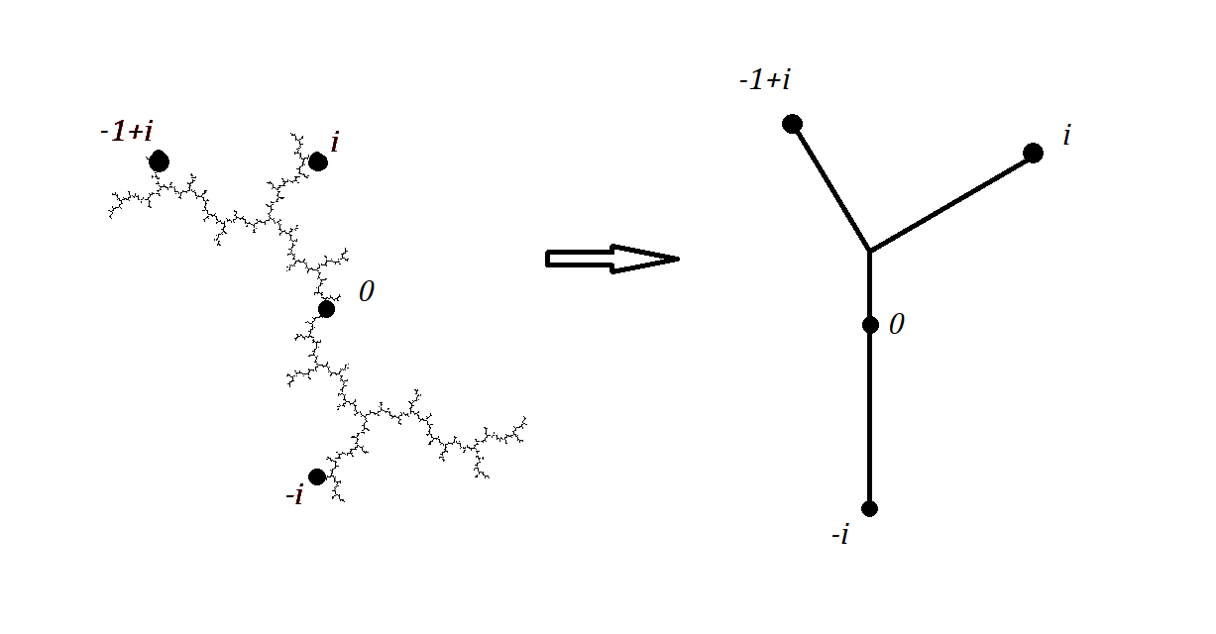





Misiurewicz Polynomials
These polynomials generate a filled Julia set which is nowhere dense
We can strip away the region into a minimum spanning tree containing the information to build back the whole region
$${K(f}_{i})$$
$$T_{i}$$

Slide 7
Mating Hubbard Trees
In a process outlined by Wilkerson, one may mate two Hubbard trees in three different constructions, where the third construction is a realization of the first two.
These are built on finite subdivision rules to generate an iterative approximation of a completed mating.
(Wilkerson)

Slide 8
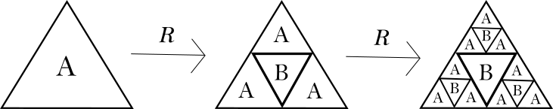

Finite Subdivision Rules
A finite subdivision rule is a way of subdividing a collection of tiles $S_{R}$ iteratively according to a rule $R$
As pictured on the right, $R$ subdivides tile $A$ into 3 $A$ tiles and a single $B$ tile which remains fixed
A second iteration of $R$ is shown at on the far right

Slide 9



Example
Let $f_{1}=f_{2}$ with $f_{1}\left(z\right)=z^{2}+i$
Pictured to the right is the minimum amount of information needed to build back the full region on the left.
$${K(f}_{1})$$
$$T_{1}$$

Slide 10
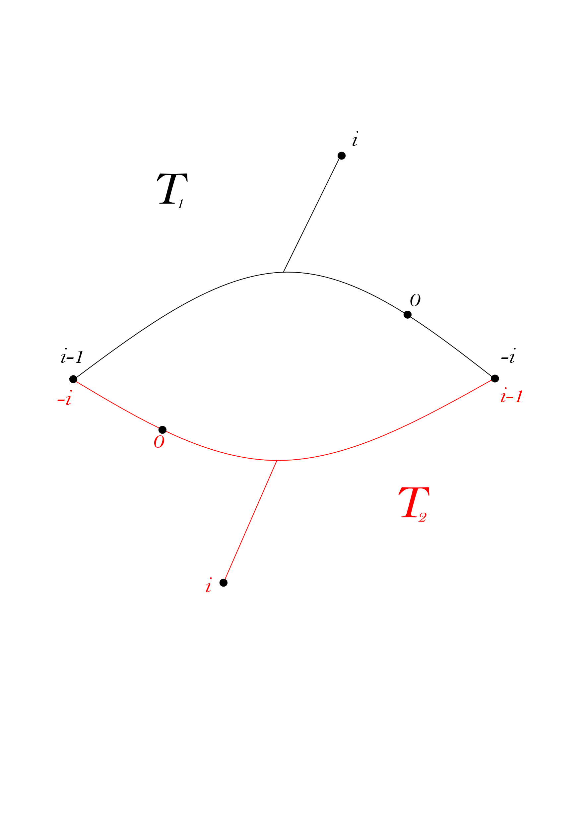

Building the 1 skeleton
We want to glue together the two Hubbard Trees like so
This serves as the 1 skeleton, $S_{R}$ to be subdivided by the subdivision rule $R$

Slide 11
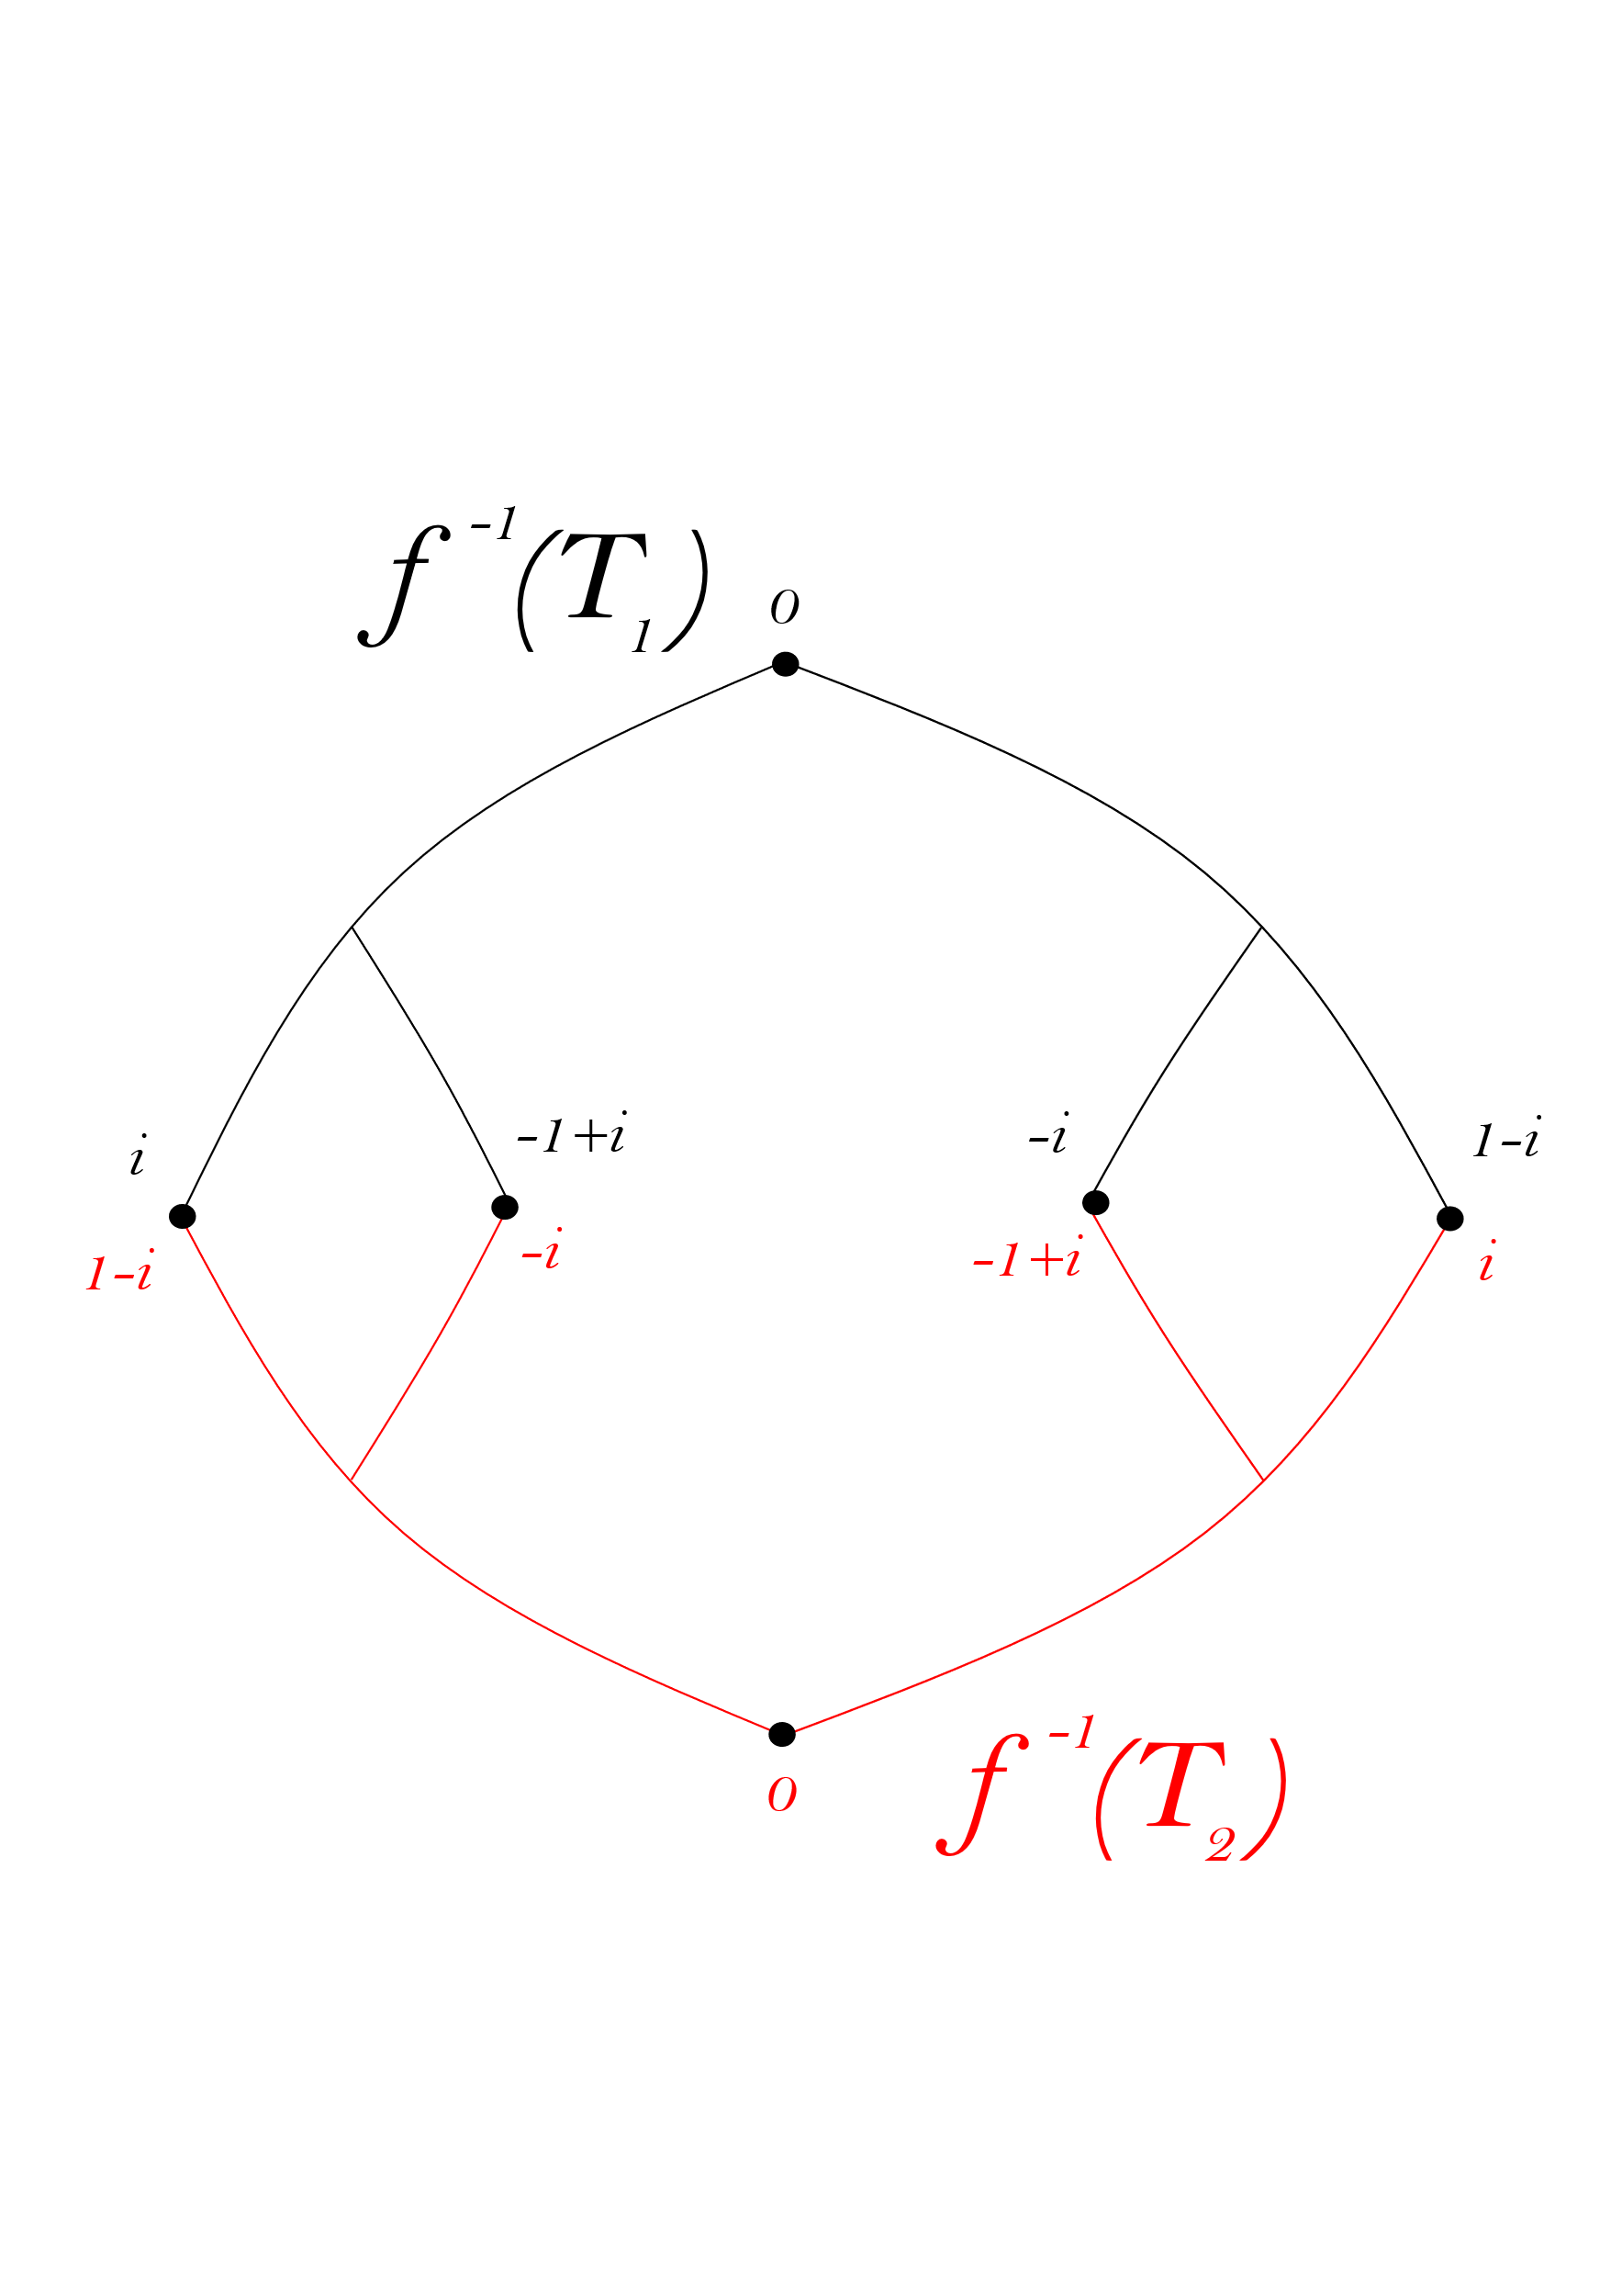


Building $R$
To derive the subdivision rule, we take the preimage of each tree and then we reglue the trees back together such that the forward image of the function takes each endpoint to the same points contained in $S_{R}$

Slide 12
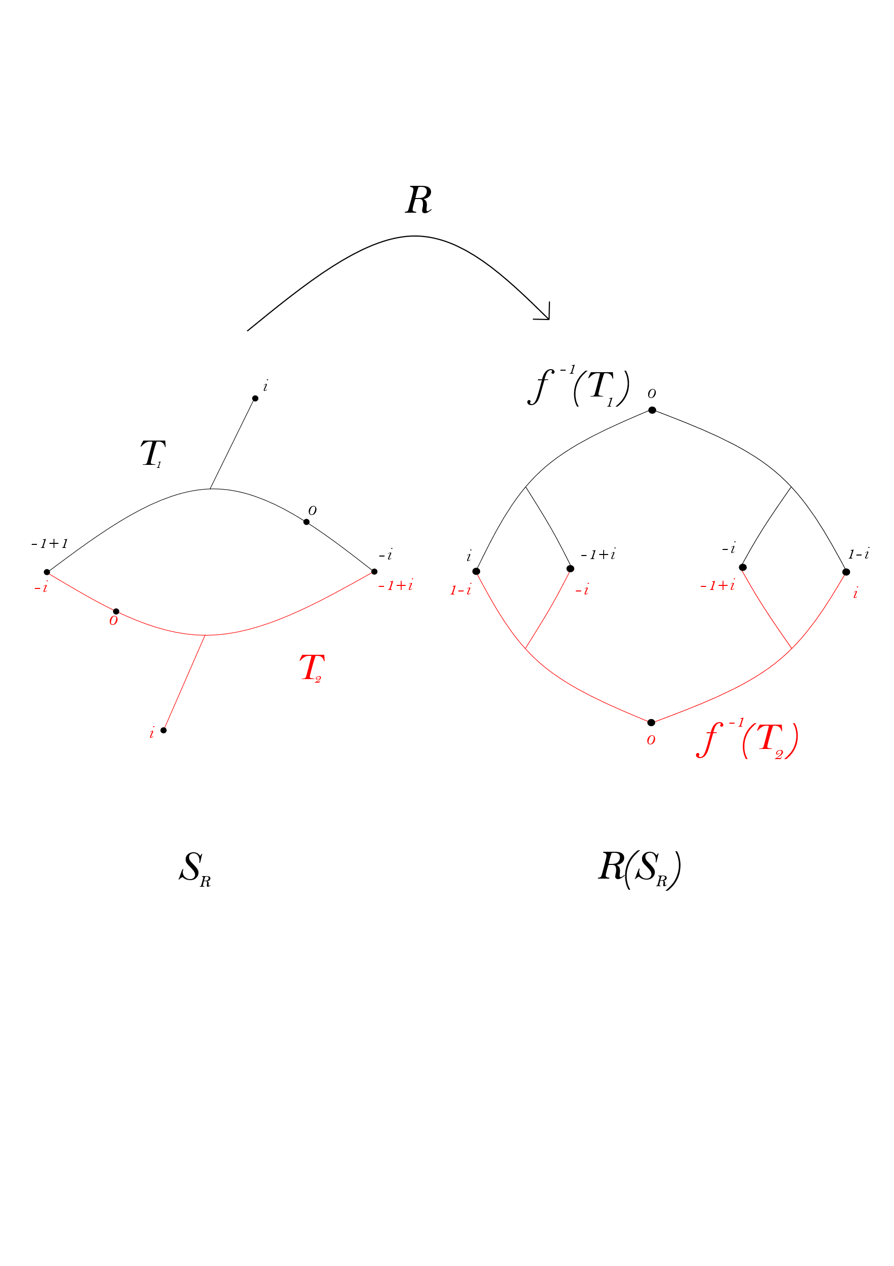















Subdivision Complex
Allows us to see how $R$ subdivides tiles of $S_{R}$

Slide 13
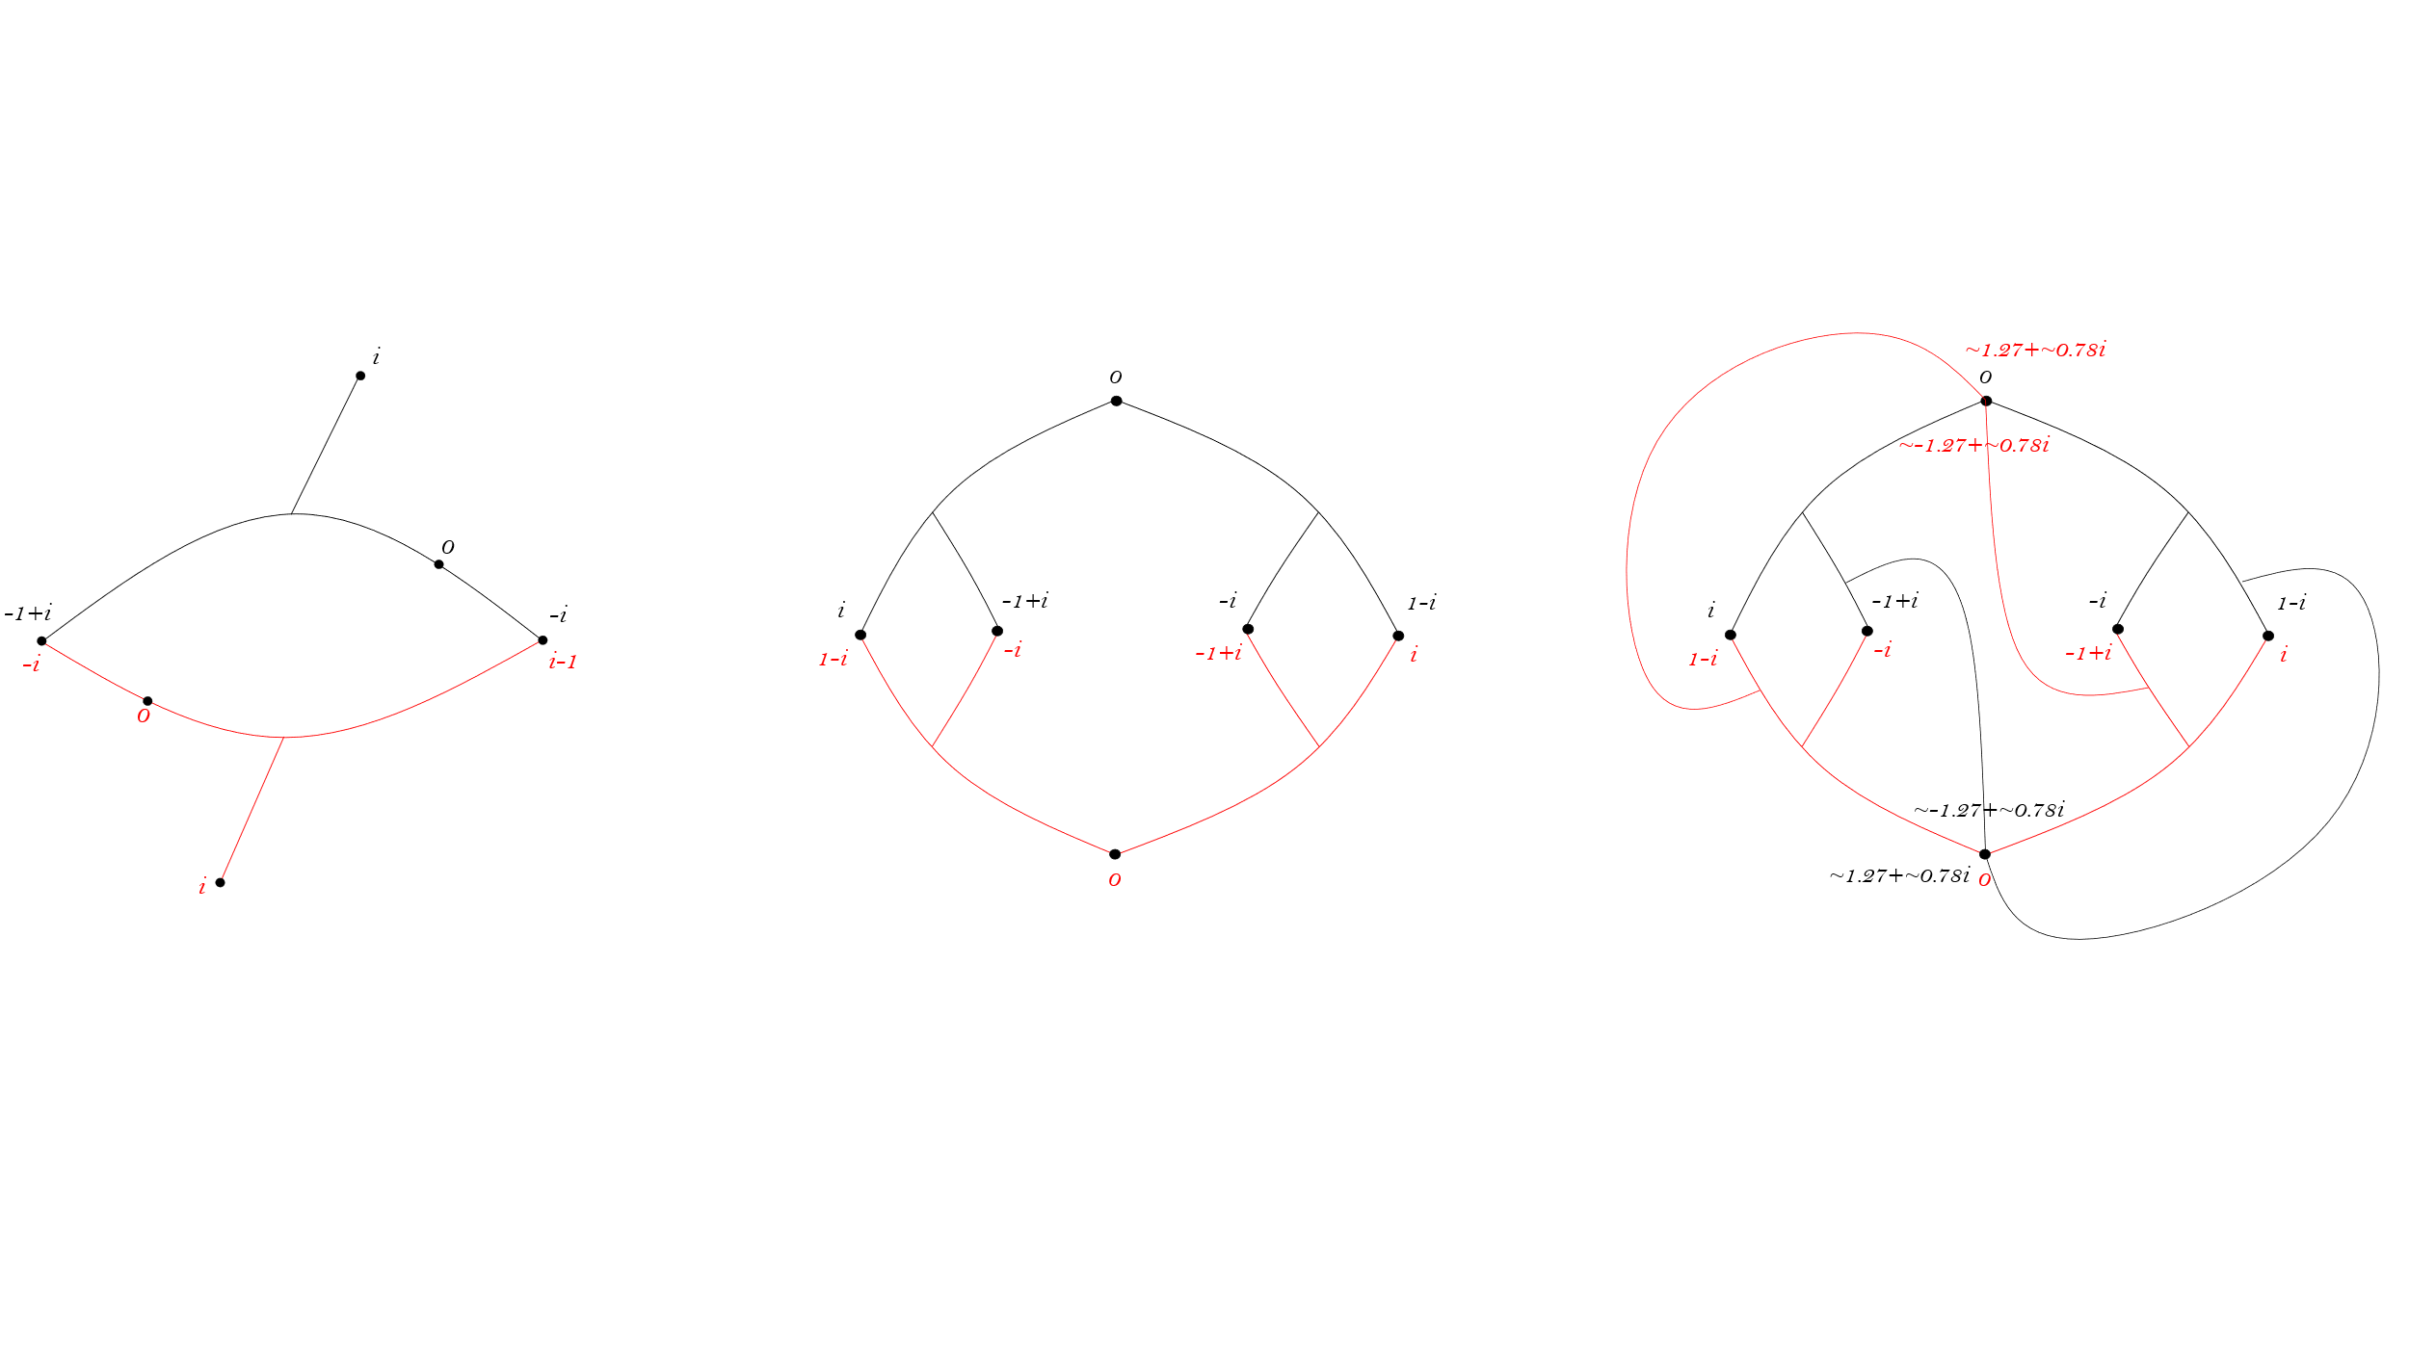

Slide 14
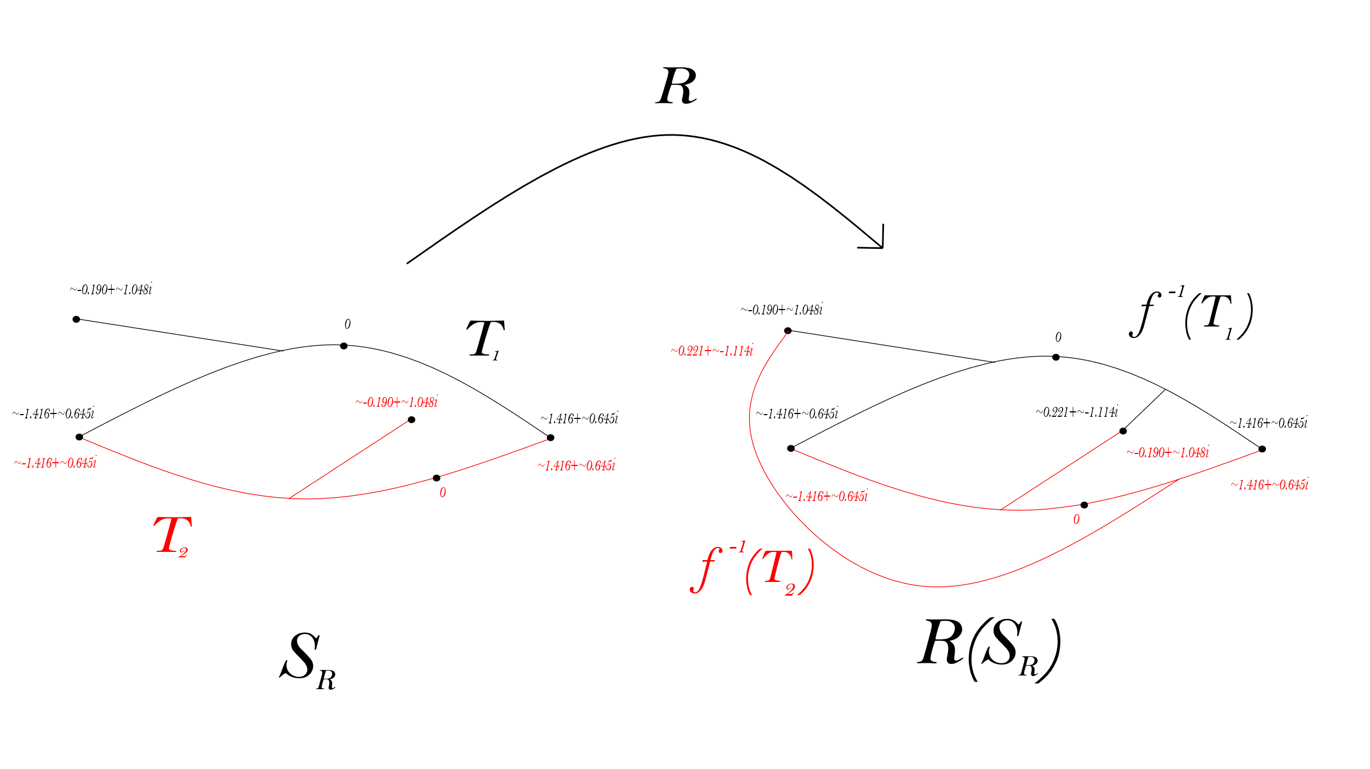
All Misiurewicz Polynomial Subdivision Complexes with less than 5 postcritical points using construction 1

Slide 15
Bibliography
Wilkerson, M. Finite subdivision rules from matings of quadratic functions: Existence and
constructions. Accepted: 2014-03-14T20:11:41Z Publisher: Virginia Tech.
Kelsey, G., and Lodge, R. Quadratic thurston maps with few postcritical points. 33–55.
Number: 201.

