Slide 1
The Effectiveness of Early Intervention Outcomes in Children with an Autism Spectrum Disorder
Bailey Hull and Haley Hill

Slide 2
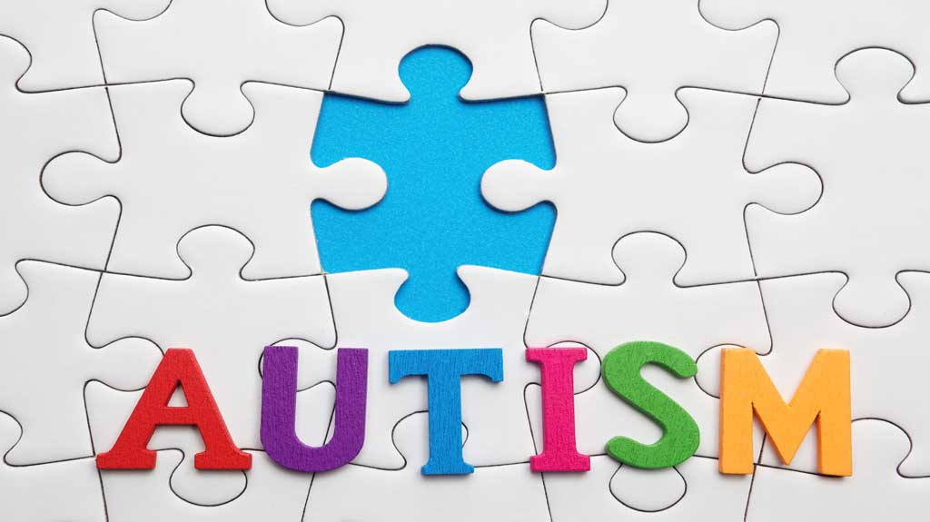
What is Autism spectrum disorder (ASD)?
Clinical definition and diagnostic criteria
Reported rates in the United States
Development
This Photo by Unknown Author is licensed under CC BY-NC-ND

Slide 3
What is Early intervention?
Multiple disciplines
Goals
https://www.nichd.nih.gov/health/topics/autism/conditioninfo/treatments/early-intervention
This Photo by Unknown Author is licensed under CC BY

Slide 4
Importance of Early Intervention

Slide 5
Our study
Meta-analysis consisting of 15 studies
Used keywords such as “early intervention” and “autism spectrum disorder”

Slide 6
Our results
Communication: d=0.73
Social Skills: d=0.63
Adaptability: d=0.77

Slide 7
What does this mean?
Early intervention is effective amongst the ASD population.
More research should be done

Slide 8
Questions?

