Slide 1
Observing Bifurcations Experimentally in a Driven Damped Pendulum
Philip Waymeyer, Dr. Doug Harper, Lars Hebenstiel, Dr. Ivan Novikov
Department of Physics and Astronomy
Western Kentucky University

Slide 2
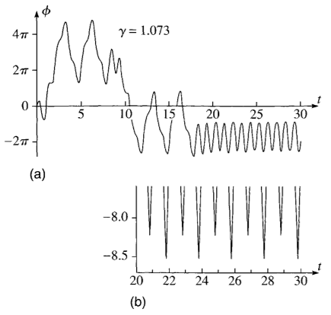
Background - Chaotic Motion
Different periodicity, such as period 2, period 3, etc., can be found by changing the drive strength of a motor. Drive strength in our setup is a quantity proportional to drive amplitude and frequency.
Chaotic motion in a pendulum is when the oscillations produced are not periodic. Ones of the easiest known ways to attain chaos is to go through a period doubling cascade.
Example of period 2

Slide 3
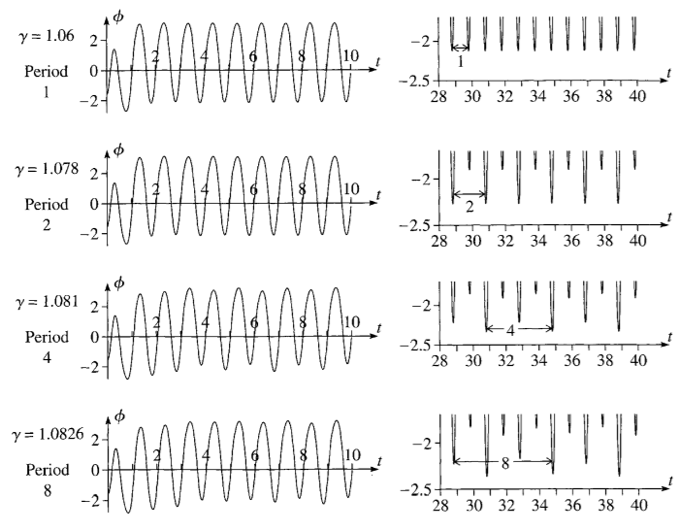
Background - Chaotic Motion
A period doubling cascade is when the period doubles as the drive strength is increased, which can lead to chaos. The way to determine these values of the drive strength is by finding bifurcation points.

Slide 4
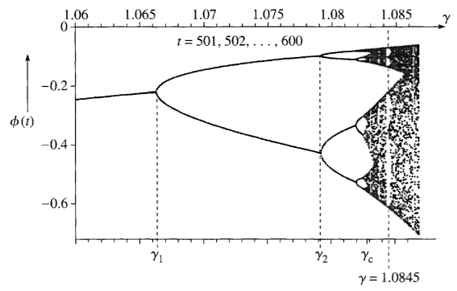
Background - Bifurcation
Bifurcation points can be found with the Feigenbaum relation $({\text{γ}}_{n+1}−{\text{γ}}_{n})≈\frac{1}{δ}\left({\text{γ}}_{n}−{\text{γ}}_{n−1}\right)$ where delta is the Feigenbaum number with value 4.6692016.
In this relation, as $n →\text{∞}$, ${\text{γ}}_{n}→ {\text{γ}}_{c}$ where ${\text{γ}}_{c}$ is the critical value. Beyond this critical value, chaotic motion sets in.
A bifurcation diagram is a graph of angular position, ϕ(t), vs γ, with ϕ(t) recorded once per cycle. This gives a visual representation of the bifurcation points and degree of oscillation, as well as areas of chaotic motion.

Slide 5
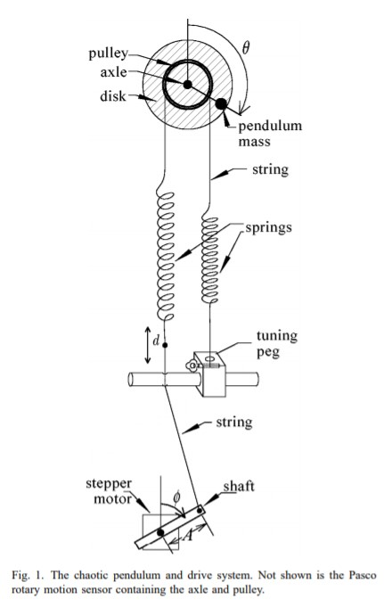
Previous Research
In research by Robert DeSerio, a very similar oscillator was constructed using the same PASCO EX-5522A product. This research demonstrated benefits of using a stepper motor at constant angular velocity to drive a chaotic pendulum¹ .
The data analysis of this research showed how this particular apparatus can give good results to study nonlinear dynamics.
A thorough study of bifurcation in nonlinear dynamics was done by Gray Davidson in the paper The Damped Driven Pendulum: Bifurcation Analysis. The analysis methods used in this paper will be similar to what we use.
Chaotic pendulum: The complete attractor, DeSerio (2003)

Slide 6
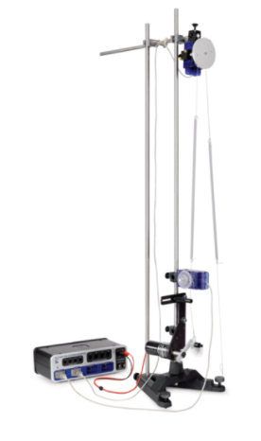
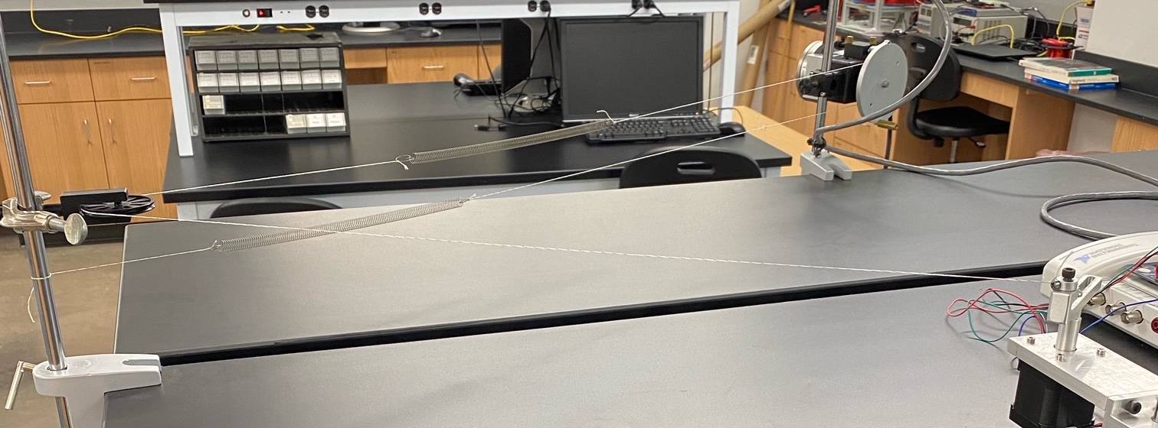
Damped Driven Oscillator: Experimental Setup (PASCO vs WKU)
Damping sources include: friction, springs, eddy current damping.

Slide 7
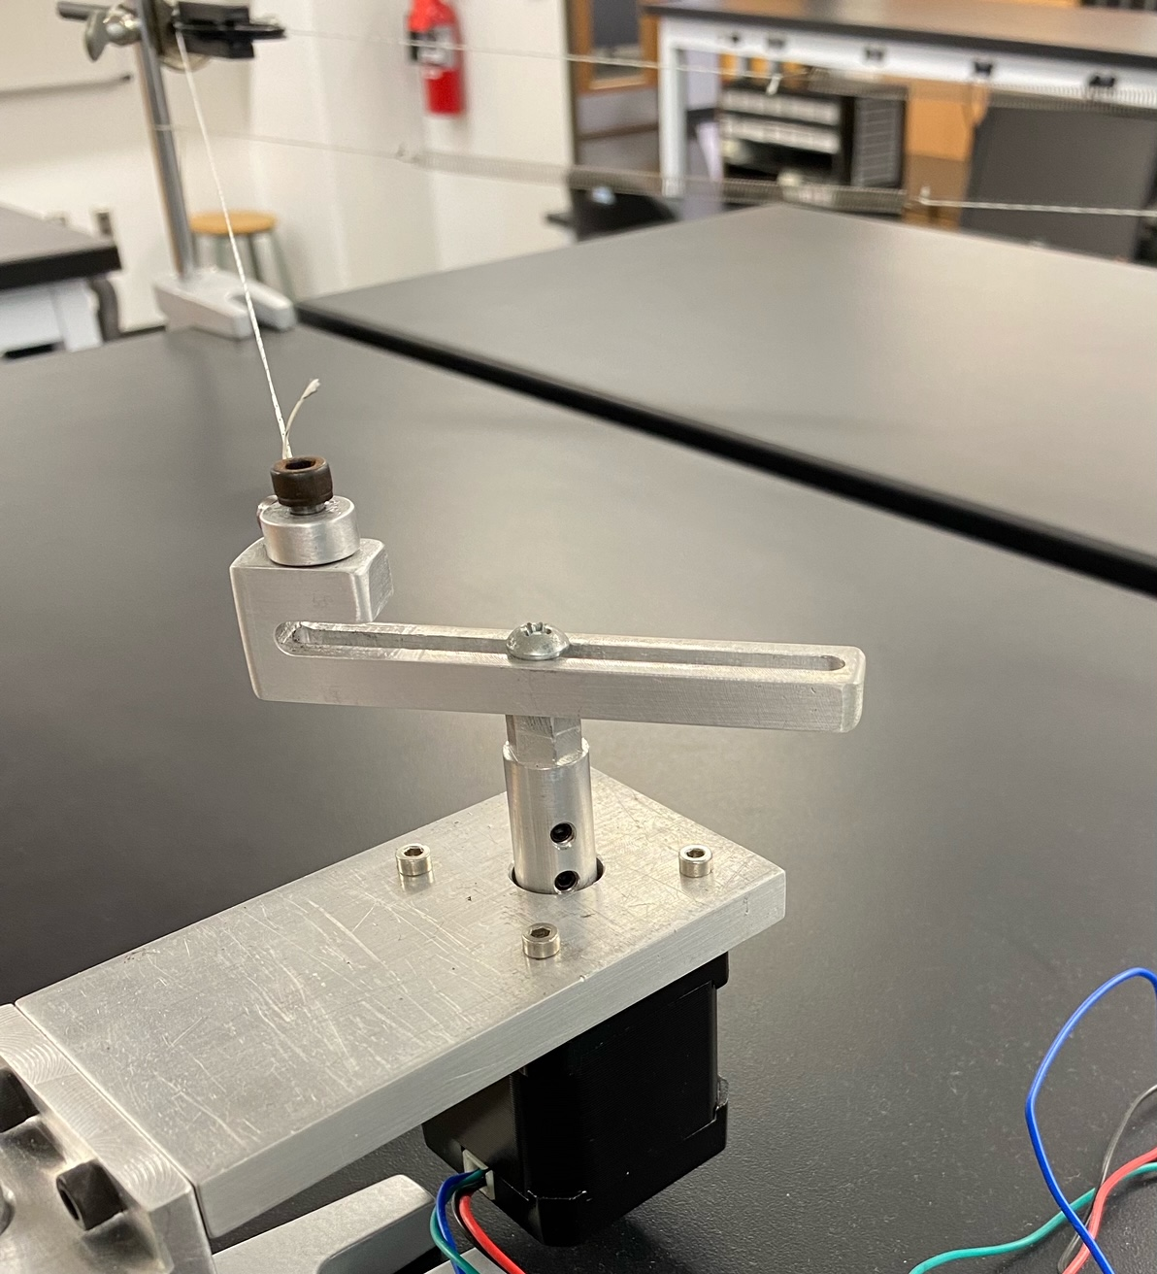
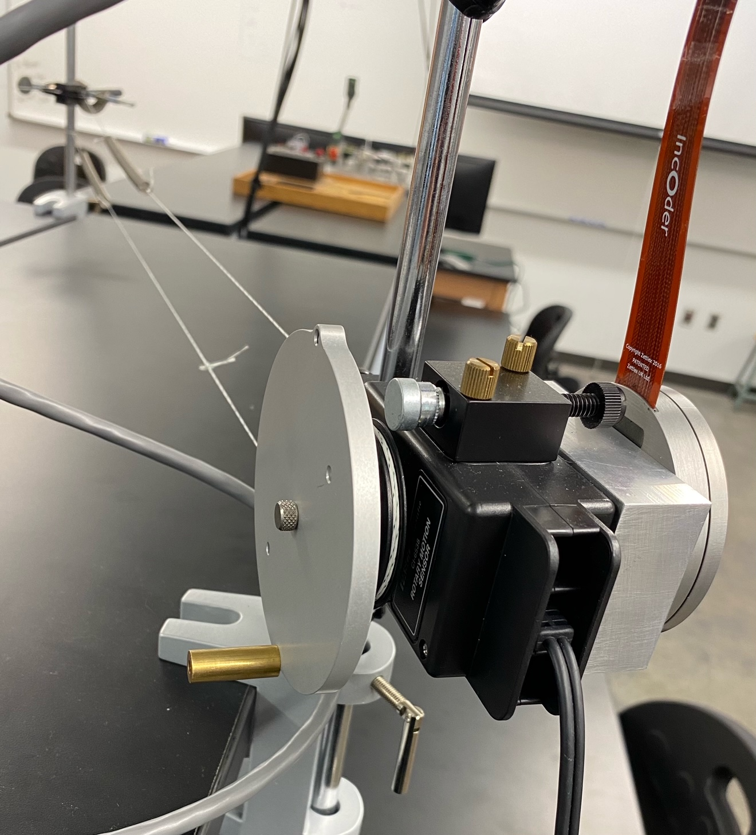
Damped Driven Oscillator: Experimental Setup
Eddy current damping
A new encoder is being used in our setup with a sensor with 4000 divisions per revolution for more precise measurement of angular position.
A
Springs
Stepper
motor
Pendulum
Pulley

Slide 8
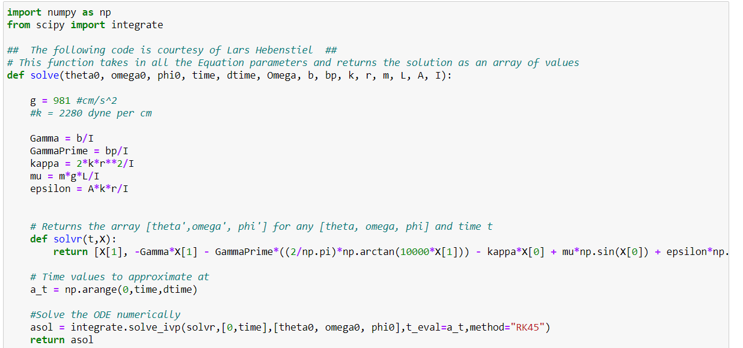
Current Progress
We are developing a simulation of the setup in python in which we can freely change parameters to search for possible regions of period doubling.
Data which we have collected so far has not shown signs of period doubling.
The LabVIEW code is being used to run the motor as well as gather and analyze data. The code is still being polished, but it is working as intended.

Slide 9
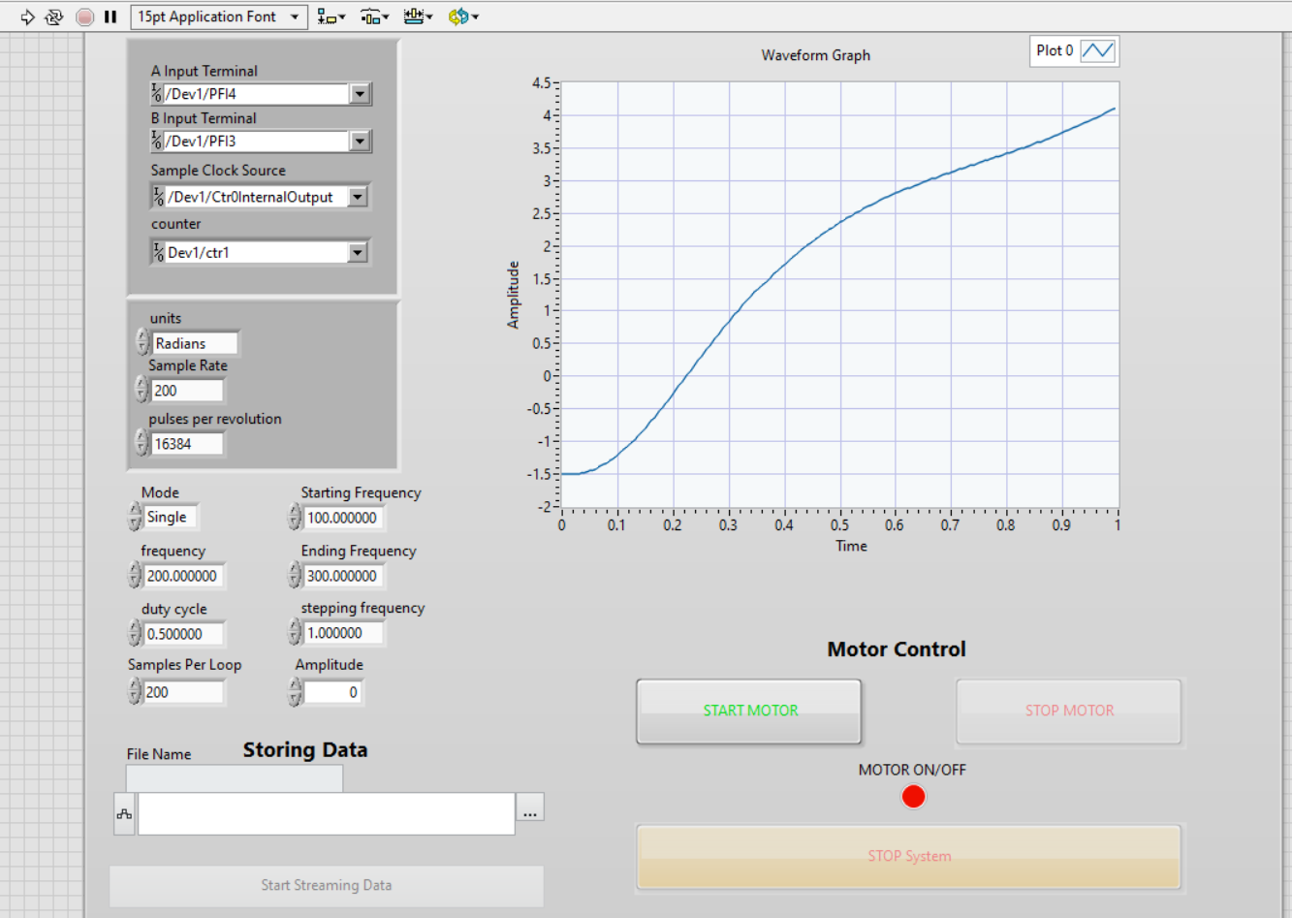
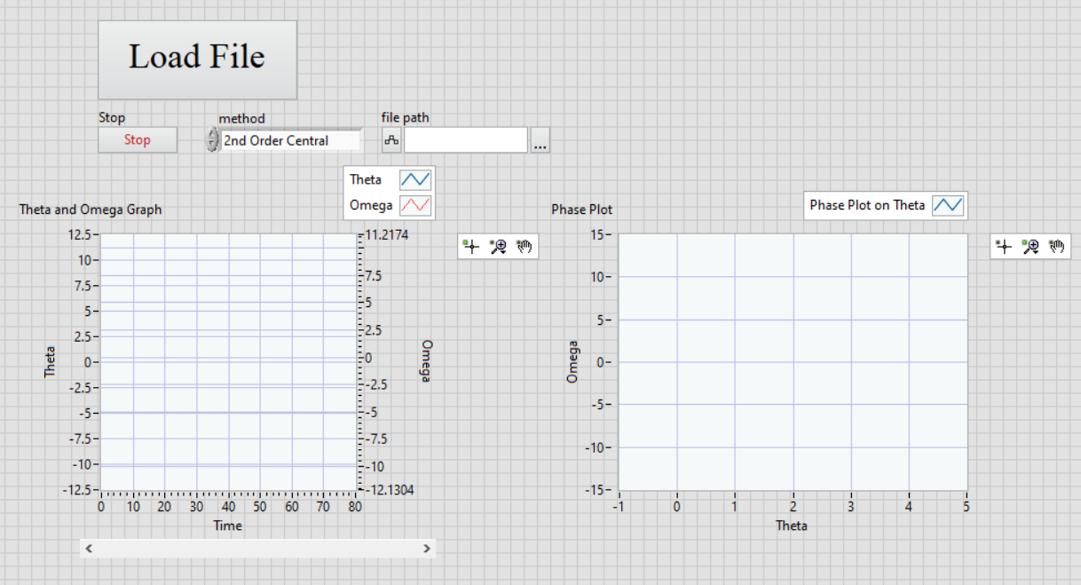
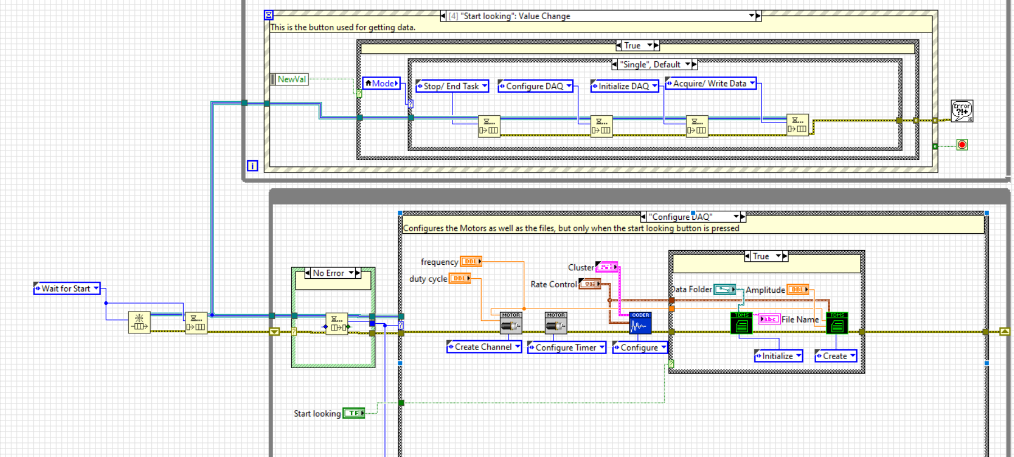
Data Acquisition (DAQ) System Development
Data Acquisition
Data Analysis
The waveform graph shows snapshots of the pendulum behavior each second
Section of the
block diagram

Slide 10
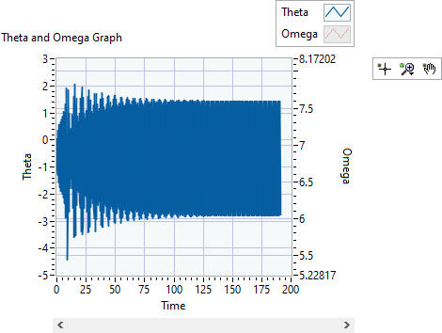
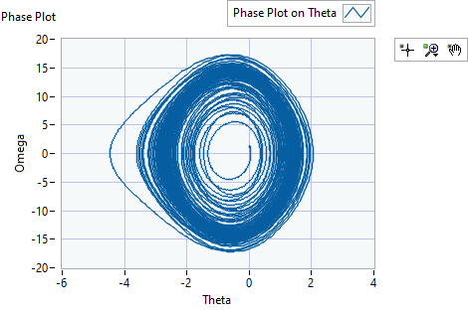
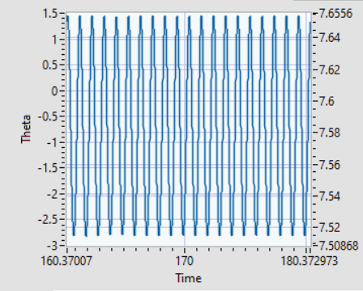
Data
Frequency: 180 (5.655rad/s), A: 3.8cm, Magnet: 1.8cm separation

Slide 11
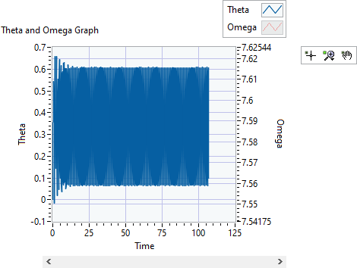
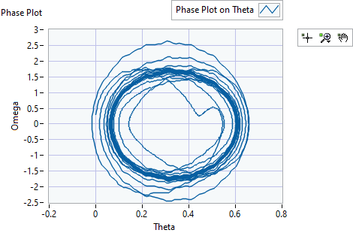
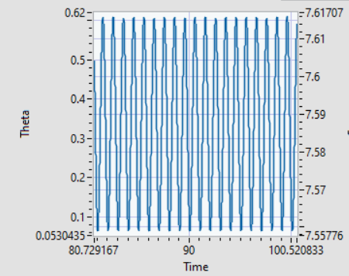
Data
Frequency: 130 (4.084rad/s), A: 3.8cm, Magnet: 1.8cm separation

Slide 12
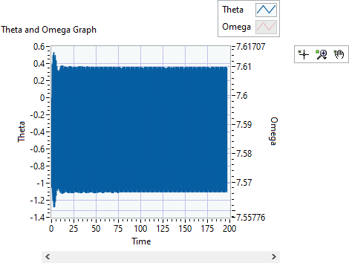
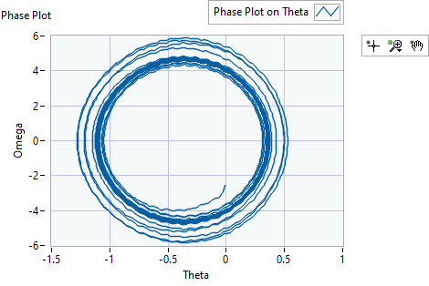
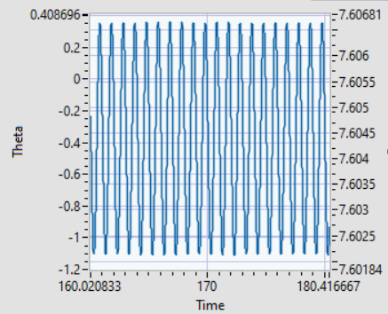
Data
Frequency: 180 (5.655rad/s), A: 3.8cm, Magnet: 0.5cm separation
After allowing time for transients to die out, the motion becomes periodic in each measurement that has been made so far

Slide 13
Future Work
Continue development of the python simulation to create a more accurate model.
Tweak the experimental setup to try to produce the behaviors required for period doubling within the setup.
Continue searching for a period doubling cascade in order to find bifurcation points in the setup and record data to create a bifurcation diagram.

Slide 14
References
﻿¹Chaotic pendulum: The complete attractor Robert DeSerio, American Journal of Physics 71, 250 (2003)
Taylor, J. R. (2005). Classical mechanics. University Science Books.
The Damped Driven Pendulum: Bifurcation Analysis Gray Davidson, (2011)

