Slide 1

First individually circularized chromosome in the yeast Saccharomyces cerevisiae
Blake Hoover & Dr. Melissa Mefford

Slide 2
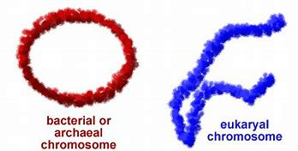
Prokaryotic vs. Eukaryotic
chromosome architecture

Slide 3
End-replication problem at telomeres
Telomerase RNA
TERT (telomerase reverse transcriptase)
Loss of telomerase activity leads to:
Telomere shortening
G2-M cell cycle arrest (senescence)
Important in both aging and cancer
Notes:
(ANIMATED)

Slide 4
Goals:
Understand evolution of linear chromosomes and their advantage in eukaryotes
Assess the consequences of losing telomeres and end-replication problem
Characterize circular chromosome viability and fitness in eukaryotes
Prokaryotes vs. Eukaryotes

Slide 5
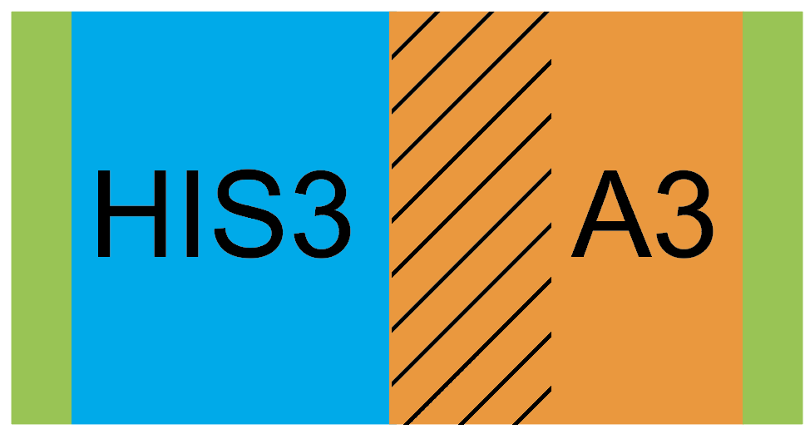
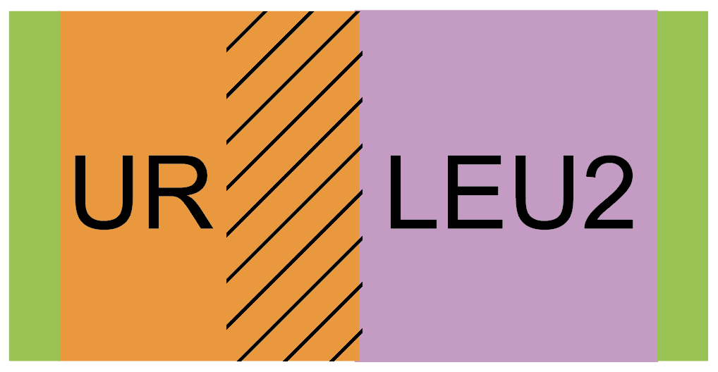
Cassettes and selectable markers used in our genetic engineering strategy
Cassettes
  Sequences of DNA containing multiple genes and/or functional elements
Selectable Marker Genes
  Genes used for identification of microbes that have underwent a transformation
Left arm cassette
Right arm cassette
Notes:
Schematic of circularization process

Slide 6

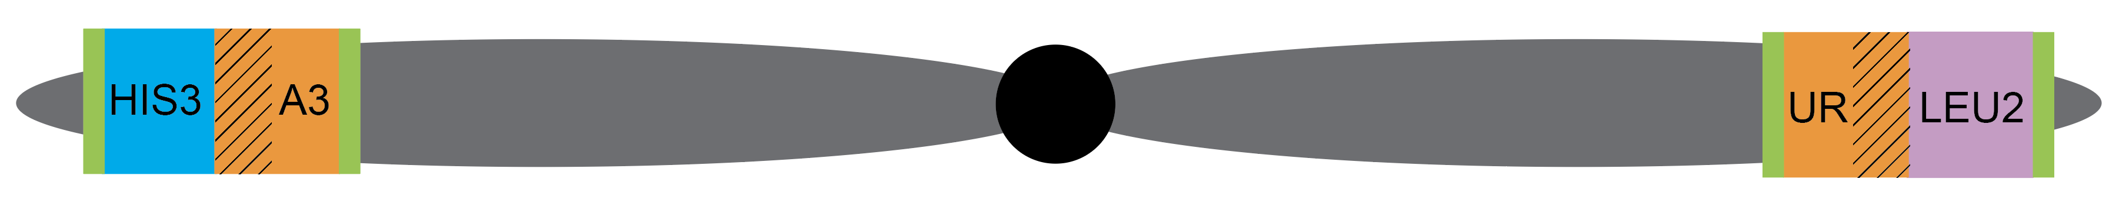
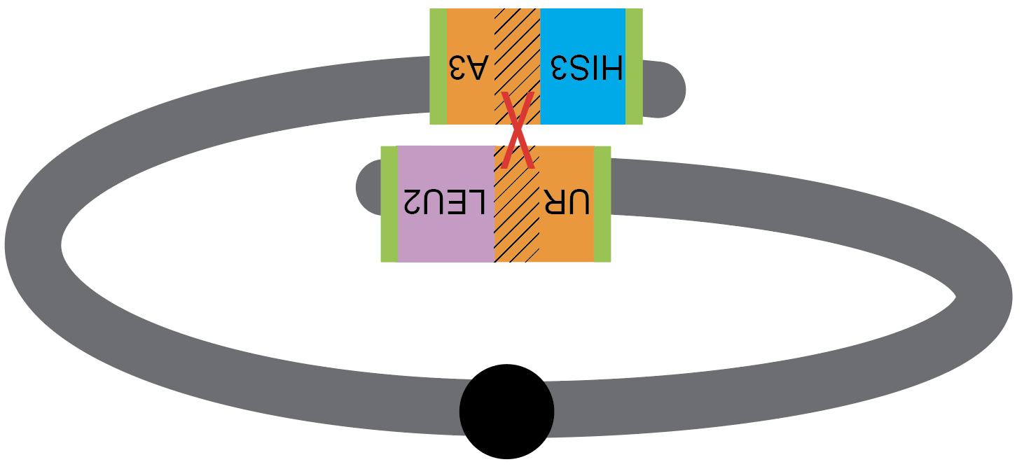
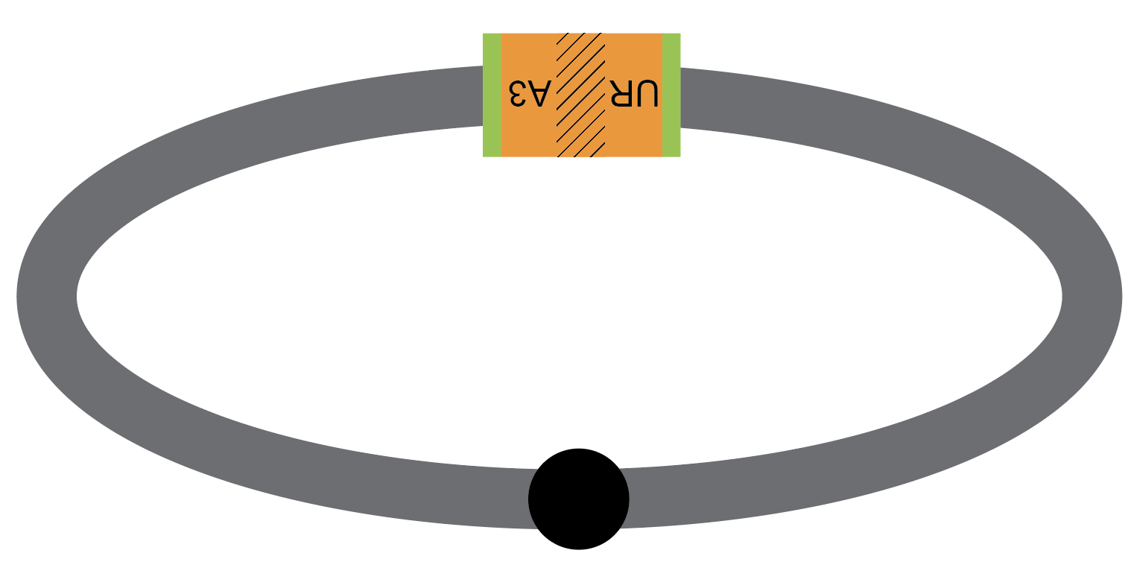
Genetic Engineering Strategy
= left arm cassette
= right arm cassette
= overlapping homology
Notes:
Schematic of circularization process

Slide 7
Building Cassettes by PCR Amplification
1st round PCR:
2nd round overlapping PCR:
L
UR (1/2 URA3)
L
UR-LEU2
0.5 kb
2.4 kb
L
LEU2
2.0 kb

Slide 8
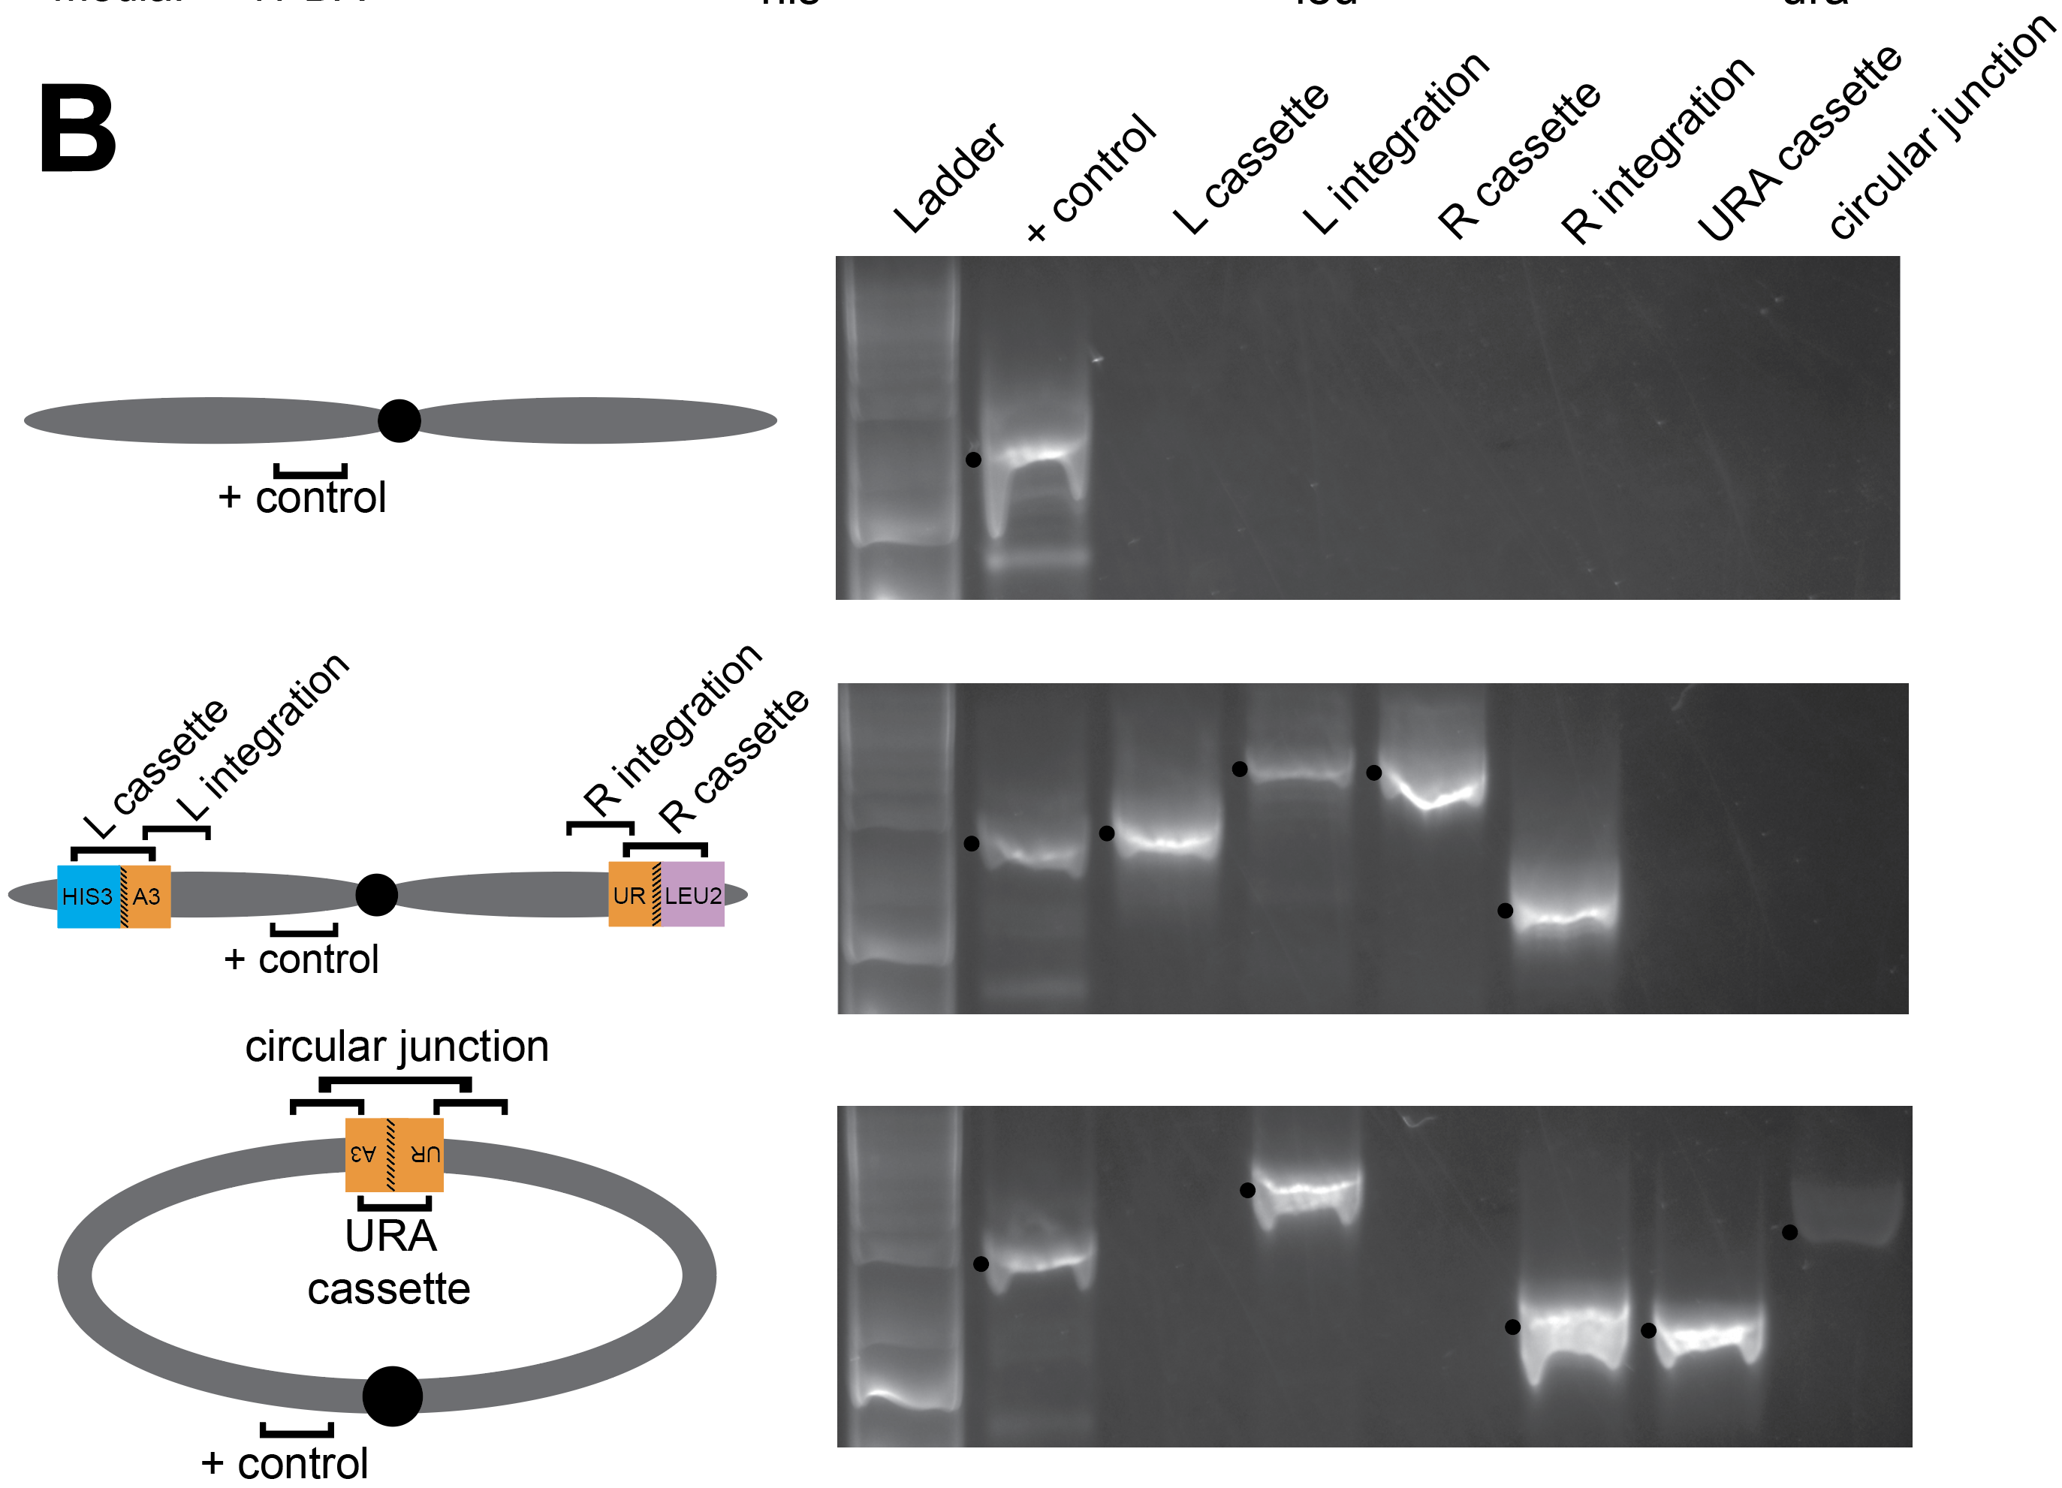
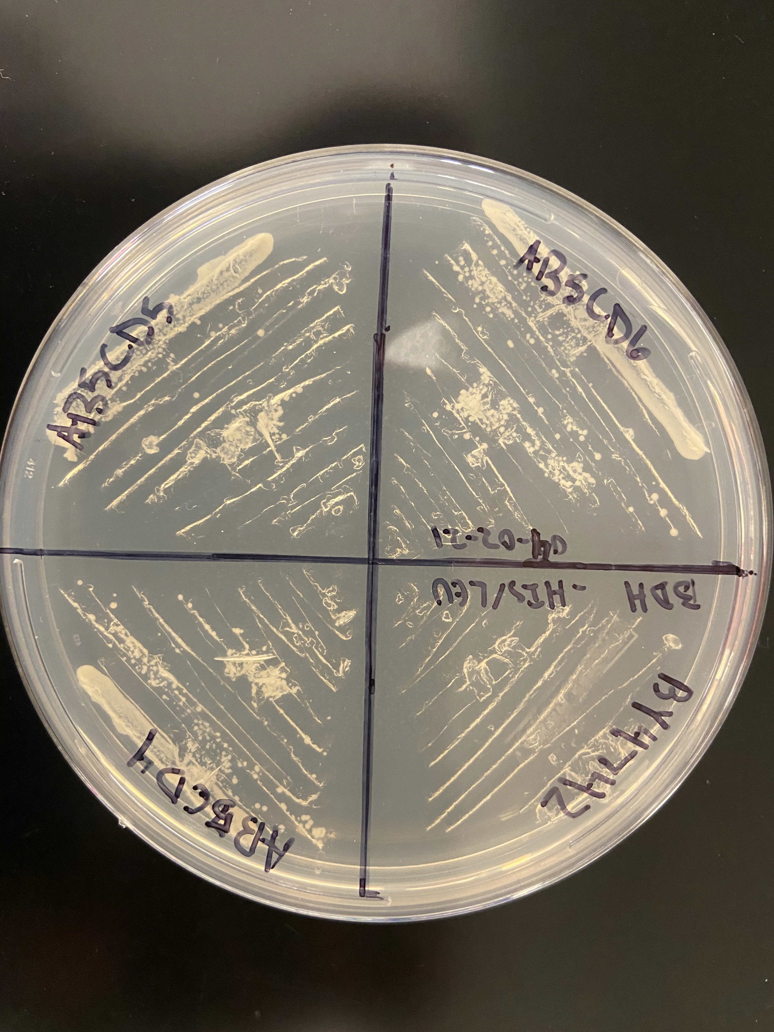
Double integration of left and right arm cassettes
L
L
+
LA
LC
RC
RA
3 conformation sets from separate circular gDNA
Growth of yeast on -his/-leu media
PCR Confirmation PCR of double integration

Slide 9
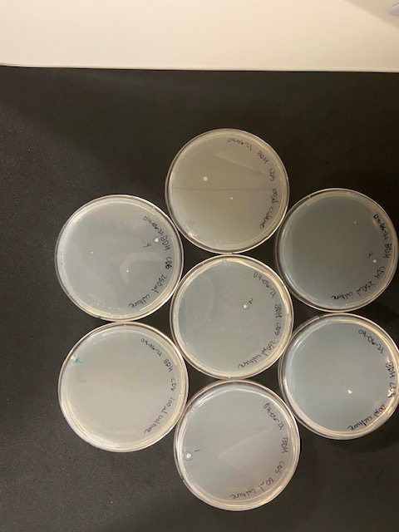
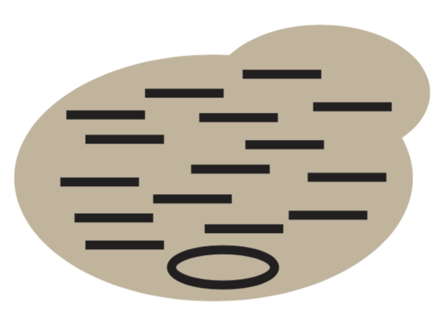
Circularization Candidates
9 colonies grew on -ura plates

Slide 10
PCR confirmation of circularization

Slide 11
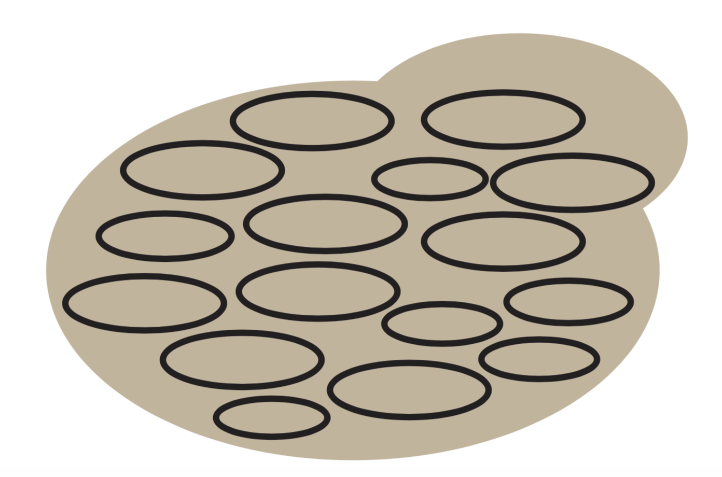
What circularization means in Saccharomyces cerevisiae
First single genetically engineered circular chromosome in yeast
does NOT equal
Can these do sexual reproduction?

Slide 12
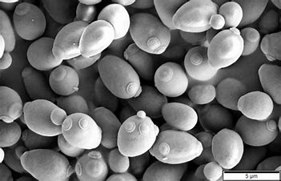
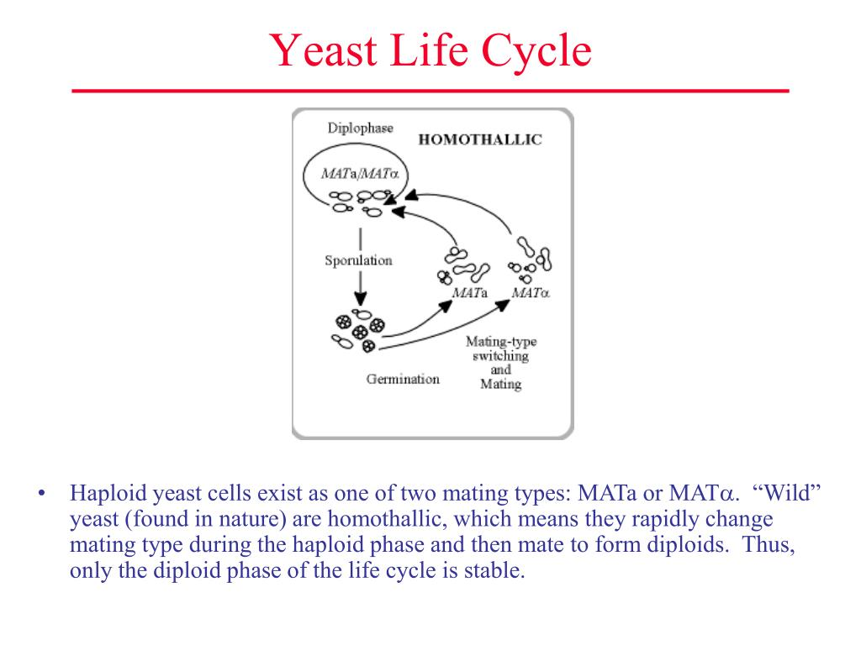
Saccharomyces cerevisiae sexual reproduction
Two mating types (MATa/MATα)
  both required for mating and sexual reproduction
Haploid MATa mates with haploid MATα to produce diploid MATa/α
Diploid MATa/α capable of sporulation(meiosis)

Slide 13
Current Work
Characterize fitness of circular Ch. IV strains
Mating and sporulation of circular strains
Circularization of MATα

Slide 14
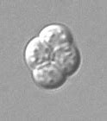
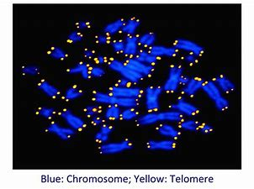
Long term goals
Finish
Circularize additional chromosomes
Use
Determine viability of spores from sporulation experiments
Use
Use FISH imaging to confirm Ch. IV circularization

Slide 15

Acknowledgements
  Dr. Melissa Mefford
  Keenan Conley
  Madison Frazier
  Blake Hoover
  Chisom Iloegbunam
  Ethan Chandler
  Duncan McGinnis
  MacKenzie Neal
  Hailey Reitz
  Funding
  MSU
  KY INBRE (NIGMS 8P20GM103436)

