Slide 1
Caffeine and Reaction Time

Slide 2
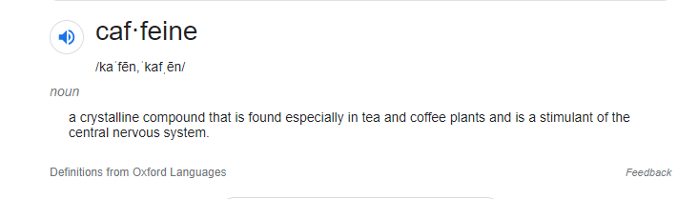
What is caffeine?
Definition:
Notes:
Caffeine is something that has a big presence in a lot of our lives. We drink coffee, tea, cola, Mountain Dew, and a variety of other “energy drinks” all day long (sometimes ending with caffeinated mixers in drinks at the bar).

Slide 3
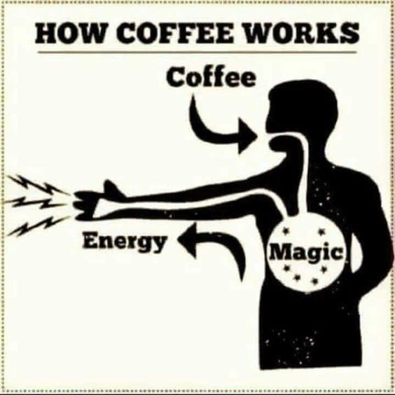
Caffeine gets you going
Notes:
Pretty much the first thing many of us do as part of our daily ritual, is to make a pot of coffee or tea. A coffee pot was the first appliance I actually HAD to have when I moved away to college.
The National Coffee Association estimates that around 60% of Americans drink coffee on a morning-to-morning basis. That’s just coffee. It’s no secret that coffee and other caffeinated beverages today are seen as being quite important, and plenty of people all around the world rely on the stimulating effects of those drinks to rouse them from sleep and give them the energy needed to prepare for waking life. To get through the day or a late night’s work.

Slide 4
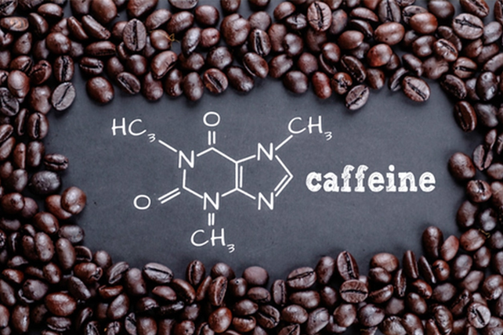
Caffeine benefits
Awareness
Mood
Alertness
Mental Function
Performance enhancement
Reaction time
Notes:
1. People report a number of neurological benefits of caffeine, including increased awareness, improved mood, and increased levels of alertness. Caffeine purportedly enhances mental functioning at a number of levels, and many people consume it because they believe that there are major cognitive performance benefits that outweigh any possible health risks. However, one thing that repeatedly comes up in the discussion of caffeine’s effects is called reaction time.

Slide 5
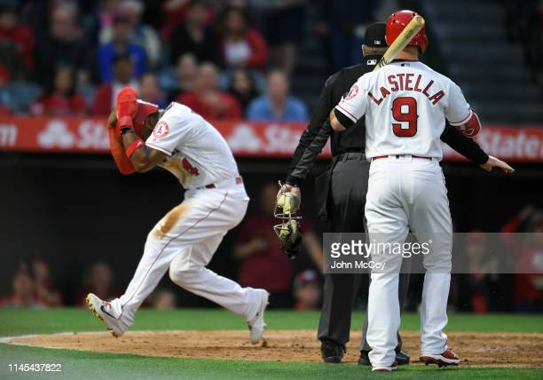
Reaction time is one way of testing this
It’s an unambiguous factor
It’s easy to measure
It can’t be cheated
American Psychological Association Definition of srt:
  “The total time that elapses between the presentation of a stimulus and the occurrence of a response in a task that requires a participant to perform an elementary behavior whenever a stimulus is presented”.
Notes:
1. Reaction Time or Simple Reaction Time (which is often referred to as SRT) is defined by the American Psychological Association as,
“The total time that elapses between the presentation of a stimulus and the occurrence of a response in a task that requires a participant to perform an elementary behavior whenever a stimulus is presented”.
For example, this is the time it takes to start to duck if you see a ball coming at your head.

Slide 6
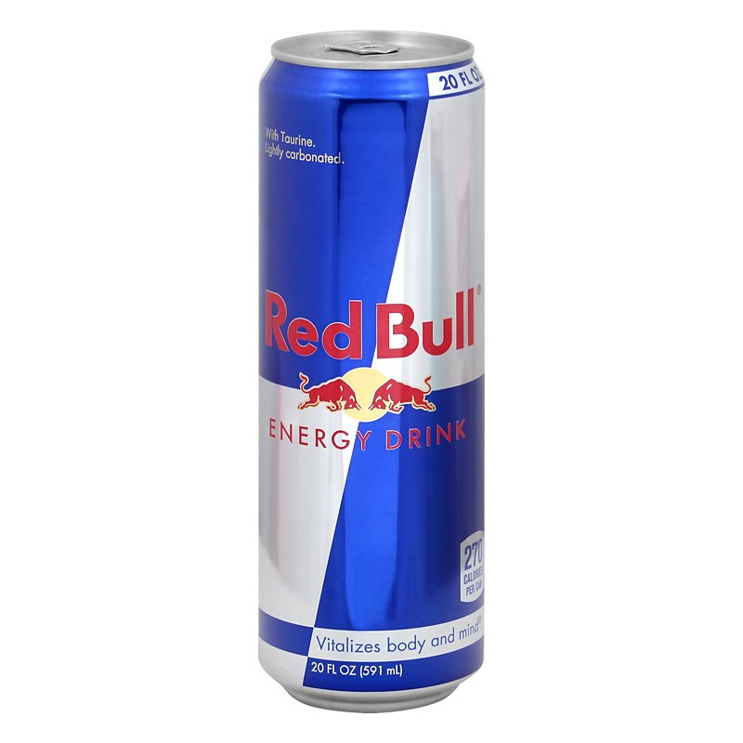

But does it actually improve the way you work?
Notes:
1. Caffeine is taken by athletes and others, as a potential performance enhancer, partly on the basis that it is presumed to be capable of improving these reaction times. But is this real improvement or not?

Slide 7
Does caffeine impact SRT?
Is there a link between caffeine and reaction time?
Notes:
1. What I wanted to know was whether the research in aggregate confirmed the idea that caffeine had a discernable impact on reaction time. So, to answer the question, I surveyed several research databases for different studies which looked at that relationship. I was able to locate 14 studies reviewing some connection between caffeine intake and reaction time.

Slide 8
The research
Many researchers have asked the same thing
Different populations were chosen
13 studies
Notes:
1. Many researchers have asked the same thing, and have conducted studies which investigated the relationship between caffeine and reaction time, either as an objective outright, or as a secondary factor to be examined at the same time as something else.

Slide 9
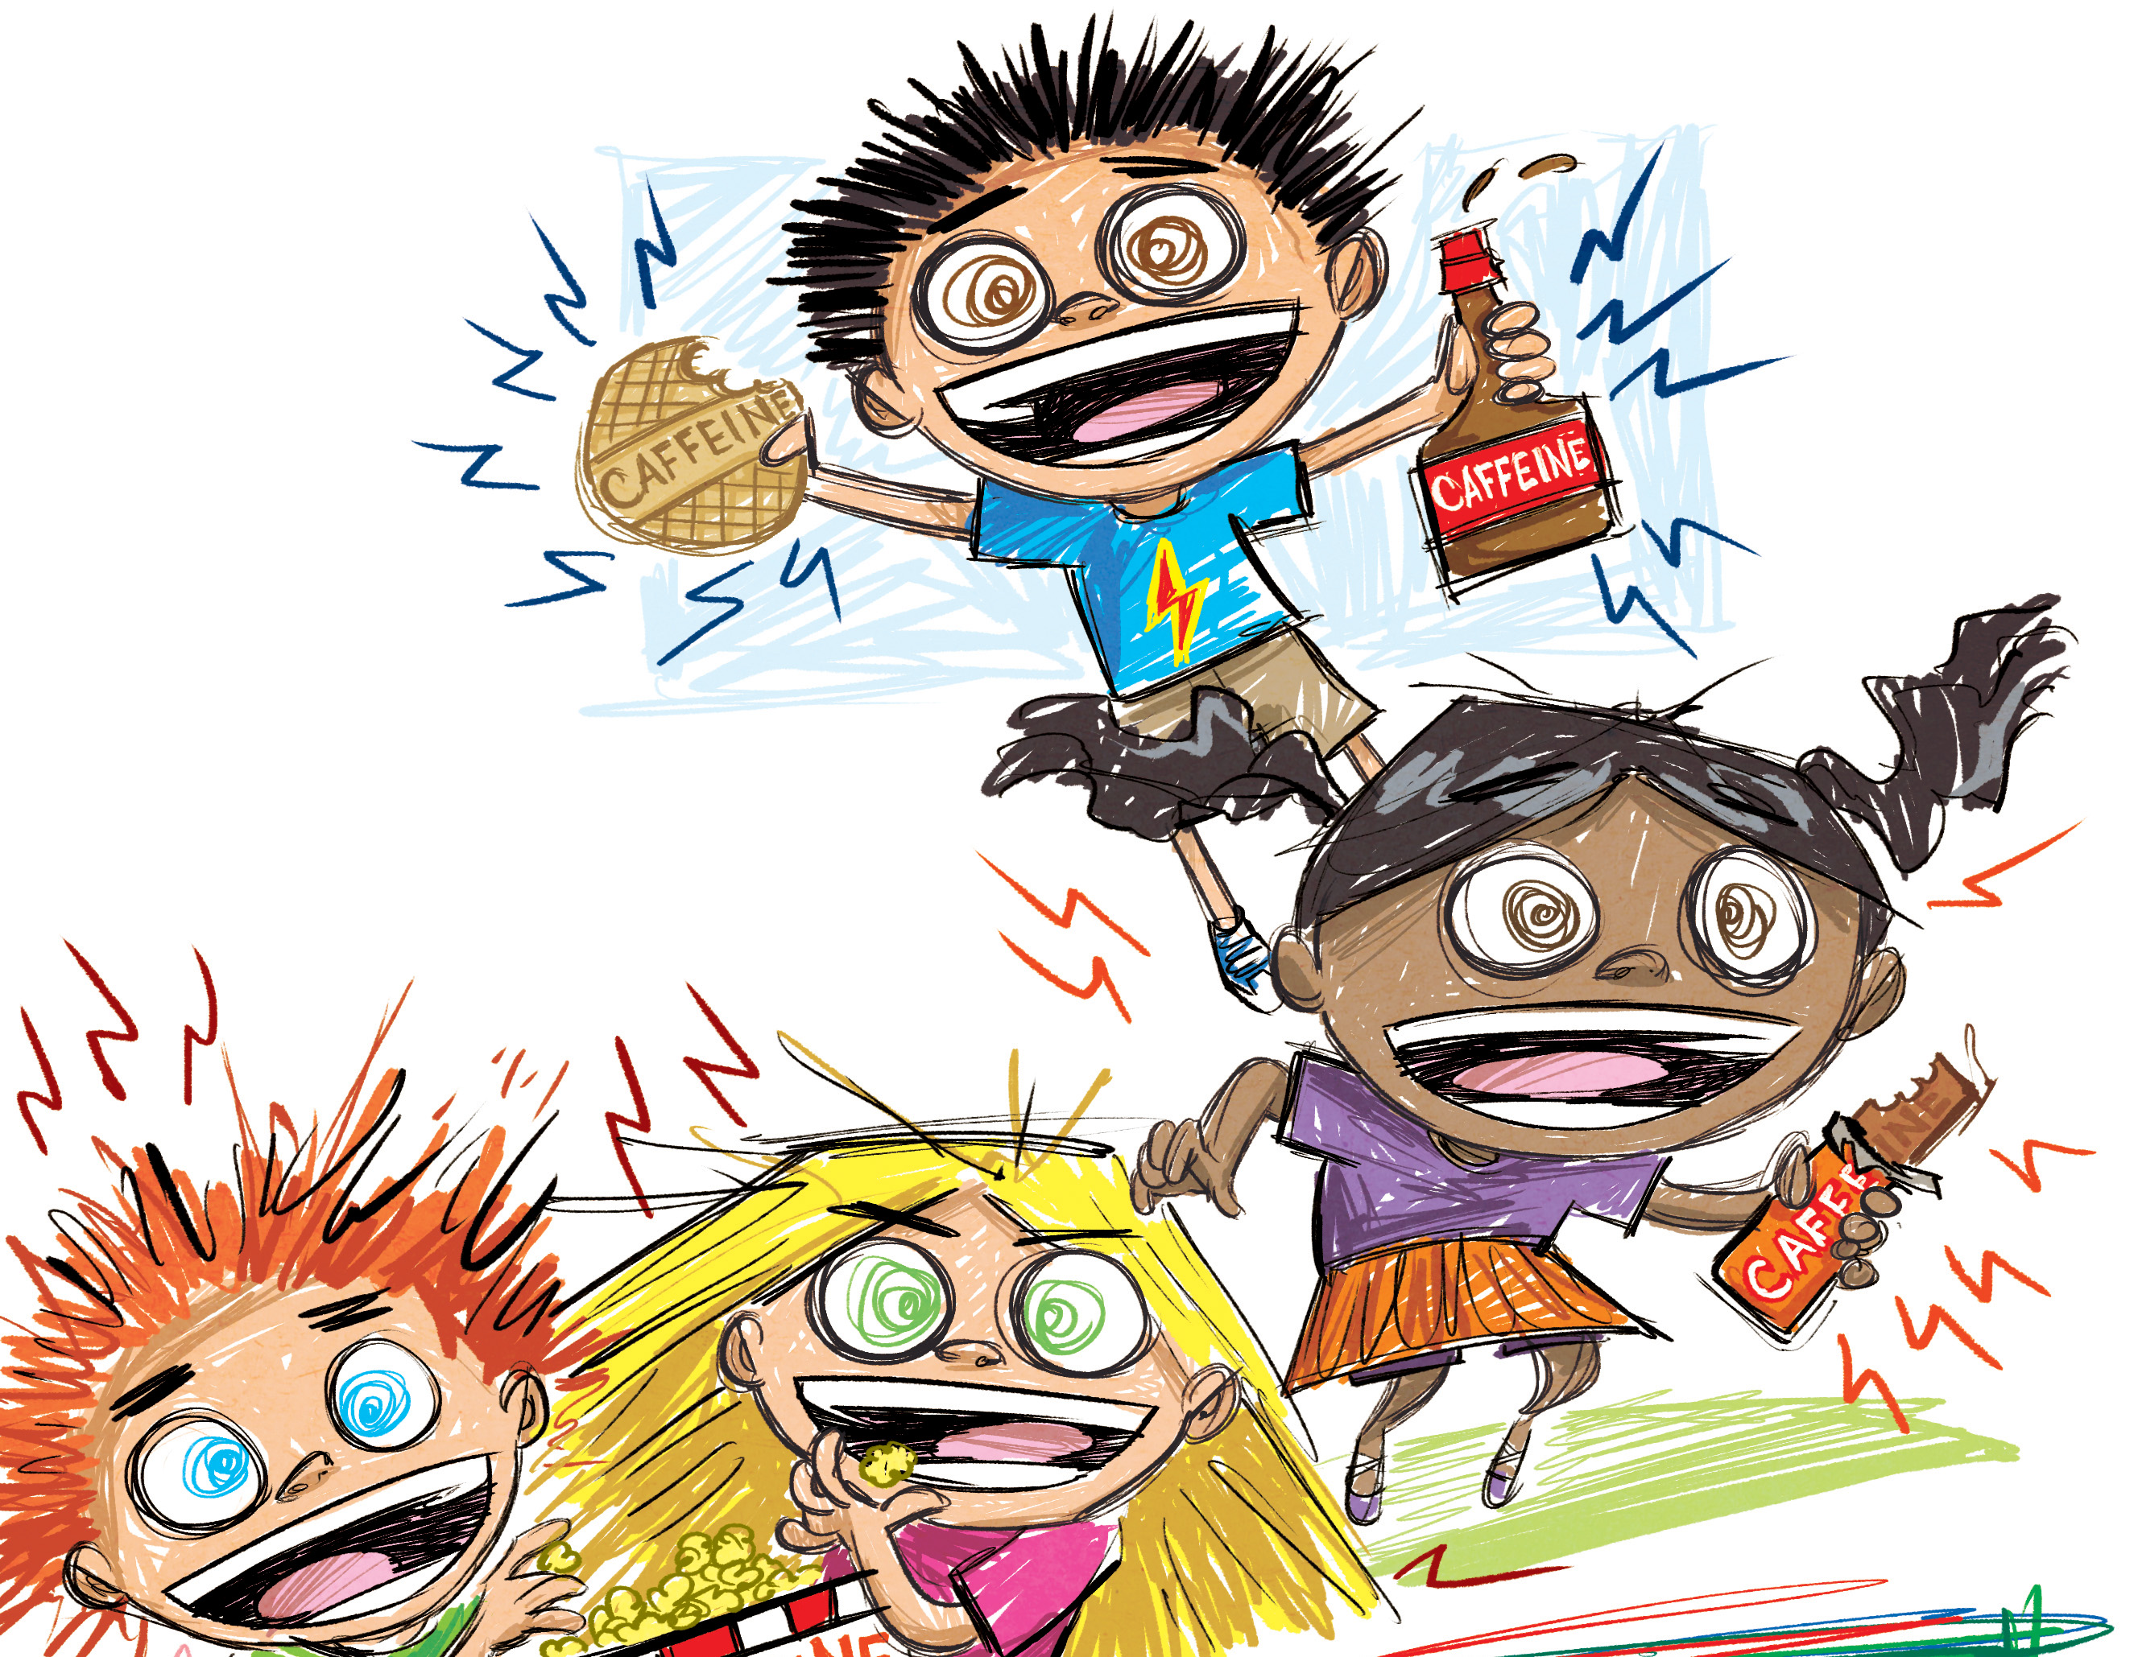
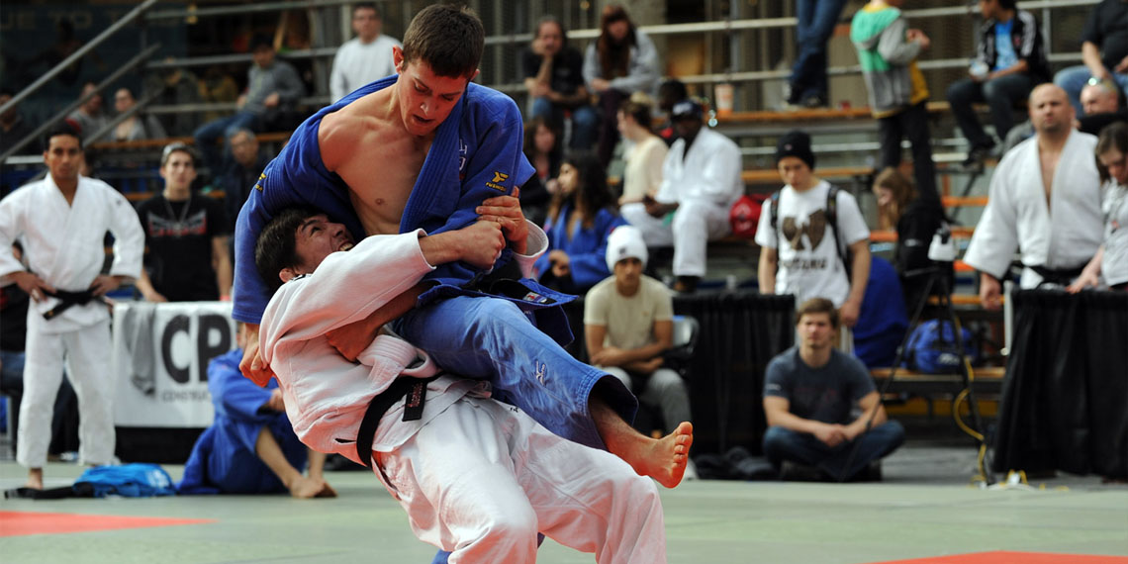
How was the research different and similar?
Different goals and objectives
Different types of reaction time
Different populations
Notes:
1. These studies examined different populations, they had in many cases very different goals and objectives, and there were multiple different types of reaction time among the 14 studies, although in every case, the times were comparable to simple reaction time.

Slide 10

Evaluating the results
Pearson’s r weighted by sample size
853 participants
R=0.18
What does this mean?
Notes:
To evaluate the effects reported in these studies, I used a statistical model and converted each reported effect to a Pearson’s r value, then weighted the results by sample size. There was a total of 853 participants for the studies surveyed and a significant margin of that came from only a few studies with participant numbers in the hundreds.
The highest r value from any of the studies was very strong at 0.82, while the lowest r value for any of the studies was -0.16. Most of the results clustered around the upper 0.10s. The weighted mean for the effect size was 0.18, which is quite a small effect, but not nothing.

Slide 11
Caffeine’s effect on reaction time
It’s often assumed that some effect of caffeine on reaction time should exist
Effect size of only 0.18, weak to moderate
There is at least some effect but it’s not much
The largest studies adhere very closely to this figure
Notes:
1. After all the hype and mythology surround it, the final result was that the real impact of caffeine on reaction time is only marginal, and two of the selected studies actually reported caffeine making reaction times worse, which is surprising considering how amenable simple reaction time is to capture in typical laboratory conditions. Other factors related to alertness might not be nearly as simple to quantify, so it is strange that the effect of caffeine would be so minimal.

Slide 12
What does this mean
To begin with, if you want to increase your srt, caffeine is not necessary
But this is on an alertness factor that’s very easy to quantify
Caffeine may not have that great an effect on mental processes at all, and the difference is primarily in heightened mood rather than increased alertness.
Notes:
1. Of course, this analysis is only concerning simple reaction time, one aspect of alertness. Other factors that make up alertness might be much more heavily impacted by caffeine consumption. However, these studies revealed that for certain reaction time tasks where people commonly cite caffeine as an aid, while confirming that there is a small amount of benefit, that benefit is not a given and sometimes consuming caffeine may be less effective than consuming nothing.

