Slide 1
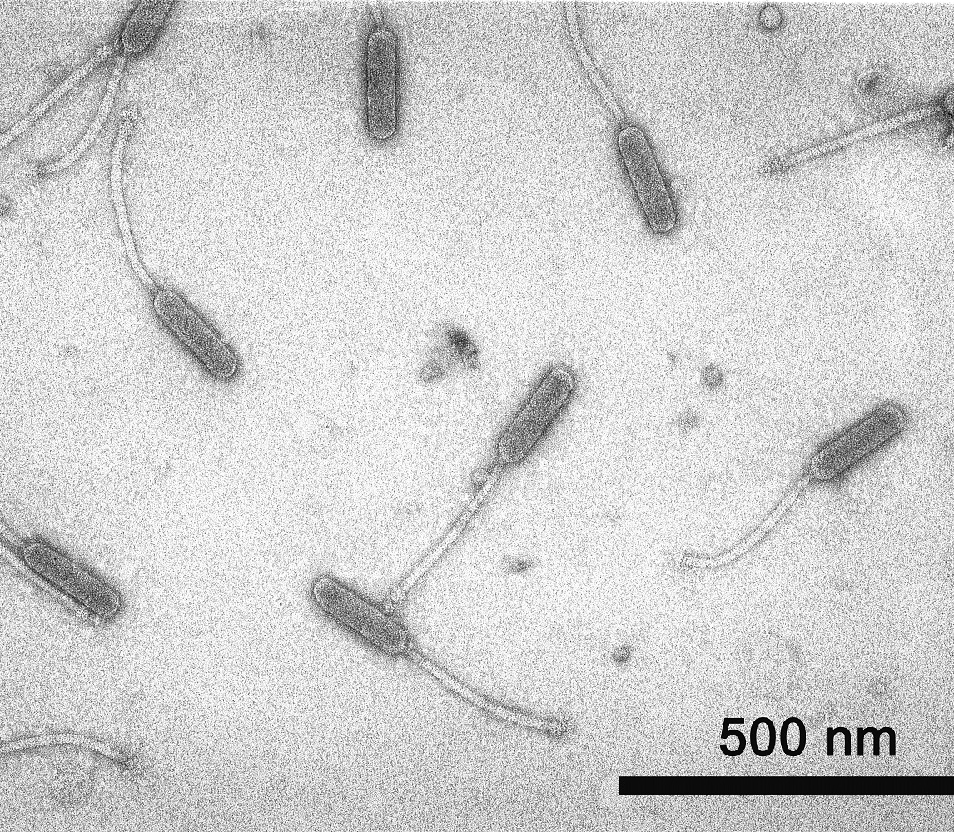
Functional characterization of Mycobacterium smegmatis phage MooMoo gene products: identification of toxic genes
Whitney Heard

Slide 2
Background: Premise of research
MooMoo is a singleton temperate bacteriophage that was isolated and propagated on Mycobacterium smegmatis
Previous studies: Characterization of the unique properties of mycobacteriophage MooMoo
Functional characterization can elucidate phage-encoded gene toxicity
Identify gene function
Possible interactions with host machinery
Why is this important?
New approach in understanding both mycobacterial host interactions and identifying potential new drug targets
Emergence of multi-drug resistant bacterial strains requires new and alternative treatment options to antibiotics

Slide 3
Questions/hypothesis
Does MooMoo encode for genes that are toxic to Mycobacterium smegmatis cells?
Can MooMoo ‘target genes’ be characterized to determine which host gene(s) is/are interacting with the phage proteins?

Slide 4
Methodology overview
Choose genes of interest
Amplification, verification, and purification of targeted genes
Cloned a gene into an expression vector by isothermal assembly
Recovery of desired clones in Escherichia coli
Verification and purification of the plasmid construct from clones
Moved the desired clones in Mycobacterium smegmatis
Identification of mycobacteriophage toxic genes
1
2
3
4
5
6
7

Slide 5
Genes of interest
Gene name | Gene length, bp
MooMoo 87 | 654
MooMoo 88 | 327
MooMoo 89 | 165
MooMoo 90 | 120
MooMoo 91 | 111

Slide 6
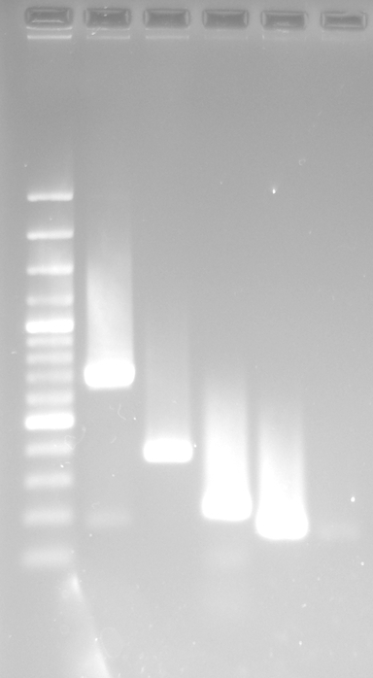
Amplification, verification, and purification of target genes
L
1
2
3
4
5
Lane | Gene name | Expected amplicon size (bp) | DNA Concentration (ng/ul) | 260/280 value
1 | MooMoo 87 | 700 | 53.0 | 1.94
2 | MooMoo 88 | 373 | 51.8 | 1.79
3 | MooMoo 89 | 211 | 57.3 | 1.82
4 | MooMoo 90 | 166 | 52.7 | 1.74
5 | MooMoo 91 | 157 | ~18.6 | 1.53
bp
3000
1500
1000
500
300
100
Gene specific primers
Ladder (L): 100bp marker NEB
DNA fragment
Insert DNA with homologous sequences

Slide 7
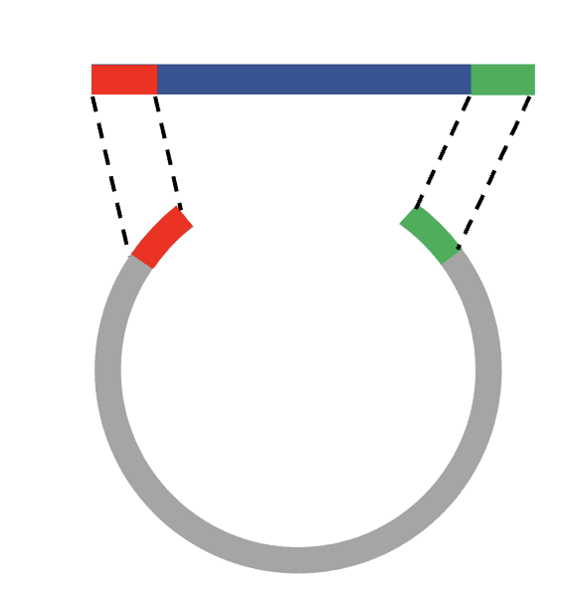
Isothermal assembly and recovery of desired clones in Escherichia coli
Linearized pExTra vector
Assembled plasmid ready for transformation
Clones ready for downstream application
Isothermal assembly
Insert DNA with overlapping ends
Notes:
The enzymatic mixture for isothermal ligation consists of an exonuclease, thermophilic DNA ligase, and thermophilic proofreading DNA polymerase
When the exonuclease is added to the DNA inserts, it digests the double-stranded DNA from its 5’ ends at high temperatures.
The reaction is inactivated at 50°C, resulting in 5’ single-stranded ends without completely degrading either DNA strand.
The DNA polymerase fills the resulting gaps with high-fidelity, and the thermophilic DNA ligase fuses the fragments together.
pExTra plasmid DNA is mixed with NEB 5-alpha F’Iq E. coli competent cells.
Bacteria transformed with plasmid DNA are readily selected based on Kanamycin resistance conferred by the plasmid
Bacterial cells are allowed to grow which begins expressing the antibiotic resistance gene
Plated cells that are transformed survive, resulting in colony growth

Slide 8
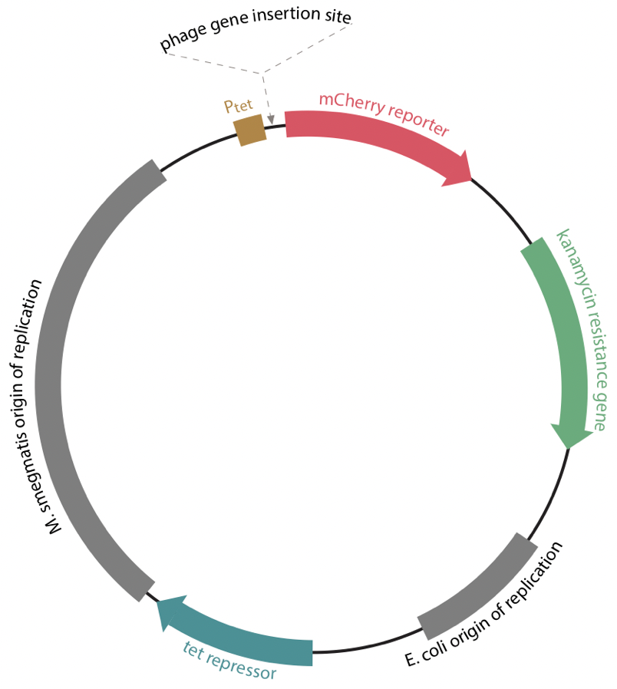
pExtra vector

Slide 9
Verification of clones
Lane | Gene name | Candidate (A, B, C) | Expected amplicon size (bp) | Plasmid Name
1 | MooMoo87 | A | 762 | pExTraMooMoo87
2 | MooMoo87 | B | 762
3 | MooMoo87 | C | 762
4 | MooMoo88 | A | 435 | pExTraMooMoo88
5 | MooMoo88 | B | 435
6 | MooMoo88 | C | 435
7 | MooMoo89 | A | 273 | pExTraMooMoo89
8 | MooMoo89 | B | 273
9 | MooMoo89 | C | 273
10 | MooMoo90 | A | 228 | pExTraMooMoo90
11 | MooMoo90 | B | 228
12 | MooMoo90 | C | 228
13 | MooMoo91 | A | 219 | pExTraMooMoo91
14 | MooMoo91 | B | 219
15 | MooMoo91 | C | 219
bp
3000
1500
1000
500
300
100
5’
……………atgcggaggaatcacttccat
………………………………….……………………………….
3’
3’
…………………………………………………..................
cagctgtgagctcagcctaggacgt…………
5’
Linearized plasmid construct

Slide 10
Moved the desired clones into Mycobacterium Smegmatis

Slide 11
Identification of mycobacteriophage toxic genes

Slide 12
Images taken after 3 days at 37 ºC
-
+
1
2
3
-
+
1
2
3
-
+
1
2
3
Dilution
factor
10⁰
10⁻¹
10⁻²
10⁻³
10⁻⁴
10⁻⁵
0 ng/ml aTc
10 ng/ml aTc
100 ng/ml aTc
Column | Plasmid name | Gene name | Toxic/Non-toxic | Colony color on 100 ng/ml aTc plate*
- Non-toxic control | pExTra03 | Fruitloop 52 mutant | Non-toxic | +
+ Toxic control | pExTra02 | Fruitloop 52 | Toxic | -
1 | pExTraMooMoo87 | MooMoo 87 replicate 1 | Toxic | -
2 | pExTraMooMoo87 | MooMoo 87 replicate 2 | Toxic | -
3 | pExTraMooMoo87 | MooMoo 87 replicate 3 | Toxic | -
*Key: NG (no growth) - (no pink color) +(faint pink color) ++(obvious pink color) +++ (dark pink color)

Slide 13
Images taken after 5 days at 37 ºC
-
+
1
2
3
-
+
1
2
3
-
+
1
2
3
Dilution
factor
10⁰
10⁻¹
10⁻²
10⁻³
10⁻⁴
10⁻⁵
0 ng/ml aTc
10 ng/ml aTc
100 ng/ml aTc
Column | Plasmid name | Gene name | Toxic/Non-toxic | Colony color on 100 ng/ml aTc plate*
- Non-toxic control | pExTra03 | Fruitloop 52 mutant | Non-toxic | +
+ Toxic control | pExTra02 | Fruitloop 52 | Toxic | -
1 | pExTraMooMoo87 | MooMoo 87 replicate 1 | Toxic | +++
2 | pExTraMooMoo87 | MooMoo 87 replicate 2 | Toxic | +++
3 | pExTraMooMoo87 | MooMoo 87 replicate 3 | Toxic | +++
*Key: NG (no growth) - (no pink color) +(faint pink color) ++(obvious pink color) +++ (dark pink color)

Slide 14
Conclusion
Determined that 2 genes demonstrated toxicity
Gene 87 showed the strongest phenotype
Awaiting sequence verification of plasmid with gene insert 87

Slide 15
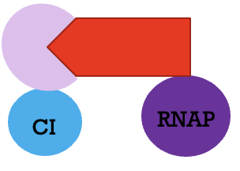
Future Work
$$p2Hα$$
plasmid
Plac*
$$α domain$$
gene of interest
E. coli OoR
Spectinomycin
Resistance
$$pCI$$
plasmid
Plac*
$$λCI$$
M. Smegmatis gene
E. coli OoR
Chloramphenicol
Resistance
In the presence of IPTG
+
Phage protein
Host lysate protein
Protein-protein interaction

Slide 16
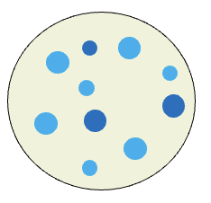
Future Work
bla
lacZ
Antibiotic resistance and lactose reporter genes
Selection plate

Slide 17
Acknowledgments
I would like to thank my advisor, Dr. Rodney King for his continuous guidance throughout my Master’s study and research. I extend my greatest appreciation to Western Kentucky University for providing the opportunity to participate in this research project. I would also like to thank the Distinguished Minority Fellowship program for their support to complete my studies. Lastly, I would like to thank my mother for her unparalleled love, help, and support.

