Slide 1
Characterization of Ligand-Independent p75^{NTR} Signaling and Associated Effects on Neurodegeneration in Parkinson’s Disease
SAMANTHA RADOMSKI, SARAH SPARKS, CASSIDY SPEASE, BROOKE JACKSON, AND BRADLEY KRAEMER

Slide 2
Importance of the Project
Parkinson’s Disease (PD) impacts 7-10 million people worldwide.
PD is a neurodegenerative disease that results in a loss of dopaminergic neurons from the substantia nigra.
A loss of neurons leads to a decrease in dopamine production.
Current treatments improve symptoms but do not prevent the underlying neurodegeneration.

Slide 3
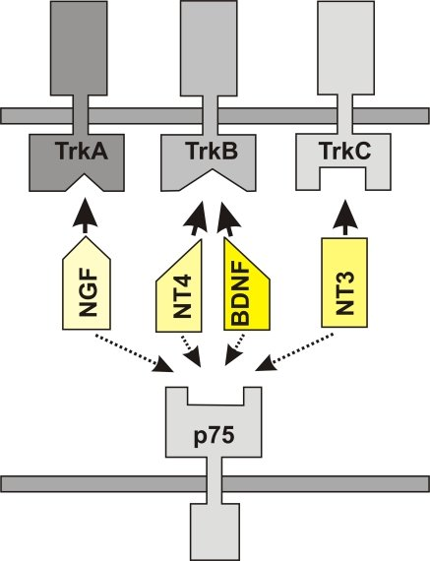
Background
Neurotrophins: family of proteins that regulate cell growth and survival.
brain-derived neurotrophic factor (BDNF)
nerve growth factor (NGF)
neurotrophin-3 (NT3)
neurotrophin-4 (NT4)
P75^{NTR} is a transmembrane protein associated with neurodegeneration.
Roles of p75^{NTR} in PD-related neurodegeneration are poorly understood.
Image source: Halbach O. 2010. Involvement of BDNF in Age-Dependent Alterations in the Hippocampus. Front Aging Neurosci 2:1-11.

Slide 4
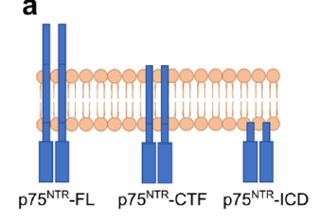
Process of Cleavage
Full length p75^{NTR} is cleaved by an enzyme to release the extracellular domain.
A second enzymatic cleavage event liberates the intracellular domain (ICD).
The ICD promotes downstream signaling.
Image source: Kraemer B, Clements R, Escobedo CM, Nelson K, Waugh CD, Elliott A, Hall W, Schemanski M. 2021. c-Jun N-terminal Kinase Mediates Ligand-Independent p75^{NTR} Signaling in Mesencephalic Cells Subjected to Oxidative Stress. Neuroscience 453:222-236.

Slide 5
Recent Discoveries from Our Lab
Dopaminergic cells express p75^{NTR1}
P75^{NTR} is cleaved in response to oxidative stress¹
Oxidative stress promotes ligand-independent p75^{NTR} signaling²
1. Kraemer B, Clements R, Escobedo CM, Nelson K, Waugh CD, Elliott A, Hall W, Schemanski M. 2021. c-Jun N-terminal Kinase Mediates Ligand-Independent p75^{NTR} Signaling in Mesencephalic Cells Subjected to Oxidative Stress. Neuroscience 453:222-236.
2. Kraemer BR, Snow J, Vollbrecht P, Pathak a, Valentine W, Deutch A, Carder BD. 2014. A role for the p75 neurotrophin receptor in axonal degeneration and apoptosis induced by oxidative stress. J Biol Chem 289(31):21205-21216.

Slide 6
Aims
Aim One: Characterization of p75^{NTR} signaling in cell culture models of PD associated with oxidative stress
Subaim 1A: Evaluate the presence of p75^{NTR} co-receptors in dopaminergic cells
Subaim 1B: Evaluate the role of rotenone on p75^{NTR} proteolysis in cultured cells
Aim Two: Investigating the effects of p75^{NTR} signaling on neurodegeneration associated with PD
Subaim 2A: Optimize a protocol for modeling PD in mice
Subaim 2B: Investigate the role of p75^{NTR} on dopaminergic neurodegeneration

Slide 7
Aim One
Characterization of p75^{NTR} Signaling in Cell Culture Models of PD Associated with Oxidative Stress

Slide 8
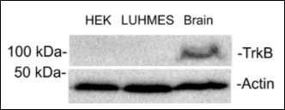
Subaim 1A: TrkB is Expressed in Dopaminergic Cells
Figure 1
HEK293: negative control
Whole brain: positive control
LUHMES: Experimental condition
Actin: Loading control.

Slide 9
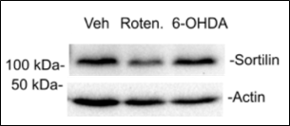
Subaim 1A: Sortilin is Expressed in Dopaminergic Cells
Figure 2
Lane 1: Vehicle
Lane 2: 1 micromolar rotenone treatment
Lane 3: 7.5 micromolar 6-OHDA treatment
Actin: Loading control

Slide 10
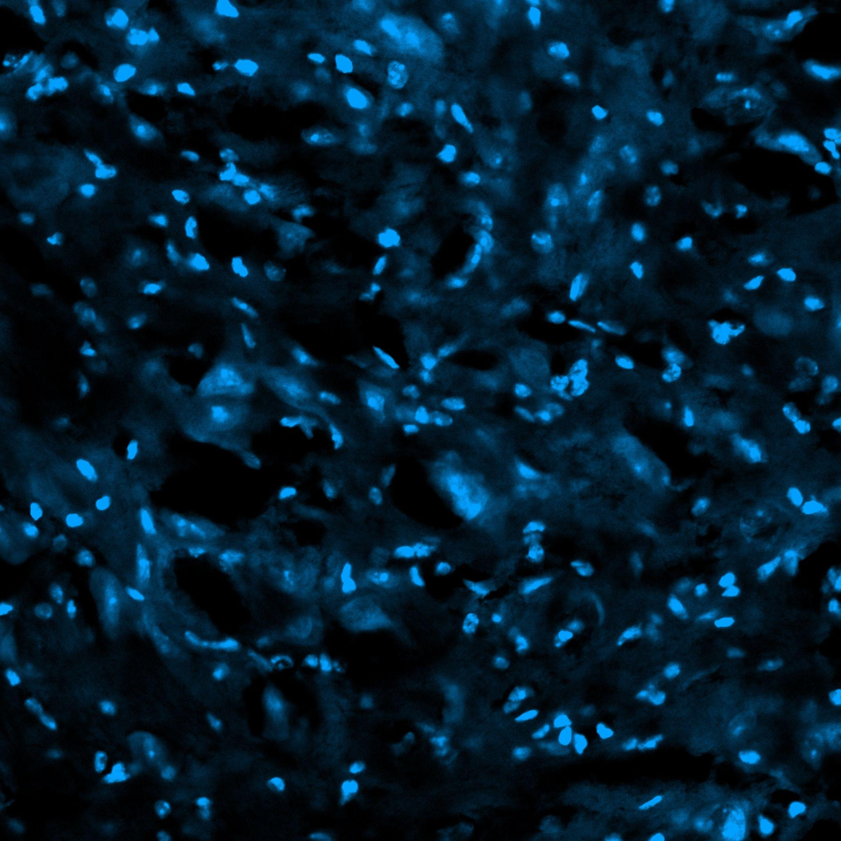
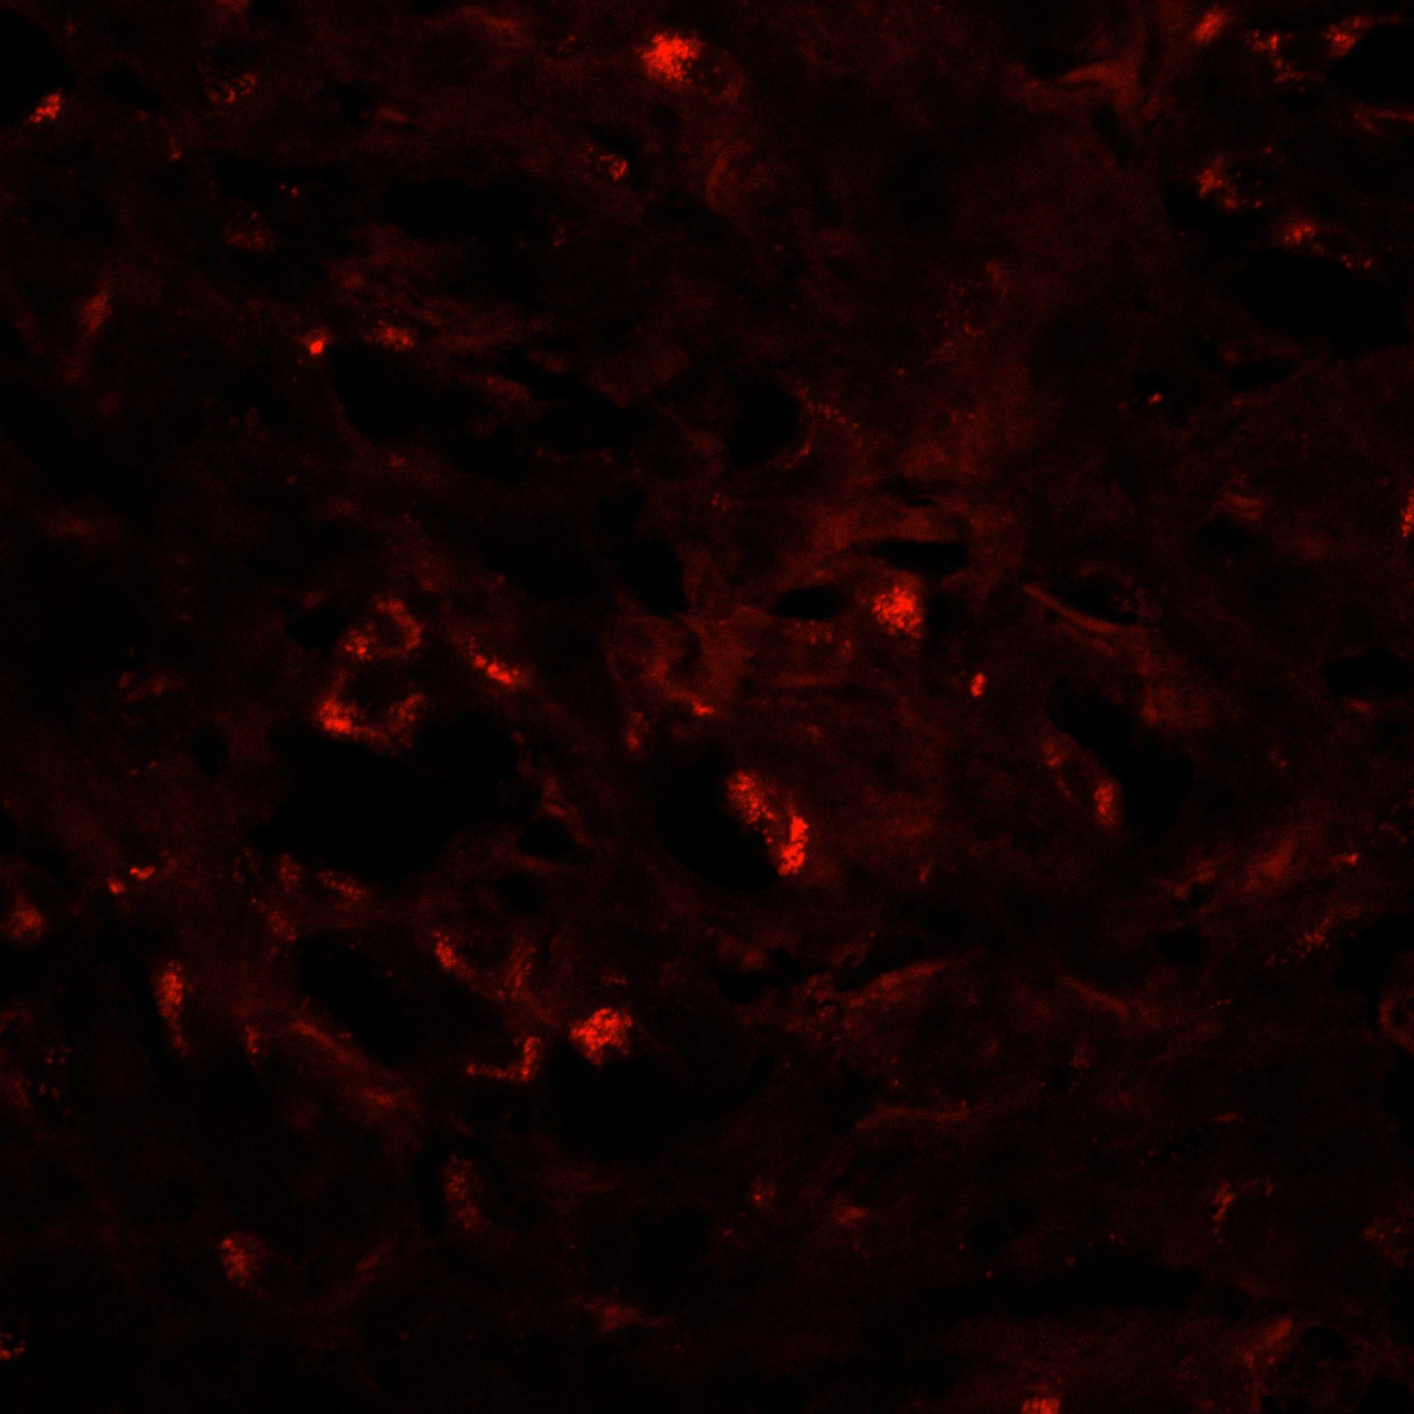
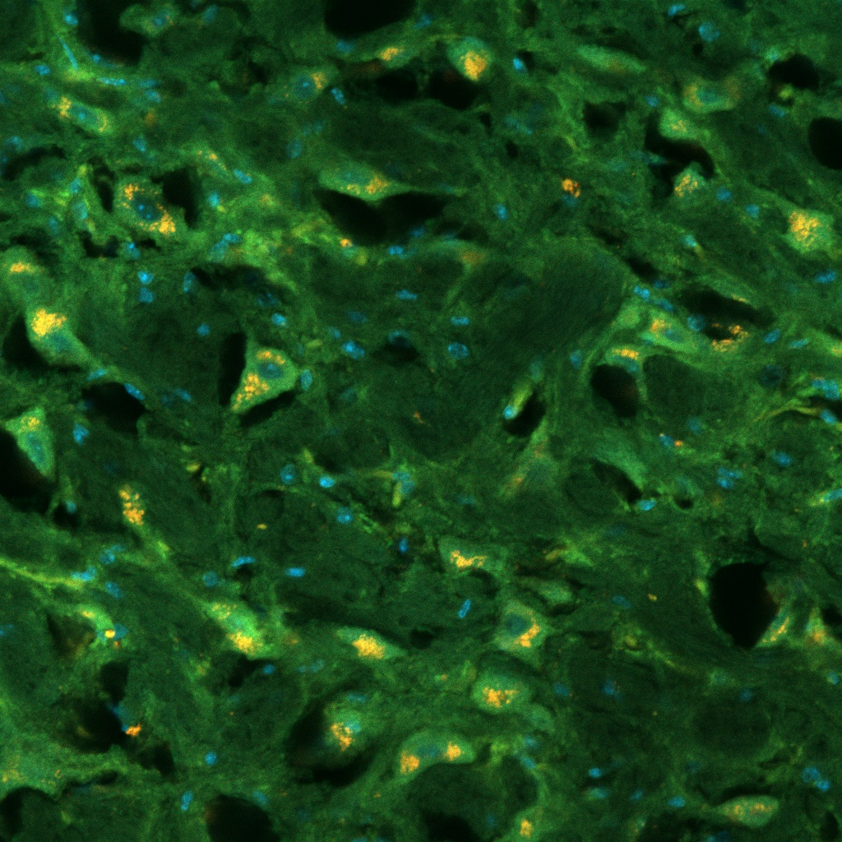
Subaim 1A: Sortilin is Expressed in Dopaminergic Cells (in vivo)
Figure 3A
Blue: DAPI staining
Figure 3B
Red: TH staining
Figure 3C
Yellow: Overlay of staining

Slide 11
Subaim 1B: Rotenone Induces p75^{NTR} Proteolysis
Rotenone induces oxidative stress in cell cultures.
Rotenone serves as a different chemical model of PD.
Rotenone forms Lewy bodies.
Utilizing a rotenone model improves the integrity of the study and validates the results.

Slide 12
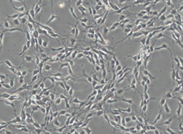
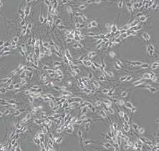
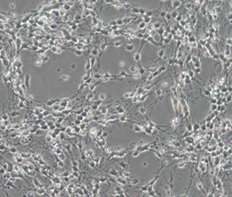
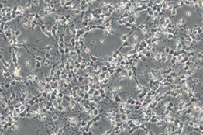
Subaim 1B: Rotenone Induces p75^{NTR} Proteolysis
Figure 4A
Pre-treatment condition of LUHMES cells
Figure 4B
Vehicle condition of LUHMES cells
Figure 4C
1 micromolar rotenone treatment of LUHMES cells
Figure 4D
10 micromolar rotenone treatment of LUHMES cells

Slide 13
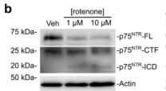
Subaim 1B: Rotenone Induces p75^{NTR} Proteolysis
Figure 5
Lane 1: Vehicle
Lane 2: 1 micromolar rotenone treatment
Lane 3: 10 micromolar rotenone treatment
Actin: loading control

Slide 14
Aim Two
Investigating the Effects of p75^{NTR} Signaling on Neurodegeneration Associated with PD

Slide 15
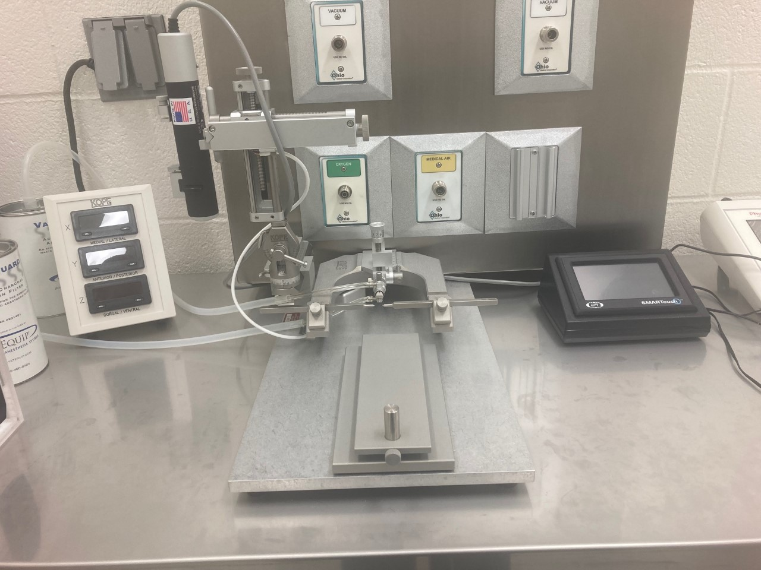
Subaim 2A: Developing a Protocol for Modeling PD in Mice
Wildtype (C57Bl6)
Intrastriatal injections with rotenone and 6-OHDA
Timepoints at 3 weeks, 1 week, and 3 days
Bregma coordinates:
anterior-posterior: +0.5 mm
medial-lateral: - 1.9 mm
dorsal-ventral: +3.5 mm
Image source: Stereotaxic rig in the Kraemer lab (surgical suite)

Slide 16
Subaim 2A: Developing a Protocol for Modeling PD in Mice
Figure 6
Comparison between uninjected and 6-OHDA injected hemispheres
Comparison between uninjected and rotenone injected hemispheres

Slide 17
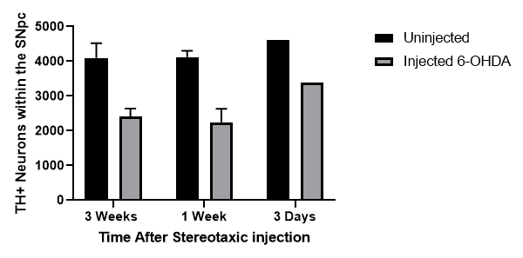
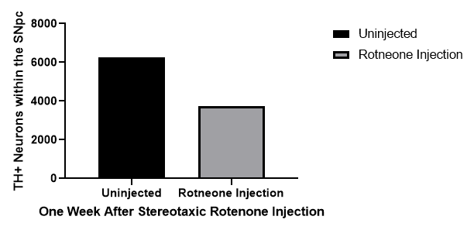
Subaim 2A: Developing a Protocol for Modeling PD in Mice
Figure 7
Quantification of TH+ cells
Studies conducted with 6-OHDA and rotenone treatments

Slide 18
Subaim 2A: Developing a Protocol for Modeling PD in Mice
Figure 8
Immunofluorescence TH staining of the striatum.

Slide 19
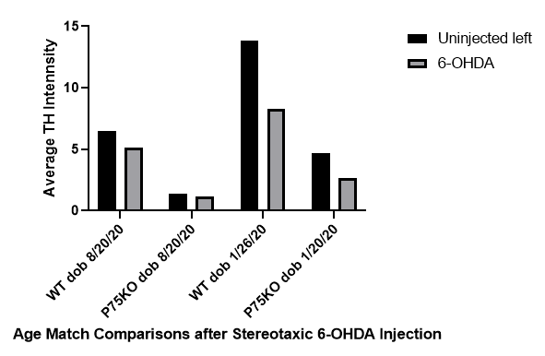
Subaim 2B: Investigating the Role of p75^{NTR} on Dopaminergic Neurodegeneration
Figure 9
Quantification of the average TH intensity of striatum tissue.

Slide 20
Conclusions from Preliminary Data
The p75^{NTR} co-receptor trkB is not expressed in dopaminergic cells from the ventral midbrain.
The p75^{NTR} co-receptor sortilin is expressed in dopaminergic cells from the ventral midbrain.
The p75^{NTR} may contribute to dopaminergic neurite degeneration associated with oxidative stress.
The p75^{NTR} may play a developmental role regulating dopaminergic innervation of the striatum.
Completion of this work will lead to novel insight into the impact of specific p75^{NTR} signaling mechanisms on neurodegeneration associated with PD.

Slide 21
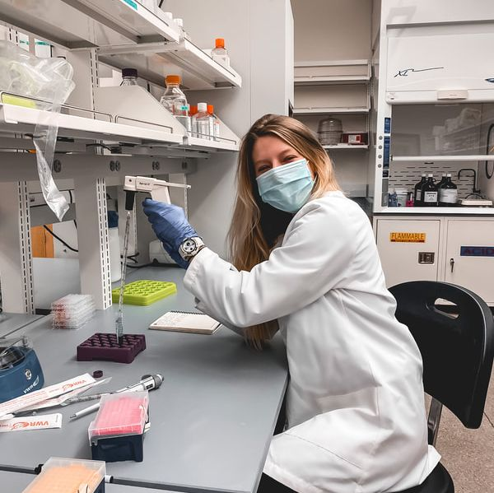
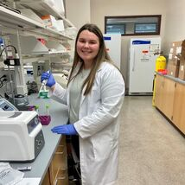
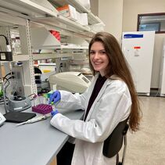
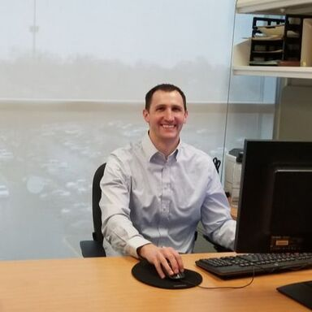
Acknowledgement and Funding
Left: Sarah Sparks
Left: Cassidy Spease
Left: Brooke Jackson
Left: Dr. Bradley Kraemer
This work was supported by the Kentucky Biomedical Research Infrastructure Network (KBRIN) [ULRF-13-1493C-04 and ULRF-13-1493B-01]; the National Institute of General Medical Sciences NIGMS [8P20GM103436-14], and the Battelle-EKU Science Scholars Program.

