Slide 1
Synthesis of precursors for an asymmetric amide-substituted phenylethynyl-[m]4-oxacalixaerene
Author: Connor Stahl
Co-author: KC Russell

Slide 2
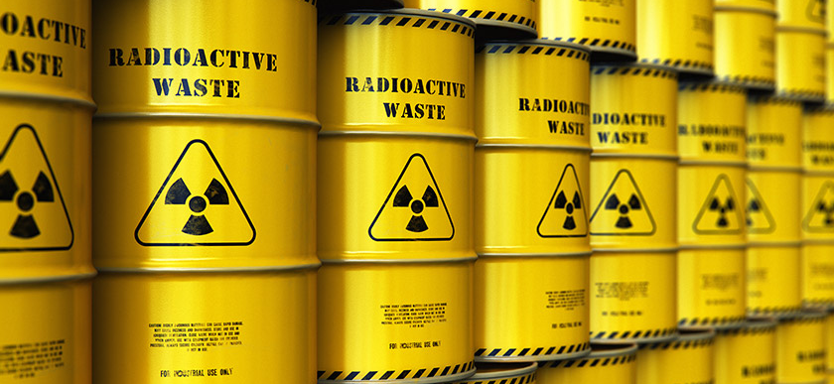

Introduction
Annulene and oxacalixarene compounds have proven to show importance in their applications ranging from energy storage to nuclear waste treatment.
The synthesis of new annulene-oxacalixerene hybrids provides the pathway to the discovery of new, real-world applications.
Annulene-oxacalixerene hybrids provide unique chemical structures that can be examined through nuclear magnetic resonance (NMR) spectroscopy
The goal was to synthesize an asymmetric oxacalixarene with amide side chains

Slide 3
Target Oxacalixarene structure

Slide 4
Methods
Scheme 1: Synthesis of 1,2-bis(OTBS)-4,5-diiodobenzene

Slide 5
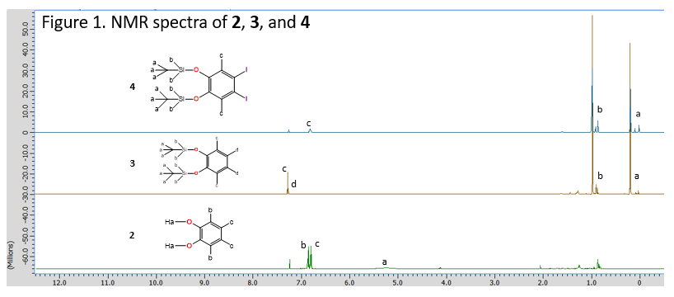
NMR Spectra

Slide 6
Methods
Scheme 2: Synthesis of N-(4-Iodophenyl)acetamide

Slide 7
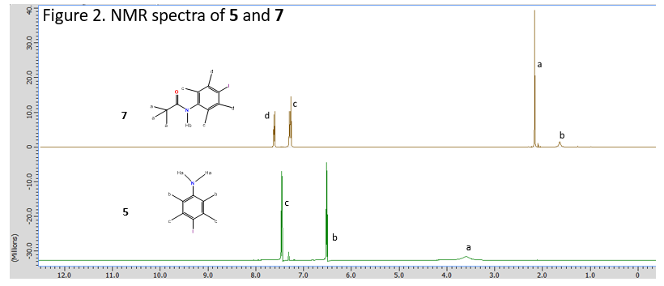
NMR Spectra

Slide 8
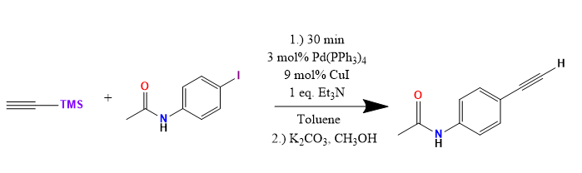
Methods
Scheme 3: Synthesis of TMS-Acetylene
10
7
11

Slide 9
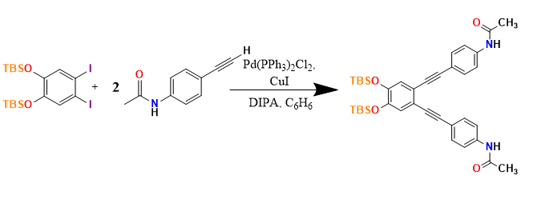

Methods
Scheme 4: Synthesis of Amide Side Chain
4
12

Slide 10
Methods
Scheme 5: Synthesis of 1,2-bis(6-chloropyrazin-2-yloxy)benzene

Slide 11
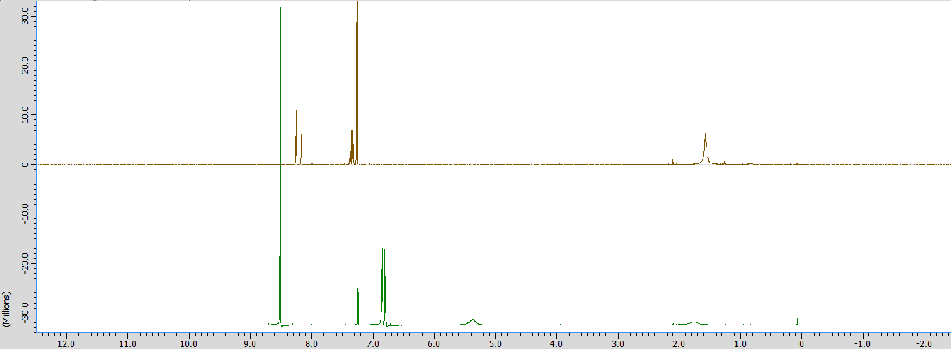


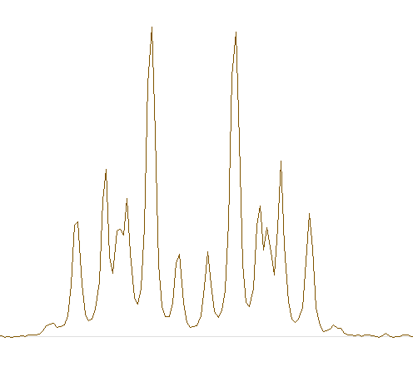
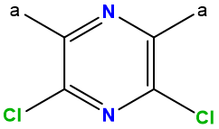
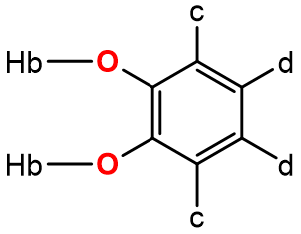


NMR Spectra
Figure 3. NMR spectra of 9, 8, and 2
9
d
c
8
a
2
b

Slide 12
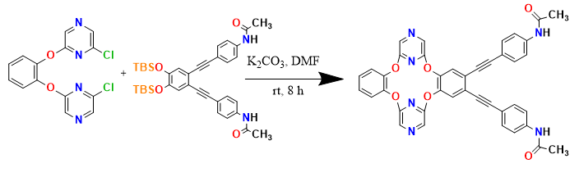

Methods
Scheme 6: Synthesis of target oxacalixarene
9
1

Slide 13
Conclusion
The final target oxacalixarene was not synthesized
NMR spectra suggested that the correct products were formed from each reaction
The next step of the synthesis will be to use the substituted catechol derived from 4 and 7 to make an asymmetric oxacalixarene by reaction with 9.

Slide 14
References
1) Yang, H.; Liu, Z.; Zhang, W. Adv. Syn. & Catal. 2013, 355 (5), 885-890.
2) Bian L, Yang D, Yin L, Zhang J, Tang W, Macromol. Chem. Phys. 2013, 214 (1), 2136-2143.
3) Ma M, Wang H, Li X, Liu L, Jin H, Wen K, Tetrahedron 2009, 65, 300–304.

Slide 15
Acknowledgments
The authors would like to thank the Northern Kentucky University Center for Integrative Natural Science and Mathematics (CINSAM), The National Science Foundation and ACS Petroleum Research Fund for financial support this project. We would also like to thank the NKU Department of Chemistry and Biochemistry and other members of the Russell Research Group.

