Slide 1
EPIKARST RECHARGE DYNAMICS UNDER AGRICULTURAL LANDUSE USING HYDROMETEOROLOGICAL AND ISOTOPIC TRACERS
AUSTIN SHANE DEERING
Center for Human GeoEnvironmental Studies
Department of Earth, Environmental & Atmospheric Sciences
2021 KAS ANNUAL MEETING
ADVISOR/ MENTOR: DR. JASON POLK
November 6th, 2021

Slide 2
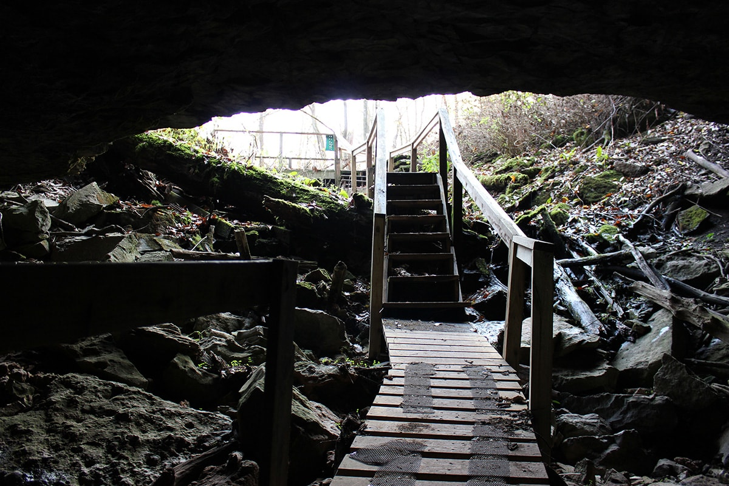
Introduction
Freshwater Preservation
Karst Landscapes
Karst Aquifers: Provide Approximately 25% Global and 40% United States Freshwater Supplies (Quinlan and Ewers 1989; Ford and Williams 2007).
Epikarst Zone: Also known as the subcutaneous zone and Layer of soil and rock interaction
My Research:
- Crumps Cave: Smiths Grove, Kentucky (also known as Pennyroyal Sinkhole Plain) and overlain by agricultural land
- Precipitation and Isotope Analysis 2011-2018 (8-year data set).
Entrance to Crumps Cave. Photo by Brandon Echter.

Slide 3
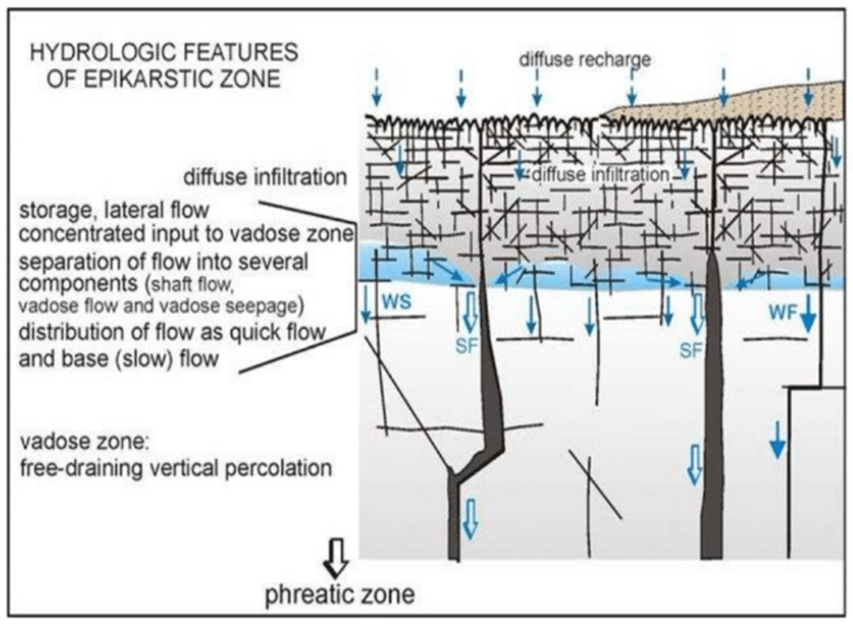
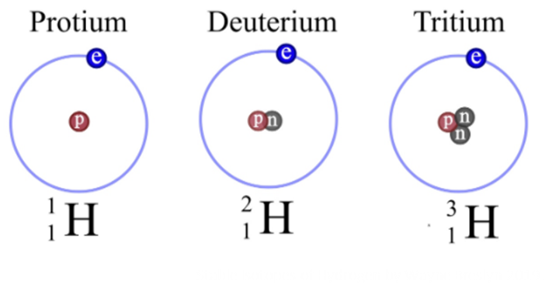
Literature Review
Epikarst: (Klimchouk 2004; Groves et al 2005; Palmer 2007; Williams 2008; Jackson 2017)
-Highly weathered carbonate bedrock with high secondary porosity
-Governed by permeability & porosity of bedrock, type of recharge, and presence of structural deformation
-Upper section vs. lower section of epikarst
-Has become better understood by the use of stable isotope and hydrogeochemical analysis
What are stable isotopes?
-Exist naturally and are non-radioactive
-Versions of a particular element
-Ratios (heavier to lighter) are needed for environmental context
-Ratios are compared to a standard Vienna Standard Mean Ocean Water (VSMOW)
-Different processes affect isotope composition (amount effect, temperature, altitude, relative humidity, evaporation, and latitude)

Slide 4
Literature Review
Some Important Equations:
(Palmer 2007)
Vienna Standard Mean Ocean Water (VSMOW):
Global Meteoric Water Line:
- LMWL indicates evaporative effects from GMWL
- Also points to the source of the water

Slide 5
Literature Review
Recent Geochemical and Isotopic Studies At Crumps Cave:
Vanderhoff (2011), Jackson (2017), Antle (2018):
-How water is transported and stored based on seasonality, storage, antecedent moisture conditions, and the intensity/ or amount of precipitation
-Dye tracing, geochemical analysis, and C isotope analysis
-Storage in soil (clay), epikarst storage model, Lost River chert layer allowing only slow leaky percolation, or water bypassing storage
-What are the thresholds?
The Gaps This Research Aims To Fill:
Understanding the thresholds and scenarios for the primary driving factors behind storage and transport
Previous studies are limited in time
Using isotopes (¹⁸O/¹⁶O) & (²H/¹H)

Slide 6
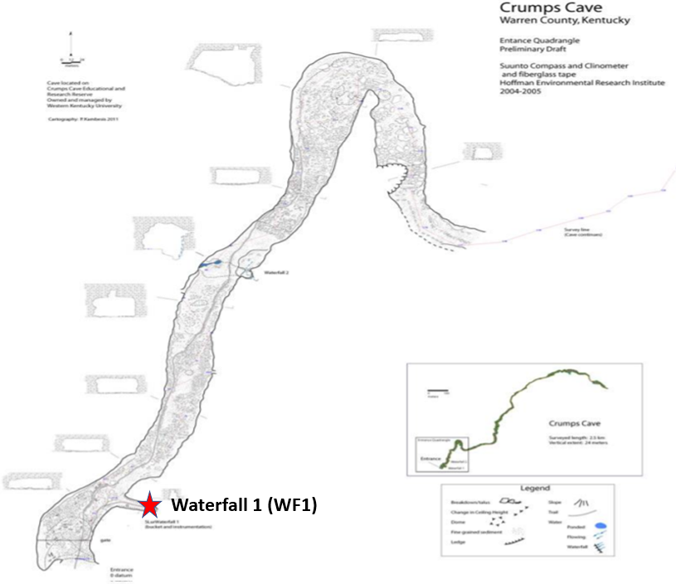
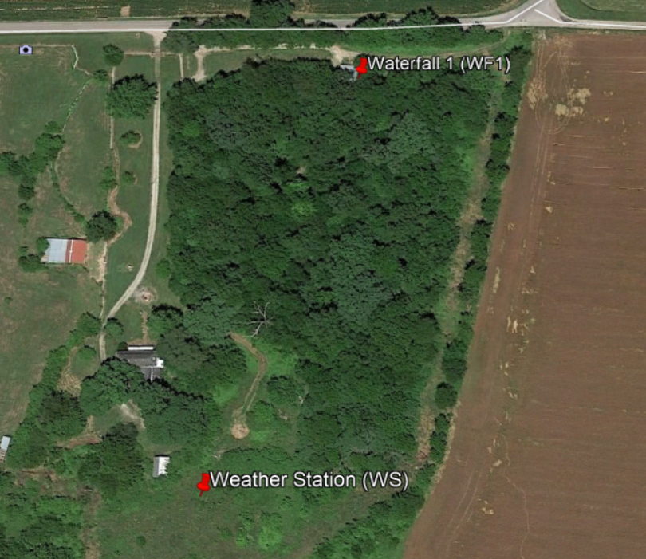
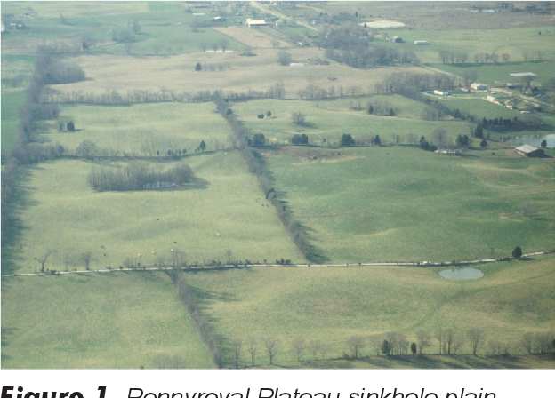
Study Area
Crumps Cave:
Located in south-central Kentucky
Known locally as the Pennyroyal Sinkhole Plain
Measured 2 km horizontally
Average Cave floor depth of 25 meters
Waterfall 1 is located about 30 meters inside cave
Map of Kentucky Showing Karst Potential and Location of Crumps Cave. Created by the Author.
Locations of study sites. Created by author in Google Earth.
Pennyroyal Sinkhole Plain. Groves (2013).
Map of Crumps Cave. Vanderhoff 2011.

Slide 7
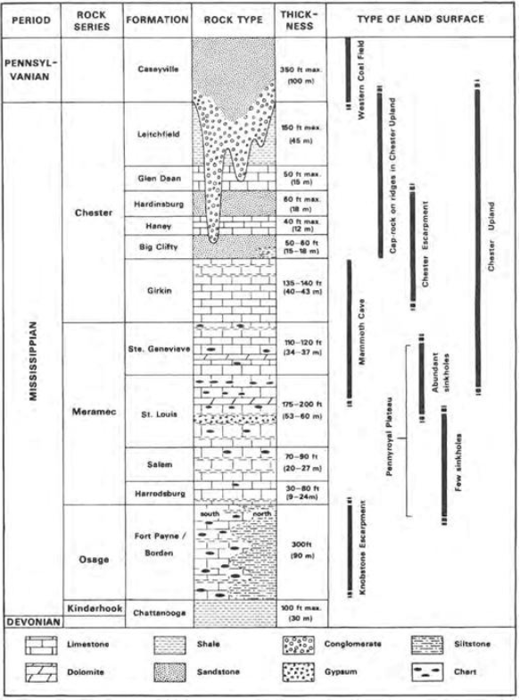
Local Geology, Hydrology, and Climate
Geology & Hydrology
- Mississippian-aged pure St. Louis Limestone
- 1-2° Dip North
- Lost River Chert Layer (between surface and cave ceiling): provides hydrologic control to in-cave epikarstic waterfalls
- Situated within the upstream section of the Graham springs groundwater basin
- Discharges southwest into the Barren River
- The springs have a total recharge area of approximately 316 km² (Jackson 2017)
Climate
- Humid Subtropical based upon Köppen climate classification scale
- Approximately 1200 mm average rainfall; (April-October)
- Average Temperature: 14°C; Ranging 7°C to 31°C
(Vanderhoff 2011)
Stratigraphic Column. (Palmer 1998; 2007).

Slide 8
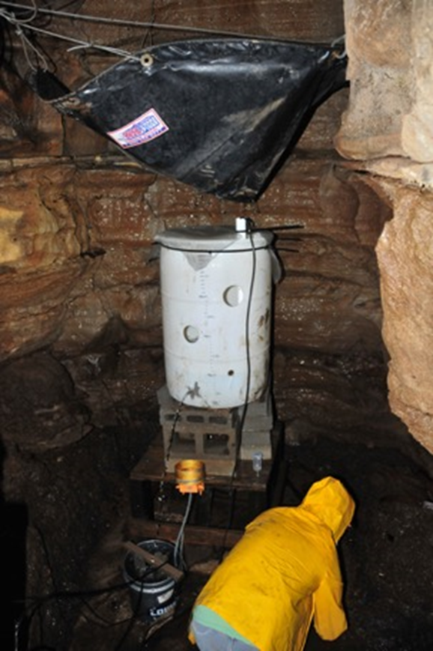
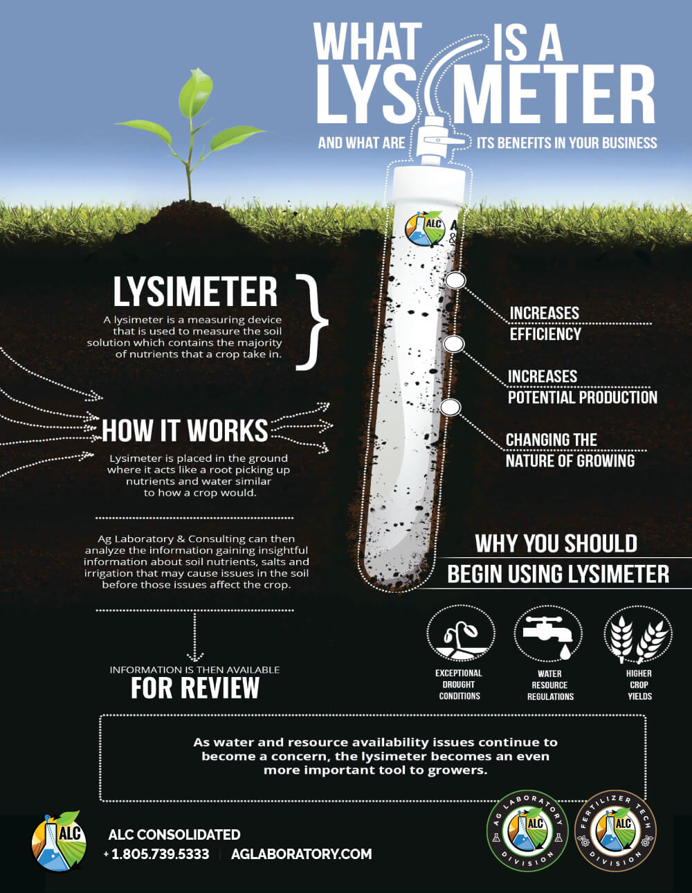
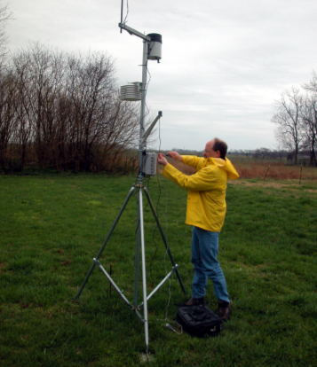
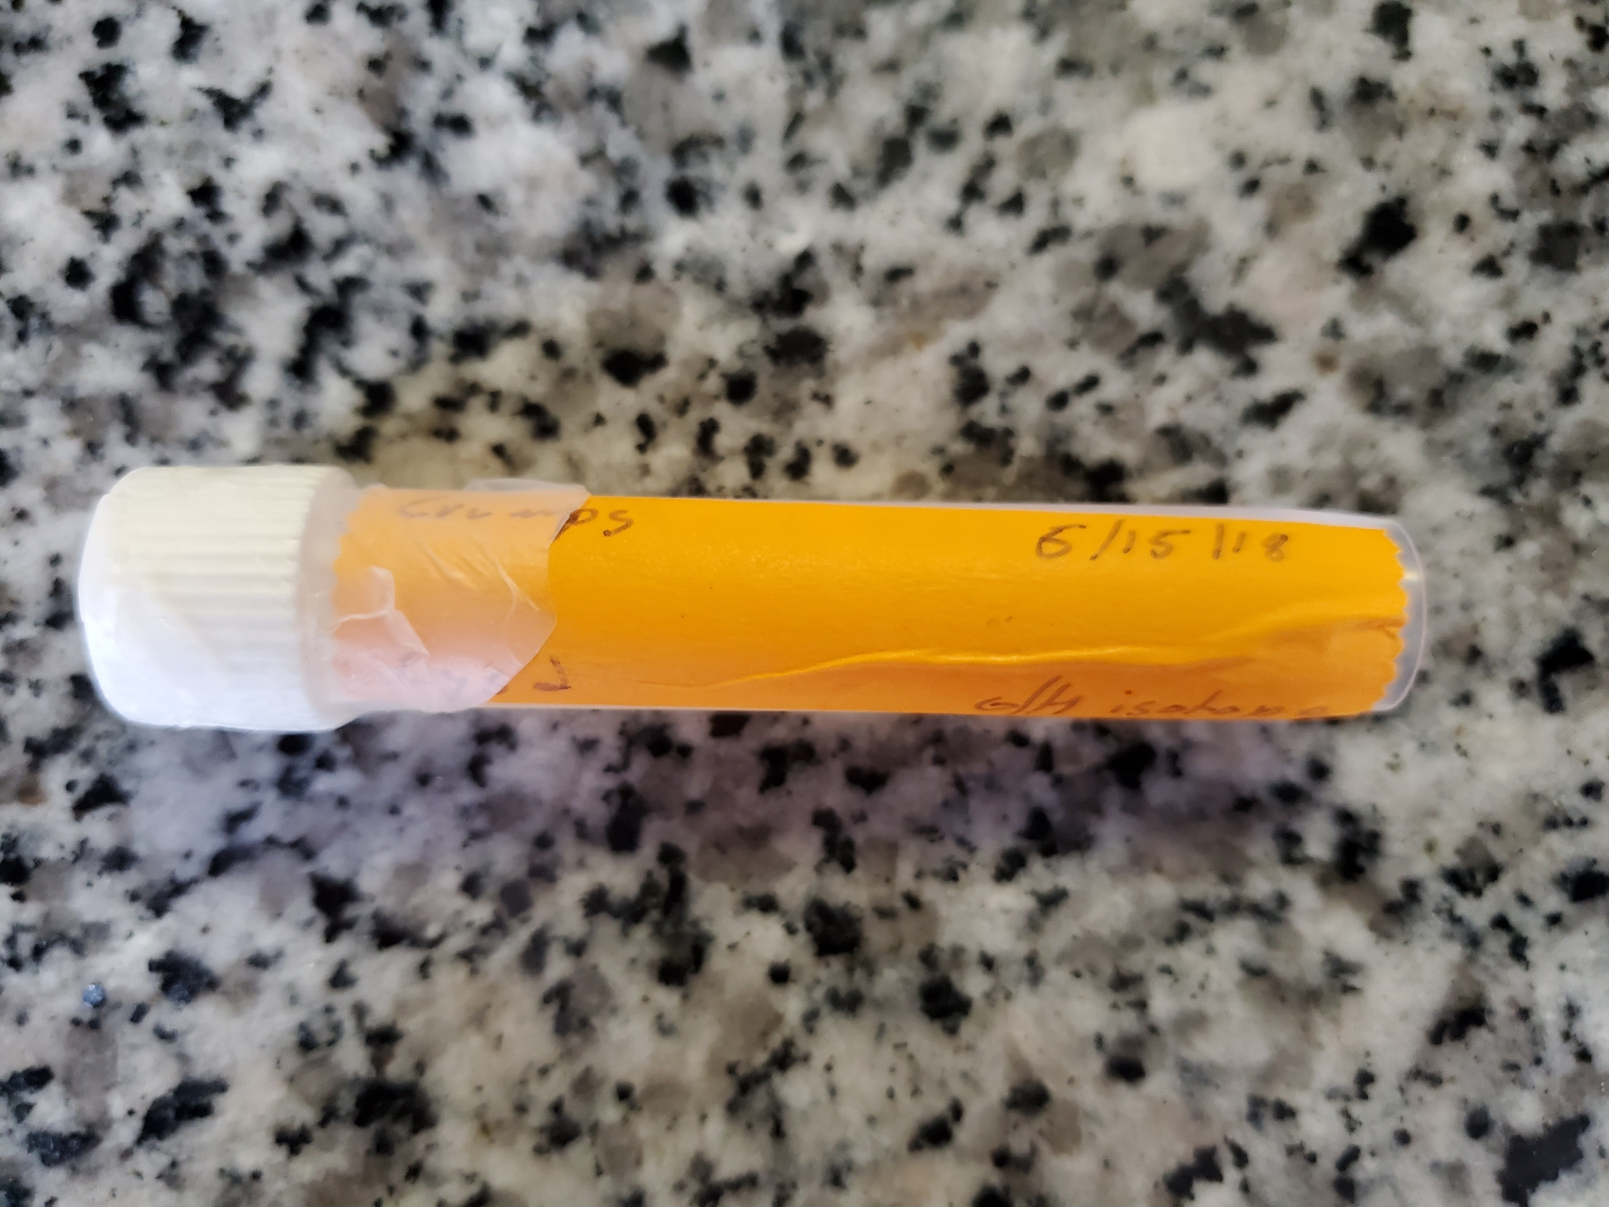
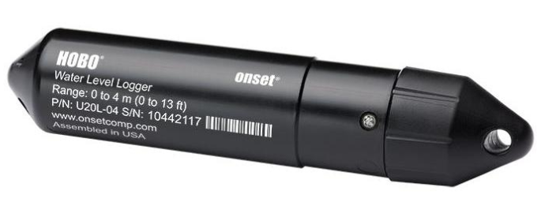
Methodology
Data Collection (2011-2018)
2 Sites (Waterfall 1 and surface Weather Station)
- HOBO Pressure Transducer measuring Water Depth (10-min res)
Weather Station: HOBO Series U30 (precipitation, temperature, and a suite of atmospheric variables)
Weekly (δ²H/δ¹⁸O) stable isotope water sampling (rainfall samples from an Onset HOBO rain gauge and epikarst Waterfall 1)
Lysimeters to collect soil water at depths of 10cm, 20cm, and 30cm
Pressure Transducer Logger (Onset, 2020).
ALC Consolidated, 2021
Weather Station at Crumps Cave. Image taken by Dr. Groves, 2013.

Slide 9
Data & Statistical Analyses
Stable Isotope Analyses
Data were organized and put into Origin Lab’s Origin Pro for analysis
Amount weighted calculations were done on both the rainfall and waterfall isotopes
Linear- regression analysis to plot (rainfall samples) δ²H and δ¹⁸O against one another to determine local meteoric water line (LMWL)
LMWL were compared to Global Meteoric Water Line (GMWL)
Time-series plots for rainfall, discharge, and δ¹⁸O of rainfall & WF1 to compare isotope variations during rain events through each year (seasonal variation)

Slide 10
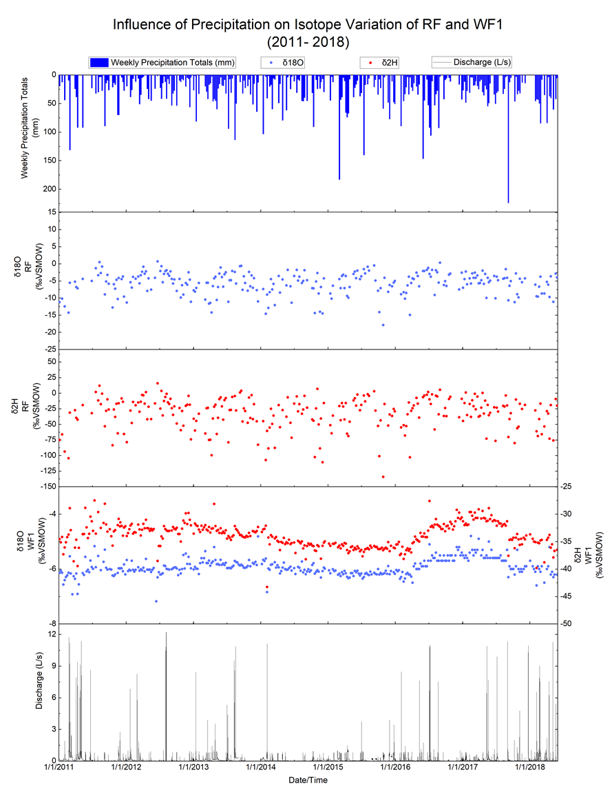
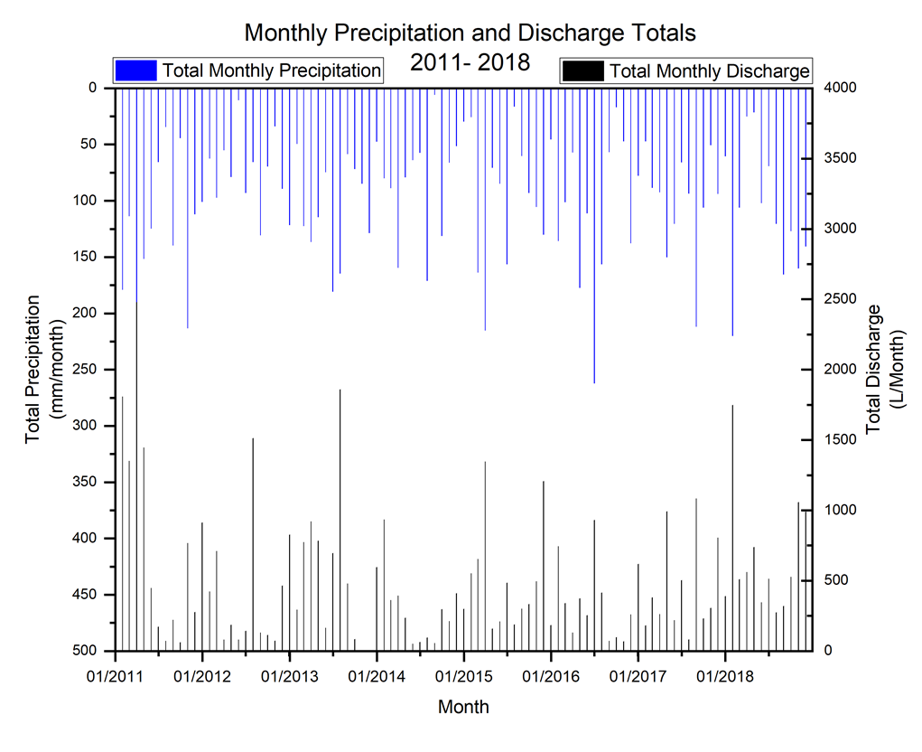
Results and Discussion
Seasonal variability in rainfall isotopes
2 Peak events created an aided in 2 major isotopic shifts (seasonal change as well)
Periods of less rainfall could be another influence on major shifts if followed up by a larger event.
The response of WF1 didn’t always reflect the precipitation event.
Intensity over Amount
Implications on contaminate transport

Slide 11
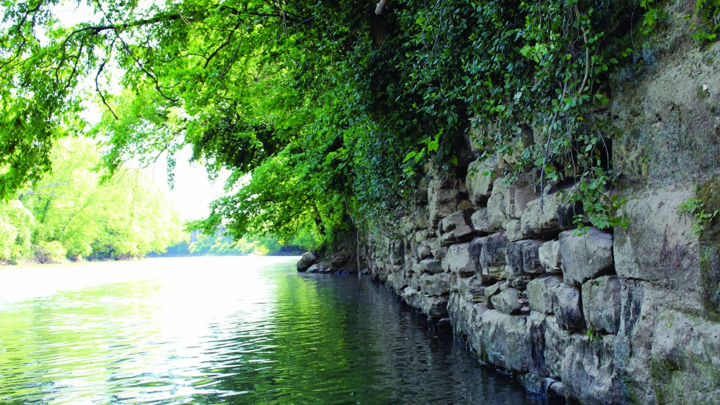
Conclusion (So What?)
Isotopes can be used as a useful tool in identifying recharge dynamics within a karst landscape
Influences, such as rainfall intensity, relative humidity, seasonality, and time of storage all major impacts on the isotopes.
Understanding the epikarst recharge dynamics is vital to protecting karst areas that are under pressure from agricultural land-use
Provide data to local management organizations and farmers
Barren River (City of Bowling Green, 2020).

