Slide 1
Development of Novel Biologic Inhibitors to Target the Phosphatase PRL-3 in Cancers. Ruby Mason¹, Shilpa Sampathi², Jessi Blackburn³
¹university of Louisville
^{2,3}University of Kentucky Department of Cellular and Molecular Biochemistry

Slide 2
What is PRL-3?
Oncogenic protein tyrosine phosphatase
Associated with increased metastasis and worse prognoses
Overexpressed in a variety of solid cancers such as breast, colon, and prostate
Not well studied in leukemia
Wei et al. 2018

Slide 3
Nanobodies
Camelids and cartilaginous fish have fractional pieces of antibodies called nanobodies
Antibodies are limited by their instability, larger size, and insufficient penetration into solid tissues
Nanobodies have additional therapeutic potential
Courtesy of Caroline Smith

Slide 4
PRL-3 Specific Nanobodies
Courtesy of Caroline Smith

Slide 5
How can nanobodies be utilized to study the functional and therapeutic roles of PRL-3?
Therapeutic
Functional

Slide 6
Functional Role of PRL-3
Promotion of migratory action and metastasis
rag2:Myc+GFP
d28
rag2:Myc+GFP+PRL3
d28
Courtesy of Jessi Blackburn

Slide 7
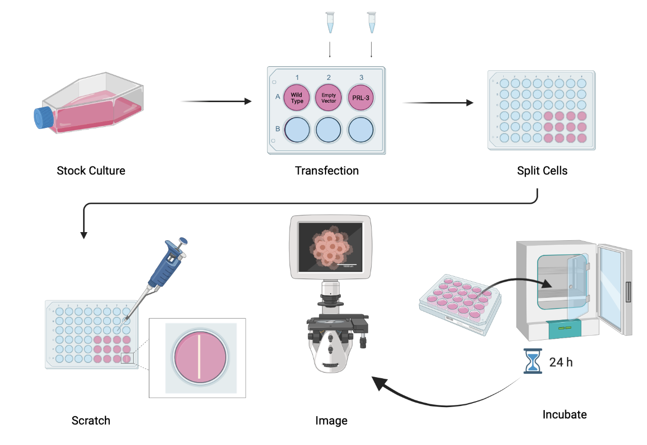
Scratch Assay
Created with BioRender.com

Slide 8
Anti PRL-3 Western Blot
WT
EV
PRL-3
PRL-3
Blot
Gel

Slide 9
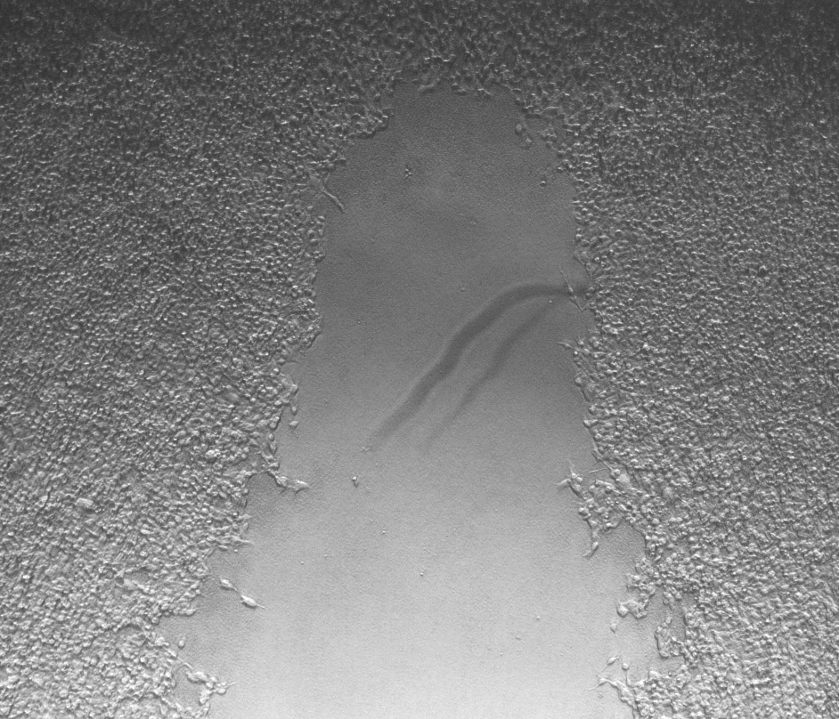
HEK293T Wild Type
HEK293T Wild Type

Slide 10
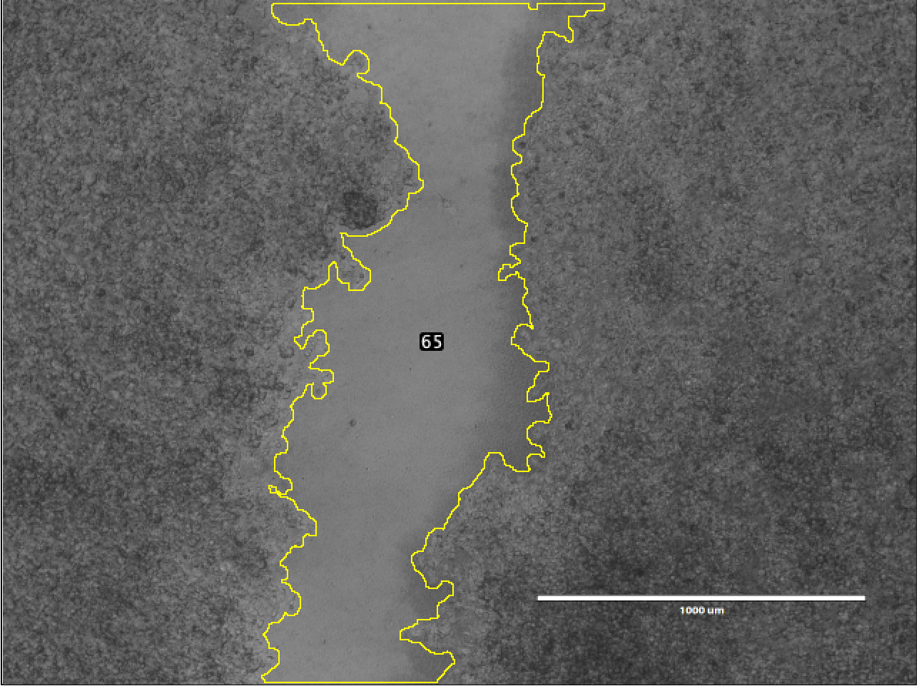
Quantification of Cell Scratch Assay

Slide 11
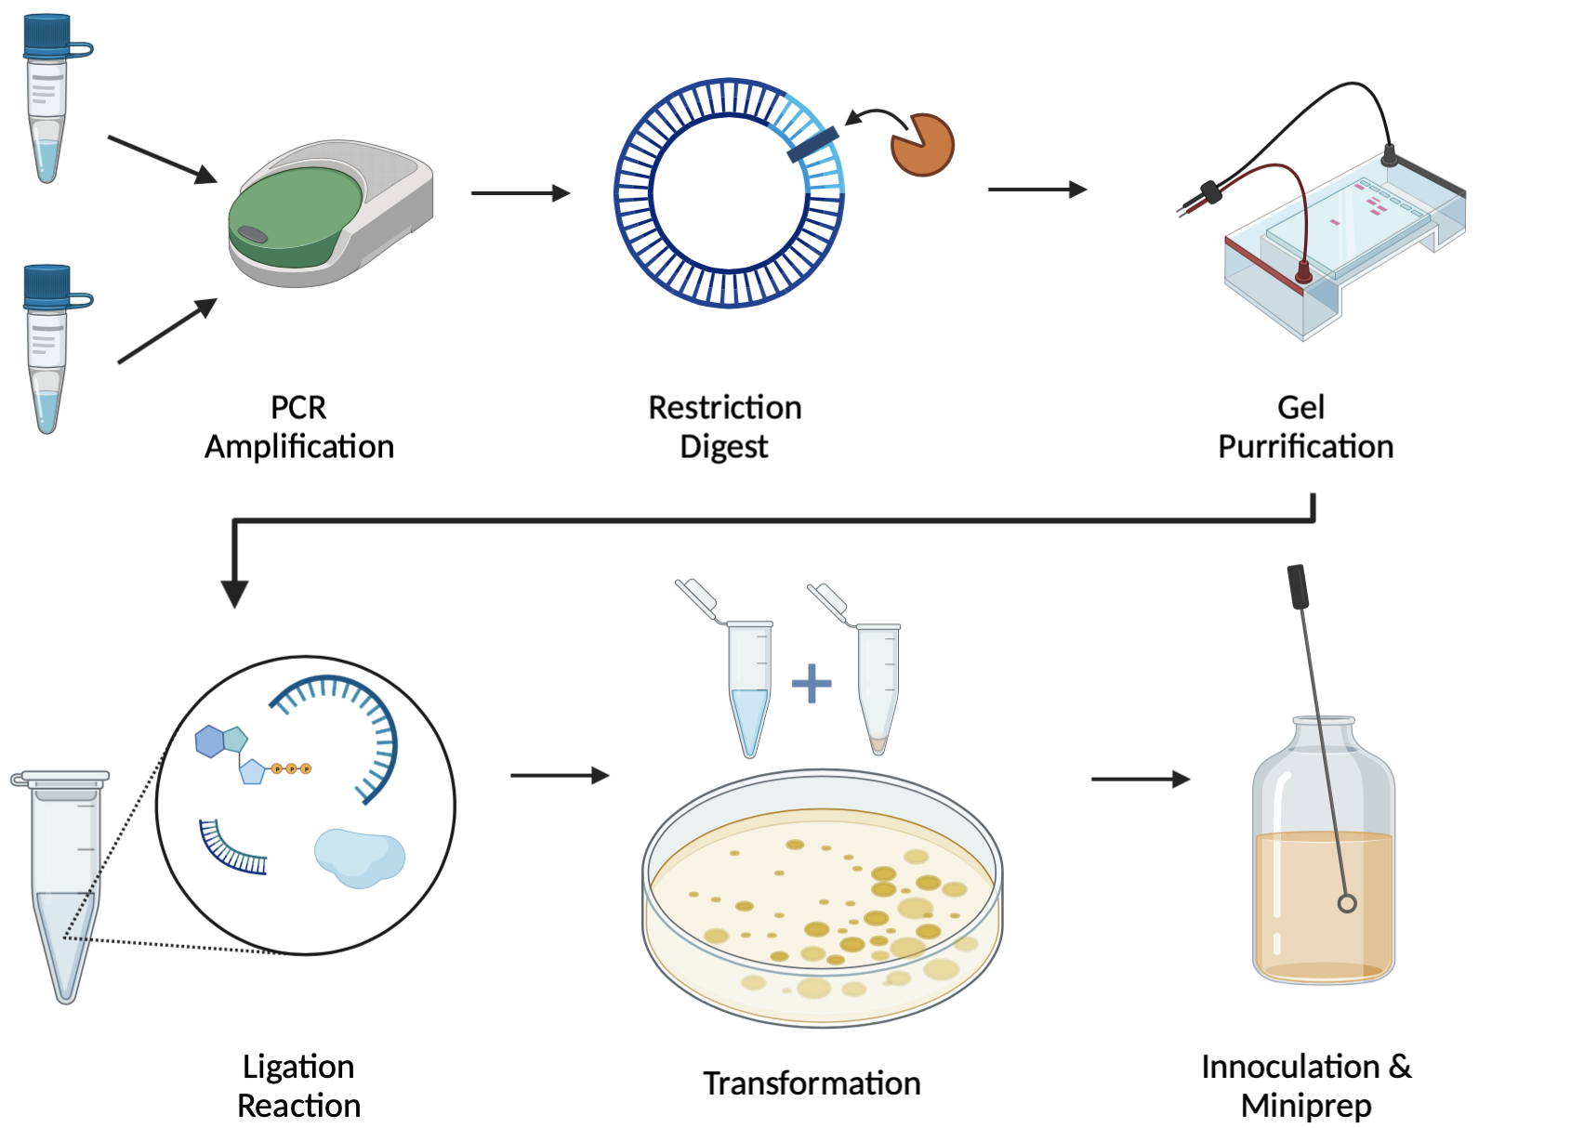
PCR Cloning – pCDNA3.1-His-Nb

Slide 12
Transfection of His tagged Nb in HEK293T cells
His-Nb
EV
Blot
Gel

Slide 13
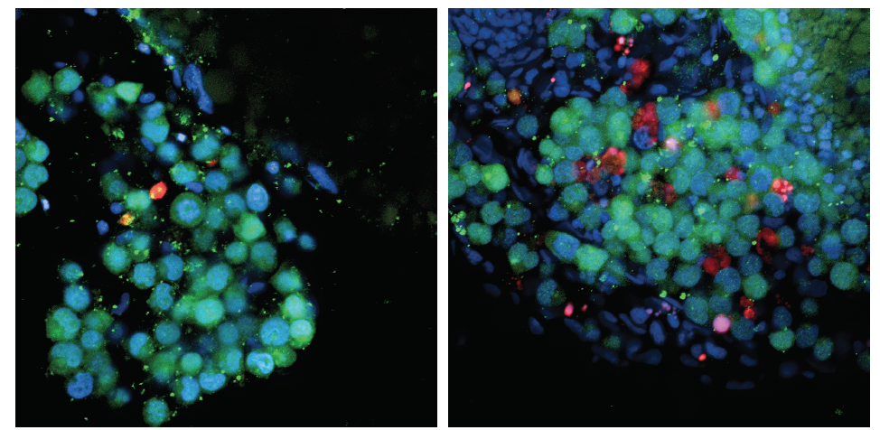
Therapeutic Role of PRL-3
T-ALL cells
DAPI
Apoptosis
Drug target
Courtesy of Jessi Blackburn

Slide 14
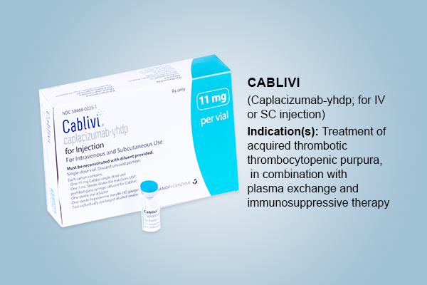
Therapeutic Potential
PRL-3 specific nanobodies can act as “homing device” to bring cytotoxic agents to cells that contain PRL-3
This allows for targeted therapies that won’t affect non-cancerous cells like traditional chemotherapy

Slide 15
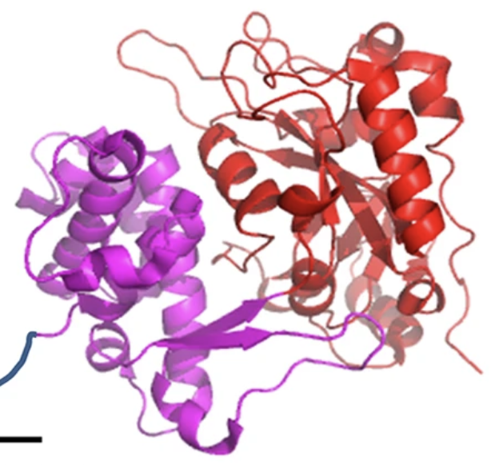
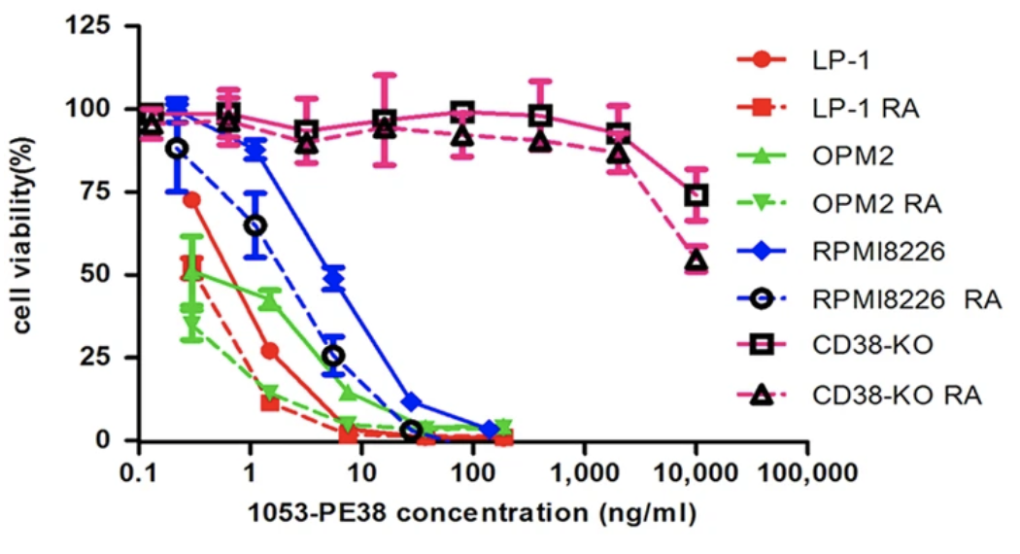
Immunotoxin PE38
Genetically engineered form of the cytotoxic pseudomonas exotoxin
TGF$α$-PE38 phase 2 clinical trial on malignant brain tumors in the Netherlands, 2004
Lim et al. 2017 used an engineered Salmonellae to infiltrate solid tumors and deliver TGF $α$-PE38
Li et al. 2016 used target-specific nanobodies coupled to PE38
PE38
Li et al. 2016

Slide 16
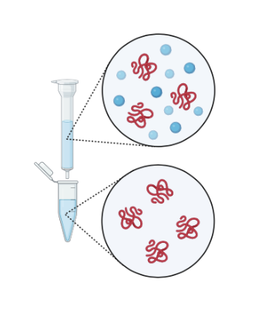
PCR Cloning – pSKB3+NB+PE38

Slide 17
pSKB3-Nb-PE38 Protein Purification
Flowthrough
Elution1
Elution2
Insoluble
Soluble
Wash
Blot
Gel

Slide 18
CellTiter-Glo

Slide 19
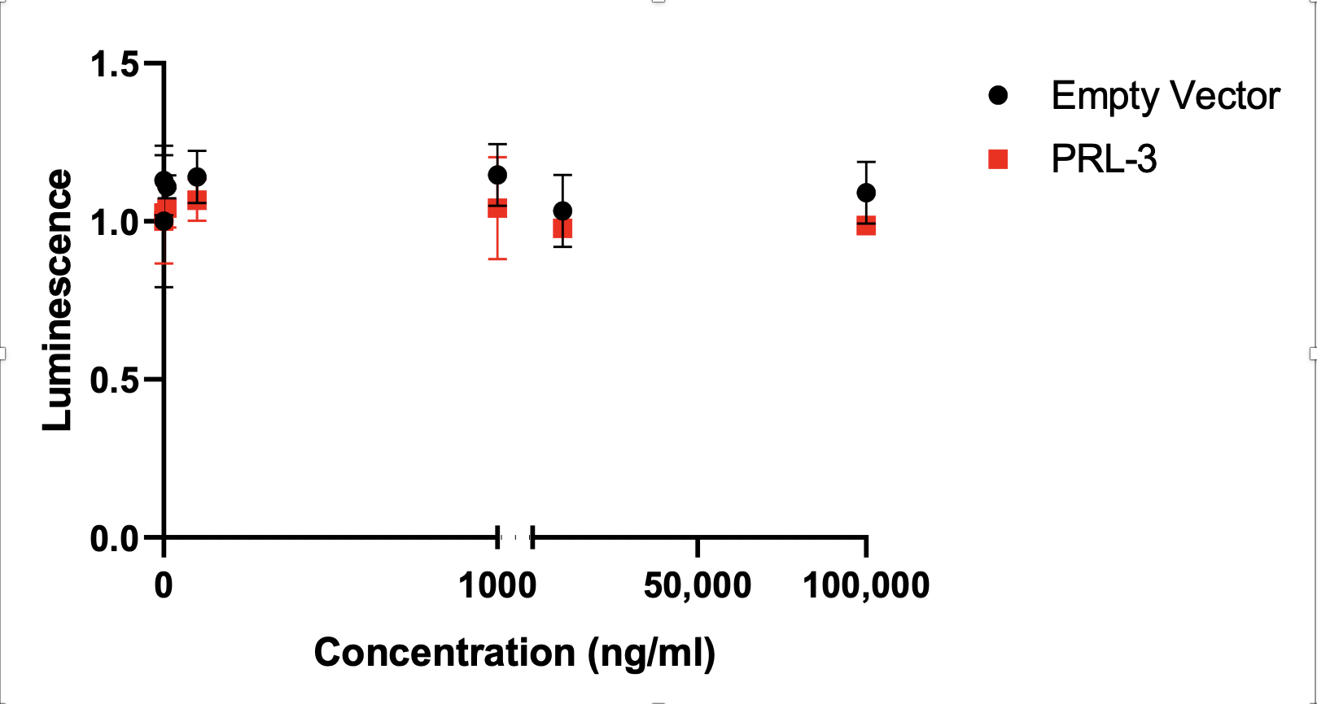
CellTiter-Glo Results

Slide 20
Conclusions
Developed two DNA constructs
His tagged Nanobody to study the functional roles of PRL-3
Nanobody fused to an Immunotoxin to study a possible therapeutic role of PRL-3
Performed a scratch assay to set a baseline behavior for HEK293T cells with PRL-3 overexpressed
Purified Nanobody+Immunotoxin (Nb+It) protein
Performed a CellTiter-Glo assay for initial testing of Nb+It

Slide 21
Future Directions
Functional roles of PRL3
Utilize His tagged Nb to study PRL3’s cellular localization, migration as well as identify it’s binding partners by Immunostaining and Immunoprecipitation
Purify His tagged Nb for in vitro approaches
Therapeutic Studies
Nb-Immunotoxin can be tested on various cancer cells expressing PRL3
Testing in zebrafish and mice cancer models to see if the tumor survival is abrogated

Slide 23
Acknowledgments
A special thanks to Drs. Blackburn and Sampathi for their mentorship and contributions, Pete Mirabito for his ongoing support and the Kentucky IDeA Networks of Biomedical Research Excellence for their funding and support of this project.
Research reported in this publication was supported by an Institutional Development Award (IDeA) from the National Institute of General Medical Sciences of the National Institutes of Health under grant number P20GM103436.

