Slide 1
Synoptic Analysis of the January 26th-28th, 2009 Kentucky Snow and Ice Storm
By: Mason Quiram

Slide 2
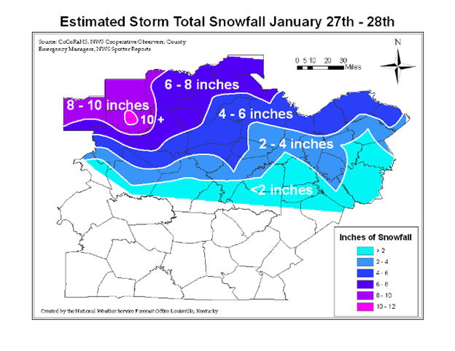
Introduction
Two part system that began as mainly rain on the 26th, and switched over to extended periods of freezing rain, sleet, and snow through the 28th.
Duration and intensity of event led to rare and historic accumulations throughout portions of Kentucky
Areas of western Kentucky saw the greatest impacts and accumulations
Statewide impacts were major and included prolonged closures, and limited resources for residents.
Storm total ice accumulations (NWS Louisville)
Storm total snow accumulations (NWS Louisville)

Slide 3
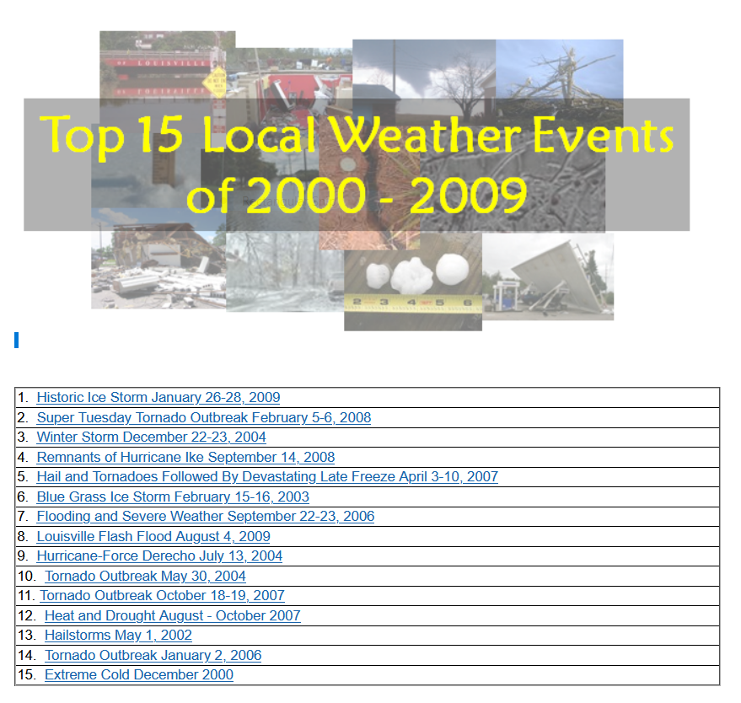
Historical Significance
- “The biggest disaster in modern Kentucky history” – former Kentucky Governor Steve Beshear.
- Ice accumulations exceeded 1-2” in some areas of Western Kentucky, which is even more significant given that just ½” of ice is considered “crippling”.
- This historic event occurred just a few months after the historic windstorm resulting from the remnants of Hurricane Ike, making the timing historic as well as the event.
- In November 2009, The Kentucky Public Service Commission issued a report explicitly addressing both disasters, titled “Ike and Ice”.
- “The ice storm in 2009 set the benchmark for the state of Kentucky. The disaster recovery and the amount of damage inflected by that storm was history.” - Kentucky Emergency Management Director Michael Dossett

Slide 4
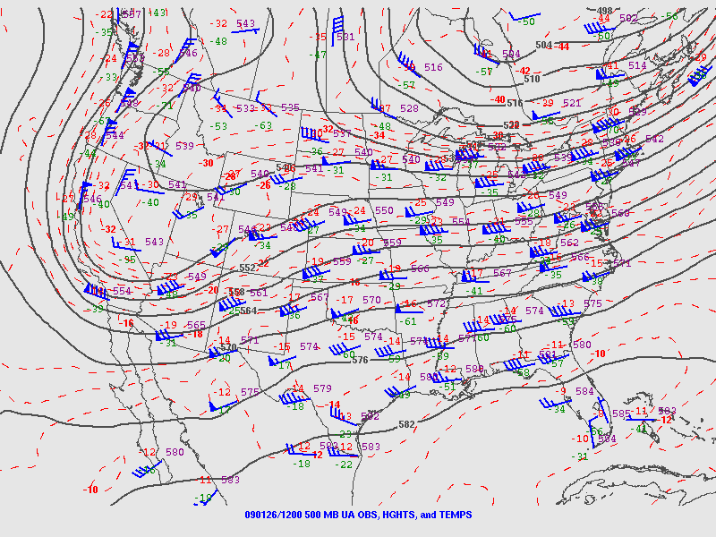
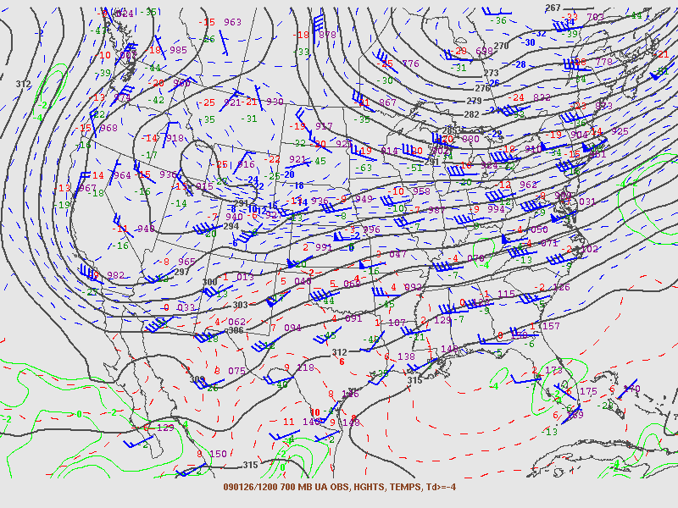
Synoptic Discussion- Upper Air Setup
Jan 26th, 2009 12z 250mb map (courtesy of NWS map archive)
Jan 26th, 2009 12z 500mb map (courtesy of NWS map archive)
Jan 26th, 2009 12z 700mb map (courtesy of NWS map archive)

Slide 5
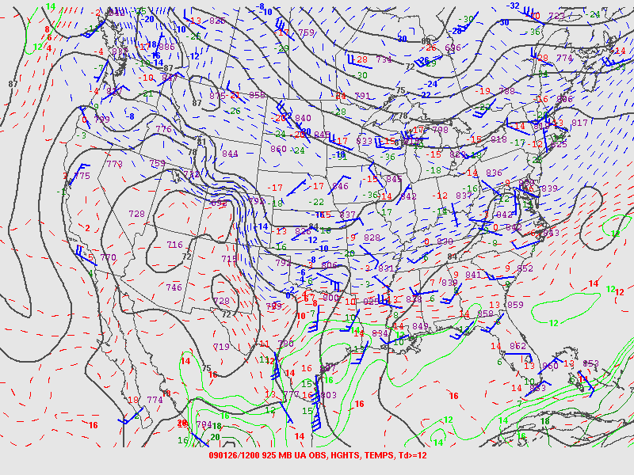
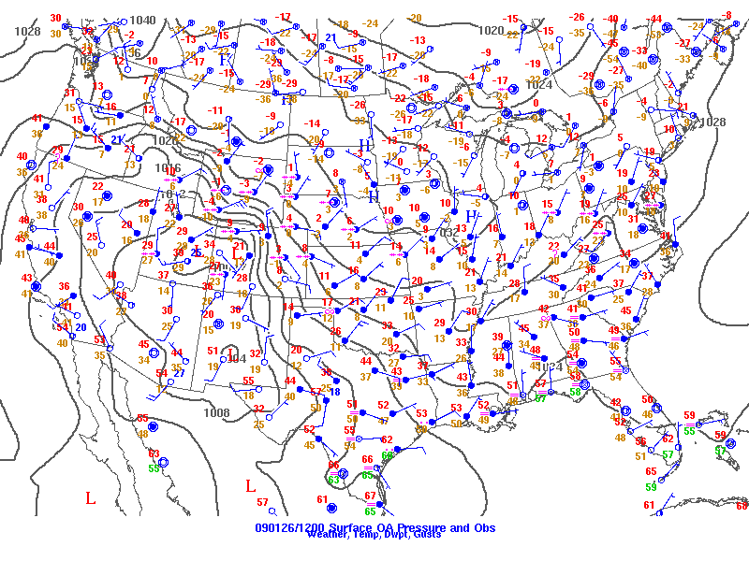
Synoptic Discussion- Lower Air Setup
Jan 26th, 2009 12z 850mb map (courtesy of NWS map archive)
Jan 26th, 2009 12z 925mb map (courtesy of NWS map archive)
Jan 26th, 2009 12z surface map (courtesy of NWS map archive)

Slide 6
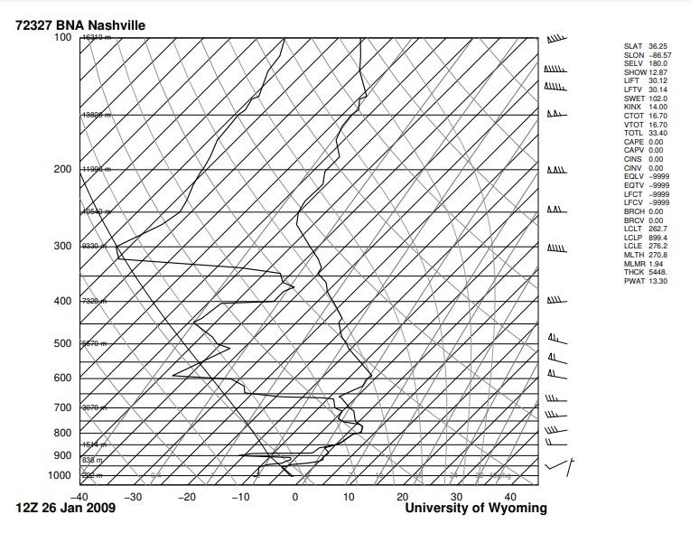
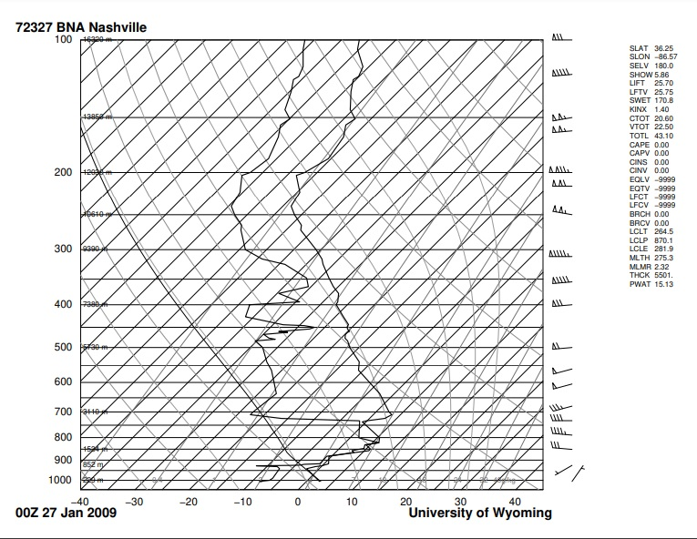
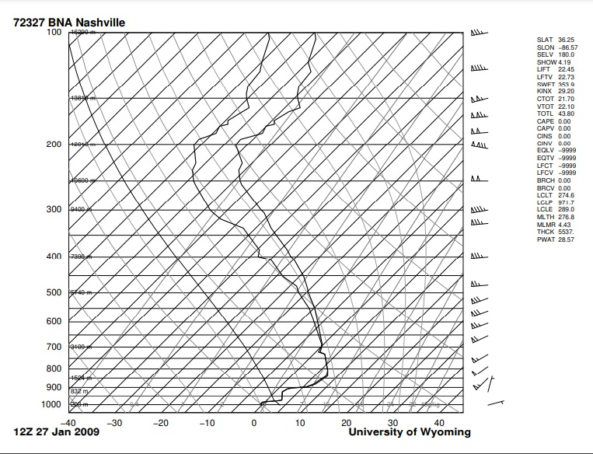
Skew-T Analysis- Nashville, Tennessee
Skew T Graph BNA Nashville, TN 12z Jan 26th, 2009 (courtesy of University of Wyoming Department of Atmospheric Science)
Skew T Graph BNA Nashville, TN 00z Jan 27th, 2009 (courtesy of University of Wyoming Department of Atmospheric Science)
Skew T Graph BNA Nashville, TN 12z Jan 27th, 2009 (courtesy of University of Wyoming Department of Atmospheric Science)

Slide 7
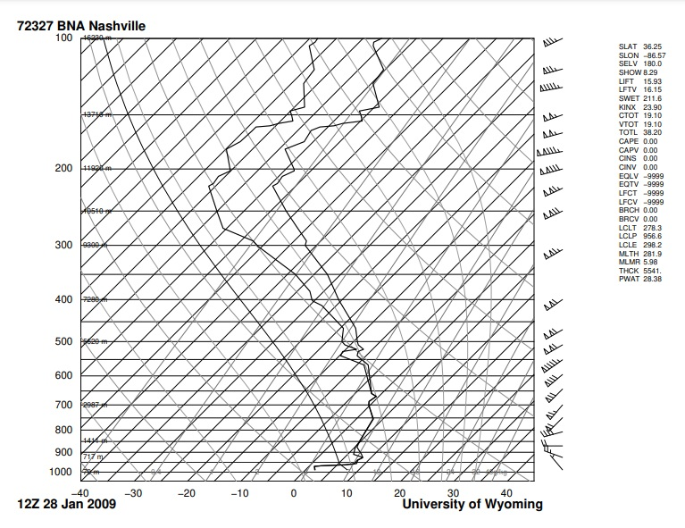
Skew-T Analysis- Nashville, Tennessee
Skew T Graph BNA Nashville, TN 00z Jan 28th, 2009 (courtesy of University of Wyoming Department of Atmospheric Science)
Skew T Graph BNA Nashville, TN 12z Jan 28th, 2009 (courtesy of University of Wyoming Department of Atmospheric Science)

Slide 8
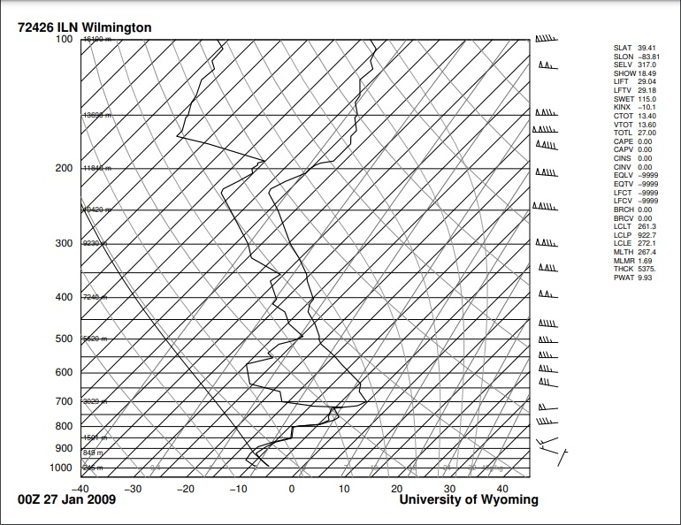
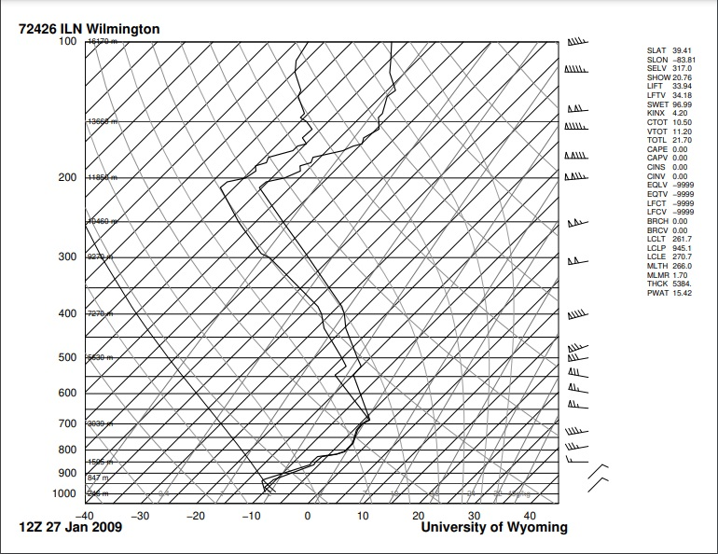
Skew-T Analysis- Wilmington, Ohio
Skew T Graph ILN Wilmington, OH 12z Jan 26th, 2009 (courtesy of University of Wyoming Department of Atmospheric Science)
Skew T Graph ILN Wilmington, OH 00z Jan 27th, 2009 (courtesy of University of Wyoming Department of Atmospheric Science)
Skew T Graph ILN Wilmington, OH 12z Jan 27th, 2009 (courtesy of University of Wyoming Department of Atmospheric Science)

Slide 9
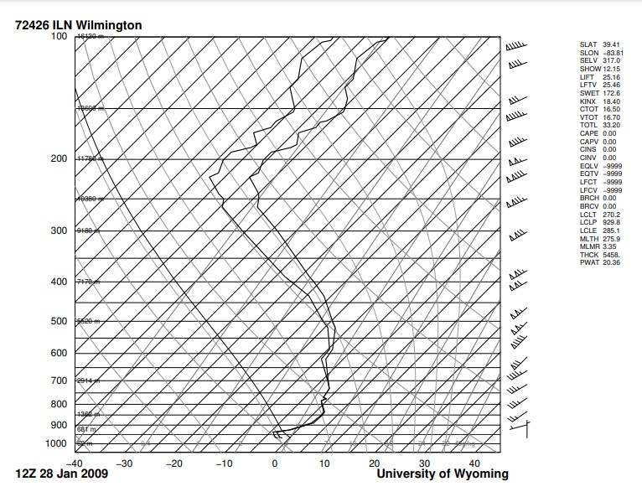
Skew-T Analysis- Wilmington, Ohio
Skew T Graph ILN Wilmington, OH 00z Jan 28th, 2009 (courtesy of University of Wyoming Department of Atmospheric Science)
Skew T Graph ILN Wilmington, OH 12z Jan 28th, 2009 (courtesy of University of Wyoming Department of Atmospheric Science)

Slide 10
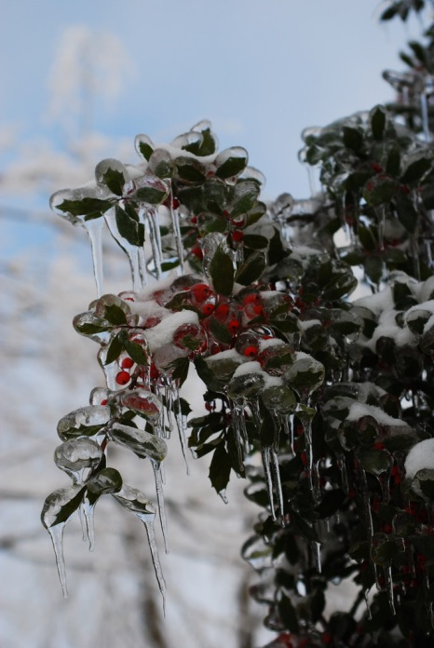
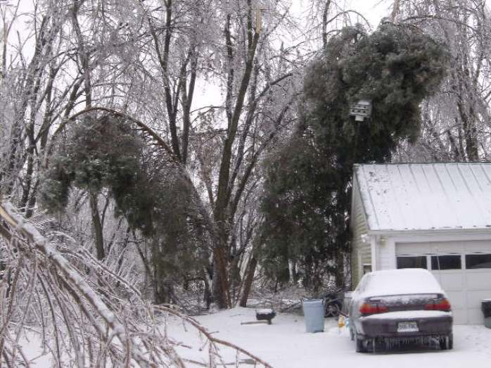
Pictures
- Tree damage from heavy ice and snow accumulation in Clarkson, Kentucky (courtesy of Scotty Gore and NWS Louisville)
- Tree damage from heavy ice and snow accumulation in Clarkson, Kentucky (courtesy of Scotty Gore and NWS Louisville)
- Some of the rare beauty in a devastating storm in Radcliff, Kentucky (courtesy of Anita Conder and NWS Louisville)

Slide 11
Works Cited
NWS Louisville, KY, n.d.: Climatology- Louisville, KY. Accessed April 19th, 2021. https://www.weather.gov/lmk/clisdf
National Oceanic and Atmospheric Administration, January 26-28, 2009.: Storm Events Database. Accessed April 19th, 2021. https://www.ncdc.noaa.gov/stormevents/eventdetails.jsp?id=148828
NWS Louisville, KY, n.d.: Ice and Snow Storm of January 26-28, 2009. Accessed April 19th, 2021
https://www.weather.gov/lmk/jan_2009_ice_and_snow
NWS Paducah, KY, n.d.: Top 10 Headlines of the Decade 2000-2009. Accessed April 19th, 2021.
https://www.weather.gov/pah/Top10ofDecade2000to2009
NWS Louisville, KY, n.d.: Top 15 Local Weather Events of the Decade 2000-2009. Accessed April 19th, 2021.
https://www.weather.gov/lmk/top_15_decade
Wikipedia, last updated February 15th, 2021.: January 2009 North American ice storm. Accessed April 19th, 2021.
https://en.wikipedia.org/wiki/January_2009_North_American_ice_storm

Slide 12
Works Cited
The Kentucky Public Service Commission, November 2009.: Ike and Ice. Accessed April 19th, 2021.
http://psc.ky.gov/ikeice/report.pdf
Wave3 News, February 11th, 2021.: 2021 vs. 2009: How the Winter Storms Compare. Accessed April 19th, 2021.
https://www.wave3.com/2021/02/11/vs-how-winter-storms-compare/
University of Wyoming Department of Atmospheric Science, n.d.: Atmospheric Soundings. Accessed April 19th, 2021.
http://weather.uwyo.edu/upperair/sounding.html
NWS Storm Prediction Center, n.d.: Surface and Upper Air Maps- Map Archive. Accessed April 19th, 2021.
https://www.spc.noaa.gov/obswx/maps/

