Slide 1
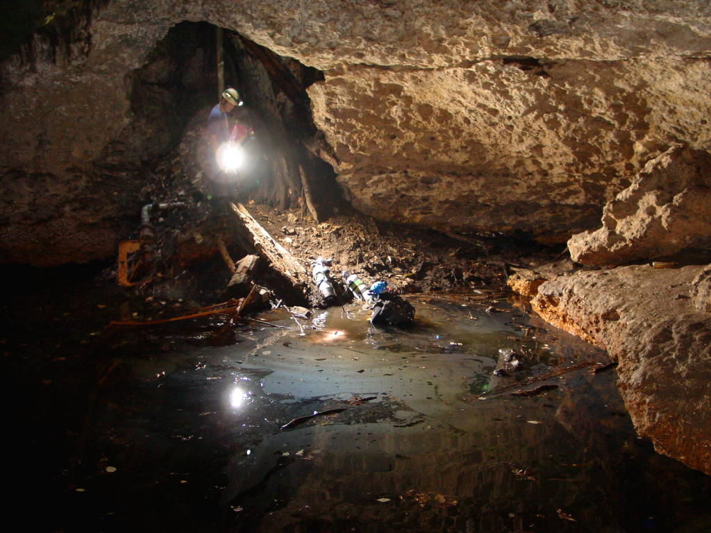



Karst Hydrogeologic Investigation
of Cave Inputs Related to the
Lost River Cave Gasoline Leak
Britton Davis¹, Jason S. Polk1, James Shelley¹, Matt Powell², James Troxell¹, Nenad Maric³
¹Center for Human GeoEnvironmental Studies (CHNGES)
Department of Earth, Environmental & Atmospheric Sciences, Western Kentucky University
²Environmental Compliance Division, Department of Public Works,
City of Bowling Green, Kentucky
³Department of Ecological Engineering, University of Belgrade

Slide 2
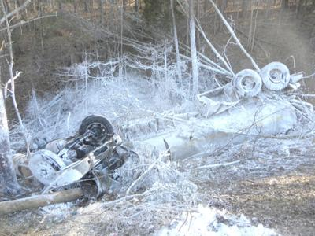
Gasoline Contamination in Karst
The occurrence of gasoline and other LNAPL contamination events in karst aquifers is common and has persisted for decades
LNAPLs are complex to cleanup, due to lack of access and complex transport mechanisms
Can persist for long periods of time in the system
Sources include stormwater injection wells, USTs, surface spills, leaking above ground tanks, industrial contamination, etc.
Remains of a tanker that spilled gasoline into cave in Pulaski County, KY Jan 30th, 2014
“Due to a considerable delay between the time of the accident and when it was finally reported, most if not all 31,000 liters (8,200 gallons) of gasoline had already leaked out of the tanker by the time emergency personnel arrived on the scene.”
- Caving News Feb 3rd 2014

Slide 3
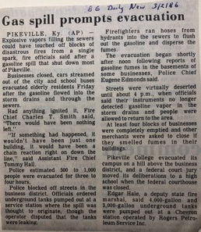
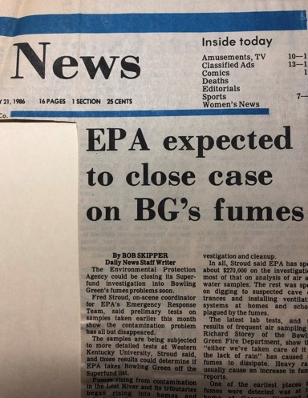
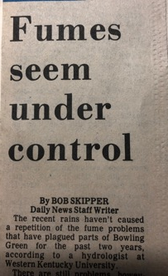
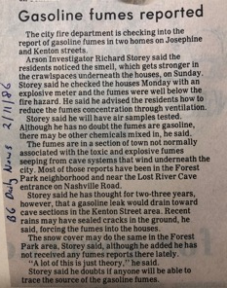
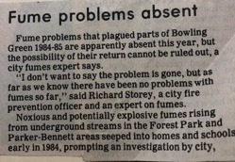
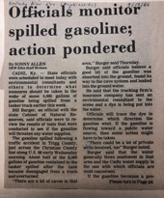
Bowling Green, KY- Historical Context
Since the late 1970s, the City of Bowling Green, KY has seen dozens of gasoline leaks
Most recent in 2019 (Lost River Cave system)
Bowling Green, Warren County, KY

Slide 4
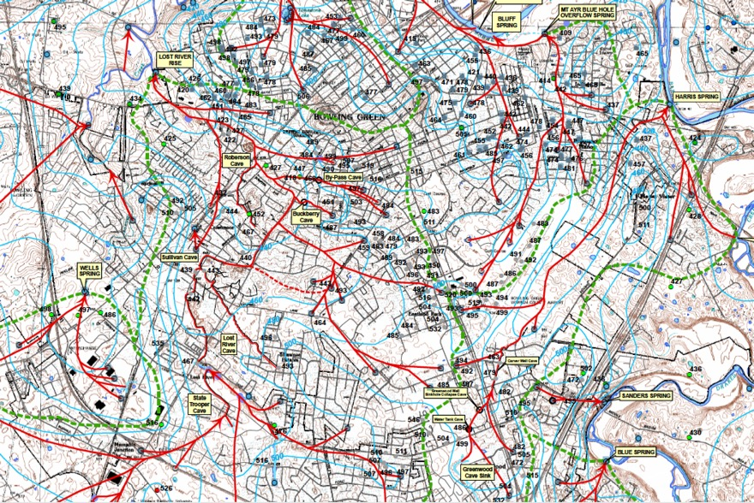
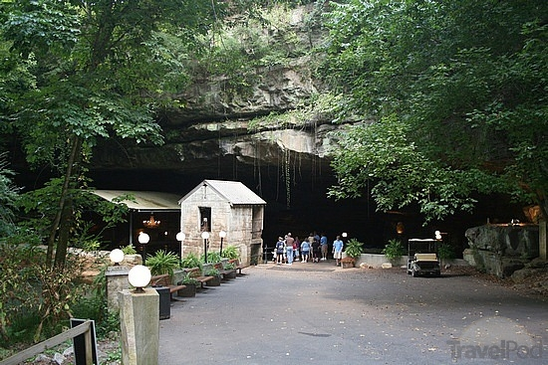
Lost River Cave System- Bowling Green
Complex urban karst hydrology, including over 1,400 injection wells
Most prominent cave system is Lost River Cave (LRC), with more than 10 km of surveyed passage and multiple tributary caves
Bowling Green Dye Trace Map (1970-now)

Slide 5
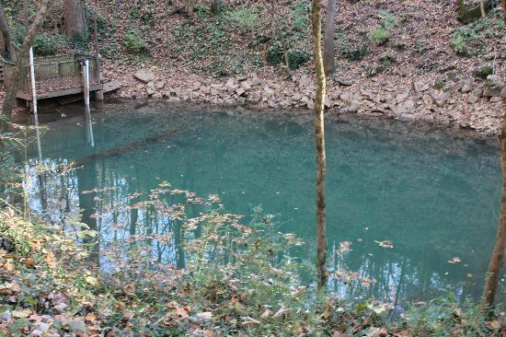
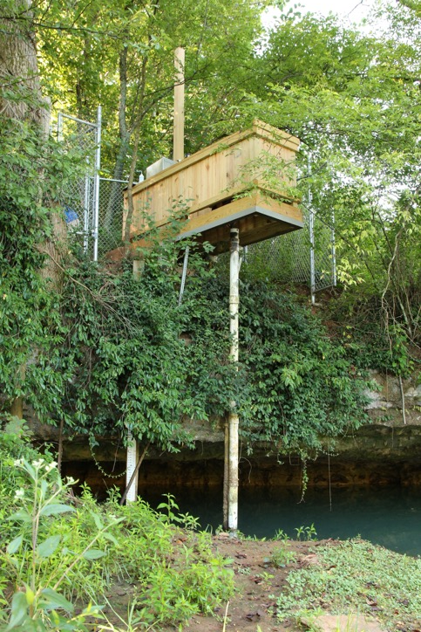
Real-time Monitoring Lost River Cave
Lost River Rise Monitoring Site
Lost River Blue Hole Monitoring Site

Slide 6
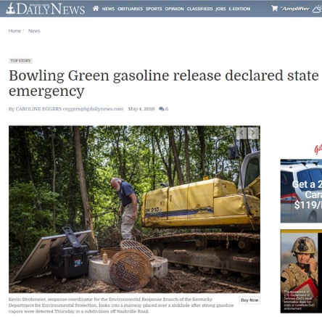
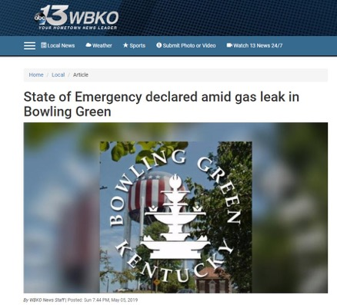
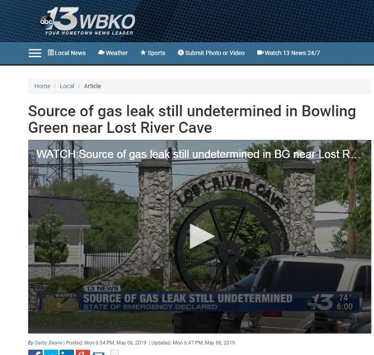
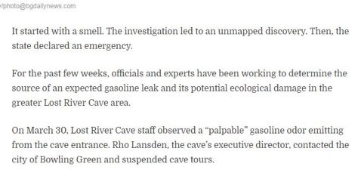
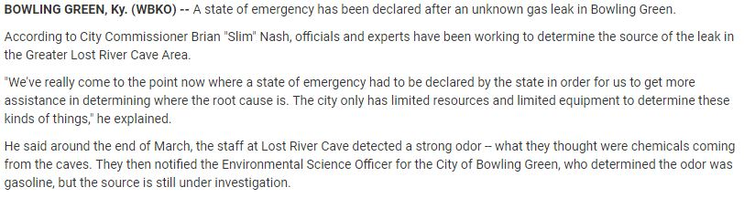
2019 Gasoline Fumes at LRC

Slide 7
Lost River Cave Gas Leak Team
Initial response by CoBG and WKU in late March as possible illicit discharge
Escalated to include Division of Waste Management in response in early April
EPA on site by mid-April
Additional members included:
  KY EEC staff
  EnSafe
  Southern Environmental

Slide 8
Project Timeline
March 2019
Initial fumes reported at LRC
Evacuation of homes and businesses locally impacted by fumes
April 2019
Investigation of known passages, inputs, sinkholes
Identification and breach into new cave system (Pit Stop), location of free phase product
May 2019
State of emergency declared (KY DEP, EPA)
Monitoring stations installed, dye tracing conducted
June 2019
July 2019
August 2019
Identification of potential sources, site investigations began
Remediation of identified source- leaking UST
Site remediation complete, monitoring complete
Additional salt dilution tracing and monitoring, exploration of LRC for inputs
Monitoring of sites for amelioration of fumes
LRC fully open, problem resolved

Slide 9
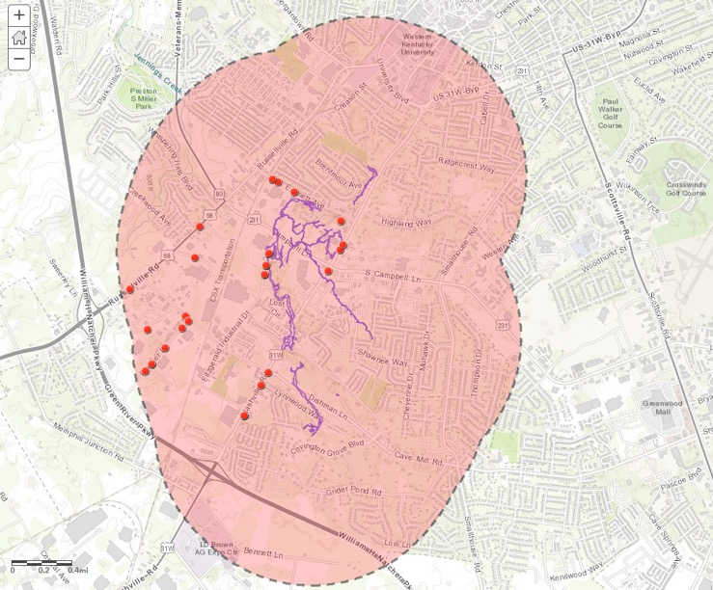
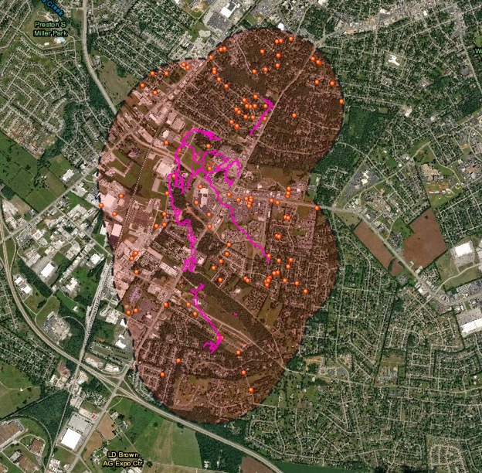
Potential Sources Investigation
Map features 1.0 mi buffer around the Lost River Cave System, and RCRA facilities, and Brownfields that fall completely within the buffer. Metadata regarding associated chemicals and manufacturing processes, as well as TRI and CWA/RCRA violations was added to the maps attribute table.

Slide 10
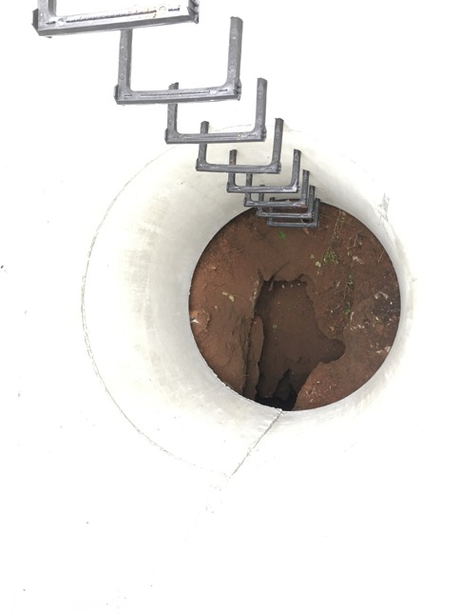
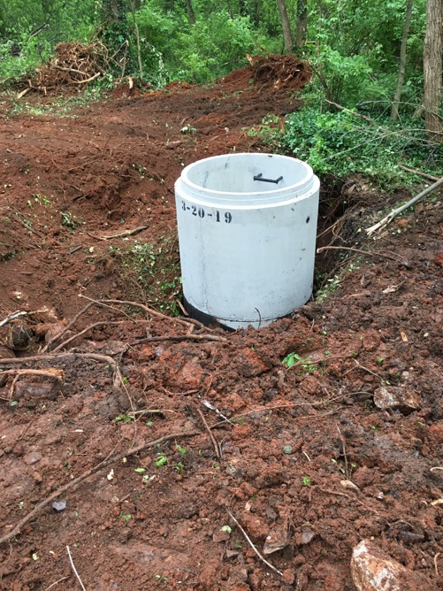
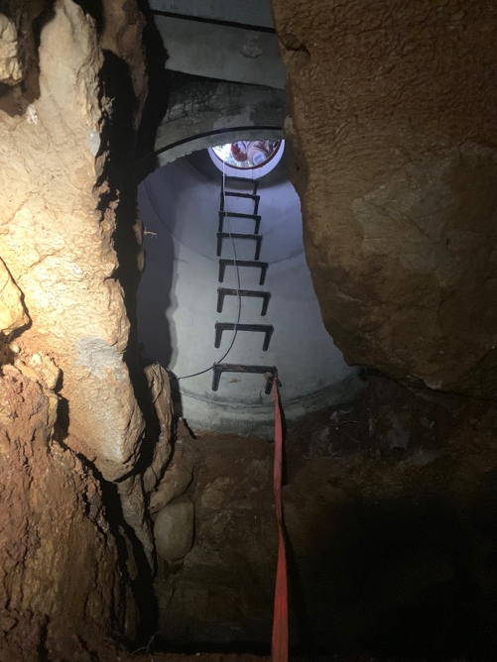
New Discovery- “Pit Stop Cave”

Slide 11
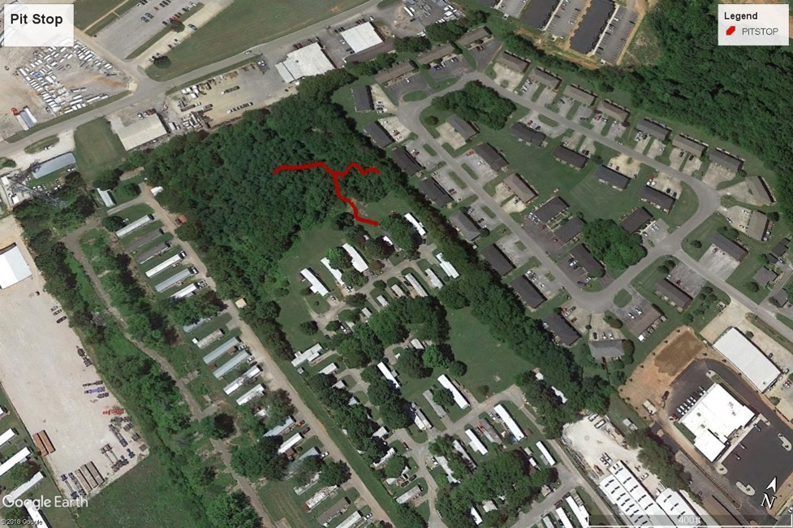
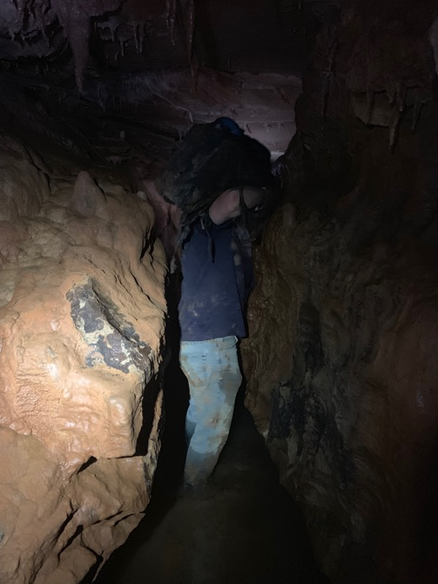
Pit Stop Cave Discovery

Slide 12
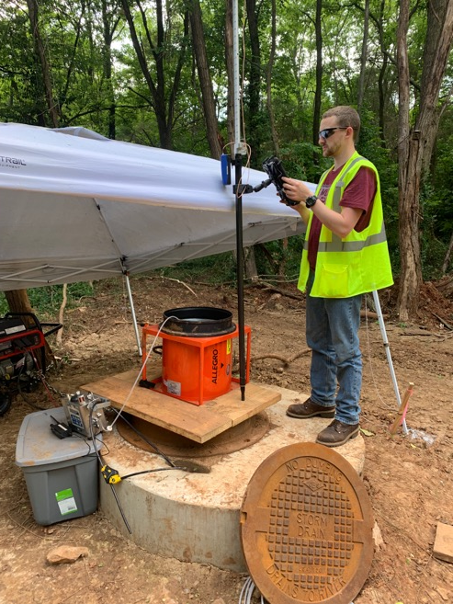
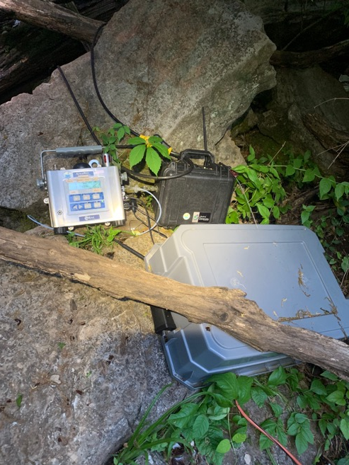
Monitoring Sites- Fumes
Sites for monitoring fumes using AreaRAE setup (1-min resolution VOCs, O2):
  Lost River Cave entrance
  Big Bertha entrance
  Pit Stop Cave entrance
  Apartment Complex crawlspace

Slide 13
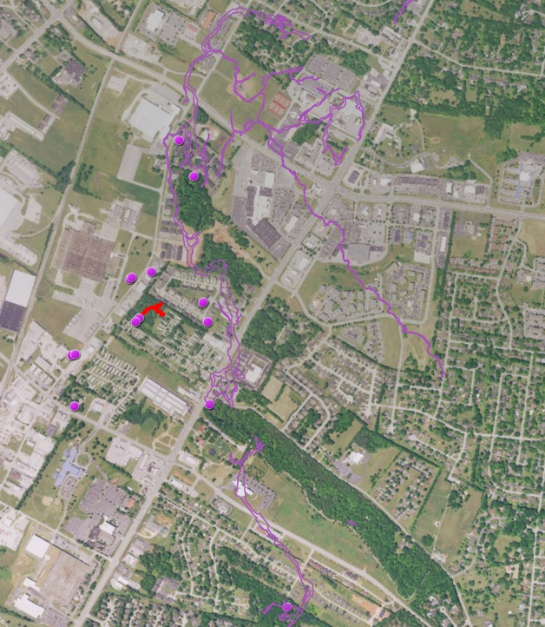
Monitoring & Sampling- Water
EXO2 Sondes, HOBO PT, HOBO Temp/Rh loggers installed at select sites (wells, cave streams, outlet spring, surface rivers) at 1-minute resolution
Water Level sites:
  Pit Stop Cave
  Bertha Entrance to LRC
  LRC Entrance
  Multiple injection & monitoring wells
Water grab sampling for VOCs conducted regularly at monitoring sites

Slide 14
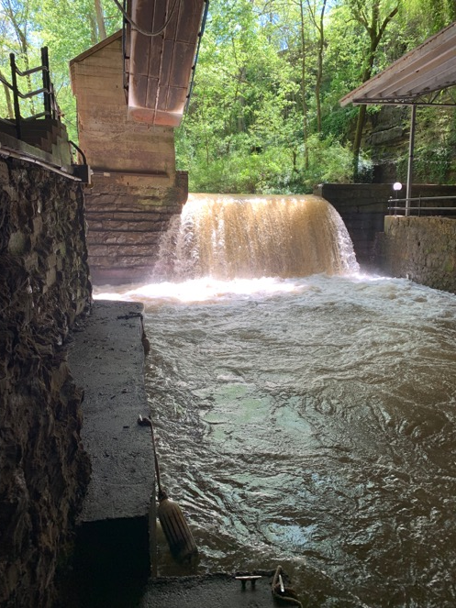
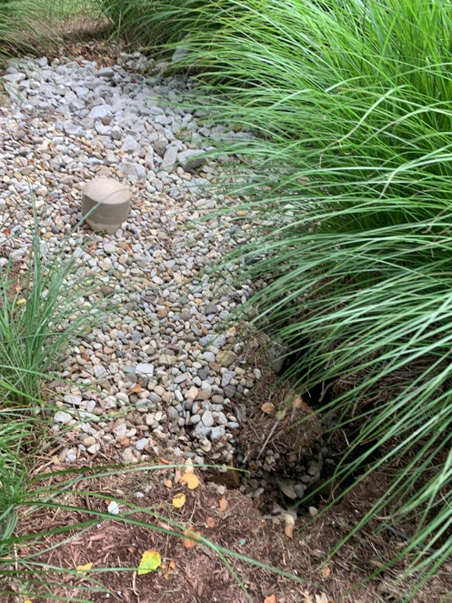
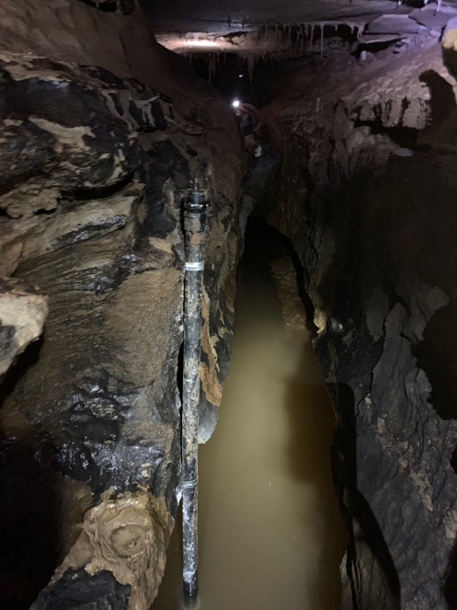
Monitoring Sites- Hydrology
Lost River Cave
Monitoring Well
Pit Stop Cave

Slide 15
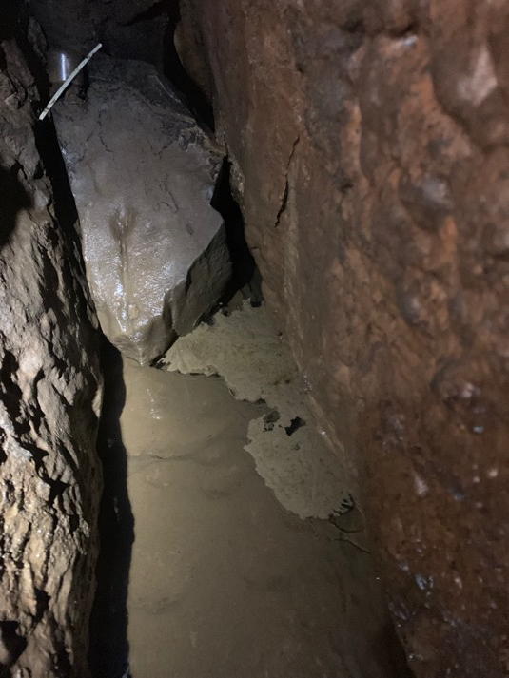
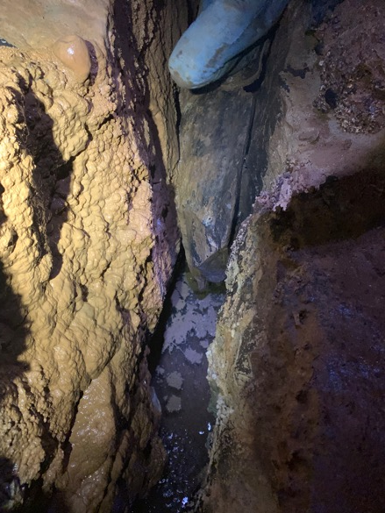
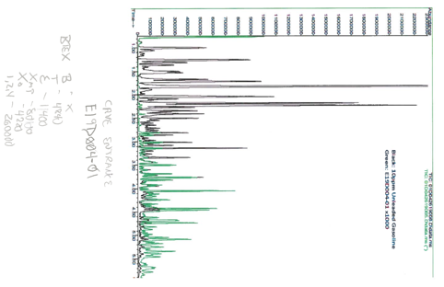
Pit Stop Cave Investigation
“Slightly weather gasoline” based on components and age analysis by EPA
Pit Stop Cave
Pit Stop Cave

Slide 16
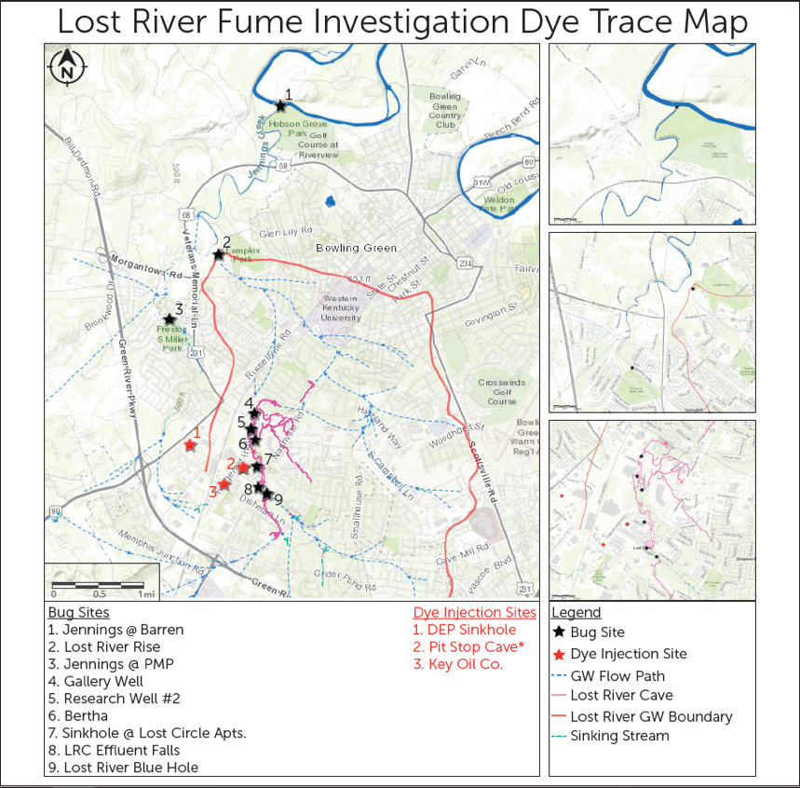
Dye Tracing 2019
Source Tracing
  Eosine (Pit Stop #2)
  Sulphurhodamine B (Bulk Plant #3)
  D&C Red 28 (DEP Sinkhole #2)
Receptors swapped at all sites:
  8 hours for the first 24 hours
  every 24 hours for 1 week
  weekly for 6 weeks

Slide 17
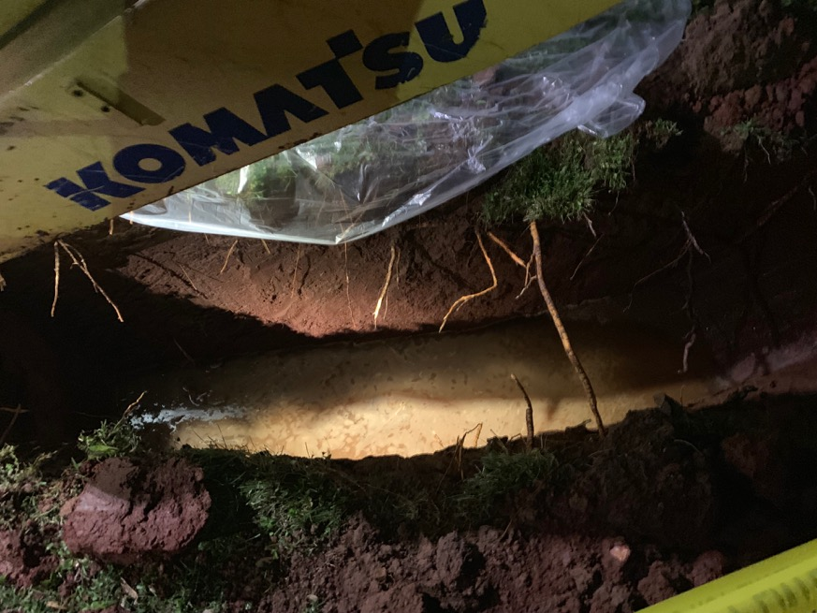
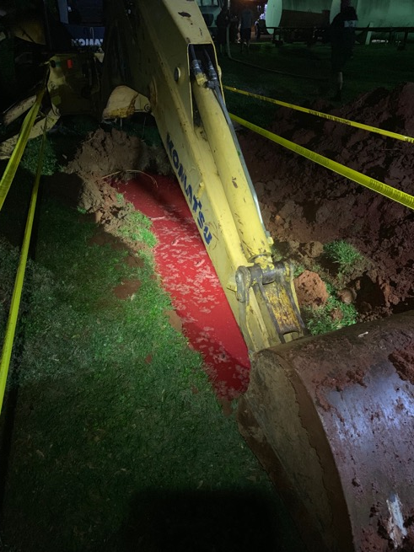
Dye Tracing 2019
Bulk Plant
Bulk Plant

Slide 18
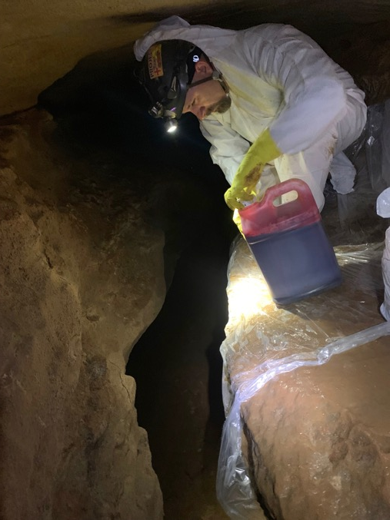
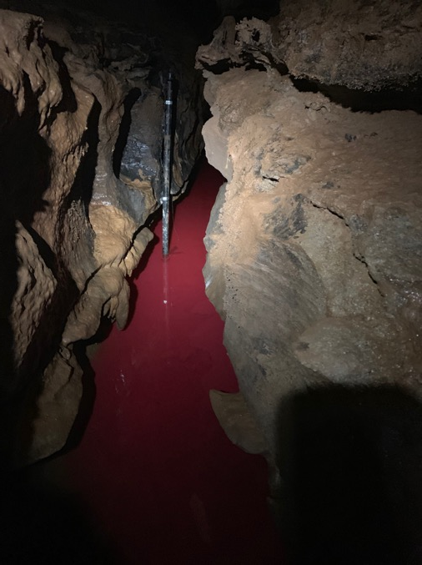
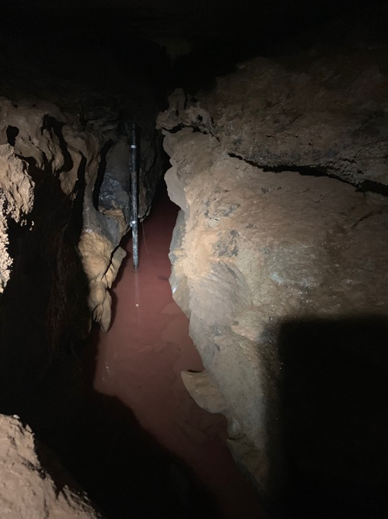
Source Investigation- Dye Tracing 2019
Initial injection
24 hours later
72 hours later

Slide 19
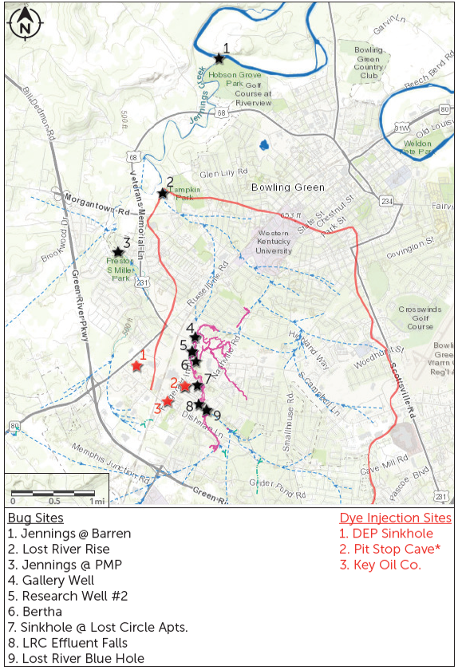
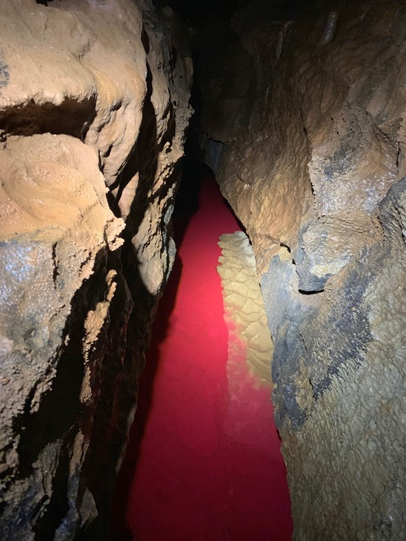
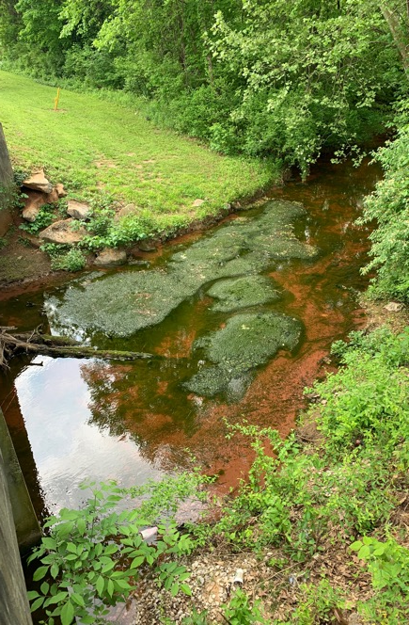
Dye Tracing 2019
Pit Stop Cave
Jennings Creek

Slide 20
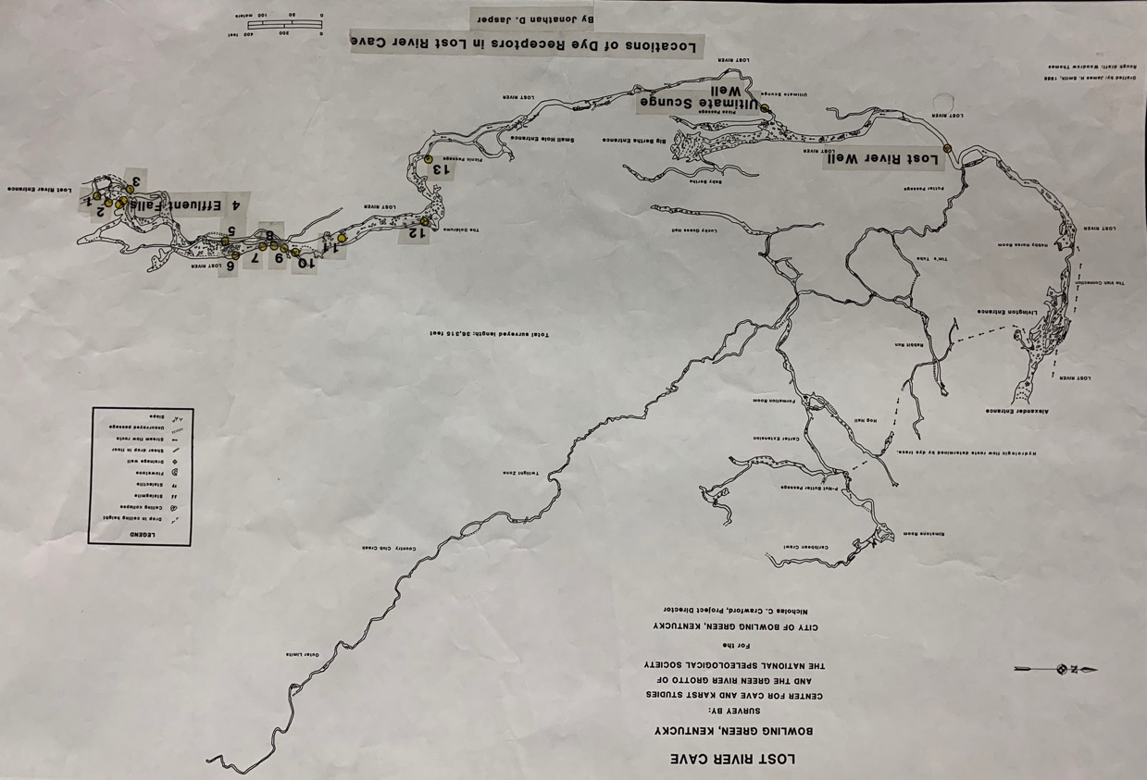
Pit Stop Cave
Bulk Plant

Slide 21
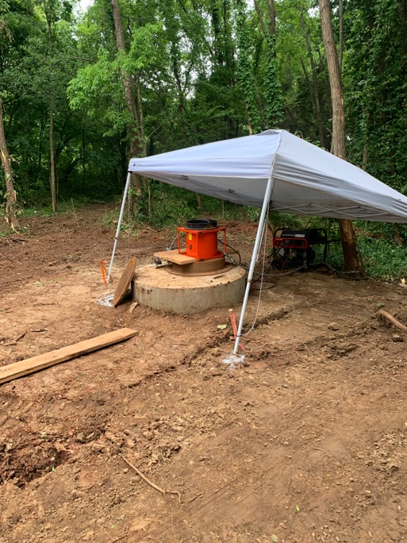
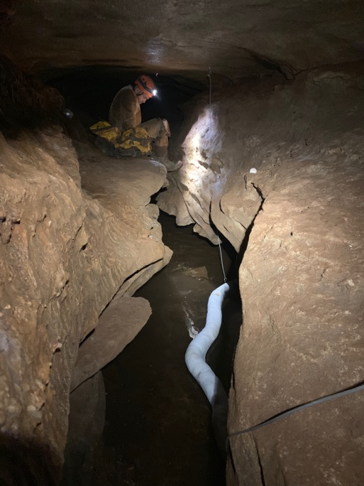
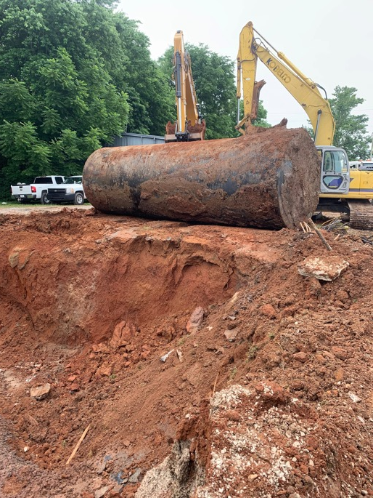
Source Remediation at Bulk Plant
Pit Stop Cave
Pit Stop Cave
Bulk Plant

Slide 22
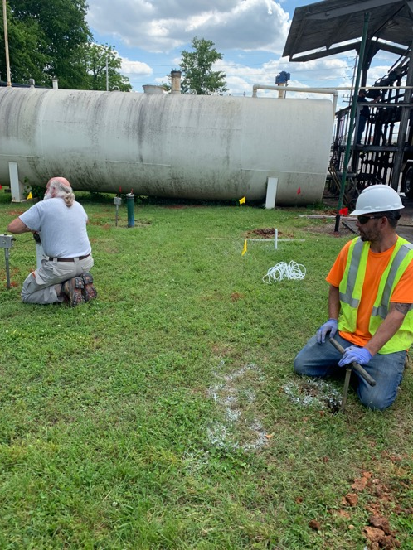
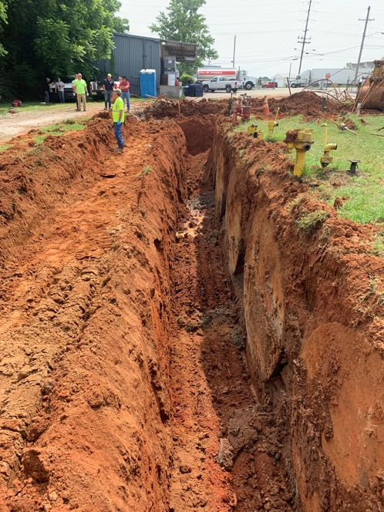
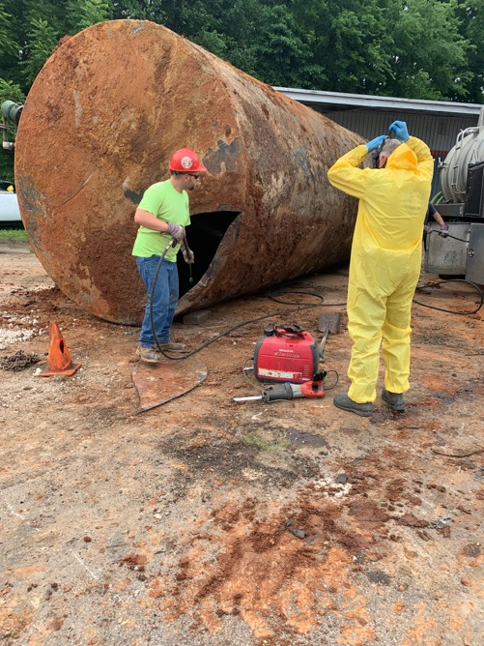
Source Remediation at Bulk Plant

Slide 23
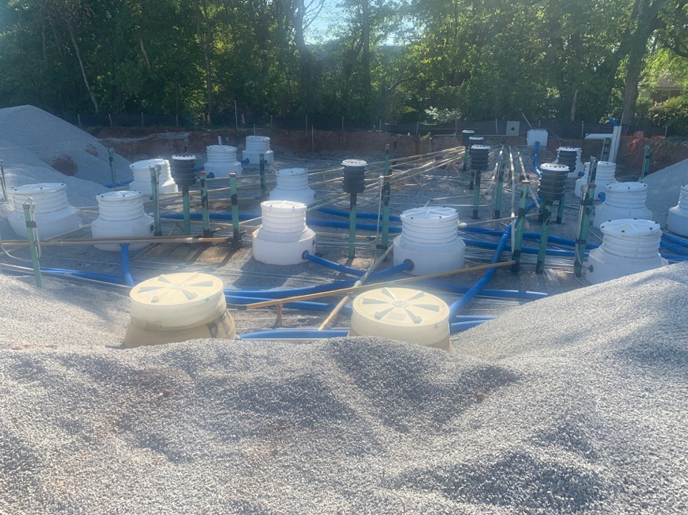

Source Remediation- Bulk Plant

Slide 24

Persistent Threat…
December 2019 in Bowling Green – damaged AST at gas station
640 gallon spill flowed into injection well directly connected to karst aquifer
Initiated further investigation into Pit Stop Cave's watershed

Slide 25

2021 Dye Tracing
Pit Stop Cave 2021 Dye Trace Map
1
Pit Stop Delineation Tracing
  1 lb. Eosine (Research Well #2)
  3 lbs. Tinopal CBS-X (Pit Stop Cave)
  2.5 lbs. Rhodamine WT (Lost River Elem. School)
Receptors swapped at 24 hours and then twice at all sites over a 6-week period when possible.
2
3
4
1
5
2
6
7
3
Bug Sites
Lost River Rise
Jennings Creek
Gallery Well
Research Well #2
Bertha Cave
Pit Stop Cave
Lost River Blue Hole
Dye Injection Sites
1. Research Well #2
2. Pit Stop Cave
3. Lost River Elem. School
Bug Site
Dye Injection Site
Watershed Boundaries
Lost River Cave System
Eosine
Tinopal CBS-X
Rhodamine WT

Slide 26



Pit Stop Dye Tracing
Research Well
Pit Stop
LR Elementary

Slide 27

Dye Trace #2
Large storm event directly after injection of dyes on 4/28/2021
Delayed access and recovery of receptor monitoring sites at several locations
Time of travel less than 24 hours for most traced sites- fast movement
Dye Injection 4/28/21

Slide 28
Pit Stop Basin Delination
Dye trace results expand possible recharge area for Pit Stop Cave
Provides additional information on potential threat sources by knowing area of contributions
Further proof of its connection and importance as an input into Lost River Cave System
Pit Stop Cave

Slide 29

Gas Leak Project Outcomes
Natural attenuation over multiple rain events after remediation of USTs and clearing of all fume issues across the LRC system
Additional sampling in 2021 suggested that any residual gas had been naturally flushed/attenuated through the system

Slide 30
Conclusions
Gasoline and other LNAPLs are common contaminants in urban karst aquifer systems
LRC gasoline leak in 2019 identified and remediated through strategic use of existing data, GIS, dye tracing, and in-cave remediation techniques
Further dye tracing revealed that Pit Stop Cave is indeed a “pit stop” or just one of the many tributary channels in the LRC system
Residual gasoline has been almost completely flushed through Pit Stop Cave through the natural movement of groundwater in less than 18 months

Slide 31






Thank You!

