Slide 1
Incorporating Research Projects in a Summer Bridge Program to Accelerate Mathematics Preparation and Retention
Axel Brandt, Seth Adjei, Joshua Cooper, Patrick M. Hare, Bethany Bowling, Brooke Buckley
KAS Annual Conference
November 6, 2021
NSF DUE IUSE 1900036

Slide 2
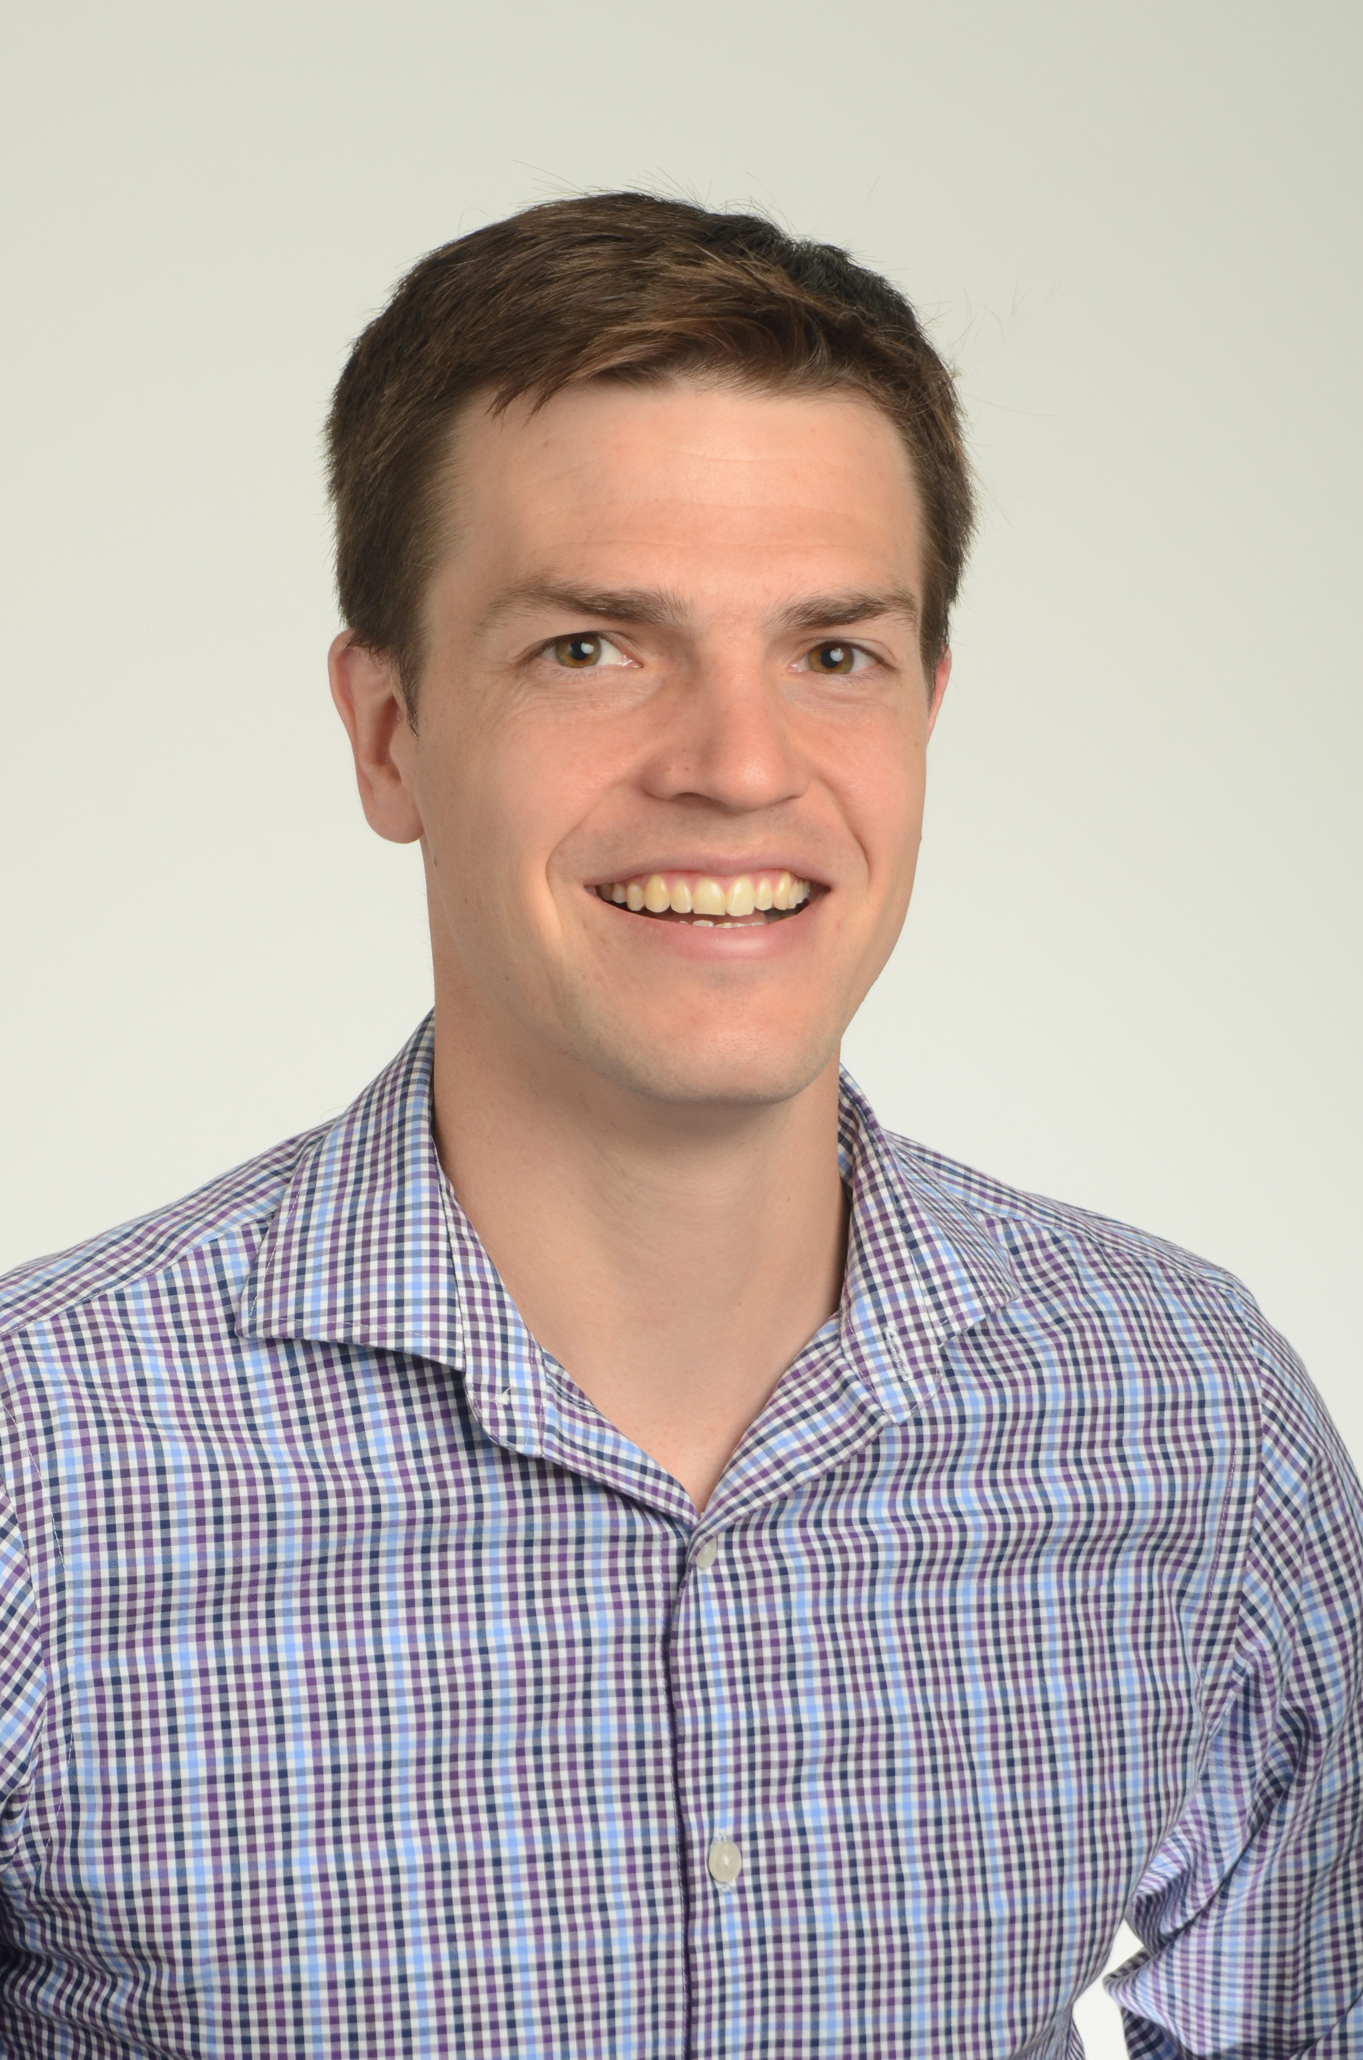
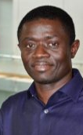
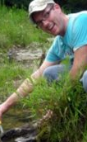
Project Team
Bethany Bowling (PI)
Brooke Buckley (co-PI)
Axel Brandt
(co-PI)
Seth Adjei
(co-PI)
Joshua Cooper
Patrick Hare

Slide 3
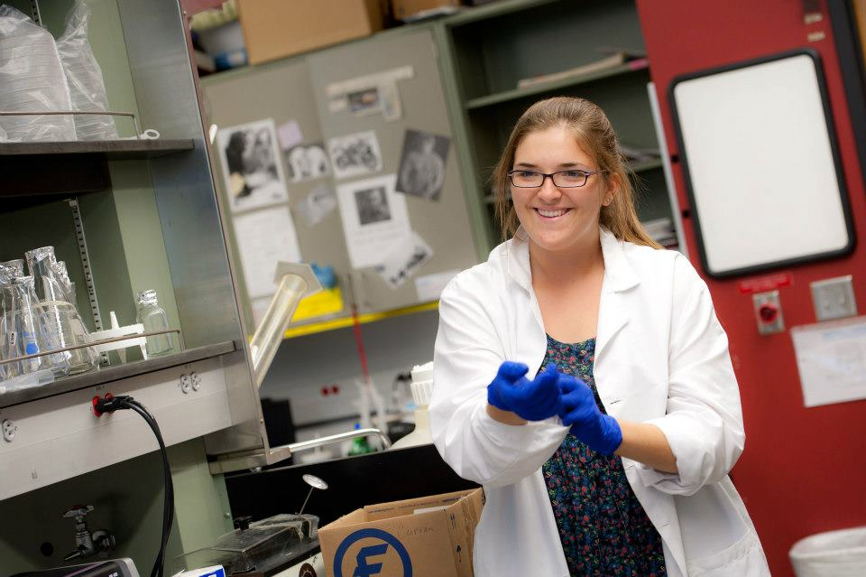
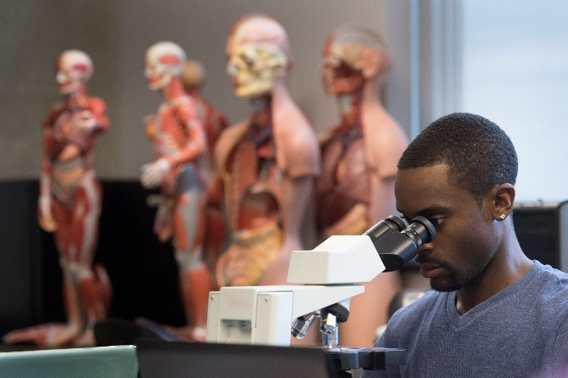
Develop program focused on increasing mathematics preparation
Compare online versus face-to-face models of 2-week summer bridge program

Slide 4
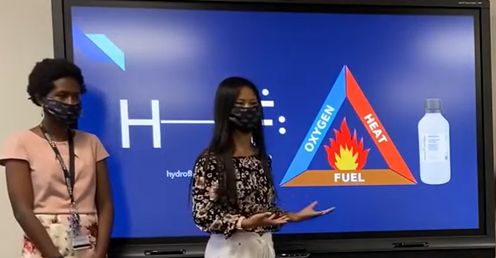
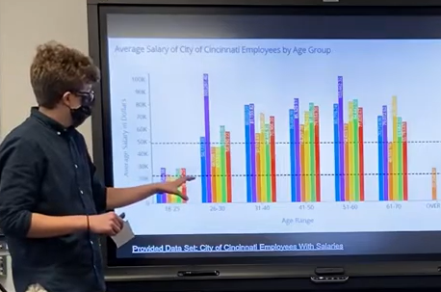
Research Projects
Students complete 3 research projects from different areas of STEM
Students present on project (not necessarily in major) at end of 2-weeks

Slide 5
Research Project Objectives
Draw connections in math & other STEM fields
Accessible to students with diverse mathematics preparation and scientific interests/backgrounds
Open-ended
Fit in 6-hour timeframe
Well-suited for in-person and online facilitation
Scalable to larger cohorts
Investigate real-world problems

Slide 6
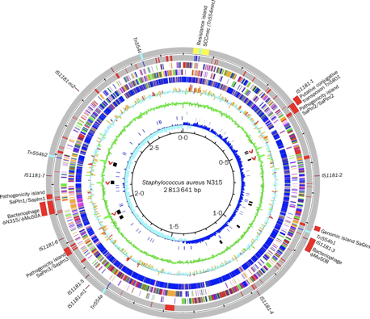
Antibiotic-Resistant Bacteria
1st Time
Use short < 10-minute pre-research video to on-board
Developed Case studies built using NCBI data
Next Time
2nd Time
One project all students worked on remotely
Watched recorded videos
Performed tasks at their own pace
Guided students through step by step
Use Research time to help develop testable hypotheses using Genomic Data

Slide 7
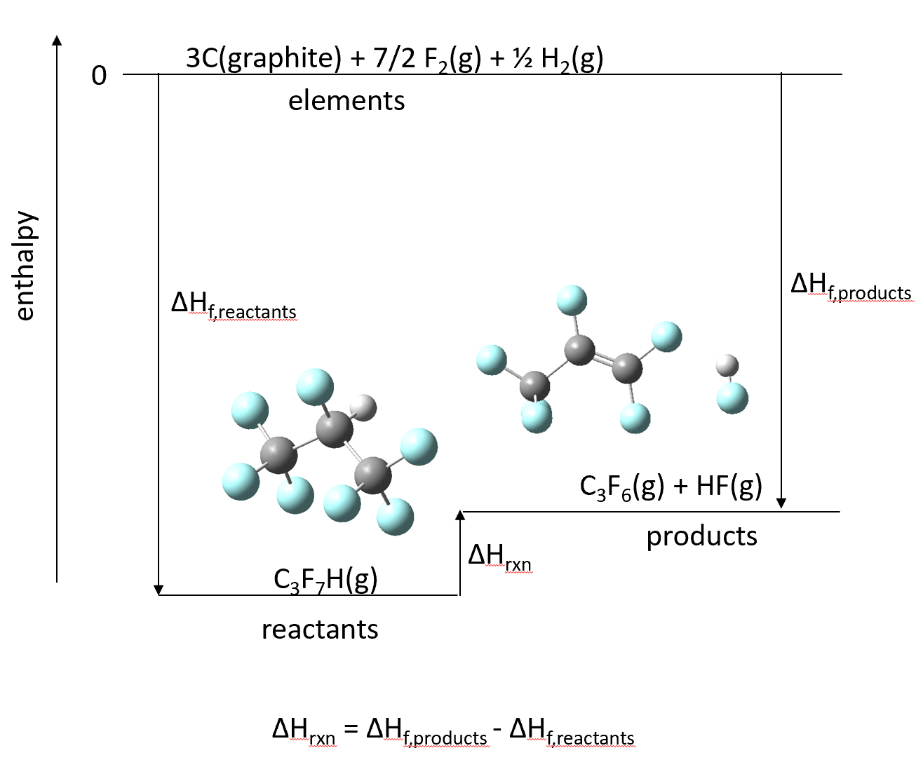
New Fire-Suppressant Molecule
1st Time
Use a simpler molecule online that is better with WebMO
Built more guided practice activities for in-person
Next Time
2nd Time
Short scaffolded videos and tasks for individual online tracks
Some pre-determined data for comparison
Implemented WebMO after remote-login issues
All students collaborated on molecule choices and methods with individual calculations
Implement the guided practice for online
Increase math emphasis in both

Slide 8
Cincinnati Data Visualization
1st Time
Single project for training
Next Time
2nd Time
Single project for all students
Single Rep Presentation
Individual student projects
Organize Group Projects
Additional presentation techniques
Group presentation based on a chosen project
Instructional Videos
Lecture and hands-on training using a single project

Slide 9
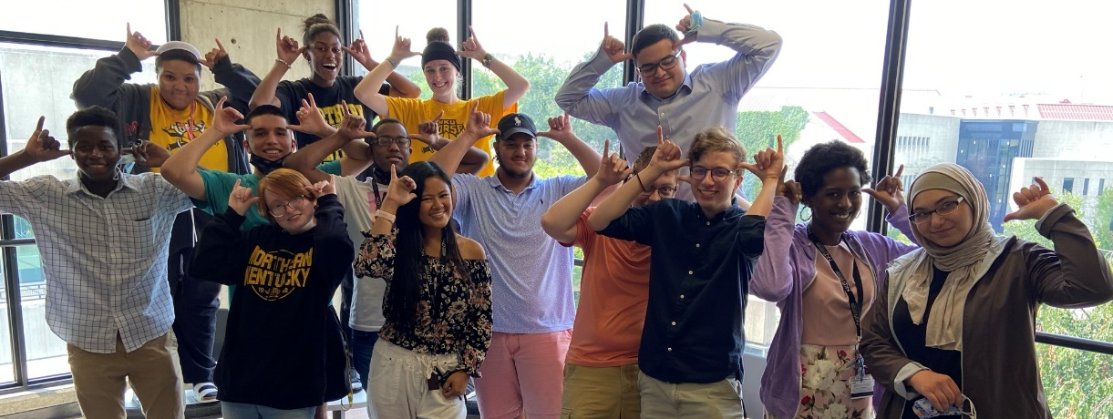
Program Outcomes
2020
22.2 mean ACT (vs 24.6 across STEM)
2.42 fall math GPA (vs 2.37 across STEM)
64% retained in major (vs 67% across STEM)
91% retained at NKU (vs 77% across STEM)
2021
64.3% increased math placement

Slide 10
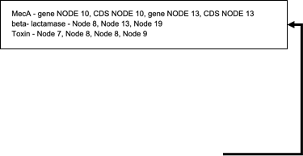
Research Project // Biology
Goal of the Project
Assemble the genomes of potentially methicillin resistant strains of Staphylococcus aureus and identify if they are pathogenic.
Tools Used
The Department of Energy Systems Biology Knowledgebase (KBase) – Webserver with bioinformatic tools
Freely accessible with an account, and easier than teaching coding in 2 days (web drop downs)
Results
Most students completed and filled out the Google Sheet with class results
Achieved the learning Goals!

Slide 11
Research Project // Chemistry
Goal of the Project
Find a potential new fire suppressor molecule through computational chemistry and thermodynamics calculations
Tools Used
Gaussian (professional computational chemistry software), available on NKU virtual machines
WebMO, a web-based computational chemistry interface
Results
Technical issues with the NKU virtual machines prompted switch to WebMO
Low completion suggests more/better support early in the project
Good results from a difficult project
Reactant Molecule | ΔH_{rxn} kcal/mol | C_{V} cal/mol K | student name
CF₃CHFCF₃ (HFC227ea) | 34.1 | 29.535 | Calculated value
CHF2CHFCH3 | 100.787056 | 1.08654 | Student Results
CH2FCF2CH2F | 44.92 | 22.3
CH2FCHFCH2F | 0.00003701 | 4.968
CHF2CHFCHF2 | 80.023 | 24.201
CF3CHFCHF2 | 31.19 | 27.066
CF3CH2CHF2 | 49.089 | 24.281
CF3CHFCH3 | 54.014 | 22.241

Slide 12
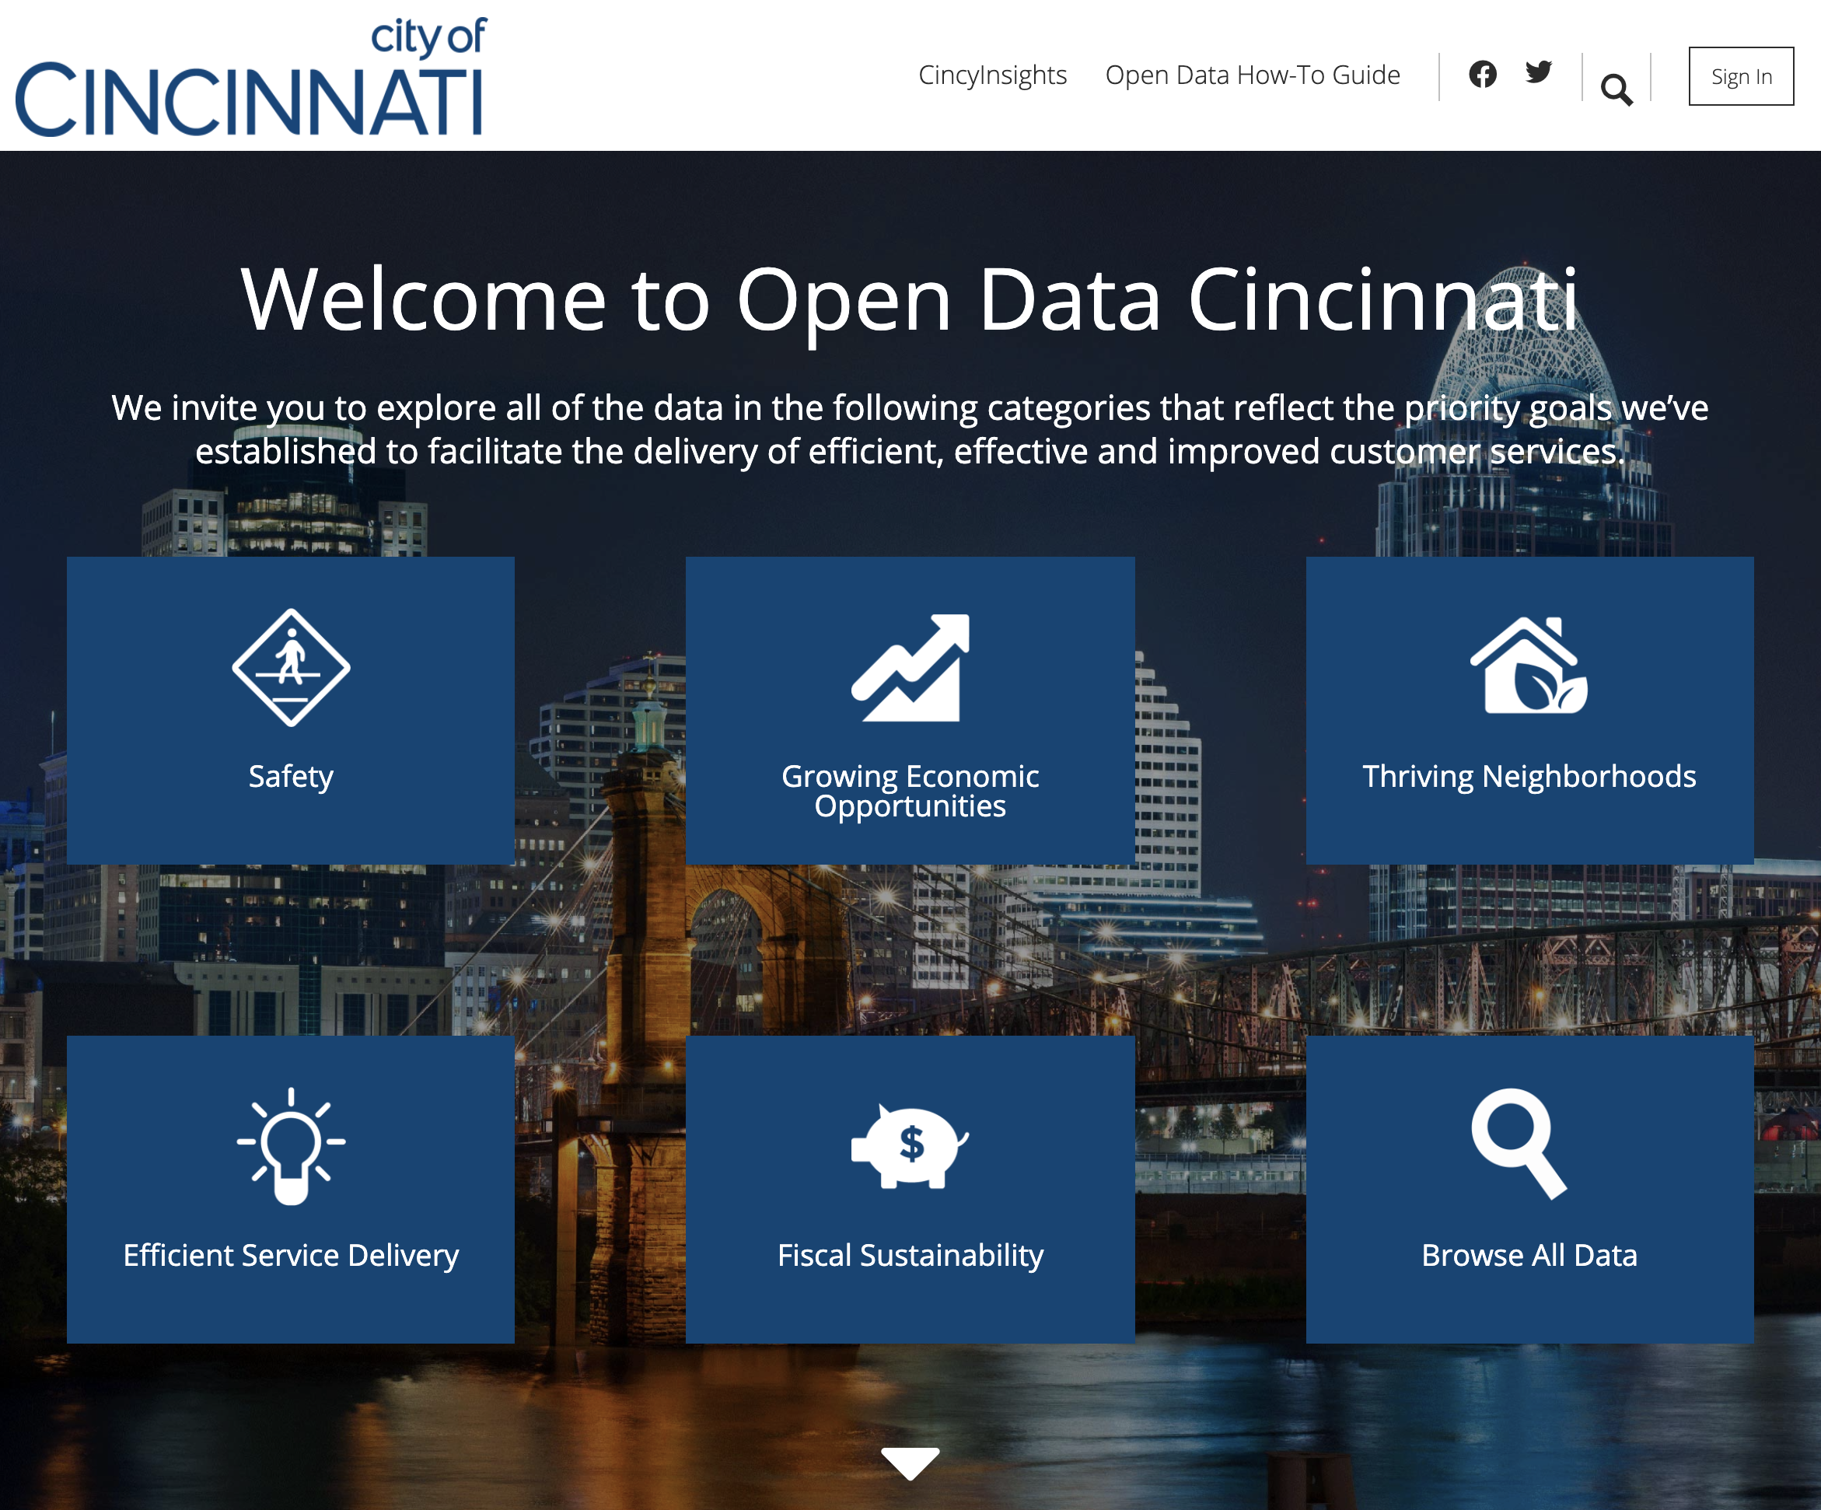
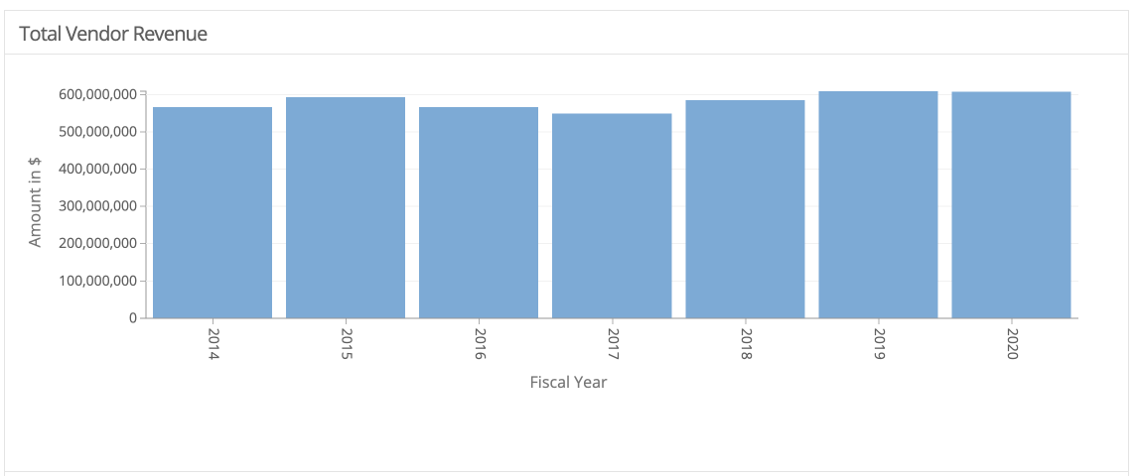
Research Project // Data Science
Goal of the Project:
Select a dataset and create visualizations to answer client specific questions
Present visualizations
Tool used:
City of Cincinnati Data Portal
Freely available
Results
100% completion rate (of those that started)
Several students indicated interest in the field
Moving forward:
Include variety and increase complexity of the project
Data Analytics Tool
Sample student solution

