Slide 1
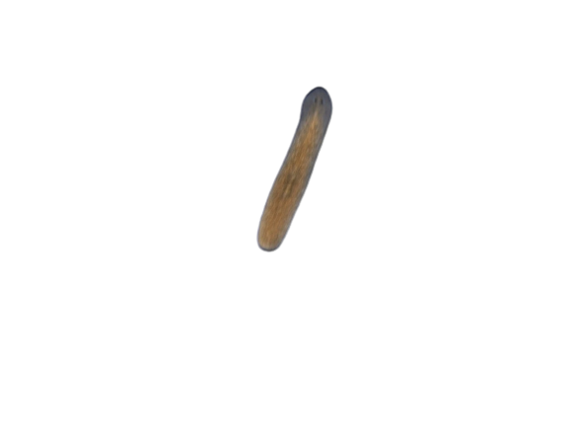
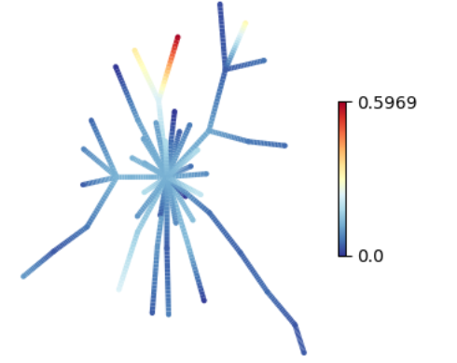
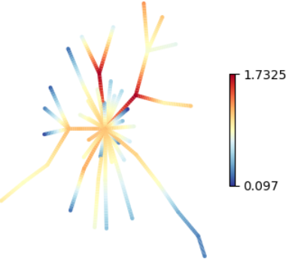
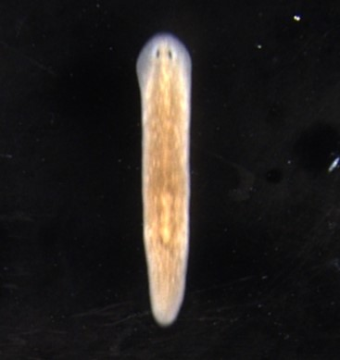
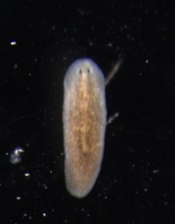
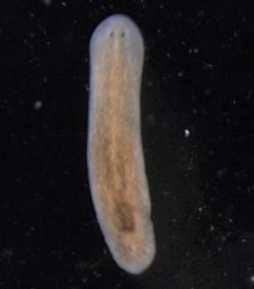
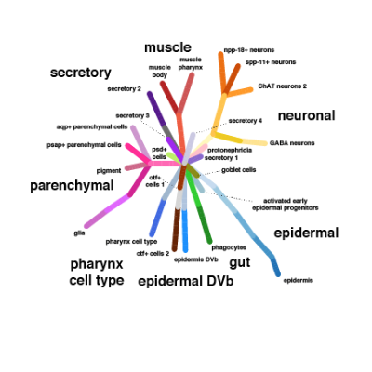
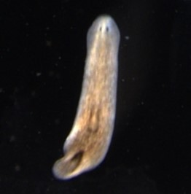
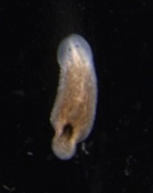
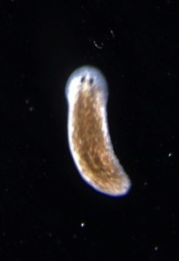
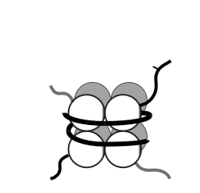
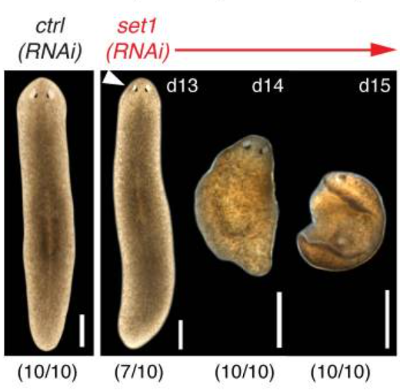
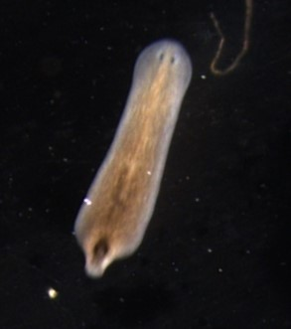
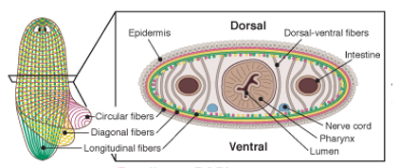
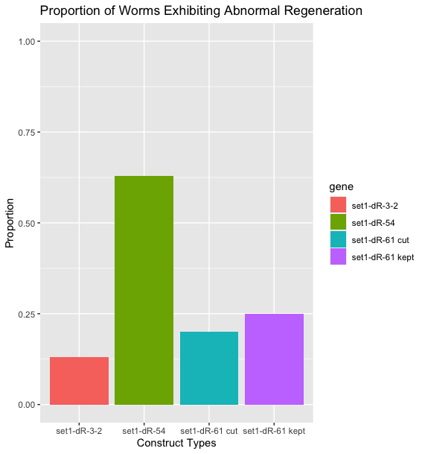
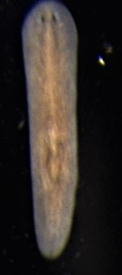
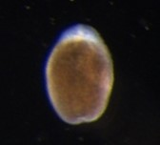
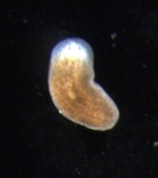
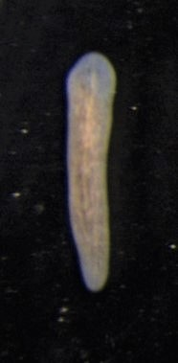
Depletion of Set1 target genes suggests myogenic phenotype in flatworm Schmidtea mediterranea
Zachary A. Farrell^{1,2}, Prince Verma², and Elizabeth M. Duncan²
¹Department of Biology, Northern Kentucky University
²Department of Biology, University of Kentucky
Schmidtea mediterranea as organism of study
Phenotype observed after RNAi
muscle pharynx
Conclusion
muscle pharynx
muscle body
muscle body
Planarian S. mediterranea has abundance of adult stem cells which allow for regeneration
Pluripotent stem cells can be used to study cancer biology
Could explain roles of known genes and discover function of unknown planarian genes
Phenotype seen after 22 days post RNAi in uncut set1-dR-3-2, set1-dR-54, set1-dR-61
Standard cut worms that regenerated tail showed same phenotype in set1-dR-61
S. mediterranea
Set1 and target genes
set1-dR-54
Single cell expression
set1-dR-61
Single cell expression
Set1 is responsible for histone H3 K4 trimethylation (H3K4me3), which has been correlated with active transcription
Set1 target tumor suppressor genes were identified from wide peaks of H3K4me3
Target genes included: set1-dR-3, set1-dR-3-2, set1-dR-54, set1-dR-61, set1-dR-65
control
22 days
set1-dR-3-2 (RNAi)
22 days
set1-dR-3 (RNAi)
22 days
Set1
Trimethyl
K4
Initial screenings suggest novel phenotype; penetrance varies
Set1-dR-54 and set1-dR-61 both related to muscle cells
Repeated experiments needed to confirm phenotype
H3
set1-dR-54 (RNAi)
22 days
set1-dR-61 (RNAi)
22 days
set1-dR-61 (RNAi)
cut
22 days
set1-dR-65 (RNAi)
23 days
Cloning and RNAi of set1 target genes
Genes were cloned via dsRNA
RNAi in feedings to knockout genes
Kept uncut worms, standard cut on others
Observe worms over next weeks
Future Directions
8 worms per gene
set1-dR-3-2: ADP ribosylation factor (ARF)
set1-dR-54: LIM and SH3 domain protein 1 (LASP1)
set1-dR-61: Tyrosine-protein kinase / C-terminal Src kinase (CSK)
set1-dR-65: TNF receptor-associated factor 6 (TRAF6)
Extend RNAi treatment to observe
Different methods of cutting to challenge regeneration of RNAi worms
In situ for gene transcripts of tissues
Screen other set1 target genes via RNAi
Mix with liver paste, feed 3 times over 2 weeks
Keep
Challenge Cut
in vitro transcription
dsRNA
References
10 worms per gene
Duncan, E. M., Chitsazan, A. D., Seidel, C. W., & Sánchez Alvarado, A. (2015). Set1 and MLL1/2 Target Distinct Sets of Functionally Different Genomic Loci In Vivo. Cell reports, 13(12), 2741–2755.
Plass M, Solana J, Wolf FA, Ayoub S, Misios A, Glažar P, Obermayer B, Theis FJ, Kocks C, Rajewsky N. (2018). Cell type atlas and lineage tree of a whole complex animal by single-cell transcriptomics. Science, 360(6391).
Rink J. C. (2013). Stem cell systems and regeneration in planaria. Development genes and evolution, 223(1-2), 67–84.
Rozanski, A., Moon, H., Brandl, H., Martín-Durán, J. M., Grohme, M., Hüttner, K., Bartscherer, K., Henry, I., & Rink, J. C. PlanMine 3.0—improvements to a mineable resource of flatworm biology and biodiversity Nucleic Acids Research, gky1070.
Scimone, M. L., Cote, L. E., & Reddien, P. W. (2017). Orthogonal muscle fibres have different instructive roles in planarian regeneration. Nature, 551(7682), 623-628.
Standard Cut
Regeneration of S. mediterranea
Acknowledgements
Research reported in this publication was supported by an Institutional Development Award (IDeA) from the National Institute of General Medical Sciences of the National Institutes of Health under grant number P20GM103436.
This project was funded by the Elsa. U Pardee Foundation. Elsa U. Pardee Foundation grants are devoted to cancer research with awards given to over 300 different institutions across the United States since 1944.
*Special thanks to members of my lab, including Dr. Duncan, Court Waterbury, Cameron McHargue, & Dr. Allen
3 dpa
6 dpa
12 dpa
*set1-dR-54 is the same as set1-dR-53, which was also described as Muscle LIM protein 1
set1-dR-61

